Slide 1
Materials
Levi Tracy

Slide 2
Materials
Materials were introduced as a design language that was developed by Google in 2014. Material Design is a tool for front-end frameworks, which helps you with visual, motion, and interaction design. It also helps you adapt across different devices and different screen sizes

Slide 3
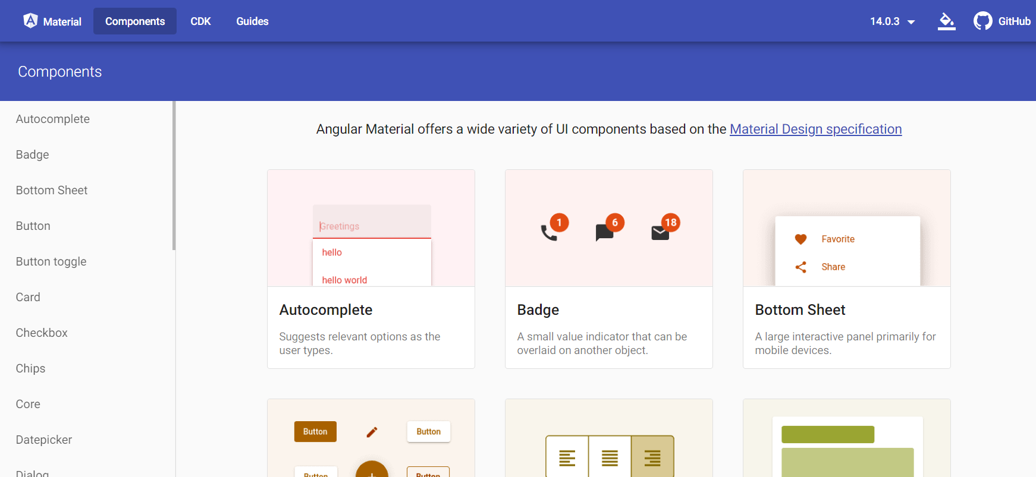
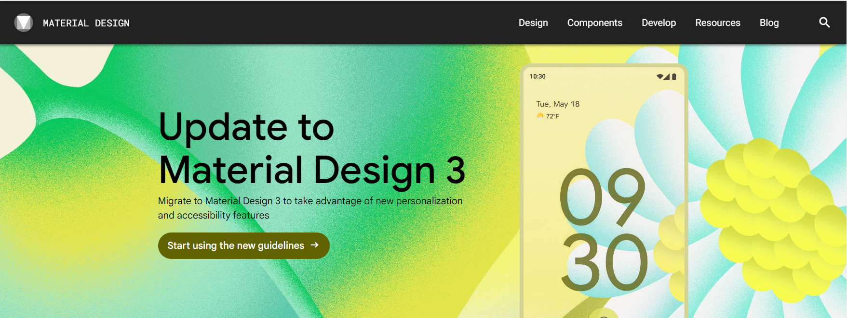
resources to get started?
material.angular.io
material.io (won’t be covered)

Slide 4
Angular Material OVERVIEW
Components
Just like Bootstrap, Angular has a large list of components to choose from. These Components come with 3 separate sections listed below.
Overview
--Explanation of how to use the Component if this is the first time using the component, or even if you need to refresh
API
--Required import/export to be added within your module form to ensure the API runs
Examples
--Examples of the Component in use.

Slide 5
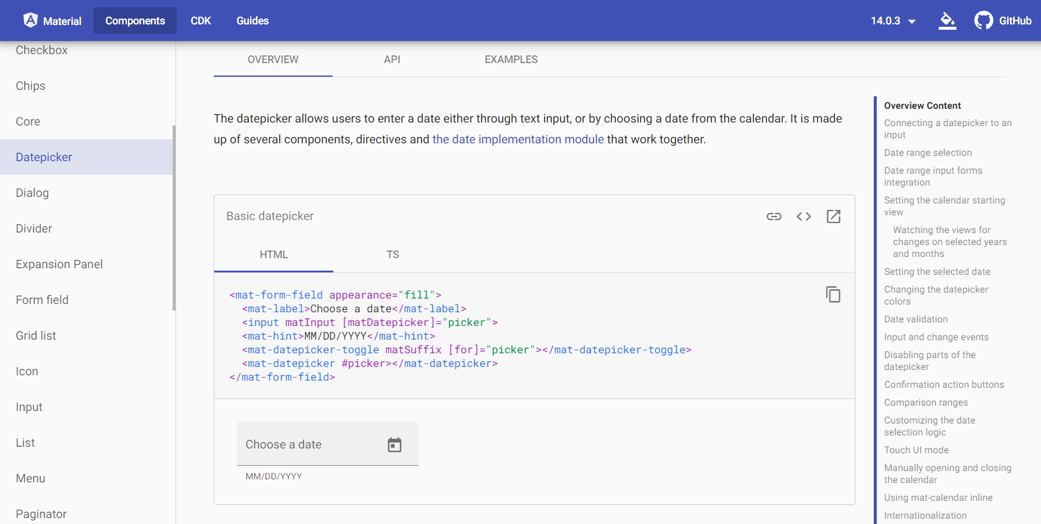

Overview
For this example we are reviewing the DatePicker Components Overview section. We’re given a thorough explanation of the use and even access to the HTML formatting and TS information required to implement the chosen DatePicker into the code. ➔ ➔ ➔ ➔ ➔ ➔ ➔ ➔ ➔ ➔ ➔ ➔
Overview Content: The table on the right of the overview tab allows for quick access to common questions or customization options you may want to see, selecting from that list will move you to that section of the page.

Slide 6
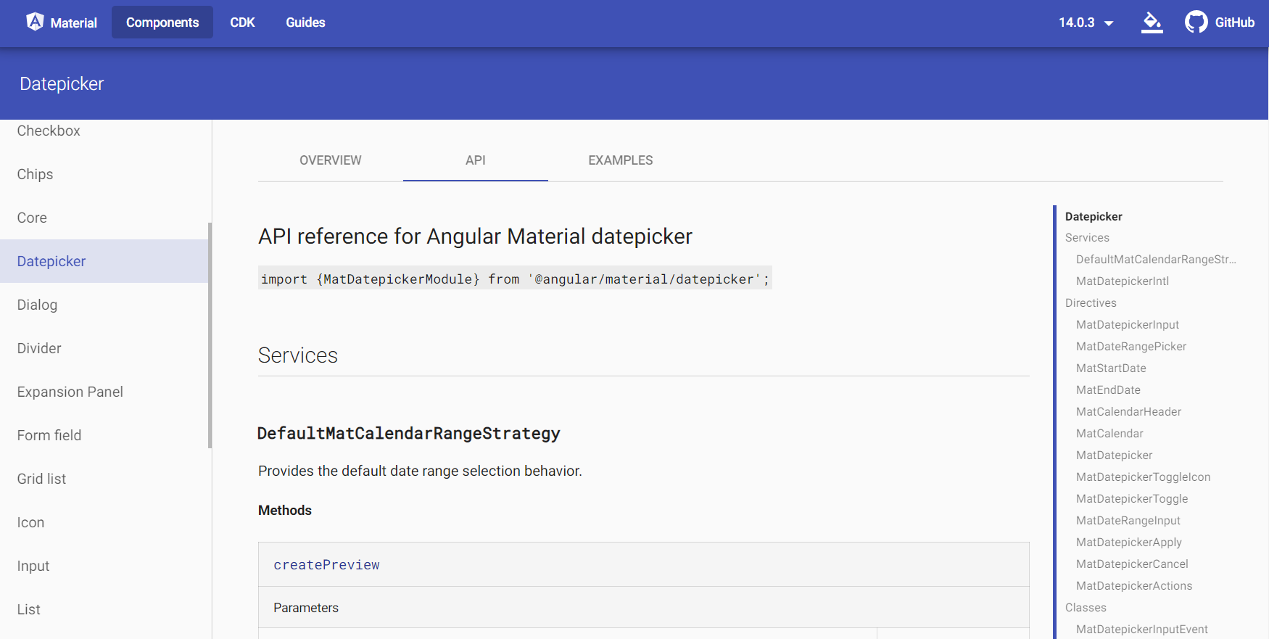
API
For this example we are reviewing the DatePicker API. If you want to use the DatePicker, it is imperative you have the module imported/exported within your program through your app.module.ts or the DatePicker will not work. *This process is followed for all Components for them to work
DatePicker : Again, the table on the right of the DatePicker tab allows for quick access to Directives/Classes/Interfaces/Aliases and more, selecting from that list will move you to that section of the page.

Slide 7
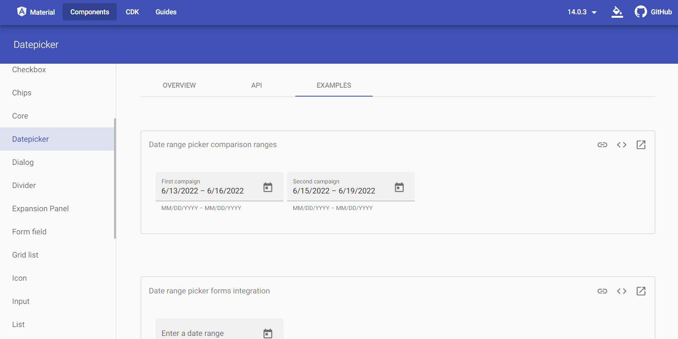
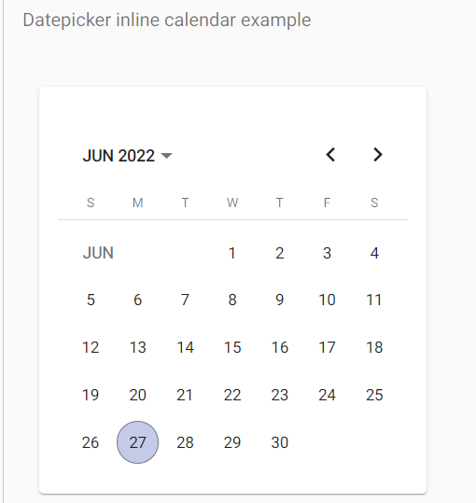
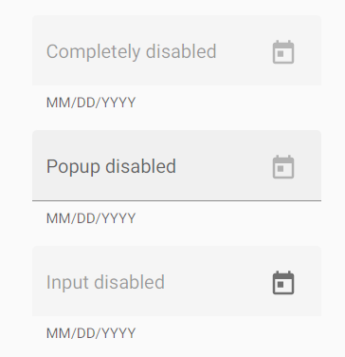
Examples
For the final section we are reviewing the DatePicker Examples. If you’ve joined me thus far, you will the above page has multiple options for different DatePickers, you can scroll through the whole page looking for the specific DatePicker you may require.
Extra Options listed ➔ ➔

Slide 8
Materials in Practice

Slide 9
Topics Today
Side Bar navigation
Excellent, clean, smooth option to navigate seamlessly through your website
Menu Buttons
The hamburger button exist!!!! This button toggles the side bar Navigation!
Forms
Creation of a User or Login all available on the front page.
Title Bars
Just like the website we had placed the menu button on every page, but the title bar has the additional navigation options that tether to it, holding the Forms, Menu Button, Side Bar Navigation.

Slide 10
Any Questions?

