Slide 1

Project: Hate Speech Detection
Exploratory data analysis
Virtual Internship
20-March-2023

Slide 2
Overview
Business Problem:
Tweeter is a global social net with millions of users, making it almost impossible to find and moderate harmful messages among all tweets.
The idea is to train an algorithm on a corpus of classified tweets to predict wherever message contain hate-speech or not

Slide 3
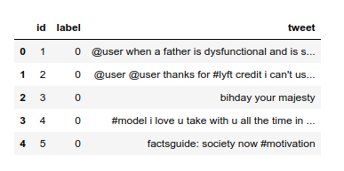
Overview
Input Data:
Input data for classification is dataset with tweets and labels, that classify them as the ones with hate-speech and otherwise
The data analysis included:
Checking for NA values
Checking for duplicates
Investigating class balance
Visual text analysis

Slide 4
Common analysis
Total amount of data in train set | 31962
Total amount of data in test set | 17197
Number of NA values | 0
Number of duplicates | 0

Slide 5
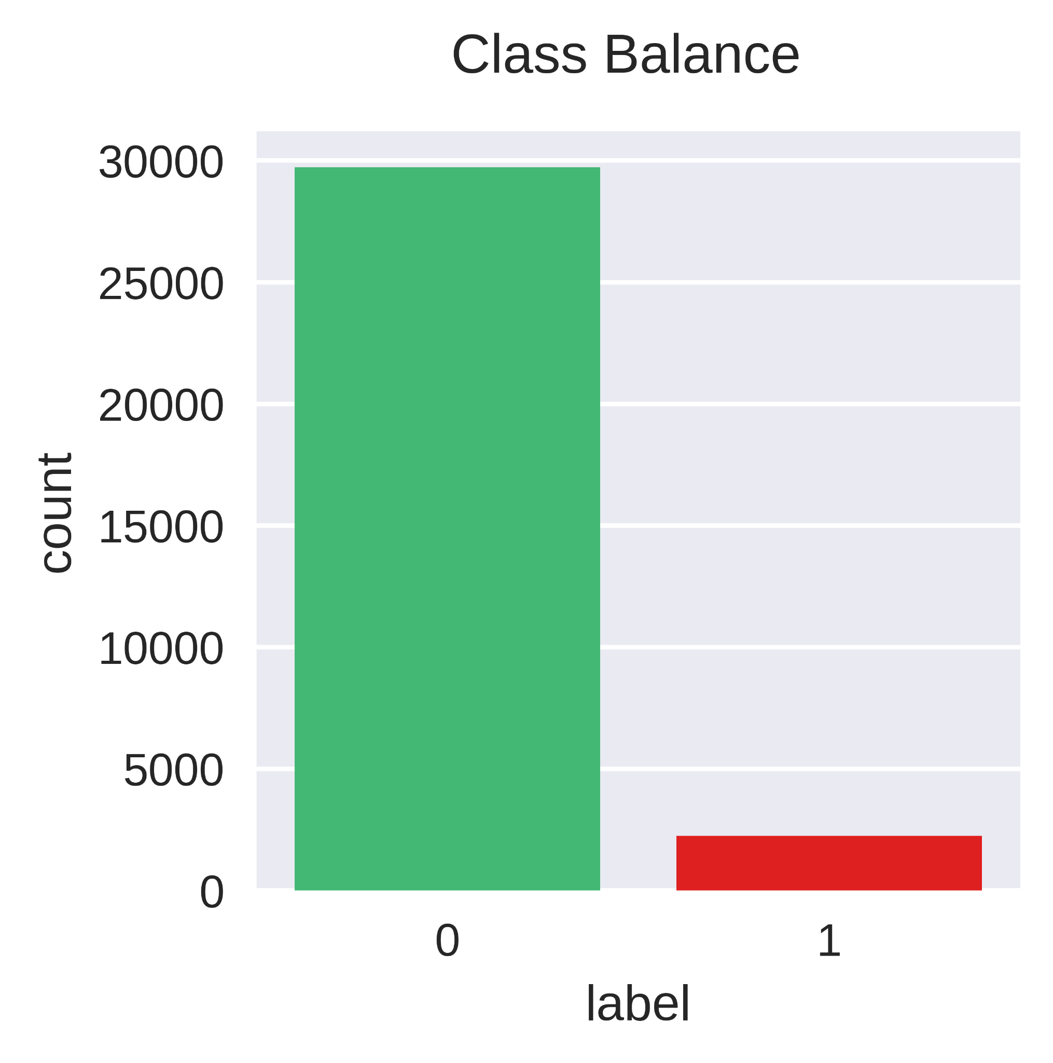
Class balance
There is significant class imbalance
Percent of positive tweets: 93%
Percent of negative tweets: 7%

Slide 6
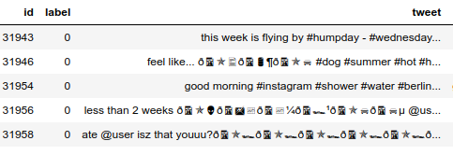
Uninformative data in tweet
stopwords (is, by, …)
# - hashtags
@ - mentions
misspelling
symbols/emojis/punctuation

Slide 7
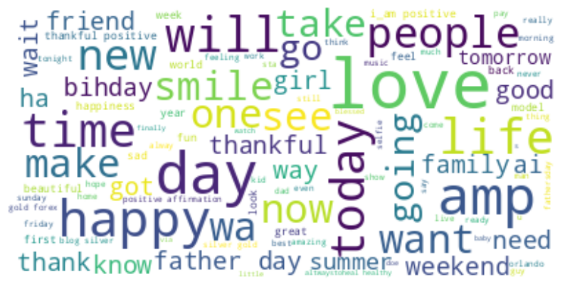
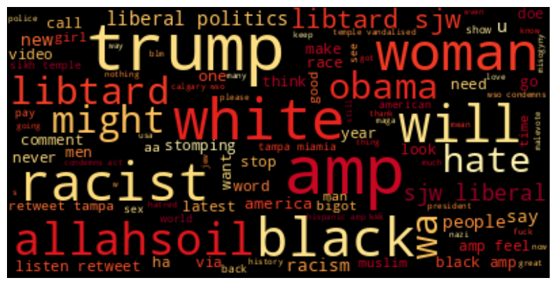
Most common words
Positive Tweets Negative Tweets

Slide 8
Recommended models
As for training process i would recommend to compare several different approaches:
Light linear model - Support Vector Classifier
Boosting model - XGboost
Deep learning transformer model - BERT
While training we should keep in mind high imbalance of data

Slide 9
Thank You

