Slide 1
Object Localization
David Lu

Slide 2
Introduction
Preprocessing and Data Augmentation
Determining the location of a phone in images
Return the object coordinates with respect to the image

Slide 3
Rationale
Coordinate Localization is regressed even in complex detection networks
Retraining feature detectors on Scarce datasets is foolish
Use weights in VGG trained on Imagenet to jumpstart custom model
Update convolutional parameters to specialize network to task

Slide 4
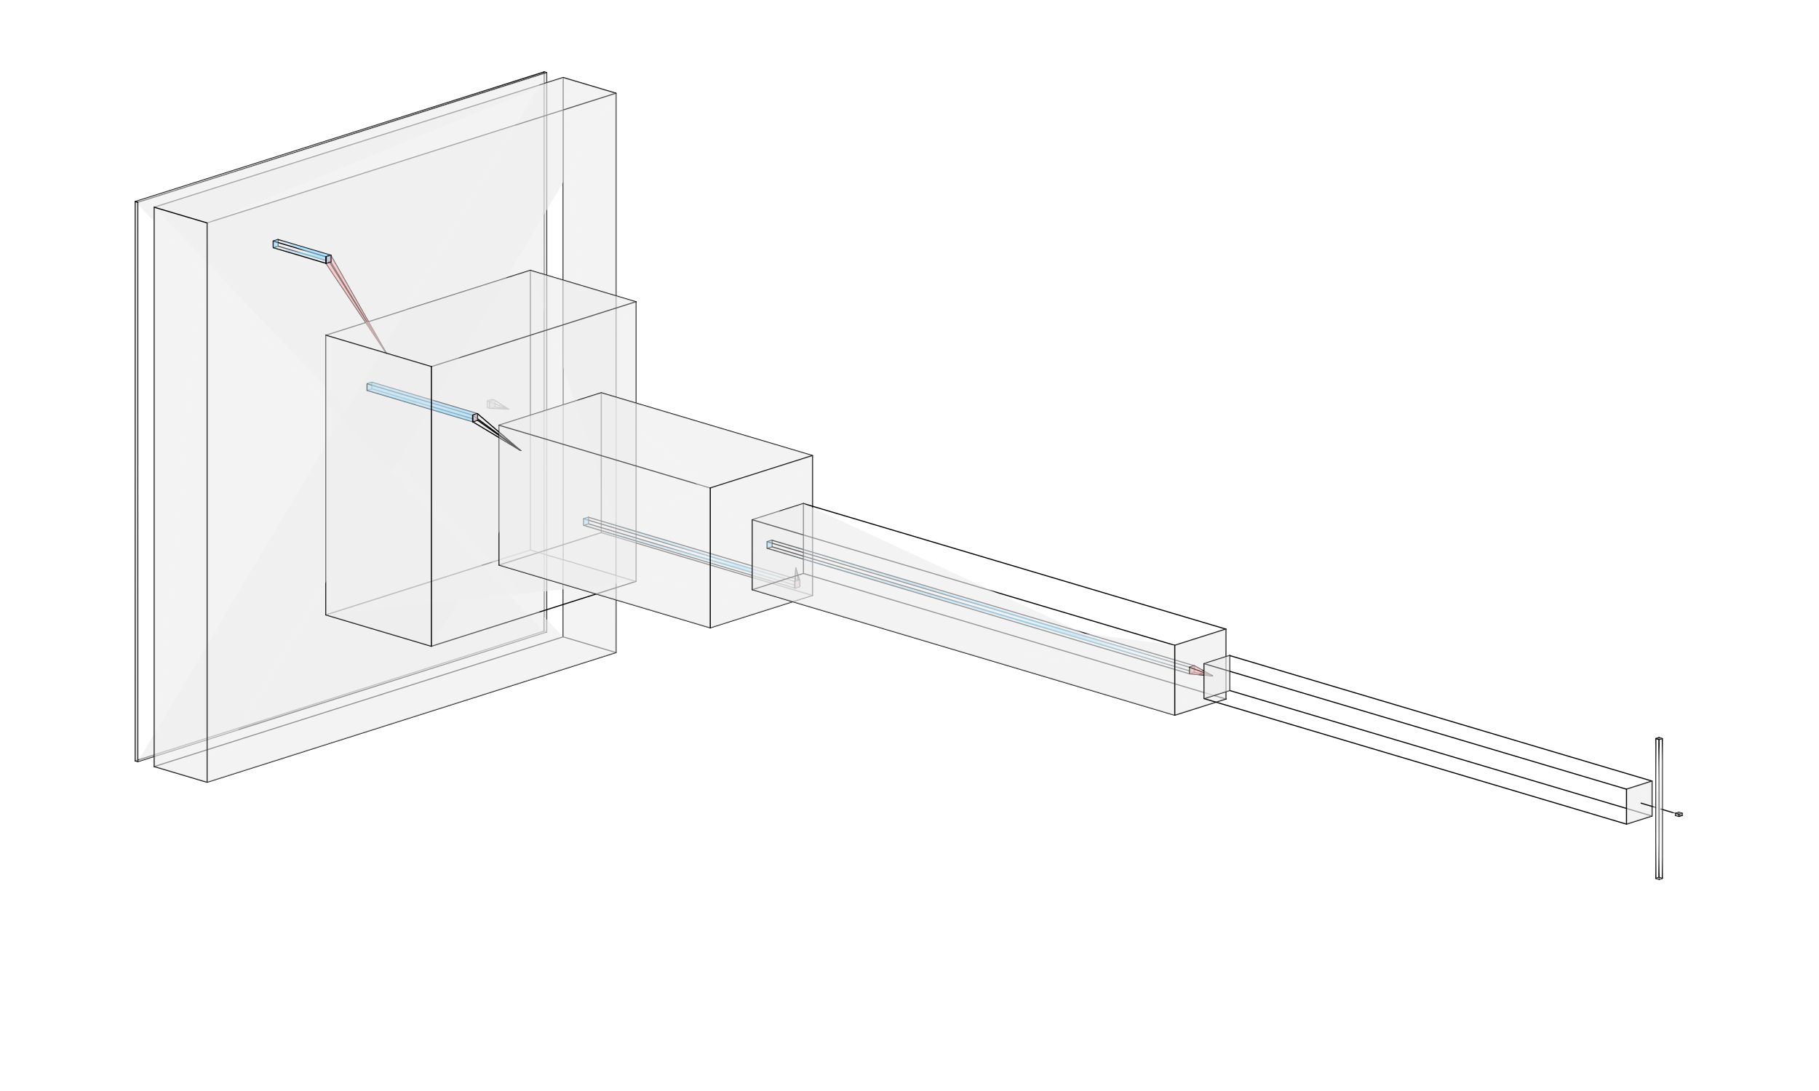
Method
Network Structure

Slide 5
Method
Input Output
256x256 input squares
Convolutional and Pooling layers similar to VGG
Fully Connected Layer for regression of two coordinates

Slide 6
Ad hoc Augmentation During Training
Preprocessing and Data Augmentation
Random Vertical Flipping
Random Horizontal Flipping
Random Brightness Adjustment
Random Contrast Adjustment
Random Saturation Adjustment
Random Hue Adjustment
Normalization

Slide 7
Hyper Parameters And Training
100 epochs
16 batch
SGD with 0.001 learning rate 0.9 momentum
0.5x / 20 epoch weight decay
MSE Loss

Slide 8
Parameters and layers
-----------------------------------------------------------------------------------
Layer (type) Output Shape Param #
================================================
Conv2d-1 [-1, 64, 256, 256] 1,792
ReLU-2 [-1, 64, 256, 256] 0
MaxPool2d-3 [-1, 64, 128, 128] 0
Conv2d-4 [-1, 128, 128, 128] 73,856
ReLU-5 [-1, 128, 128, 128] 0
MaxPool2d-6 [-1, 128, 64, 64] 0
Conv2d-7 [-1, 256, 64, 64] 295,168
ReLU-8 [-1, 256, 64, 64] 0
Conv2d-9 [-1, 256, 64, 64] 590,080
ReLU-10 [-1, 256, 64, 64] 0
MaxPool2d-11 [-1, 256, 32, 32] 0
Conv2d-12 [-1, 512, 32, 32] 1,180,160
ReLU-13 [-1, 512, 32, 32] 0
Conv2d-14 [-1, 512, 32, 32] 2,359,808
ReLU-15 [-1, 512, 32, 32] 0
MaxPool2d-16 [-1, 512, 16, 16] 0
Conv2d-17 [-1, 512, 16, 16] 2,359,808
ReLU-18 [-1, 512, 16, 16] 0
Conv2d-19 [-1, 512, 16, 16] 2,359,808
ReLU-20 [-1, 512, 16, 16] 0
MaxPool2d-21 [-1, 512, 8, 8] 0
AdaptiveAvgPool2d-22 [-1, 512, 7, 7] 0
Linear-23 [-1, 64] 1,605,696
Sigmoid-24 [-1, 64] 0
Dropout-25 [-1, 64] 0
Linear-26 [-1, 2] 130 ================================================

Slide 9
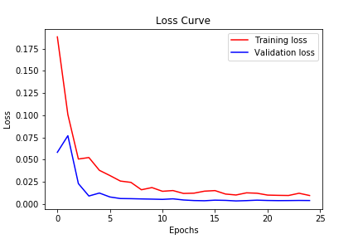
Results
Loss Curve

Slide 10
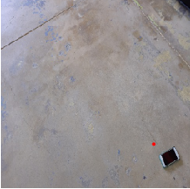
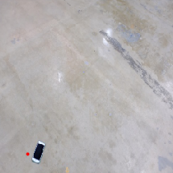
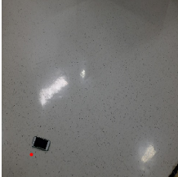
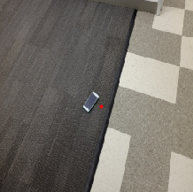
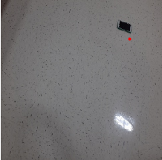
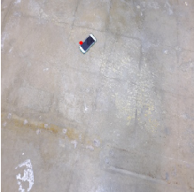
Results
120.jpg
121.jpg
122.jpg
Predicted Visualizations
123.jpg
124.jpg
126.jpg

Slide 11
Results
Name | X | Y
120.jpg | 0.7976 | 0.7551
121.jpg | 0.1528 | 0.8774
122.jpg | 0.1555 | 0.8610
123.jpg | 0.5137 | 0.5422
124.pg | 0.7865 | 0.2362
126.jpg | 0.4059 | 0.2117
Coordinates

Slide 12
Conclusion
Difficulties
Generalization to test images
Overfitting with larger structures
Custom dataloader
Sensitive to scale

Slide 13
Conclusion
Future steps
Multi-scale network for different scale phones
Skip connections to avoid overfitting
Usage of UNET style network to remove background before dense layers

