Slide 1
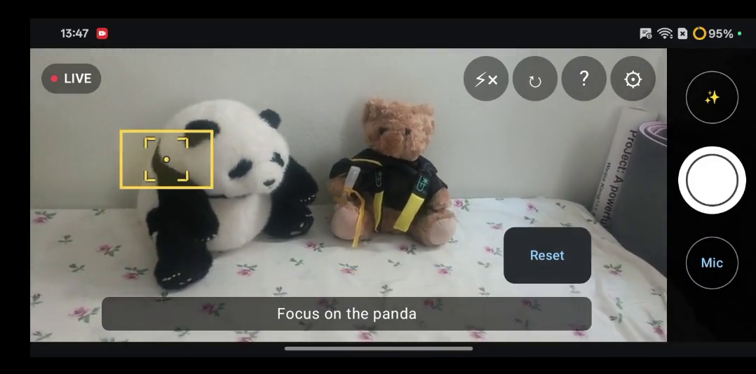
LIFE AGENT · TEAM FIVECENT
PHOTO HELPER
Speak in outcomes, not camera settings.
PROBLEM
SOLUTION
People speak in outcomes.
Cameras expose controls.
Say the result.
Photo Helper handles the controls.
“Make it brighter” still requires exposure, focus and timer decisions.
Voice, the live frame and device telemetry become a bounded camera plan.
HOW IT WORKS
VOICE REQUEST
AI proposes. The phone decides.
“Focus on the panda.”
1 SPEAK
→
2 PLAN
→
3 CHECK
→
4 ACT
→
5 RESET
Human
Qwen
Android
CameraX
Human
The yellow reticle is the focus point Android applied on-device.
The model proposes; Android validates and executes.
AI proposes
Phone decides
Human controls
voice + frame → plan
validate → execute
start → stop → reset
One spoken goal.
A safe camera plan.
WORKBUDDY’S ROLE
SMART MODE
WorkBuddy accelerated implementation and strengthened product quality.
“Make this shot look nicer”
HY3 implementation · specialist review across architecture, UX and QA
Tap ✨: Qwen safely adjusts exposure, colour, framing or focus.
Notes:
[Sources]
- W:\Projects\CameraAgent\README.md — architecture, privacy, product behavior, device-test evidence
- W:\Projects\CameraAgent\submission.md — product positioning and WorkBuddy contribution
- W:\Projects\CameraAgent\submission-assets\project-brief.md — WorkBuddy product-quality pipeline and shipped interaction changes
- W:\Projects\CameraAgent\submission-assets\demo-video-plan.md — HY3, Kimi-K3, UI/UX expert, and human-approval division of labor
- W:\Projects\CameraAgent\submission-assets\demo-video-full-script.md — WorkBuddy build-reflection narrative and before/after Stop/Reset evidence
- W:\Projects\CameraAgent\app\src\main\java\com\bolin\photohelper\capture\CaptureScreen.kt — Smart Mode button label and interaction
- W:\Projects\CameraAgent\app\src\main\java\com\bolin\photohelper\capture\CaptureViewModel.kt — Smart Mode request path and result handling
- W:\Projects\CameraAgent\app\src\main\java\com\bolin\photohelper\visual\CommandContracts.kt — bounded Smart Mode output schema and supported camera changes
- W:\Projects\CameraAgent\submission-assets\demo-day-screenshots\panda-02.png — frame extracted from the project’s physical-device demo recording
[/Sources]

