Slide 1
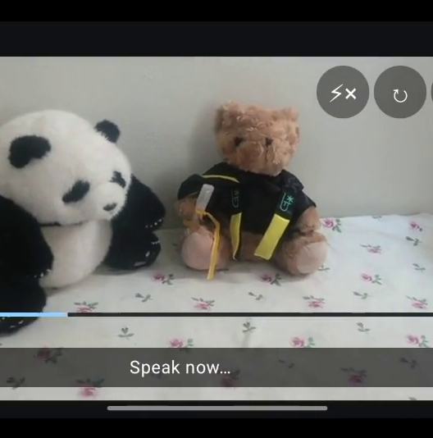
AI TINKERERS × TENCENT CLOUD · LIFE AGENT
PHOTO HELPER
Speak in outcomes,
not camera settings.
“Make it brighter.”
“Focus on the panda.”
“Take a photo in five seconds.”
FIVECENT · LU BOLIN · ETHAN YAP · NATHANAEL LEONG
Notes:
0:00–0:12 — Introduce the team
Good afternoon. We’re Team Fivecent—Lu Bolin, Ethan Yap, and Nathanael Leong—and we built Photo Helper.
0:12–0:35 — Establish the problem with the panda image visible
People usually know the result they want: a brighter image, focus on the right subject, or enough time to join the picture. The difficult part is translating that intention into camera controls.

Slide 2
02
THE PRODUCT
One request becomes a safe camera plan.
ONE REQUEST.
THREE ACTIONS.
ONE PHOTO.
01
UNDERSTAND
Voice + live scene + camera context
02
PLAN
Qwen creates ordered semantic actions
03
CHECK
Android validates against real capabilities
“Make the picture brighter, focus on the panda, and take a photo in five seconds.”
04
ACT
Brightness · focus · timer · capture
QWEN INTERPRETS · ANDROID VALIDATES · CAMERAX EXECUTES
PHOTO HELPER · FIVECENT
02
Notes:
0:35–1:18 — Explain the technical workflow
Photo Helper is a voice-first camera agent designed for mobile phones; our current prototype runs natively on Android. The app captures speech on the phone, then combines the transcription with a reduced frame from the live scene and the camera’s current capabilities. Does your grandmother know how to focus on you when taking a photo? Does your dad know how to make the color warmer? Or even you, are you using your camera fully? Do you know how ISO works? Photo helper can help all of you.
We pass the speech and frame data to a multimodal model. The model of choice is qwen 3.7 flash, but in principle any would work.
Qwen turns those inputs into a small, ordered plan using supported actions such as brightness, zoom, white balance, focus, timer, and capture. Android remains the execution layer: it validates each step against the device, applies supported actions through the camera APIs, and preserves Reset whenever a change can be reversed.
1:18–1:30 — Introduce Smart Mode and transition to the demo
Users can state an exact outcome, or tap Smart Mode to make a one-step request: “Make this shot look nicer.” It uses the same bounded planning and validation path. Let me show you the result.

Slide 3
DEMO
Notes:
1:30–1:38 — Switch to the prepared demo footage
This is the working prototype on a real phone. I am giving it one request that combines an adjustment, a visual focus target, and a timed capture.
1:38–1:48 — Let the recorded command play clearly
“Make the picture brighter, focus on the panda, and take a photo in five seconds.”
1:48–2:15 — Narrate while the plan and camera actions appear
The transcript, scene frame, and camera context produce the ordered plan you see here. Android validates each step, then executes the sequence: increase brightness, focus on the panda, run the countdown, and capture the photo.
When the countdown reaches three, stop talking. Let the final beats and shutter carry the demo.
2:15–2:30 — Let the Smart Mode clip play and land the demo
That entire flow came from one spoken request. The second clip shows Smart Mode using the same system when the user simply asks the camera to make the shot look nicer.
Playback fallback: Keep a second copy of the combined one-minute video on the presentation laptop. If playback fails, switch to that copy immediately.

Slide 4
04
WHY WORKBUDDY
WorkBuddy became our product-quality team.
FAST LOOPS
BUILD.
EXPERT PASSES
REFINE.
MODEL
Reasoning engine
EXPERT
Specialist role + domain framing
TEAM
Divide work + cross-check
WORKSPACE
Review connects to implementation
Deeper judgment where it had the most leverage.
PHOTO HELPER · FIVECENT
04
Notes:
2:30–2:42 — Return to the deck and connect the demo to the development workflow
That is the user experience. I also want to explain how WorkBuddy helped us move from an end-to-end prototype to this polished flow.
2:42–3:10 — Explain why and how WorkBuddy was used
We began with GPT-based tools because they were familiar and gave us tighter control over token usage during rapid build-and-debug loops. But setting up separate mobile-development and UI-design skills, plus their MCP integrations, became complicated. That led us to try WorkBuddy. It surprised us by turning different models and specialist roles into one structured product-quality workflow.

Slide 5
05
WORKBUDDY WORKFLOW
Three specialist passes made the product stronger.
01
02
03
HY3
KIMI-K3
HY3
MOBILE APPLICATION
DEVELOPER
UI DESIGNER
SOFTWARE WORKSHOP
Trace the Android journey
Find evidence-backed issues
Challenge comprehension
Refine Stop + Reset
Implement selected changes
Rebuild + verify on OnePlus
INVESTIGATE → CHALLENGE → IMPLEMENT → VERIFY
PHOTO HELPER · FIVECENT
05
Notes:
3:10–3:43 — Stage one: mobile engineering review
First, HY3 worked with the Mobile Application Developer expert. We supplied the Android workspace, product documents, screenshots, tests, and intended journey. It traced the experience from onboarding and permissions through voice input, AI planning, camera actions, and failure recovery. For every issue, it had to explain user impact, point to implementation evidence, and recommend the smallest credible fix.
3:43–4:05 — Stage two: user-interface review
Next, Kimi-K3 worked with the UI Designer expert as a fresh pair of eyes. This review focused on comprehension, accessibility, and recovery. It helped us align the listening guidance with the compact square Stop button and keep Reset available whenever an adjustment could still be reversed.
4:05–4:20 — Stage three: implementation and device verification
Finally, HY3 returned with the Software Workshop expert. It implemented the selected changes, rebuilt and installed the APK, and verified the result on a physical OnePlus phone.
4:20–4:30 — Summarize the value of the workflow
So WorkBuddy gave us more than suggestions. It created a repeatable loop—investigate, challenge, implement, and verify—with each specialist focused on where it added the most value.

Slide 6
FUTURE
Three gaps. One more capable camera.
FOCUS
Object masks replace coarse grid cells
PRECISE.
RESPONSIVE.
PERSONAL.
SPEED
On-device commands handling model
AESTHETICS
Rapid variants → user choice → learned preferences
FIVECENT · PHOTO HELPER
Notes:
4:30–5:00 — Show the future-work slide
Three gaps define the next version. For focus, replace the grid with an object mask. For speed, move commands on-device and accelerate image understanding. For aesthetics, capture a rapid burst with several safe configurations and let the user choose the best result. That choice becomes the preferred example; the alternatives become rejected examples for post-training. Across many choices, Smart Mode learns a shared baseline, then personalizes its ranking for each user. Precise, responsive, personal. Thank you.
Cut line if running long: omit “the alternatives become rejected examples for post-training.”

