Slide 1
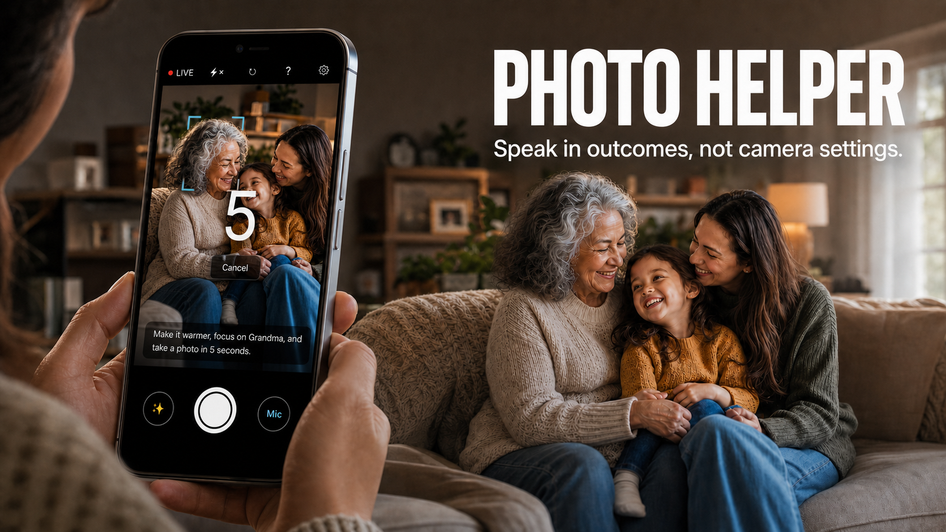
LIFE AGENT · TEAM FIVECENT · SINGAPORE
Notes:
0:00–0:27
Say:
Hi, we are Team FiveCent. We built Photo Helper, a voice-first camera-control agent for casual photography. People know the outcome they want—a brighter picture, a closer subject, or time to join the frame—but not which settings create it. Photo Helper translates that request into a bounded workflow on the phone camera.
Presenter cue: Let the family scenario establish the problem before advancing.
[Sources]
- C:\Users\bolin\Desktop\CameraAgent\submission-assets\photo-helper-cover-16x9-v6-actual-ui.png
- C:\Users\bolin\Desktop\CameraAgent\submission.md

Slide 2
02
THE GAP
People describe outcomes. Cameras expose settings.
What people say
Less-confident users should not have to translate intent into exposure compensation, focus regions or timer menus.
“It’s too dark.”
“Focus on that.”
“Take it in five seconds.”
A translator for supported controls—not an autonomous photographer.
PHOTO HELPER · FIVE­CENT
Notes:
0:27–1:08
Say:
People do not think in technical terms such as exposure compensation, focus coordinates, or timer menus. They say, “It is too dark,” “Focus on that,” or “Take it in five seconds.” The challenge is translating those intentions before the moment is lost. This can be harder for less-confident smartphone users, including older adults, less tech-literate people, and people with accessibility challenges. We have not yet tested directly with every group, so our claim is deliberately narrow: Photo Helper translates ordinary language into supported camera controls. It is not an autonomous photographer.
Presenter cue: Point first to the three phrases, then land on the product boundary.
[Sources]
- C:\Users\bolin\Desktop\CameraAgent\submission.md
- C:\Users\bolin\Desktop\CameraAgent\submission-assets\project-brief.md

Slide 3
DEMO
Notes:
1:08–2:13
Say:
Let’s see a demo.
Presenter cue:
1. Advance to this holding slide.
2. Switch to the pre-recorded demo tab.
3. Play the approximately 60-second stitched demo.
4. Switch back and advance immediately to the pipeline slide.
Timing allowance: about 60 seconds for playback and five seconds total for tab switching.
[Sources]
- C:\Users\bolin\Desktop\CameraAgent\submission-assets\demo-video-full-script.md

Slide 4
04
AGENT DESIGN
The model interprets. Your phone retains authority.
1 · CONTEXT
2 · QWEN PLAN
3 · VALIDATE
4 · EXECUTE
Voice request
On-device transcript
Clean + labelled frames
Camera telemetry
Qwen3.7 Flash
Strict JSON
≤ 8 ordered actions
No free-form controls
Schema + allowlist
Capabilities
Lens / frame / session
Reject or approve
CameraX / Camera2
Focus + settings
Capture
Rollback / Reset
THE ONLY ACTIONS THE MODEL MAY PROPOSE
ADJUST
SET CAMERA
SET FLASH
FOCUS CELL
RESET
CAPTURE
Privacy boundary: microphone audio stays on-device; Qwen receives transcribed text and request still frames, never a preview stream.
PHOTO HELPER · FIVE­CENT
Notes:
2:13–3:05
Say:
The behavior you saw follows four stages. First, the app supplies the voice request, its on-device transcript, clean and labelled frames, plus current camera settings and context. Second, Qwen3.7 Flash returns strict JSON: at most eight actions from six permitted types. The architecture could use another multimodal model, but it would need prompt and contract tuning. Third, Android validates syntax, the allowlist, device capabilities, and whether the lens, frame, and session are still current—similar to the test stage in an agent loop. Only then are CameraX or Camera2 controls applied. Failed setting transactions roll back, and Reset restores the baseline. Qwen receives transcribed text and request still frames, but never microphone audio or a continuous preview stream.
Presenter cue: Trace left to right, then finish on the privacy boundary.
[Sources]
- C:\Users\bolin\Desktop\CameraAgent\README.md
- C:\Users\bolin\Desktop\CameraAgent\app\src\main\java\com\bolin\photohelper\visual\CommandContracts.kt
- C:\Users\bolin\Desktop\CameraAgent\app\src\main\java\com\bolin\photohelper\visual\VisualContracts.kt

Slide 5
05
BUILD · VERIFY · PRIVACY
Agents divided the work. Android kept authority.
1
2
3
4
CODEX
WORKBUDDY · HY3
KIMI-K3 · UI/UX
VERIFY + PRIVACY
Rapid prototype
Design documents
Focused fixes + tests
Repo-wide audit
Implementation pass
Physical-device checks
Interaction review
UI/UX iteration
Second pair of eyes
211 unit tests
57/57 device tests
Audio stays on-device
Final pass
HY3 + Software Workshop · Human approval
PHOTO HELPER · FIVE­CENT
Notes:
3:05–4:02
Say:
Development used both Codex and WorkBuddy. Codex supported rapid prototyping and design documents, then traced failures, added regression tests, and made focused changes. In WorkBuddy, HY3 led the repo-wide audit, implementation pass, and physical-device verification, supported by the Mobile Application Developer expert. Kimi-K3 and the UI Designer expert acted as a second pair of eyes on interaction and interface decisions. A final HY3 and Software Workshop pass checked the shipped behavior. The current code passes 211 unit tests, and WorkBuddy’s deterministic device run passed 57 out of 57 tests. Throughout, human approval separated agent roles, Android retained camera authority, and microphone audio stayed on-device.
Presenter cue: Move across the four roles, then land on verification and privacy.
[Sources]
- C:\Users\bolin\Desktop\CameraAgent\outputs\workbuddy\HY3_AUDIT_PACKET.md
- C:\Users\bolin\Desktop\CameraAgent\outputs\workbuddy\WORKBUDDY_CHANGELOG.md
- C:\Users\bolin\Desktop\CameraAgent\outputs\workbuddy\K3_DEVICE_VERIFICATION.md
- C:\Users\bolin\Desktop\CameraAgent\outputs\workbuddy\FINAL_STABILIZATION_REPORT.md
- C:\Users\bolin\Desktop\CameraAgent\app\build\test-results\testDebugUnitTest

Slide 6
PHOTO HELPER
Speak in outcomes,
not camera settings.
A trustworthy voice-to-camera translator for casual photography.
NOW
NEXT
Voice-first casual camera utility
Optional mode for phone makers or camera apps
Next: local models · focus accuracy · manual interactions · retakes · confidence
FIVECENT · LU BOLIN · ETHAN YAP · NATHANAEL LEONG
Notes:
4:02–4:55
Say:
The immediate product is a casual camera utility: a trustworthy translation layer between spoken intent and controls already on the phone. Future distribution could involve phone makers or camera-app partners. Photo Helper might become an optional voice mode, a limited integration exposing the same allowlisted actions, validation, and Reset behavior, or an overlay for an existing camera app. That is a direction, not a current partnership. We would also explore local models for faster response, improve focus accuracy, and measure manual interactions, retakes, and agent confidence before making broader claims. Photo Helper: speak in outcomes, not camera settings.
Presenter cue: Separate today’s utility from the future distribution path, then finish on the tagline.
[Sources]
- C:\Users\bolin\Desktop\CameraAgent\submission.md
- C:\Users\bolin\Desktop\CameraAgent\submission-assets\project-brief.md
- C:\Users\bolin\Desktop\CameraAgent\submission-assets\pitch-day-plan.md

