Slide 1
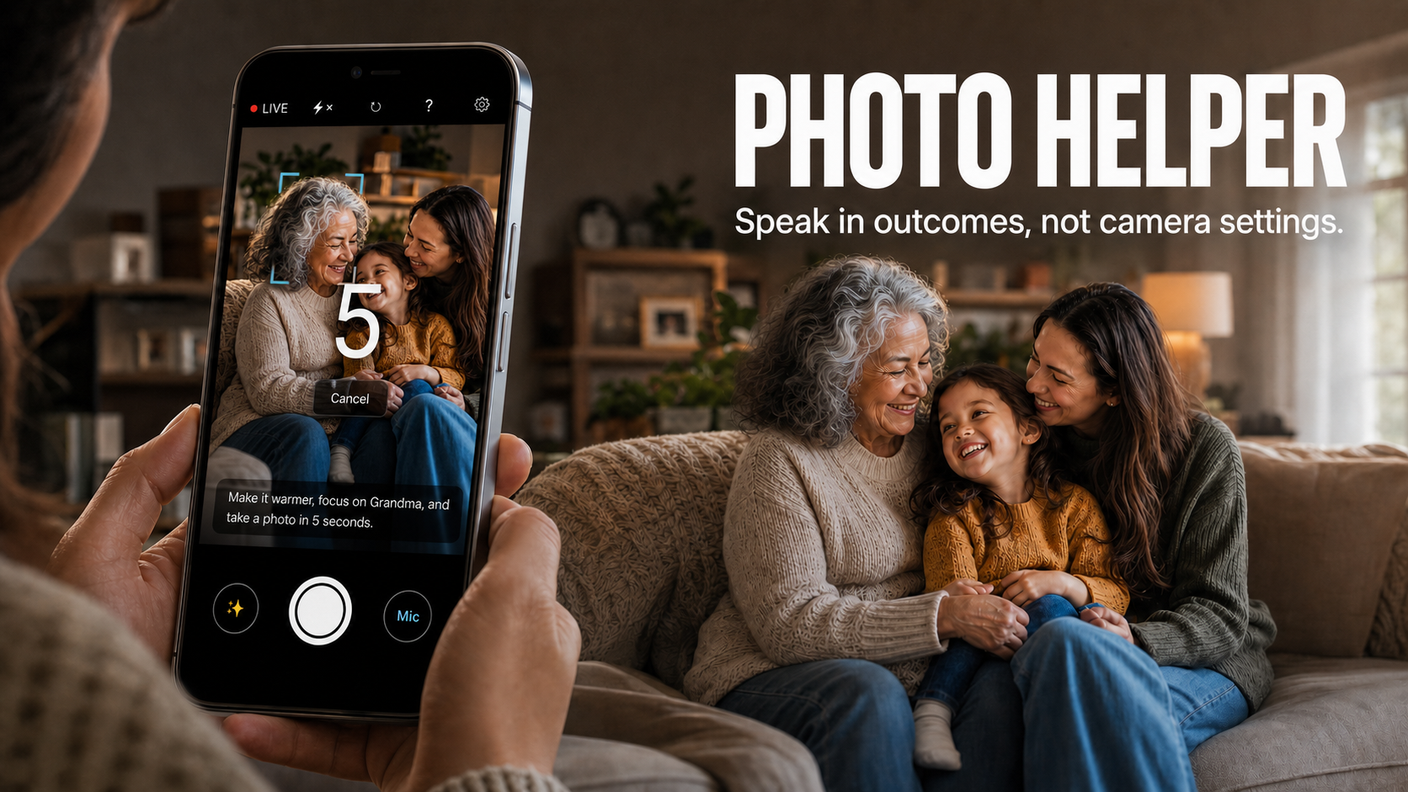
LIFE AGENT · TEAM FIVECENT · SINGAPORE
Notes:
0:00–0:25
Say:
Good afternoon. We built Photo Helper, a voice-first camera-control agent for family photography. People know the outcome they want—a brighter picture, a closer subject or time to join the frame—but not which settings create it. Photo Helper translates that request into a bounded workflow on an Android camera.
Presenter cue: Let the cover image establish the family scenario before advancing.
[Sources]
- C:\Users\bolin\Desktop\CameraAgent\submission-assets\photo-helper-cover-16x9-v6-actual-ui.png
- C:\Users\bolin\Desktop\CameraAgent\submission.md

Slide 2
02
THE GAP
People describe outcomes. Cameras expose settings.
What people say
The user should not have to translate that into exposure compensation, metering, focus regions and timers.
“It’s too dark.”
“Focus on that.”
“Take it in five seconds.”
Photo Helper acts as the translator—not the photographer.
PHOTO HELPER · FIVE­CENT
Notes:
0:25–1:02
Say:
People do not think in exposure compensation, focus coordinates or timer menus. They say, ‘It is too dark,’ ‘Focus on that,’ or ‘Take it in five seconds.’ The challenge is translating those intentions before the moment is lost. This can be harder for less-confident smartphone users, including older adults, although we have not completed research with that group. Photo Helper translates ordinary language into supported camera controls; it is not an autonomous photographer.
Presenter cue: Point first to the natural phrases, then to the translation statement.
[Sources]
- C:\Users\bolin\Desktop\CameraAgent\submission.md
- C:\Users\bolin\Desktop\CameraAgent\submission-assets\project-brief.md

Slide 3
DEMO
Notes:
1:02–2:22 — Reserved demo block; no live narration.
Presenter cue:
1. Advance to this holding slide.
2. Switch to the video tab.
3. Play the 75-second stitched demo.
4. Switch back to the deck after the video ends.
5. Advance immediately to the architecture slide.
Timing allowance: seventy-five seconds for playback and approximately five seconds total for switching out of and back into the deck.
[Sources]
- C:\Users\bolin\Desktop\CameraAgent\submission-assets\demo-video-full-script.md

Slide 4
04
AGENT DESIGN
The model interprets. Android retains authority.
1 · CONTEXT
2 · QWEN PLAN
3 · VALIDATE
4 · EXECUTE
Voice request
Clean frame
Gridded frame
Camera telemetry
Qwen3.7 Flash
Strict JSON
≤ 8 ordered actions
No free-form controls
Allowlist + schema
Capabilities
Lens / frame / session
Approval gates
CameraX / Camera2
Focus + settings
Capture
Rollback / Reset
THE ONLY ACTIONS THE MODEL MAY PROPOSE
ADJUST
SET CAMERA
SET FLASH
FOCUS CELL
RESET
CAPTURE
Privacy boundary: audio stays on-device; hosted interpretation receives reduced still frames, not a preview stream.
PHOTO HELPER · FIVE­CENT
Notes:
2:22–3:03
Say:
What you saw has four stages. The app supplies the request, a clean frame, a labelled grid and trusted camera telemetry. Qwen returns only strict JSON: at most eight actions from six permitted types. Android validates the schema, capabilities and whether the context is current before applying CameraX or Camera2 controls. Failed setting transactions roll back, and Reset restores the baseline. Voice is transcribed on-device; Alibaba receives reduced still frames for eligible requests, but never microphone audio or a continuous preview stream.
Presenter cue: Trace the four boxes from left to right, then finish on the privacy boundary.
[Sources]
- C:\Users\bolin\Desktop\CameraAgent\README.md
- C:\Users\bolin\Desktop\CameraAgent\app\src\main\java\com\bolin\photohelper\visual\CommandContracts.kt
- C:\Users\bolin\Desktop\CameraAgent\submission.md

Slide 5
05
ENGINEERING EVIDENCE
Bounded by design. Verified on hardware.
209
57/57
6
JVM UNIT TESTS
DEVICE TESTS
ACTION TYPES
Core planning, validation and state behavior
Deterministic run on a physical OnePlus
Small allowlist; maximum eight per plan
↺
Transactional rollback + persistent Reset
⌁
Stale frame, lens, session and capture context rejected
●
Push-to-talk; up to 15 seconds; audio stays local
The evidence supports reliable camera control—not a claim that AI automatically creates better photos.
Notes:
3:03–3:34
Say:
Reliability is part of the design. The code passes 209 JVM unit tests, Android lint and a clean debug build. WorkBuddy completed 57 out of 57 instrumented tests on a physical OnePlus. They cover voice capture, encrypted key storage, Reset persistence, baseline restoration and responsive layouts. This does not prove better photography. It shows that real camera behaviour is bounded, testable and recoverable.
Presenter cue: Read the three headline figures first; use the bottom sentence to qualify the claim.
[Sources]
- C:\Users\bolin\Desktop\CameraAgent\submission.md
- C:\Users\bolin\Desktop\CameraAgent\outputs\workbuddy\FINAL_STABILIZATION_REPORT.md
- C:\Users\bolin\Desktop\CameraAgent\outputs\workbuddy\unit-test-run.log
- C:\Users\bolin\Desktop\CameraAgent\outputs\workbuddy\deterministic-connected-run1.log

Slide 6
06
BUILD APPROACH
Agents had distinct jobs—and human approval between them.
1
2
3
4
CODEX
WORKBUDDY HY3
KIMI-K3 + UI/UX
HUMAN APPROVAL
Trace failures
Write regression tests
Implement focused fixes
Repo-scale audit
Implementation pass
Device verification
High-leverage review
Interaction decisions
Evidence checks
Resolve tradeoffs
Run the phone demo
Accept shipped behavior
Shipped outcome
Clear square Stop guidance · Persistent right-aligned Reset · 57/57 final device tests
PHOTO HELPER · FIVE­CENT
Notes:
3:34–4:08
Say:
The development agents had distinct jobs. I used Codex to trace failures, add regression tests, make focused changes, rebuild and install. WorkBuddy handled the HY3 audit, implementation pass and physical-device verification. Kimi-K3 and a UI/UX specialist supported interaction decisions, with human approval between stages. This produced concrete improvements: the guide matches the square Stop control, Reset remains visible and right-aligned, and all 57 final device tests completed.
Presenter cue: Move across the four roles, then land on the concrete shipped changes rather than the tool names.
[Sources]
- C:\Users\bolin\Desktop\CameraAgent\outputs\workbuddy\HY3_AUDIT_PACKET.md
- C:\Users\bolin\Desktop\CameraAgent\outputs\workbuddy\WORKBUDDY_CHANGELOG.md
- C:\Users\bolin\Desktop\CameraAgent\outputs\workbuddy\K3_DEVICE_VERIFICATION.md
- C:\Users\bolin\Desktop\CameraAgent\outputs\workbuddy\FINAL_STABILIZATION_REPORT.md

Slide 7
PHOTO HELPER
Speak in outcomes,
not camera settings.
A trustworthy voice-to-camera translator for everyday family photography.
NOW
NEXT
Consumer family camera utility
Partner with phone makers or camera apps
Pilot metrics: successful capture · time-to-capture · manual interactions · retakes · confidence
FIVECENT · LU BOLIN · ETHAN YAP · NATHANAEL LEONG
Notes:
4:08–5:00
Say:
The immediate product is a family-camera utility: a trustworthy translation layer between spoken intent and controls already on the phone. If a pilot shows value, future distribution could involve phone makers or camera-app partners. Photo Helper might become an optional voice mode, or a limited integration exposing only the same allowlisted actions, validation and Reset behaviour. That is a direction, not a current partnership. Next, we would measure successful capture, time-to-capture, manual interactions, retakes and confidence, then research directly with older adults before making accessibility claims. Photo Helper: speak in outcomes, not camera settings.
Presenter cue: Clearly separate what exists now from the future partnership path, then finish on the tagline.
[Sources]
- C:\Users\bolin\Desktop\CameraAgent\submission.md
- C:\Users\bolin\Desktop\CameraAgent\submission-assets\project-brief.md
- C:\Users\bolin\Desktop\CameraAgent\submission-assets\pitch-day-plan.md

