Slide 1
Digital Image Processing
Experiment 2
Few-Shot Learning
shenzy13@qq.com
2018.5.8

Slide 2
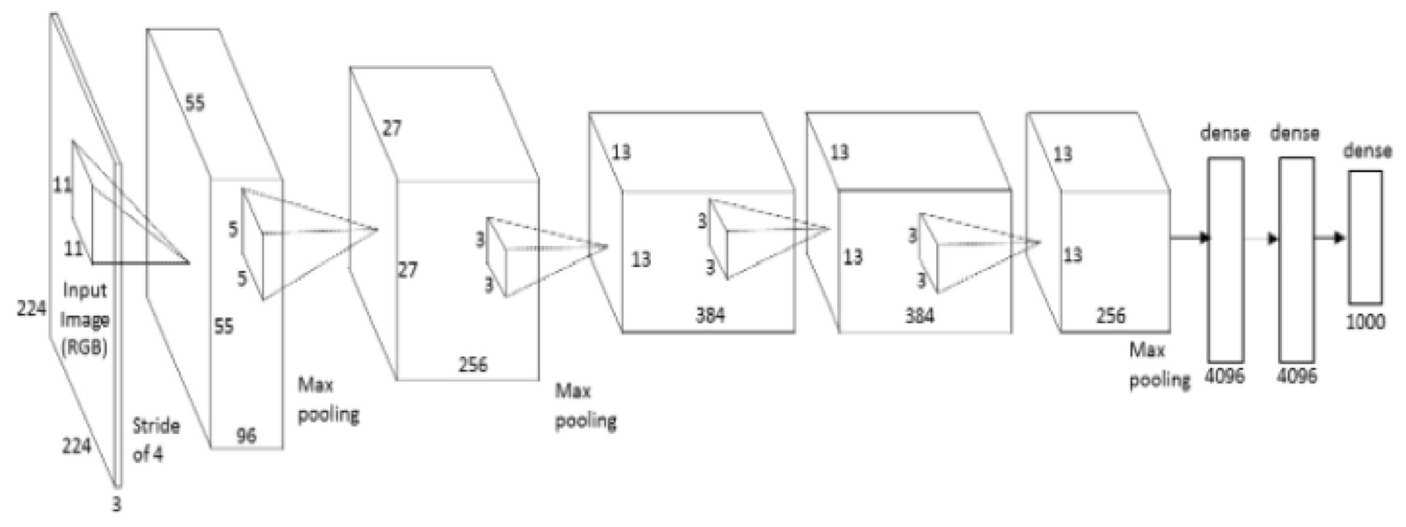
Problem Definition
Hard to Learn New Category
Data Hungry

Slide 3
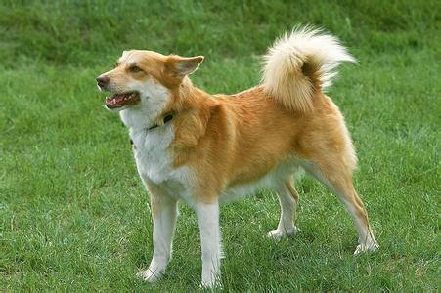
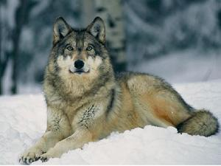
Problem Definition
Human are far better learners:
Similar
Dogs (Already Learned)
Wolves (To be learned)
After observing only one or a few images, humans could learn wolves better. As humans have a mechanism of visual analogy.

Slide 4
Problem Definition
Traditional Image Classification Problem:
DNN Framework
(e.g. AlexNet)
N classes
Training Data
Test on testing data
Use Some methods to adapt the knowledge to new classification problem
Novel Classes Classification Problem:
Another M classes
Training Data
Uh, I don’t want to spend many hours to re-train a model.
Well, the new dataset is too small and cannot use Deep model.

Slide 5
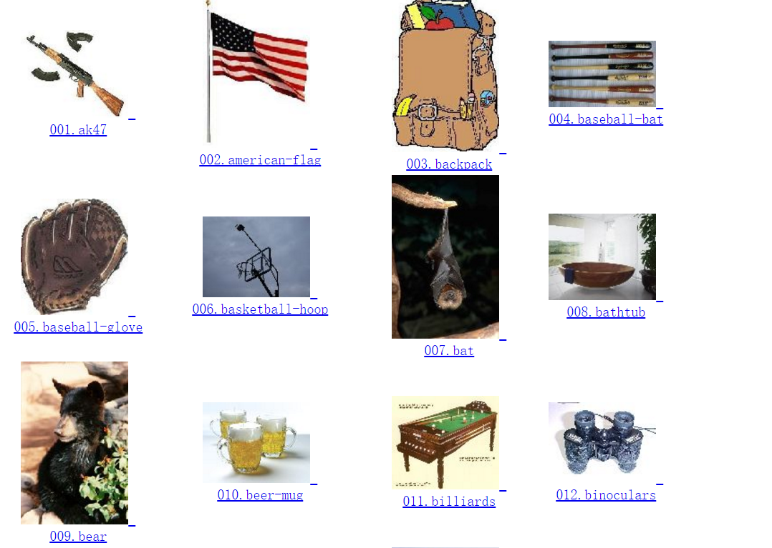

Experiment - Dataset
Base Classes Dataset – ILSVRC2015
Novel Classes Dataset – Caltech256
Example:
Example:
Total Classes: 256 (We only use 50 of them in our experiment)
Average #Images each class: Around 100, ~10 for training
Total Classes: 1,000
Average #Images each class: Around 1,300

Slide 6
Experiment Setting
What we have:
A pre-trained model using AlexNet & ILSVRC2015 (1000 classes)
A text file listing all the base classes
Feature of base classes(100 per class)
10 images/novel class for training
Your task:
Train a new classifier to recognize the 50 novel classes

Slide 7
Several Baselines
Baselines:
Fine-tune pre-trained networks
Softmax regression
Metric-Based Classification

Slide 8
Reference
Prototypical Networks for Few-shot learning (2017‘NIPS)
Learning to Compare: Relation Network for Few-Shot Learning (2017‘CVPR)
…

Slide 9
Experimental requirements
Group Work: 3~4 members
Submission: prediction files (one per group), code and report(everyone)
Presentation: In class, week 16
Deadline: week 16

Slide 10
Evaluation
Prediction Results: 30% (Group)
Idea: 30% (Group)
Report and Contribution: 40% (Individual)

Slide 11
Reserve the right of final interpretation
Questions are welcome

