Slide 1
How to prevent shark attacks
Data Analysis - Source Kaggle

Slide 2

Top 5 Shark Attacks
USA
2. Australia
3. South Africa: 206
4. Bahamas
5. Brazil

Slide 3
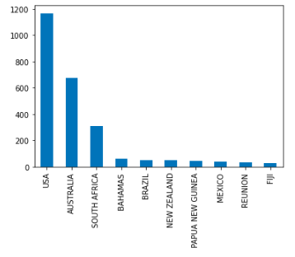

🦈
Where are you most likely to experience a Shark Attack
Please do not go to USA 🇺🇸
Please do not go to Australia 🇦🇺
Please do not go to South Africa 🇿🇦

Slide 4
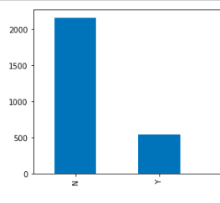
🦈
Fatality
How many shark attacks are fatal?
N =No // Y = Yes

Slide 5
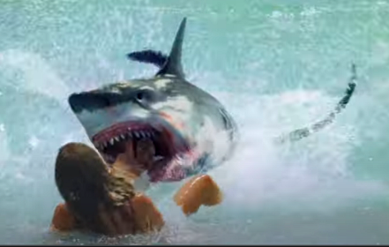
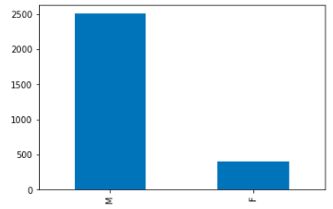
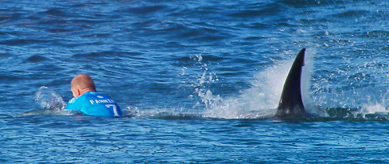
🦈
Are mostly Women or Men?
M = Male // F = Feminine

Slide 6
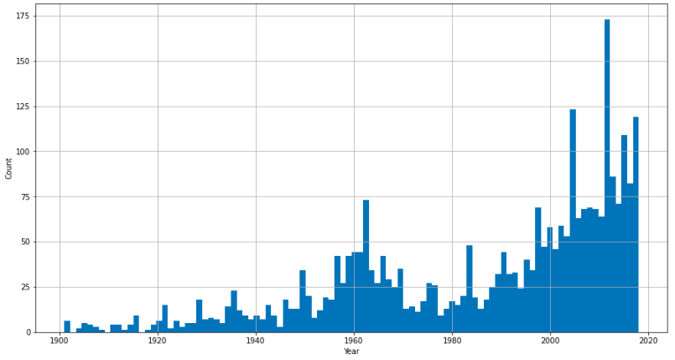
How many cases were reported since 1990?
Top reported cases in 2018

Slide 7
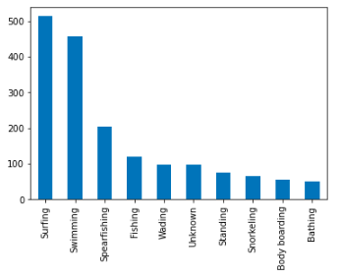
If you Surf & Swim,
be careful!

Slide 8
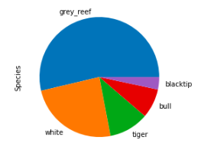
Before you travel → This are the worst sharks
Grey Reef Shark
White Shark
Tiger Shark
Bull Shark
Blacktip

Slide 9
Thanks!
Lucia Costilla

