Slide 1

Presented by Group 1

Slide 2
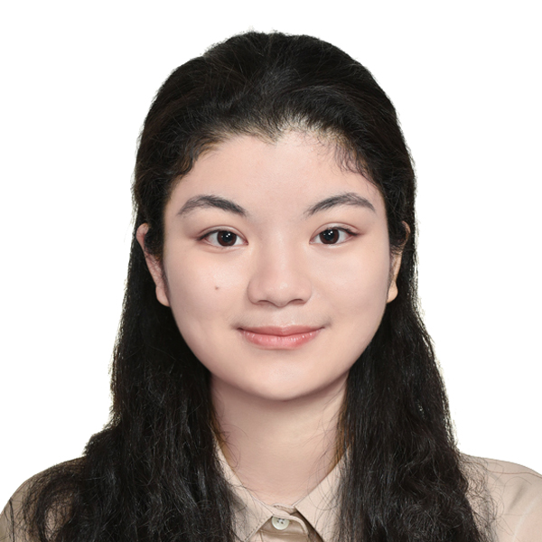
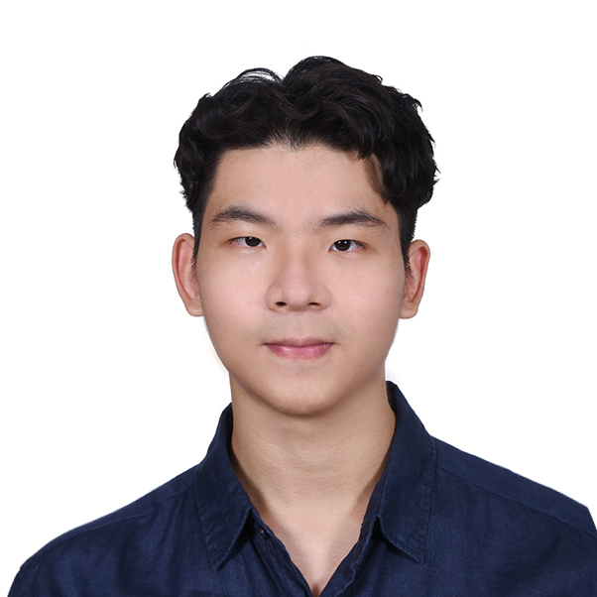
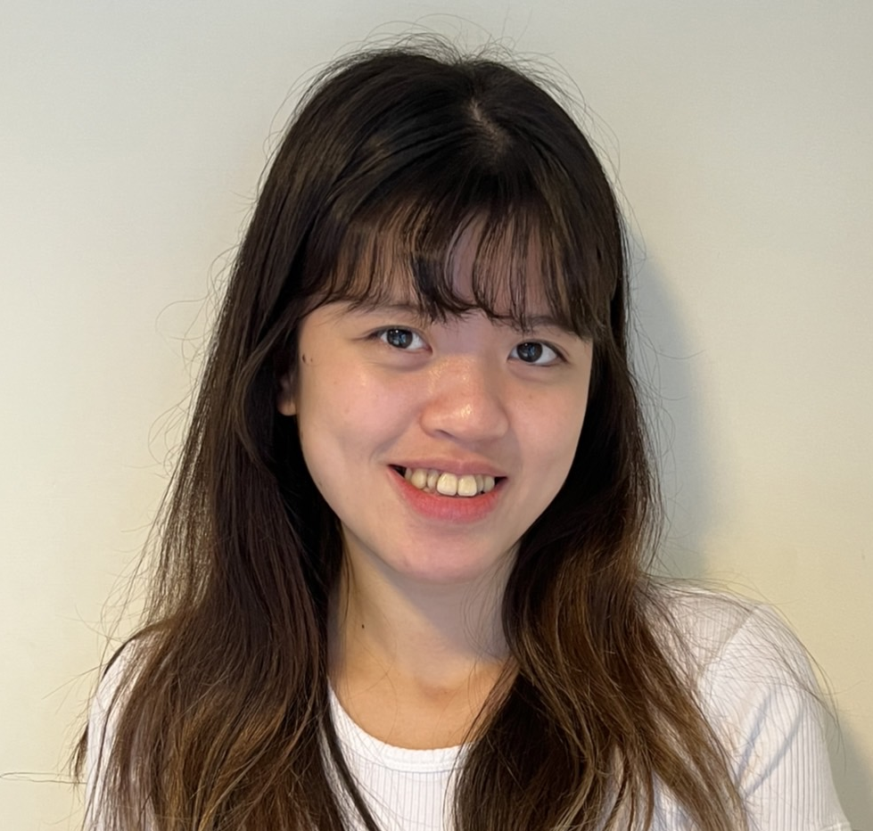
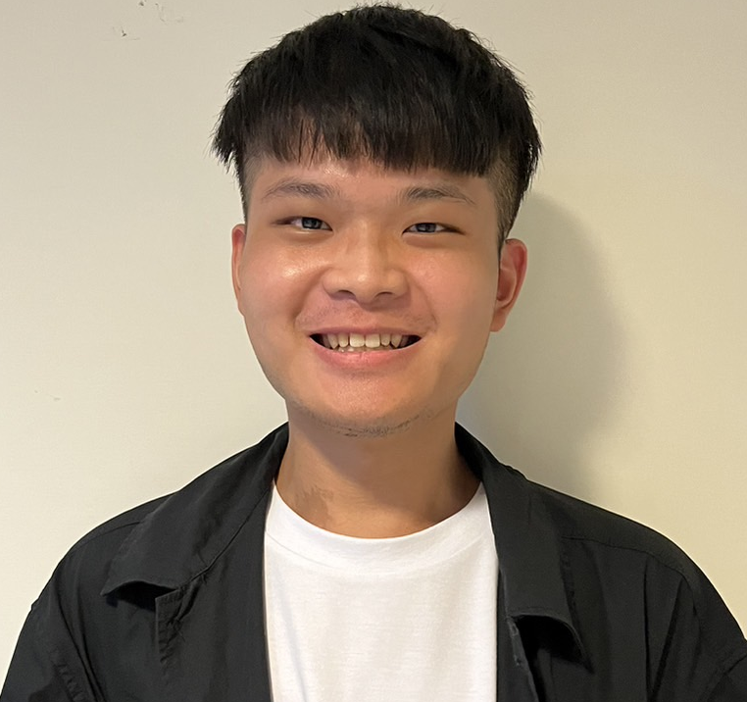
Team Members
Hanna Hsu
Daniel Lu
Candy Lin
Willis Hsiao
Sophomore in
Management Information Systems
Sophomore in
Management Information Systems
Sophomore in
Money and Banking
Sophomore in Public Finance

Slide 3
Summary

Slide 4
1.Problem Definition

Slide 5
Problem Definition
How to commercialize
Lynk’s transdermal technology
into products and
boost international expansion of their products?

Slide 6
2.Observation

Slide 7
Insight of Lynk’s current strategy
Build transparency in the efficacy of the product
Get a third party help
Prove the product’s objectivity and credibility
Clinical trials
Reduce of the testing time
Create reputation for the company
Establish the long-run strategy

Slide 8
Analysis of Lynk
Competitors:unknown
Power of customers:low
Entrants:
unkown
Power of
suppliers: low
Threat of substitutes:
low
Though they have high quality of the products based on the data, they have huge problems in their costs and time.

Slide 9
Current plights
Expensive costs
Clinical trials
Long lead times from sales to product development
Sub-problems
Local regulation
Requirement of passing local trial tests
Insufficient funding
No government’s help

Slide 10
3.Conclusion

Slide 11
Conclusion
In order to enter international market increase financial aid and commercialize the technology

Slide 12
4.Suggestions

Slide 13
4.1 Short-term

Slide 14
Commercialize the technology by collaborating with A*Star
-Implementation
-Collaborate with A*Star
A*Star is a government led institution, so it will be much easier for them to ask for government funding
-Target customer: Middle-aged Women
Develop Repairing cosmetics with the transdermal technology
-Utilize the market that A*Star owns
This way Lynk can save promoting money

Slide 15
A below the line promoting program
Only target on middle age patient
Improve the testing experience for the patient
Free package
Reviews posting
After-sales service
-Implementation
This way we can have a clearer TA and lower the unnecessary cost
independent room for the testing
Offer them snacks
The new cosmetics
The TGC cream
Call to make sure they know how to apply
Send them manual
Ask them to post their reviews on their own social media in order to get a new package

Slide 16
How can we increase funding?
In short-term, we suggest the company to seek financial assistance from outside investors. In the previous successful experiences, we believe now with more solid evidence of the feasibility of this technology and the predicted market growth, the company has a pretty high chance to attract investors.
194.2 Billion
CAGR
9.3%
95.3 Billion

Slide 17
4.2 Long-term

Slide 18
Two ways to predict the future international market
Prediction
Marketing Information System
Clinical Trials Expert System (CNES)
Combine multiple algorithms and build an AI model
Uses lists of binary methods in an information system to help conclude results
Determine Objectives
Data Collection
Data Process
Data Analysis
Determine which country is the best option to promote LYNK’s product first with the less country’s clinical trials regulations

Slide 19
How does the marketing information system work ?
Data collection
Determine Objective
Data process
Data Analysis
According to the Global Topical Drug Delivery Market’s Overview Snapshot chart, the growth is owing to aging population and people with chronic diseases – TA is middle-aged people
Focus on the specific market niche of medical products with middle-aged people
Collection of First hand and second hand data
=>
Online surveys or offline surveys
The data includes data cleaning and data modification
=>
Delete duplication data, falsely input data
SEO (Search Engine Optimization): the process of improving your site to increase its visibility when people search for products or services in order to capture the data when customers in different countries access
Integrate with companies that provide CRM services

Slide 20
How does the Clinical Trials Expert System (CNES) work?
Is a dietary supplement
……
Countries remaining data
Country name
Needs local trial test
Is not a dietary supplement
Countries Regulations of clinical trials data
Is a medical drug
……
Doesn’t need local trial test
Countries remaining data
Country name
Is not a medical drug

Slide 21
Network Diagram of CNES System
Gather Countries Regulations
A
Engineer Build Database/Store Data
Integrate with User Interface
C
D
E
Build Inference Engine
B
Gather other countries information

Slide 22
Gantt chart of CNES system
Initial Project Timeline (in years)
Activities
1
2
3
4
5
6
7
8
Gather Countries Regulations
Gather other countries information
Engineer Build Database/Store Data
Build Inference Engine
Integrate with User Interface

Slide 23
How can CNES improve current system?
CNES
Better decision quality
Consistency
Speed
Reliability
Help manual labor who have to read and collect through data conserve energy and reduce workload
Manual labor only has to supervise the server machine => reduce labor cost
Current: Manual
CNES can be performed at night.
The result can be gotten quickly.
Downtime possibility low
Improved : Computer CNES

Slide 24
Modularize working process
Payment fee to TP
Current
Working progress
Procedure fee to patients
Free a package of TGC cream to patients
Hospital charge: accordingly to the procedures
New
Working progress
Modularize
(reduce time)

Slide 25
5.Risk

Slide 26
Main costs of the suggestions
Marketing Costs
To increase the exposure, we suggest the company to keep giving out free samples and use social media to promote.
Regulations Costs
To get permission, the company need to pass local trial tests in every country it chose to expand.
Time Costs
To make international expansion, the company needs time to evaluate different regulations in different countries. Besides, it will take times to get permission.

Slide 27
Short-term risk Mitigation
Money
(million)
Revenues
Fortunately the marketing costs can be seen as a fixed costs At the beginning, the expenses can be covered by investments. After the company start to make money, there will be revenue. The revenue can be expected to growth in the future according to the expected growth of the market. Therefore we can highly expected that in the
long-term, the company can make profits.
These expenses will be paid by investments
Expenses
Time
(year)

Slide 28
Long-term Risk Mitigation
Money
(million)
Revenues
Although the costs of regulations can be different, but as it could be predict, the slope of it is more flat than the slope of revenues. Since the company can decide when and where to expand, they can make the process be more moderate. Therefore, in the long-term, the company can still make profits.
Expenses

Slide 29
6.Impact

Slide 30
Overall impact
Short-term plan
Short-term plan
Long-term plan
Long-term plan
Commercialize the technology by collaborating with A*Star
Below the line promoting program
Database
Clinical trial
The quickest way to increase funding
Gain trust
A way to promote with smaller cost
Gain trust by friends promotion
Systematize for a long term will decrease overall cost
A better way to break into international market
Lower overall cost

Slide 31
Q&A

