Slide 1
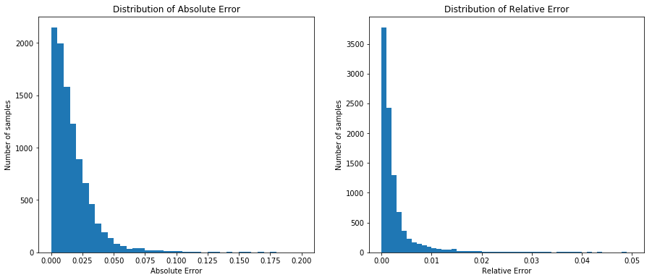
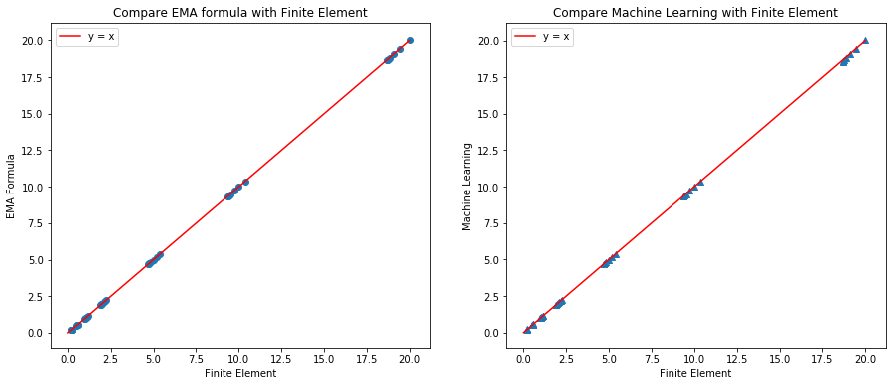
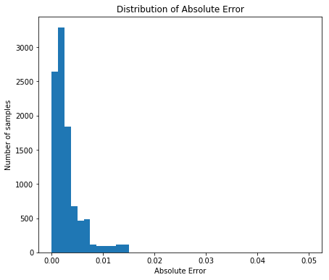
Nan vs Model
10,000 test samples;
P{Absolute error < 0.1} = 99%;
P{Relative error < 0.01} = 93%
MSE(test) = 0.001349; MSE(train) =0.001951
Nan vs FE & Model vs FE
All the points are approximately on the line of x = y
To extend the model to other shapes, train a model to predict p value
P{Absolute error < 0.01} = 96%;
P{Absolute error < 0.02} = 100%;

Slide 2
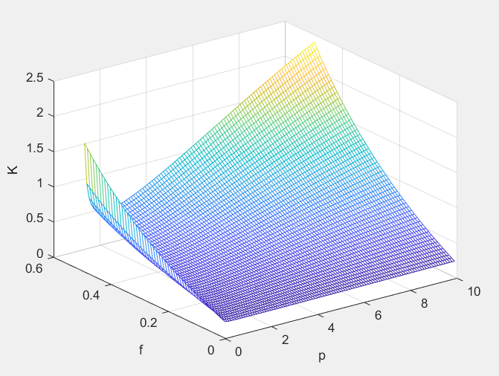
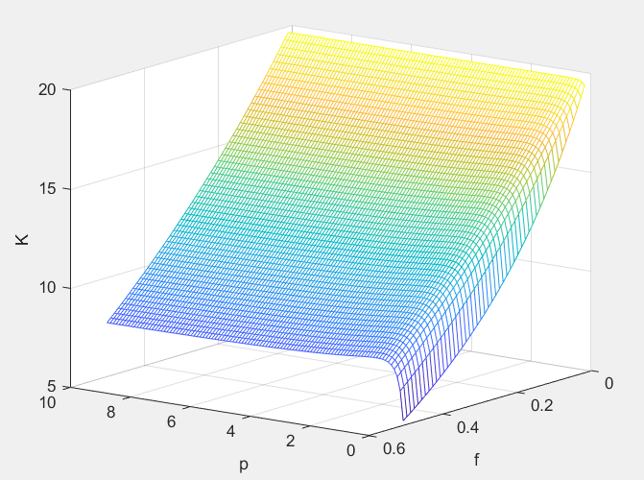
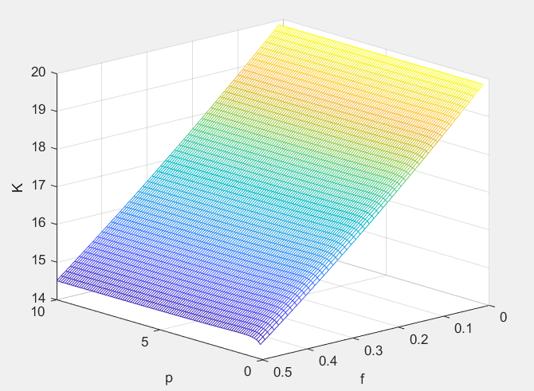
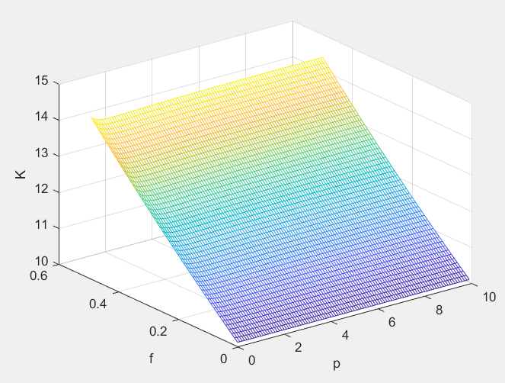
Effect of P
Related to f. When f is big, the effect of p is stronger, otherwise weaker.
Related to Kp, Km. The greater difference of Kp, Km, the effect of p is stronger, otherwise weaker.
Figure 1
Figure 2
Fig. 1 Kp = 20; Km = 0.2
Fig. 2 Kp = 0.2; Km = 20
Fig. 3 Kp = 10; Km = 20
Fig. 4 Kp = 20; Km = 10
Figure 3
Figure 4

