Slide 1




A Millimeter Wave Backscatter Network for Two-Way Communication and Localization
Haofan Lu, Mohammad Hossein Mazaheri, Reza Rezvani, Omid Abari
SIGCOMM’23, New York, USA
Sept. 11th 2023
Notes:
Good morning, everyone. I am Haofan Lu from UCLA. Today, I am going to talk about our paper: a millimeter wave backscatter network for two-way communication and localization.
This is a joint work with my colleague Mohammad, Reza and Omid.

Slide 2



Emerging IoT Applications
Constraints
High datarate communication
High resolution localization
Low power consumption
Unfortunately, today’s wireless systems cannot support these all together
Notes:
Internet of Things paradigm promises to connect everything together and will nurture a bunch of new applications such as smart city, smart industry, and virtual reality. If we look at these emerging technologies and applications, they have some common requirements or constraints: first, they all require high datarate communication for delivering huge amount of data. Second, they requires high resolution sensing or localization to interact with the surrounding environment. Third, they usually have limited power supply and thus requires low power consumption. Unfortunately, today’s wireless technology has not yet been able to support these all together.

Slide 3


Millimeter Wave Technology
Large licensed and unlicensed bandwidth
High datarate communication
High resolution localization
Low power consumption
Problem: Existing mmWave radios have high power consumption
Notes:
Luckily, there is a new technology called millimeter wave. mmWave refers to the radio wave of wavelength at millimeter scale. There are orders of larger licensed and unlicensed bandwidth at mmWave frequency, which translates to much higher network throughput and high resolution sensing capability. With mmWave technology, we can naturally satisfy the first two constraints: high data rate communication and high resolution localization. But about low power consumption? unfortunately, existing mmWave radios have very high power consumptions.

Slide 4
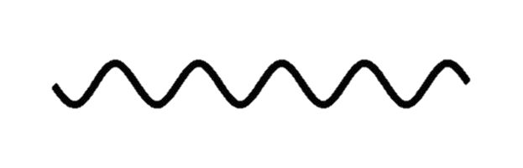

Solution: mmWave Backscatter Technology
AP
Node
Notes:
To solve this problem, researchers propose to use backscatter technique in mmWave communication. For those who are not familiar with Backscatter. In backscatter communication, there is AP or Reader which wants to get data from a node device. The node devices do not actively transmit radio signals. Instead, AP transmits a query signal.

Slide 5
Solution: mmWave Backscatter Technology
AP
Node
101001…
The Node can be very simple and power efficient
Notes:
The node simply absorb or reflect the query signal to piggyback its data on the signal. The AP looks at the signal power reflected from the node to decode the data. Because of this nature, the node design can be very simple and power efficient.

Slide 6
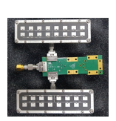
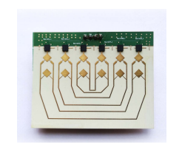
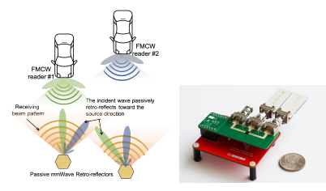
Past mmWave Backscatter Systems
mmTag
(HotNets’20 Sigcomm’21)
Millimetro
(MobiCom’21)
OmniScatter
(MobiSys’22)
Past work does not support Downlink Communication
Notes:
There have been some pioneer attempts in mmWave backscatter, including our previous work mmTag. However, all these past work supports only localization or uplink communication. None of them support downlink communication, which is very important for IoT applications.

Slide 7
This Paper
How can we design a mmWave backscatter system which supports uplink, downlink and localization?
Notes:
In this work, we are trying to solve the problem: how can we design a mmWave backscatter system which supports uplink, downlink and localization all together?
Wait 3~4 sec

Slide 8
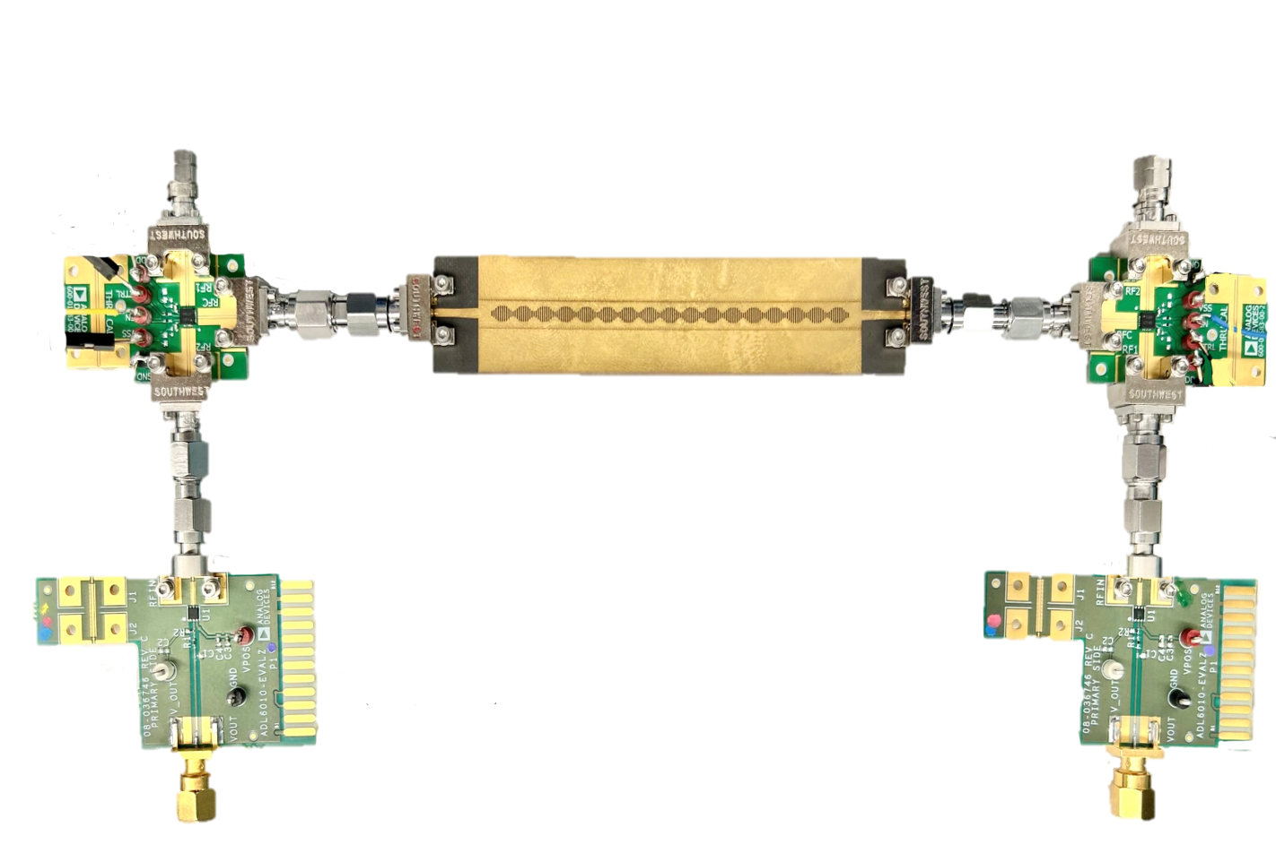
MilBack
The first mmWave backscatter system which supports localization, orientation sensing, uplink, and downlink communication.
Proposed a novel beamforming technique and an orientation assisted modulation scheme.
Built a prototype of MilBack and evaluated its performance in real-world scenarios.
Notes:
We propose MilBack, the first mmWave backscatter system which supports localization, orientation sensing, uplink and downlink communication. The innovation of MilBack is a novel beamforming technique and orientation assisted modulation scheme. We built a prototype of MilBack and evaluated its performance in real-world scenarios.

Slide 9
passively
How to perform beamforming
?
High Frequency
→ Severe Pathloss
→ Concentrate Energy
AP
Node
Notes:
The first challenge in enabling miliback is to design passive beam forming. Let me explain what I mean. Because of the high frequency nature, mmWave signal experiences severe pathloss as it propagates through air. To combat with pathloss, we need to create narrow pencil-like beams to concentrate energy. The AP and Node can only talk to each other when their beams are aligned. Note that we have to do this passively to make sure our design is very low power

Slide 10
How to perform beamforming passively?
Past mmWave backscatter work uses Van atta array
Van atta array
Van Atta cannot be used for receiving signal → No downlink
Notes:
Past work solve this problem using Van atta array. Van atta array works by connecting each antenna to its mirrored antenna and by tuning the length of transmission lines carefully, the signal can be reflected to its coming direction. In this way, van atta array creates a beam that is always pointing to the transmitter. However, Van atta array does not have a port for receiving signal, hence cannot be used for downlink communication.

Slide 11







Our idea: use Frequency Scanning Antenna
in mmWave backscatter communication
$$f_{3}$$
$$f_{4}$$
$$f_{5}$$
$$f_{2}$$
$$f_{6}$$
$$f_{1}$$
$$f_{7}$$
RF Port
IoT Node
Frequency Scanning Antenna
(FSA)
Notes:
Our idea is to use Frequency scanning antenna in mmWave backscatter communication. Frequency scanning antenna is also a passive structure which creates beams for signal of different frequencies towards different directions. We use FSA on the IoT node. The good thing about FSA is that it has an RF Port that can be connected to a baseband processor for receiving and processing signals.

Slide 12








Our idea: use Frequency Scanning Antenna
in mmWave backscatter communication
AP needs to figure out the node’s orientation to pick the right frequency
AP
$$f_{3}$$
$$f_{4}$$
$$f_{5}$$
$$f_{2}$$
$$f_{6}$$
$$f_{1} f_{2} f_{3} f_{4} f_{5} f_{6} f_{7}$$
$$f_{1}$$
$$f_{7}$$
Notes:
However, using FSA raise another problem: the beam is no longer naturally pointing to the AP. The AP needs to find out the orientation of the node to picks the right frequency to align the beams

Slide 13









How to estimate orientation of node?
Frequency
$$f_{7}$$
AP
$$f_{1}$$
Time
Node
$$f_{3}$$
$$f_{4}$$
$$f_{5}$$
$$f_{2}$$
$$f_{6}$$
$$f_{1}$$
$$f_{7}$$
RF Port
Notes:
This brings us to our second challenge: How to esimtate orientation of the node, to estimate the orientation, the AP sends a signal whose frequency sweeps across the whole bandwidth. For those who are not familiar with radar technology, this is the exact waveform used in many radars for localization. MilBack use this signal for estimating both location and orientation of the node.

Slide 14
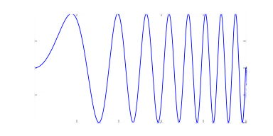
How to estimate orientation of node?
Frequency
$$f_{7}$$
AP
$$f_{1}$$
Time
Frequency matching with the node orientation
Received Power
Node
$$f_{3}$$
$$f_{4}$$
$$f_{5}$$
$$f_{2}$$
$$f_{6}$$
$$f_{1}$$
$$f_{7}$$
Time/Frequency
RF Port
Notes:
So the AP sends this signal, it hits the node and gets reflected back to the AP. Because of the frequency dependent beam pattern of FSA, the reflected signal gets stronger as the frequency matches with the corresponding orientation. More specifically, if we plot the received signal power versus time or frequency, we can see a plot like this. From this plot, we can pinpoint the frequency corresponds to the peak power and identify the orientation of the node.

Slide 15
How to enable two-way communication?
Our idea: Two port FSA and Orientation Assisted Quadrature Frequency Modulation (OAQFM)
Notes:
So far I have explained how MilBack do beamforming and orientation sensing. Now let me show you how MilBack enables two-way communication. Our idea is two use two-port FSA and an orientation assisted modulation scheme we called OAQFM

Slide 16














How to enable two-way communication?
Our idea: Two port FSA and Orientation Assisted Quadrature Frequency Modulation (OAQFM)
AP
$$f_{5}$$
$$f_{4}$$
$$f_{3}$$
$$f_{3}$$
$$f_{4}$$
$$f_{5}$$
$$f_{6}$$
$$f_{4}$$
$$f_{2}$$
$$f_{2}$$
$$f_{3}$$
$$f_{5}$$
$$f_{6}$$
$$f_{7}$$
$$f_{2}$$
$$f_{6}$$
$$f_{1}$$
$$f_{1}$$
$$f_{7}$$
$$f_{1}$$
$$f_{7}$$
Port A
Port B
Notes:
An interesting fact about FSA is that it is actually a symmetric structure, which means we can easily add another port on the other side. In this way, naturally we get two sets of beams overlapping on top of each other and their frequencies are simply mirrored. In other words, each direction beam corresponds to two frequencies.

Slide 17
















How to enable two-way communication?
Our idea: Two port FSA and Orientation Assisted Quadrature Frequency Modulation (OAQFM)
AP
“10”
“11”
$$f_{5}$$
$$f_{4}$$
$$f_{3}$$
$$Presence of f_{6}$$
$$f_{6}$$
$$f_{4}$$
$$f_{2}$$
$$f_{3}$$
$$f_{5}$$
$$f_{7}$$
$$f_{2}$$
$$f_{6}$$
$$f_{1}$$
“00”
“01”
$$f_{1}$$
$$f_{7}$$
$$Presence of f_{2}$$
Port A
Port B
Notes:
Now that we have two sets of beams, the node and AP can use two frequencies for communication. Now, how do we use this? We introduce a new type of modulation which encodes bits to two frequencies. Here I am showing you the constellation of the modulation. We use the presence of these two frequencies for encoding the bits. For example, the presence of both frequencies corresponds to bits “11”

Slide 18
















How to enable two-way communication?
AP transmitted signal
Downlink Communication
AP
Frequency
$$f_{6}$$
$$f_{2}$$
$$f_{5}$$
$$f_{4}$$
$$f_{3}$$
$$f_{6}$$
$$f_{2}$$
Time
$$f_{3}$$
$$f_{4}$$
$$f_{5}$$
$$f_{7}$$
$$f_{2}$$
$$f_{6}$$
$$f_{1}$$
$$f_{1}$$
$$f_{7}$$
Port A
Port B
Notes:
Next, let me explain how we can use this concept for downlink and uplink communication. For downlink communication, the AP wants to send data to the node. Now that the AP has estimated the orientation of the node and knows f2 and f6 are the frequencies that align the beams. It will use these two frequencies to send bits.

Slide 19
How to enable two-way communication?
AP transmitted signal
Downlink Communication
AP
Frequency
10
$$f_{6}$$
$$f_{2}$$
$$f_{5}$$
$$f_{4}$$
$$f_{3}$$
$$f_{6}$$
$$f_{2}$$
Time
$$f_{3}$$
$$f_{4}$$
$$f_{5}$$
$$f_{7}$$
$$f_{2}$$
$$f_{6}$$
$$f_{1}$$
$$f_{1}$$
$$f_{7}$$
Port A
Port B
Notes:
For example, If I want to send bits “10”, the AP can simply send a single frequency signal at f6.

Slide 20
How to enable two-way communication?
AP transmitted signal
Downlink Communication
AP
Frequency
10
11
01
00
01
10
$$f_{6}$$
$$f_{2}$$
$$f_{5}$$
$$f_{4}$$
$$f_{3}$$
$$f_{6}$$
$$f_{2}$$
Time
$$f_{3}$$
$$f_{4}$$
$$f_{5}$$
$$f_{7}$$
$$f_{2}$$
$$f_{6}$$
$$f_{1}$$
$$f_{1}$$
$$f_{7}$$
The node measure the received power at each port and decode the bits
Port A
Port B
Notes:
Similarly, if the AP wants to send bits “11”, it sends two frequencies together. And the signal gets splitted naturally to two ports at the FSA. So on and so forth. The node can simply measure the signal power at these two ports to decode the bits.

Slide 21



How to enable two-way communication?
Uplink Communication
The AP transmits continuous signals at both $f_{2}$ and $f_{6}$
AP
Node’s reflected signal
$$f_{5}$$
$$f_{4}$$
$$f_{3}$$
Frequency
$$f_{6}$$
$$f_{4}$$
$$f_{2}$$
$$f_{3}$$
$$f_{5}$$
$$f_{7}$$
$$f_{2}$$
$$f_{6}$$
$$f_{1}$$
10
01
11
01
00
10
$$f_{6}$$
$$f_{1}$$
$$f_{7}$$
$$f_{2}$$
Port A
Port B
Time
Notes:
Next, let’s take a look at uplink communication. Remember, we use backscatter technique for uplink, the AP continuously transmits two frequencies f2 and f6 as query signal. The node, depending on which bits it wants to send, either reflecting or absorbing these two frequencies to encode bits.

Slide 22














Node Design
$$f_{4}$$
$$f_{5}$$
$$f_{3}$$
$$f_{6}$$
$$f_{4}$$
$$f_{2}$$
$$f_{3}$$
$$f_{5}$$
$$f_{7}$$
$$f_{2}$$
$$f_{6}$$
$$f_{1}$$
$$f_{1}$$
$$f_{7}$$
Port A
Port B
RF Switch
RF Switch
Ground
Ground
Notes:
So far I haved explain how miliback works at a high level, lets look at the architecture of the miliback node. Remember we use a two-port FSA, each port connects to an RF switch. These two switches enable the node to either absorb or reflect the signal.

Slide 23

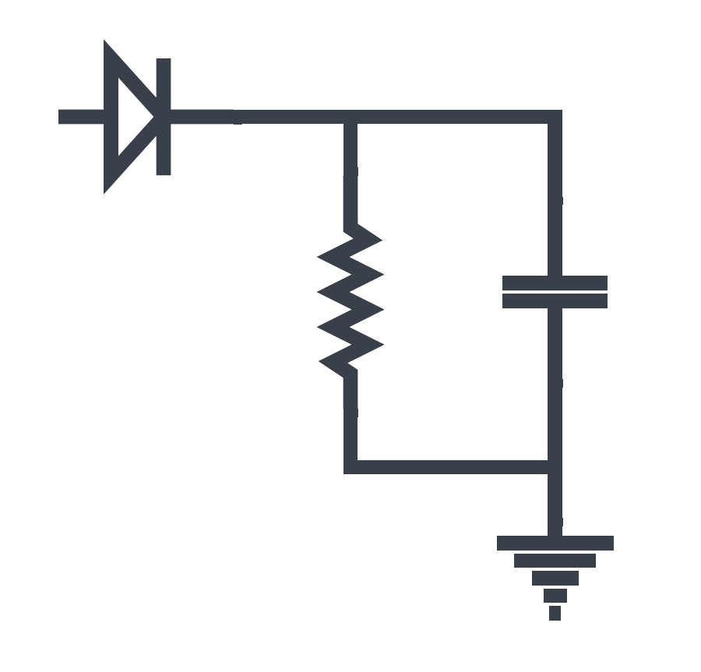
Node Design
$$f_{4}$$
$$f_{5}$$
$$f_{3}$$
$$f_{6}$$
$$f_{4}$$
$$f_{2}$$
$$f_{3}$$
$$f_{5}$$
$$f_{7}$$
$$f_{2}$$
$$f_{6}$$
$$f_{1}$$
$$f_{1}$$
$$f_{7}$$
Port A
Port B
RF Switch
MCU
RF Switch
Ground
Ctrl
Ctrl
Ground
Power
Detector
Power
Detector
Our Design is simple, low-power and low-cost
Notes:
Each switch is connected to a power detector. These power detectors are used for measuring the received signal power to decode the bits. Finally, we have a low-cost microcontroller for processing the data and controling the switches. Note our design is very simple, low-power and low-cost.

Slide 24
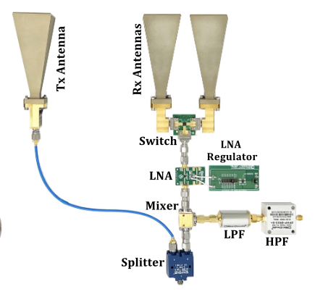
Evaluation
We built MilBack’s node and AP using off-the-shelf components
AP
Node
Notes:
Now we present some of the evaluation results of MilBack.
We built MilBack Node and AP using off-the-shelf components and evaluate it in indoor environment.

Slide 25
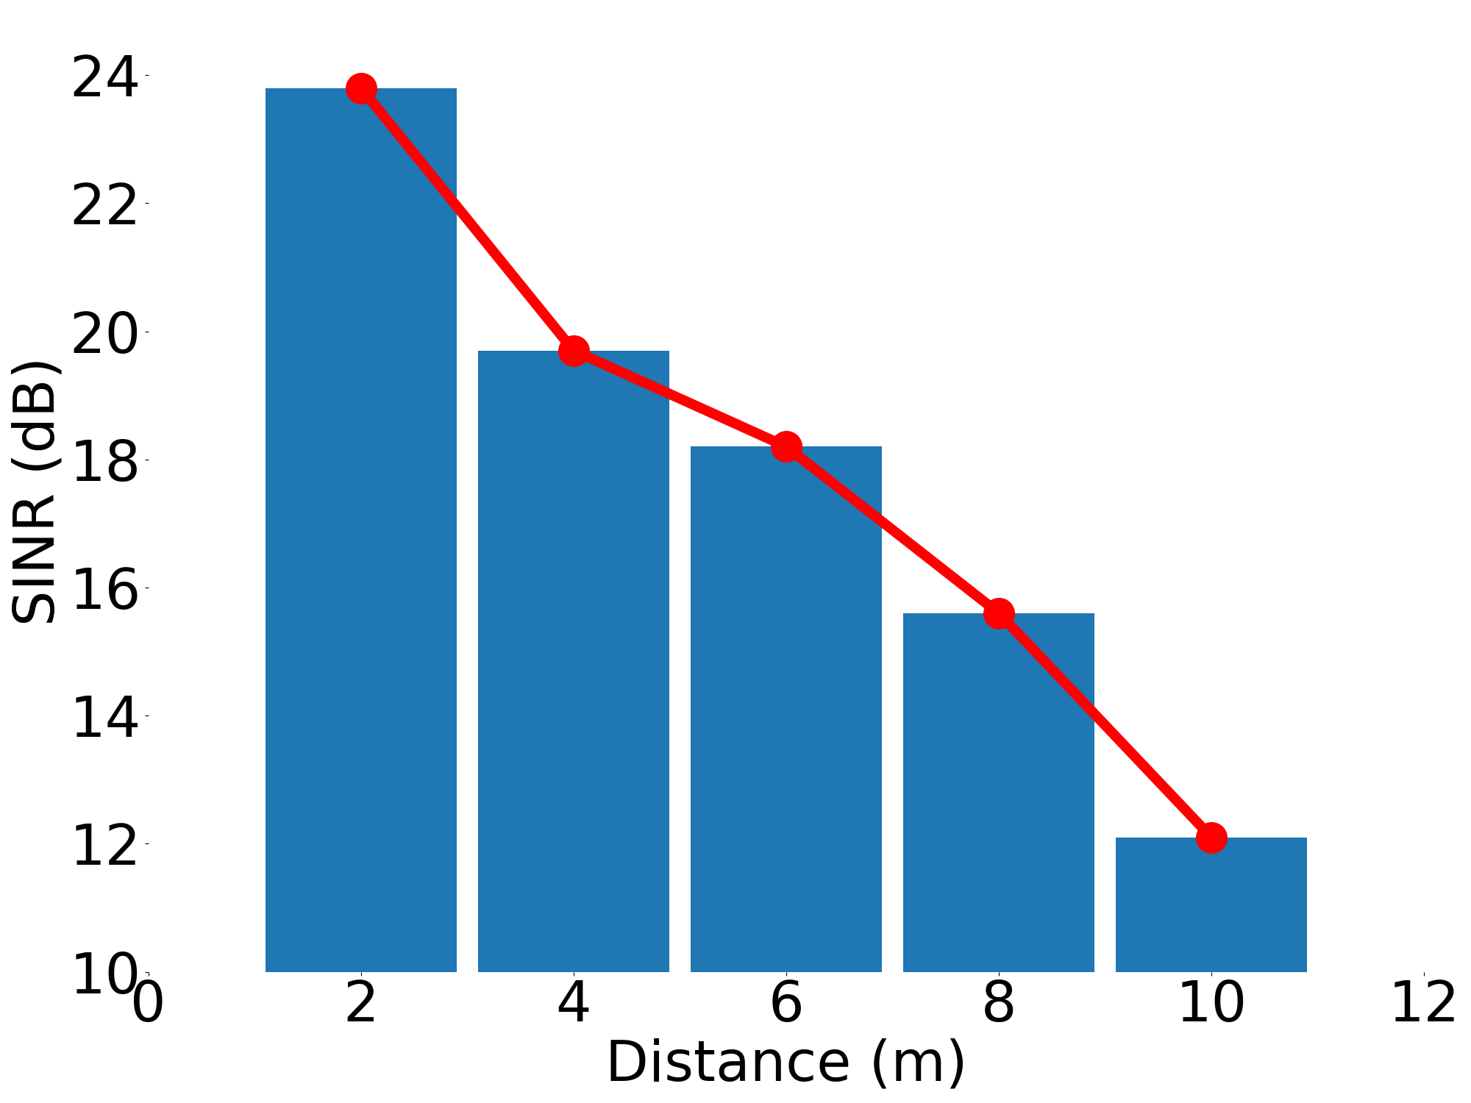
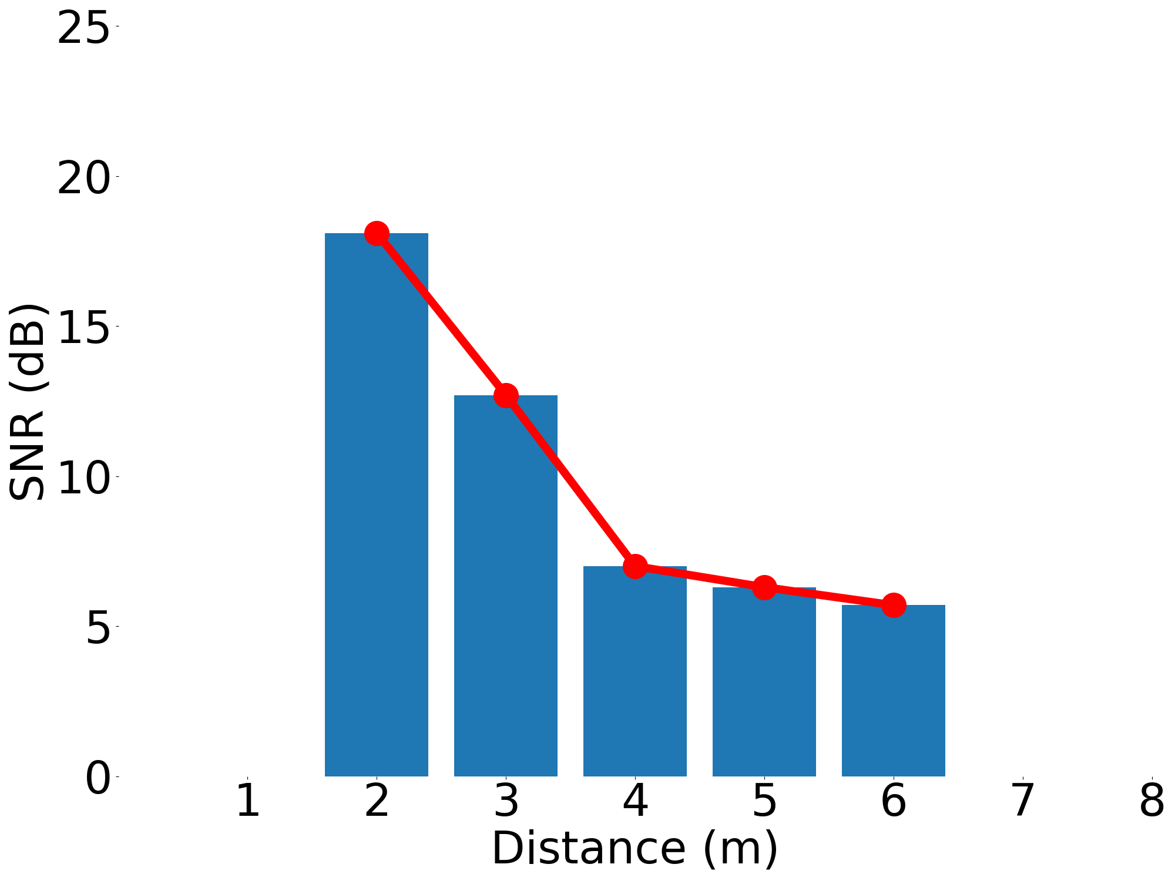
Downlink and Uplink Communication
Downlink 36 Mbps datarate
Uplink 40 Mbps datarate
BER: 3e-3
BER: 1e-8
MilBack supports both uplink and downlink communication
Notes:
Next, let’s take a look at the communication performance. First, I am going to show you downlink communication performance when the data rate is 36 Mbps, here is the result, when the data rate is 36 Mbps, even at 10 meters, our SNR is big enough to support BER of 1e-8. We get similar results for uplink. So far, I have shown you MilBack supports both uplink and downlink communication with very low bit error rate.

Slide 26
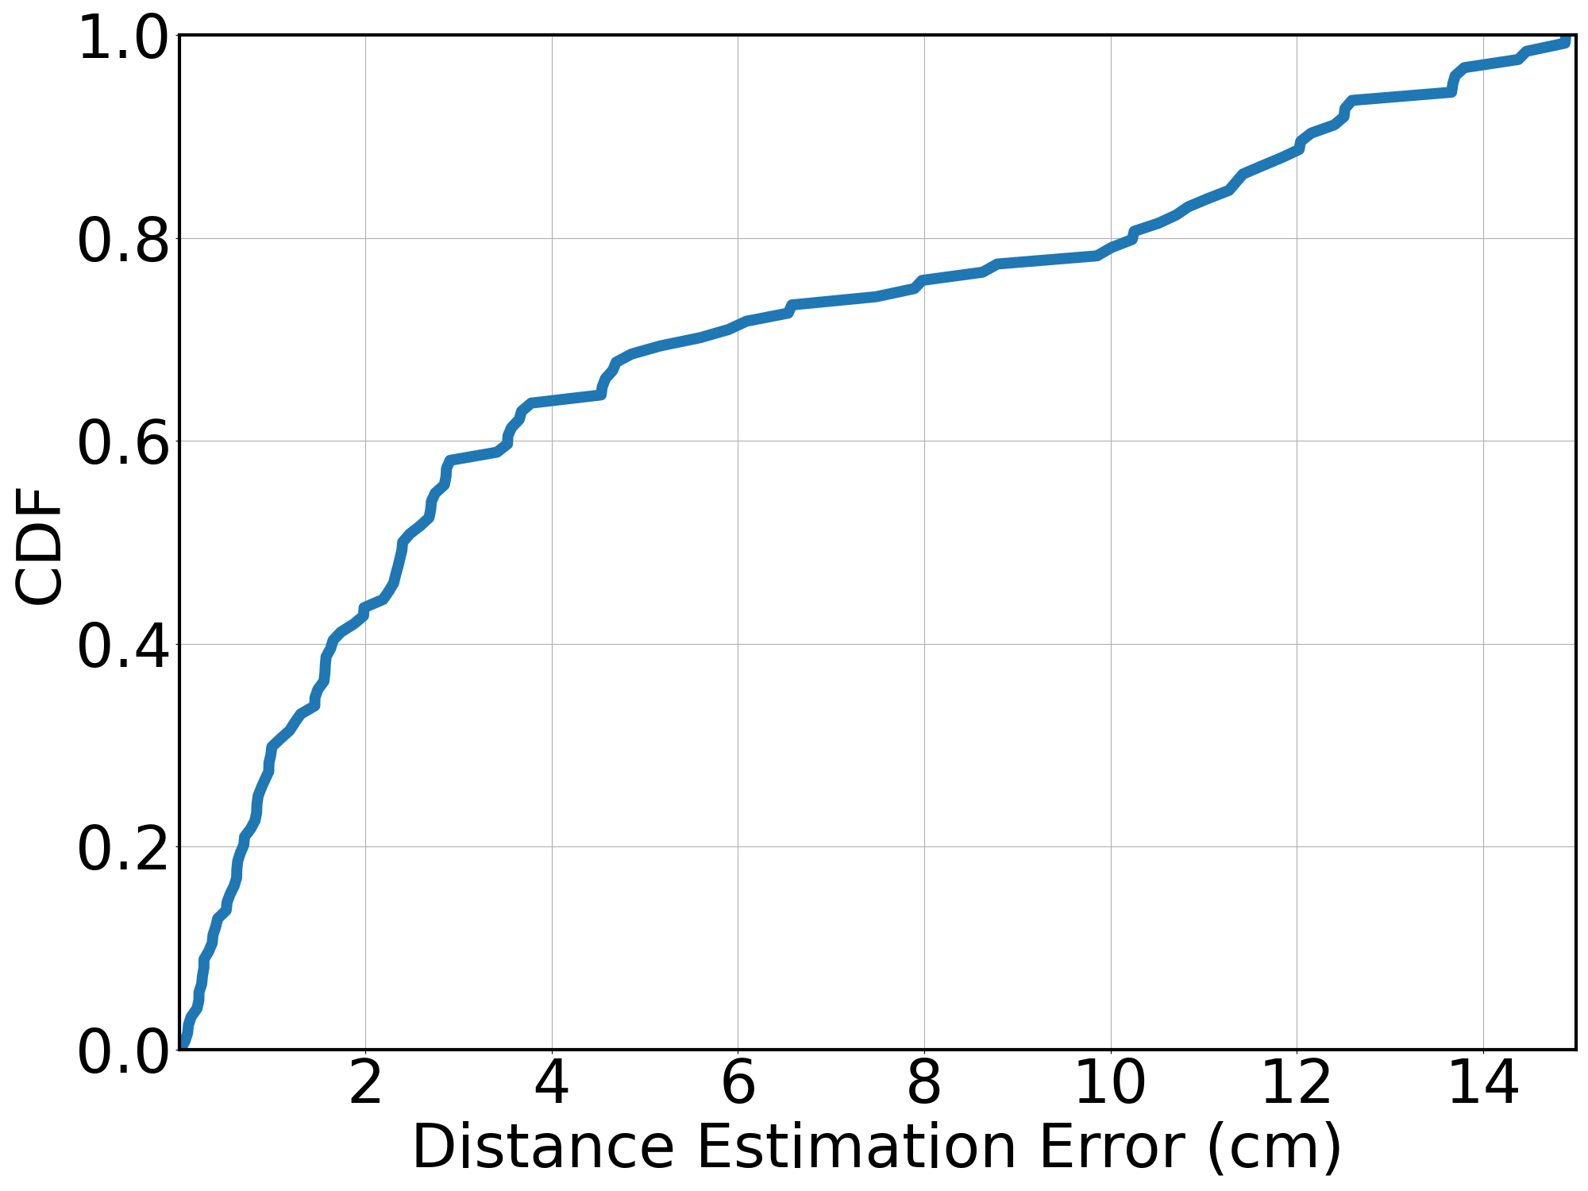
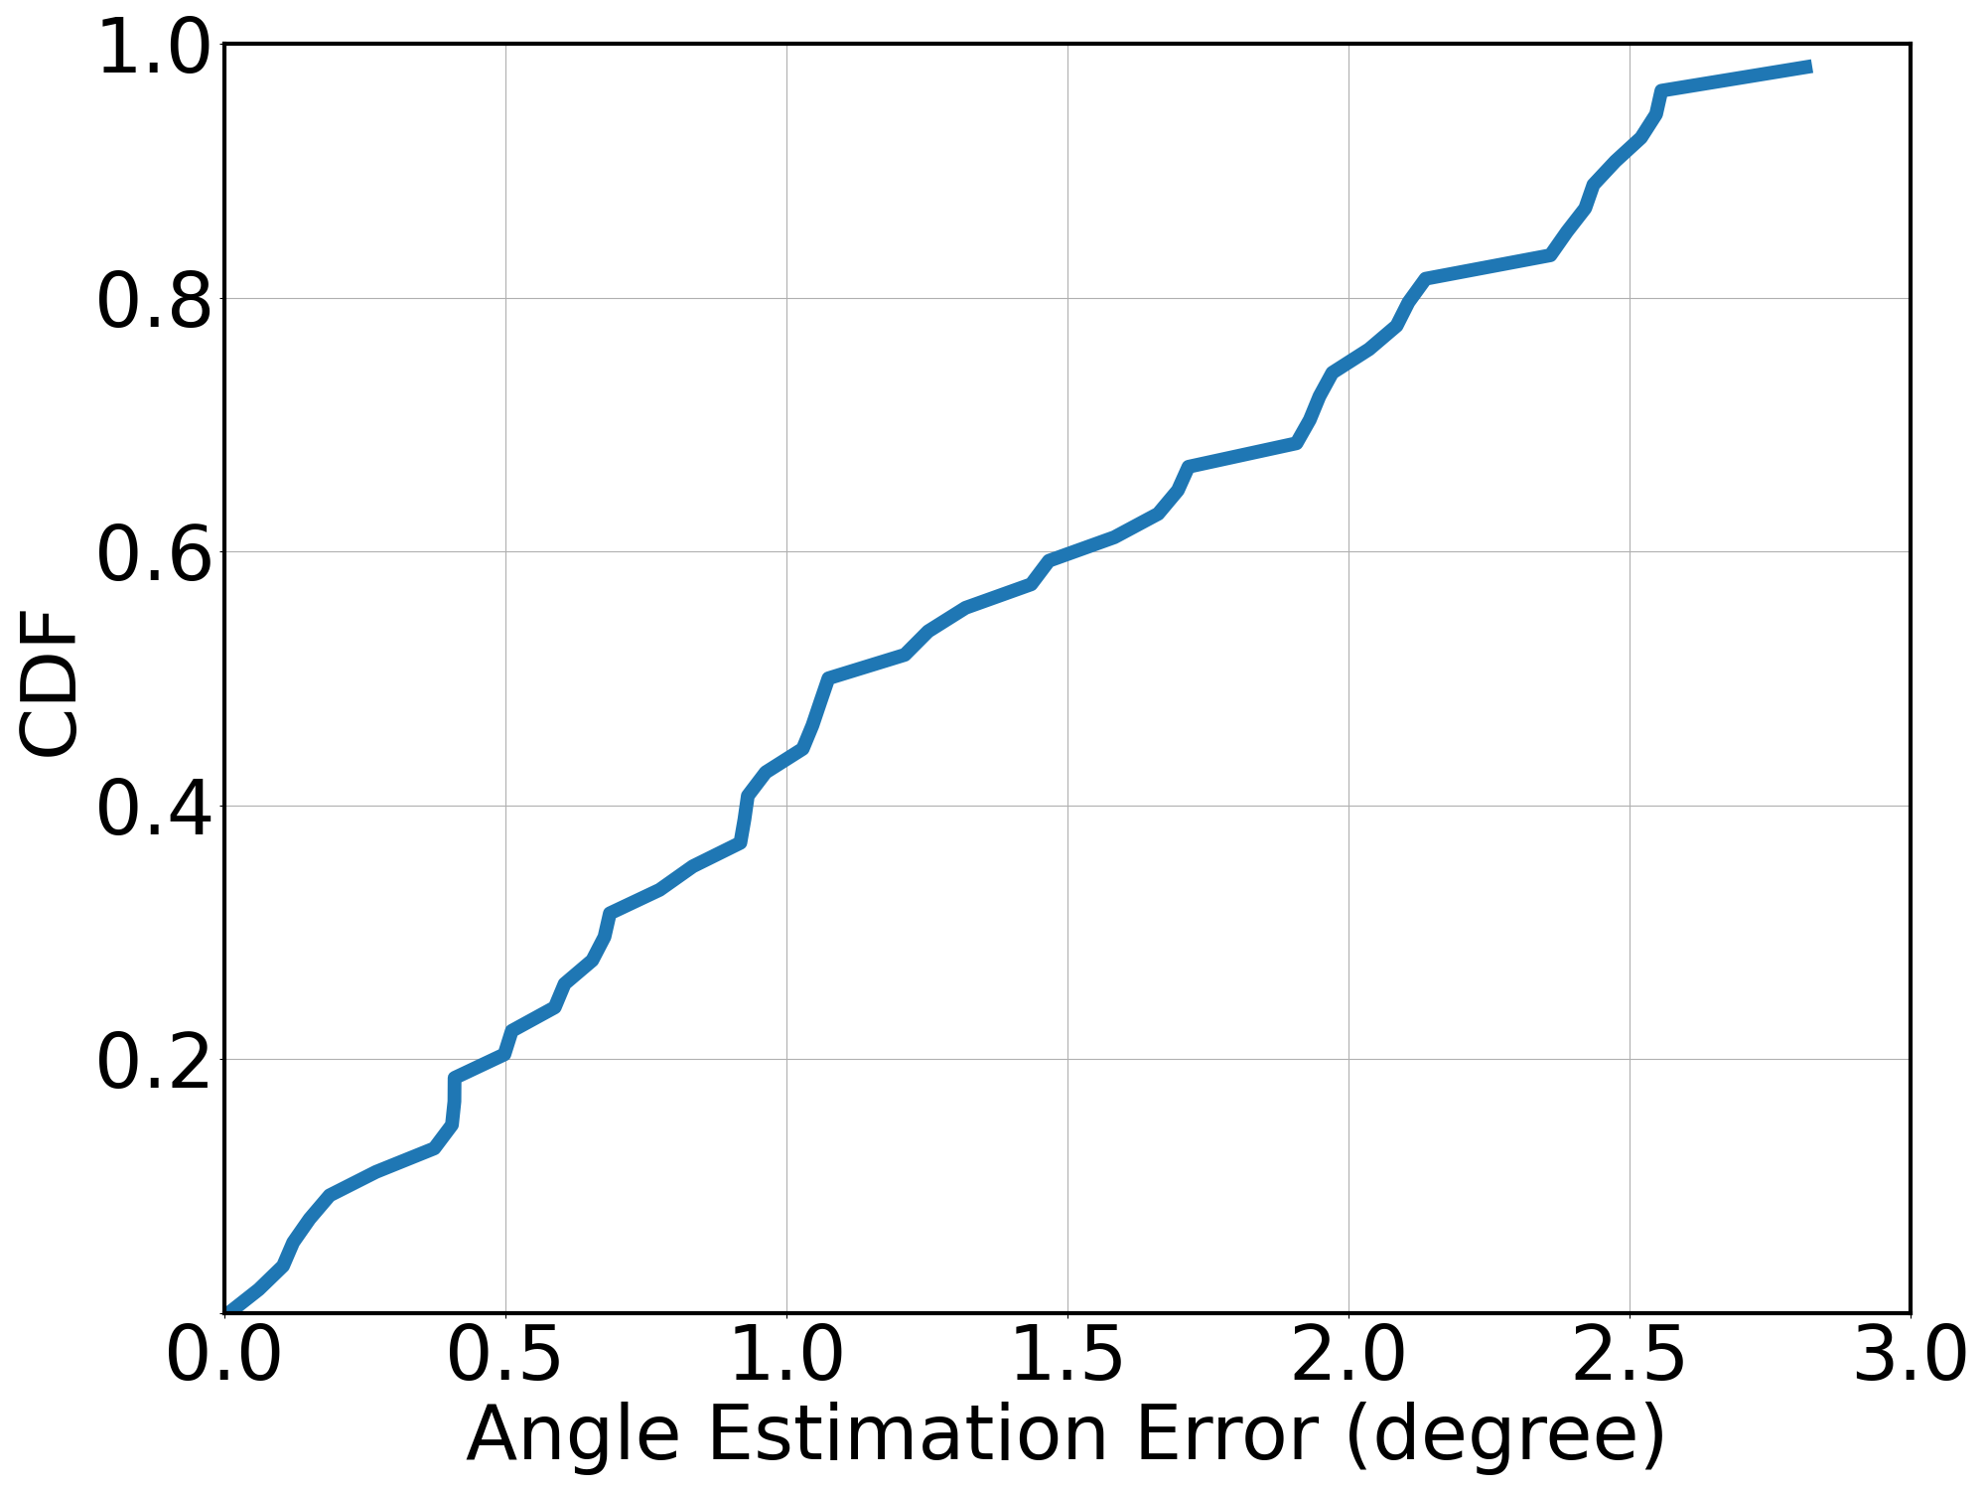
Localization
MilBack localizes the node very accurately
Notes:
Next, let’s see how accurate MilBack can localize the node. I am going to show you the CDF of distance estimation error. And here is the result. As you can see, most of the time, the distance estimation error is lower than 10 cm, which is very good. Next, I am also showing you the CDF of angle estimation error in degree. As you can see, our angle estimation error is mostly around 1 to 2 degrees, which is also very accurate. Overall, we can localized the node very accurately.

Slide 27
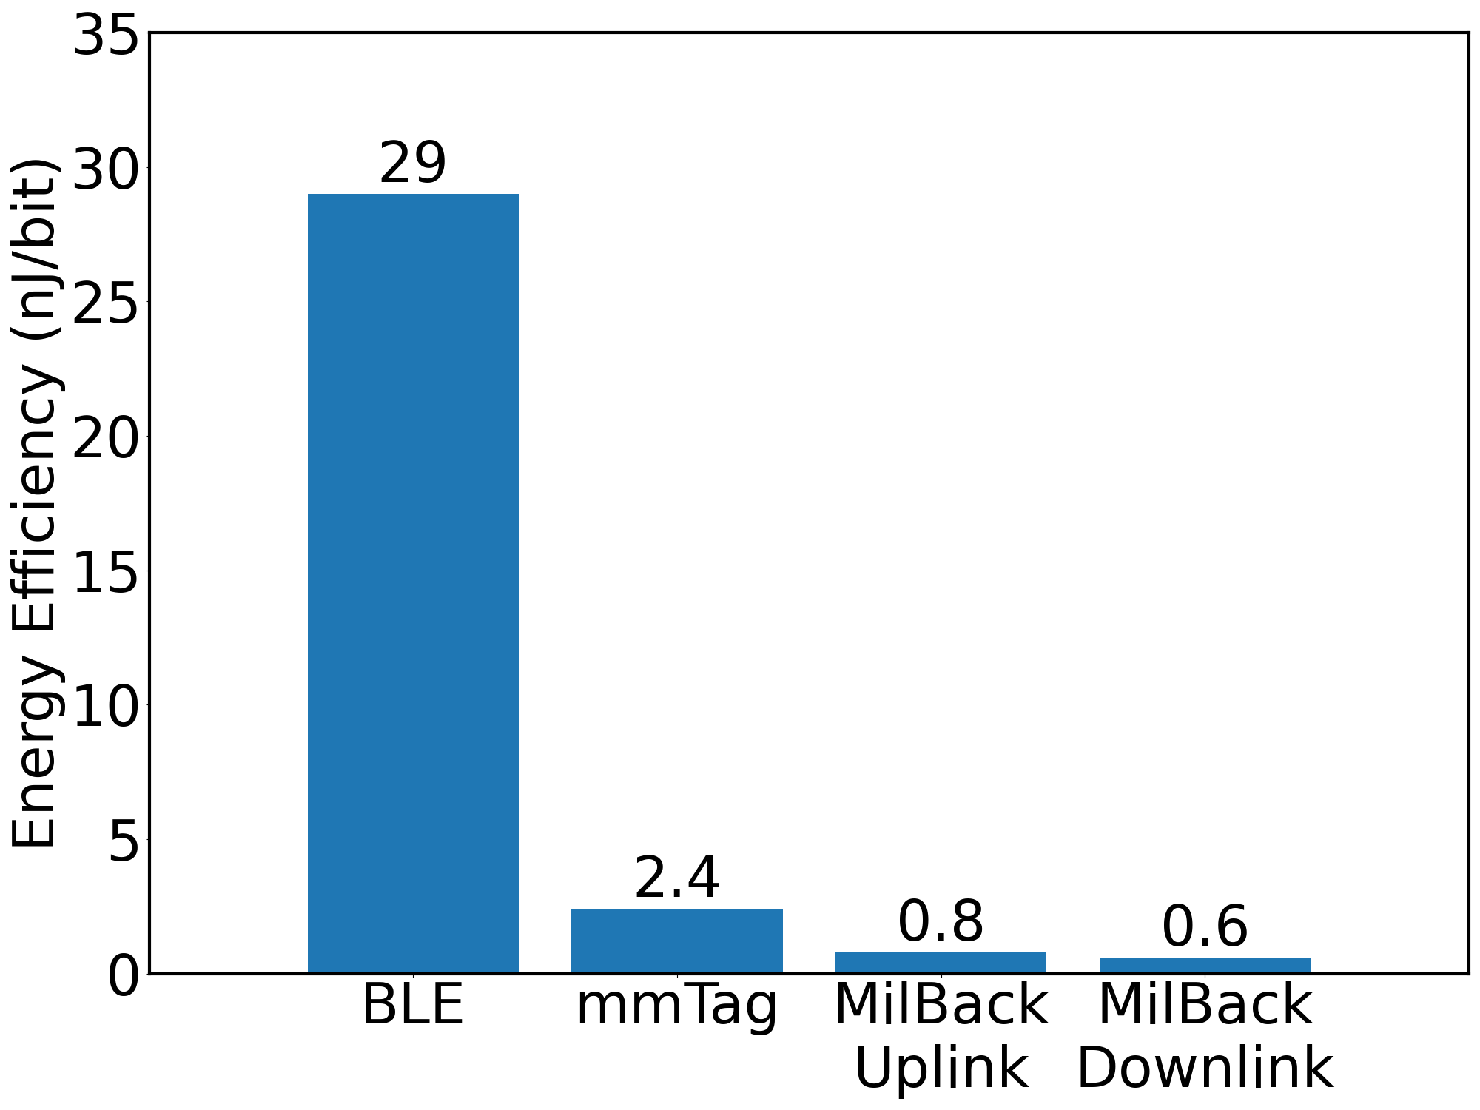
Power Consumption
(SIGCOMM’21)
MilBack has very low power consumption
Notes:
Finally, we are looking to see how power efficient is our system comparing to Bluetooth and previous mmWave backscatter system. As you can see, MilBack’s energy efficiency is way lower than BLE. Even compared to our previous mmWave backscatter system, mmTag, which only supports uplink comm, MilBack consumes 6 times lower energy for delivering the same amount of data

Slide 28


Conclusion
First mmWave backscatter system which supports uplink, downlink communication and localization all together
Novel passive beamforming technique and orientation assisted modulation scheme
Notes:
To conclude, In this work, we propose the first mmWave backscatter system that integrate localization, orientation sensing, and two-way communication.
We enable these functionalities by introducing a novel beamforming technique and an orientation assited modulation scheme

