Slide 1



NeWRF: A Deep Learning Framework for Wireless Radiation Field Reconstruction and Channel Prediction
Haofan Lu, Christopher Vattheuer, Baharan Mirzasoleiman, Omid Abari
ICML’24

Slide 2
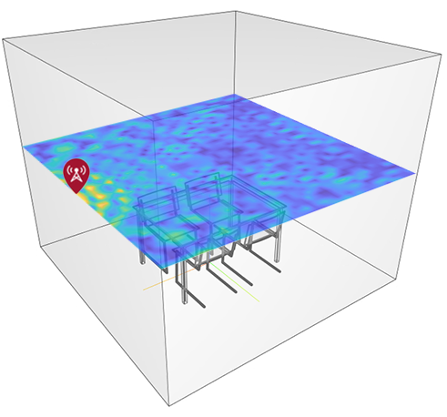
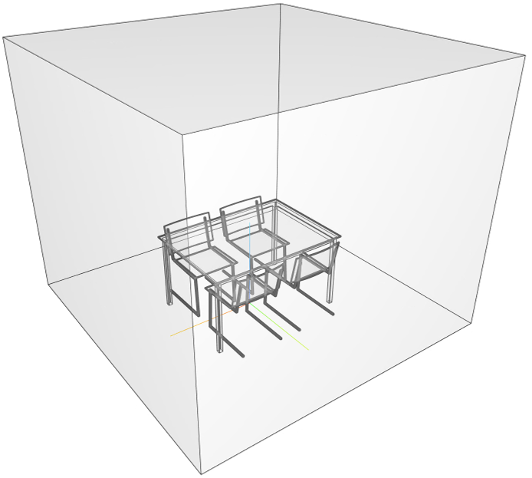
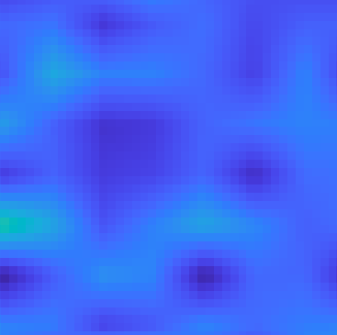
Dead Zones in Wireless Networks
Dead zone: areas with bad signal quality
→ sudden outage and low quality of service
Causes: blockage, interference, etc.
More severe in next generation wireless networks
0.4 m
Access Point
0.4 m
Dead Zone
How can we identify the dead zones?
Notes:
Wireless network has become an indispensable part of our life.
However, today’s wireless networks usually suffer from a critical problem called dead zone.
Dead zones refer to the area in which the wireless signals are very weak, as I show you here, in this simple environment, if we visualize the wireless signal strength in this space, we can see some dark areas, these are the dead zones.
Devices in dead zones can experience sudden outage and low quality of services.
Dead zones are usually caused by blockages and interference.
Unfortunately, this problem is going to get more severe in the next generation wireless networks as we are moving to higher frequencies, because higher frequency signals experience higher loss and are more vulnerable to blockage.
Therefore, an important problem to solve for the next generation wireless networks is to effectively identify the dead zones.

Slide 3
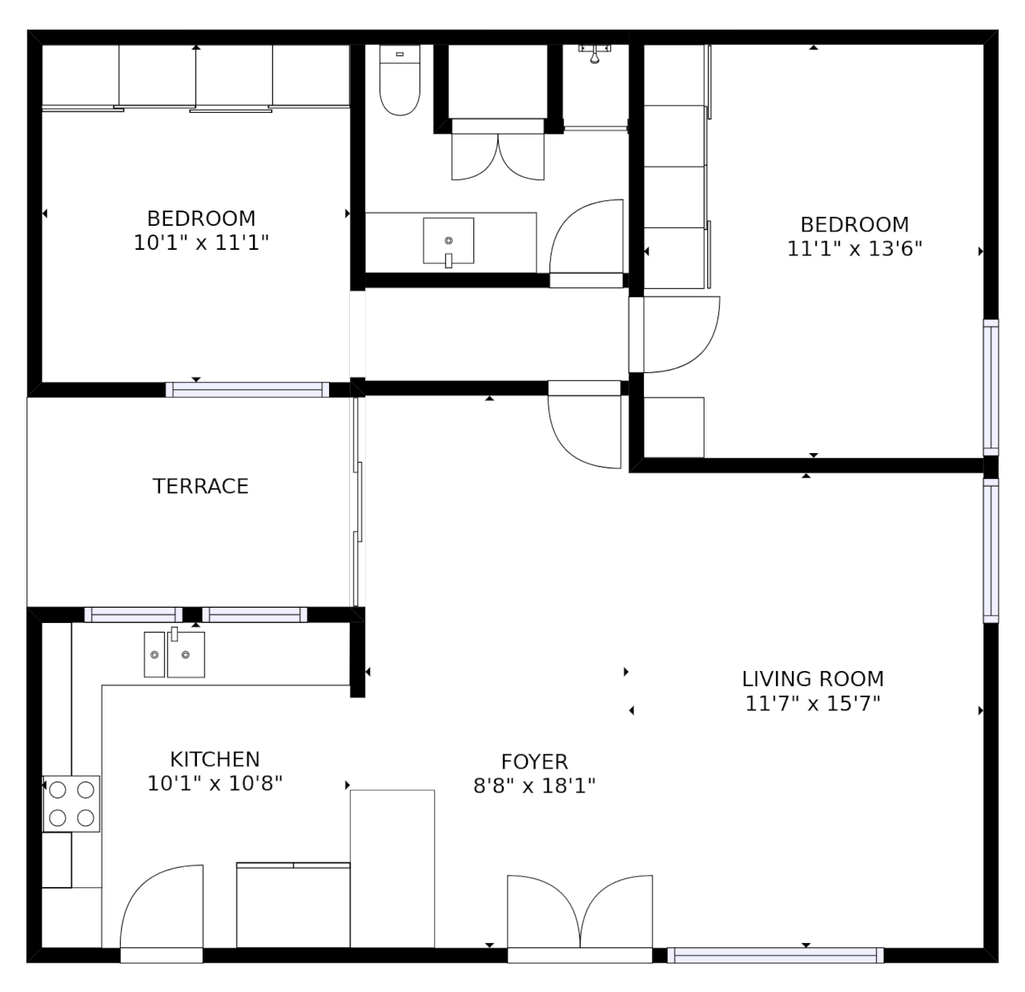
How can we identify the dead zones?
Naïve Solution:
Our Solution:
Can we predict the wireless signal quality at any locations with only a sparse set of measurements?
Notes:
A naïve solution would be taking a lot of measurements in the environments.
However, it will take a lot of manual labor to perform the measurements. How can we make it a bit easier?
Basically, what if we just take a few sparse measurements in the environment, can we accurately predict the signal quality and any other locations?

Slide 4
NeWRF: Neural Wireless Radiation Fields
First wireless channel prediction framework for sparse measurements
Adapt Neural Radiance Fields (NeRF) to wireless domain and solve the following challenges:
Distinct propagation model
Large room-scale scenes
Direction-of-arrival (DoA) ambiguity
First unsupervised learning-based DoA-finding algorithm for inferencing at unvisited locations
Achieve high prediction accuracy with orders of lower measurement density
Notes:
To solve this problem, we present Neural Wireless Radiation Fields (NeWRF), which is the first wireless channel prediction framework for sparse measurements
Our approach is inspired and developed based on the NeRF method originated from computer vision. However, in order to bring it wireless, we need to solve a series of challenges, including
Bridging the gap between different propagation model of wireless signals and visible light
Handling large room-scale environments with limited observation data
And resolving direction-of-arrival (DoA) ambiguity due to the omnidirectionality of wireless antennas
We also present the first unsupervised learning based doa finding algorithm for inferencing wireless signal quality at unvisited locations
Our experiments demonstrate that our algorithm achieves high prediction accuracy with orders of lower measurement density than previous state of the art.

Slide 5

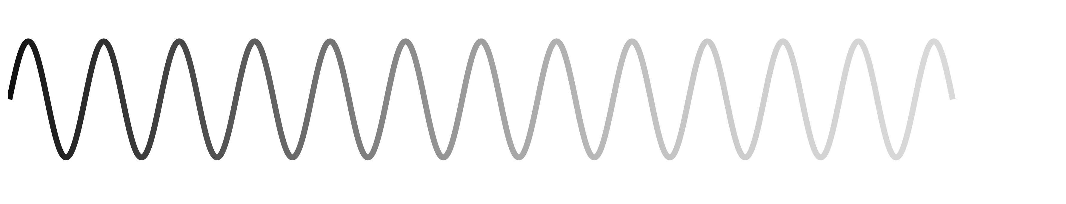
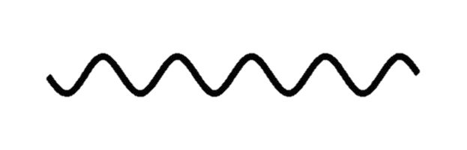
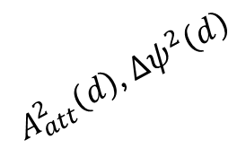
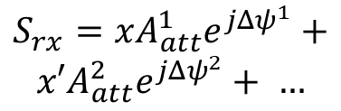



Modeling Wireless Scenes
$$S_{tx}=Ae^{jψ}$$
$A_{att}^{1}\left(d\right)$, $Δψ^{1}\left(d\right)$
$$S_{rx}=x{A_{att}^{1}e}^{jΔψ^{1}}+$$
$$x′{A_{att}^{2}e}^{jΔψ^{2}}+ …$$
Transmitter
Receiver
Virtual Transmitter
$A_{att}^{2}\left(d\right)$, $Δψ^{2}\left(d\right)$
Reflective Surface
$$x′=A′e^{jψ′}$$
Absorption
A wireless scene can be represented by the location of transmitters and the signals they transmit
Notes:
Let’s see how NeWRF works. The first step is to find a proper way to model the wireless scenes.
In a wireless communication system, there is a transmitter and a receiver. The transmitter sends a complex signal. The signal has amplitude and phase.
As the signal propagates from transmitter to receiver, it experiences amplitude attenuation, and phase rotation, which are functions of propagation distance.
Since the signal can also be reflected to the receiver, where part of its energy get absorbed, we model the reflector as if there is a virtual transmitter transmits a new complex signal.
The received signal is the sum of transmitter and all virtual transmitter signals weighted by their corresponding attenuation and phase shift
We can abstract this scene with simply the location of the transmitter, including virtual transmitters and their transmitted signals.

Slide 6





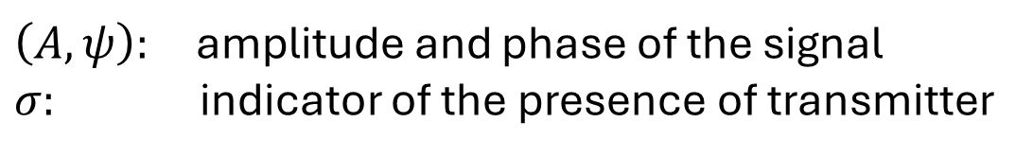
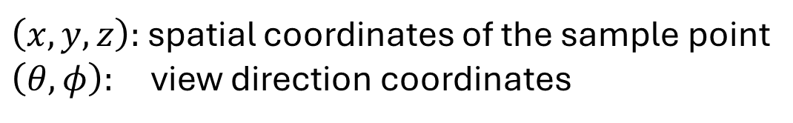

Representing a Wireless Scene with Neural Network
$$f_{Θ}:\left(x, y, z, θ, φ\right)$$
$$→(A, ψ, σ)$$
$$\left(x,y,z\right)$$
$\left(x, y, z\right):$ spatial coordinates of the sample point
$\left(θ, φ\right):$ view direction coordinates
$\left(A, ψ\right):$ amplitude and phase of the signal
$σ:$ indicator of the presence of transmitter
$$(θ,φ)$$
$$σ$$
$$A, ψ$$
Notes:
As in NeRF, we approximate a wireless scene with a neural network model,
where the inputs are the spatial and view direction coordinates.
Different from NeRF, we let the network output the amplitude and phase of the signal emitted at the particular location and direction,
as well as sigma, which is an indicator of the presence of a transmitter or virtual transmitter at the location.

Slide 7




Neural Channel Synthesis
$$(σ, A, ψ)$$
$$f_{Θ}$$
$$L=|\left|\hat{S_{rx}}−S_{rx}\right||$$
$$(x, y, z, θ,φ)$$
Transmitter
Receiver
Virtual Transmitter
Reflective Surface
Notes:
Now we have a model to capture the wireless scene. To synthesize the wireless signal at a receiver location, we back trace the rays coming to the receiver.
Along each ray, we uniformly take samples. We take coordinates of each sample point to query the neural network for the signal amplitude and phase at this location.
And finally, we take the weighted sum of all the samples along all rays to synthesize the signal at the receiver.
This predicted signal can be compared with ground truth to obtain the loss and update the model parameters.
For more details about the algorithm please refer to our paper.

Slide 8
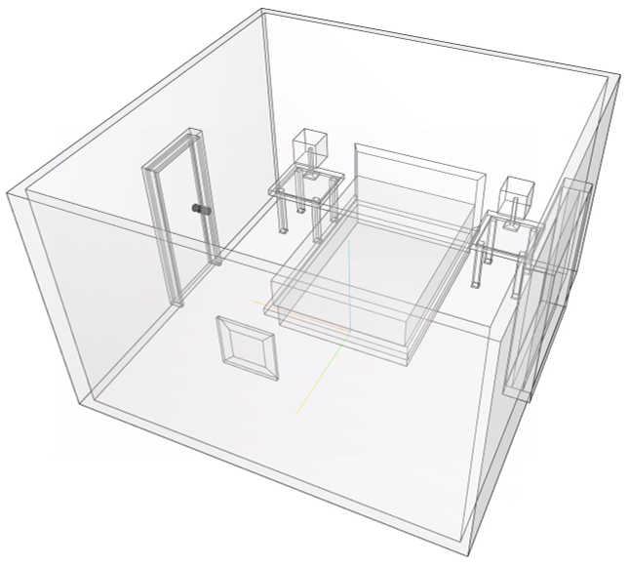
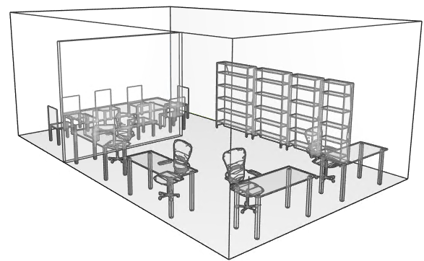
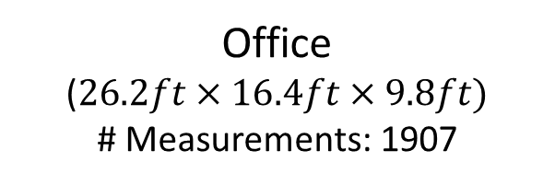
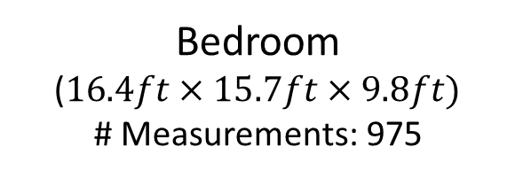
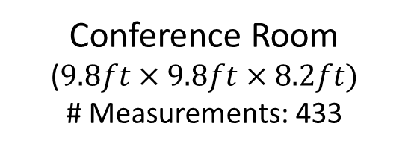
Experiment
Conference Room
($9.8ft×9.8ft×8.2ft)$
# Measurements: 433
Bedroom
($16.4ft×15.7ft×9.8ft)$
# Measurements: 975
Office
($26.2ft×16.4ft×9.8ft)$
# Measurements: 1907
Notes:
We evaluated our framework in three different environment, with different size and reflectors.
For each of these environment, we take a bunch of random locations and run ray-tracing simulation to obtain the signal quality at each of these locations.

Slide 9
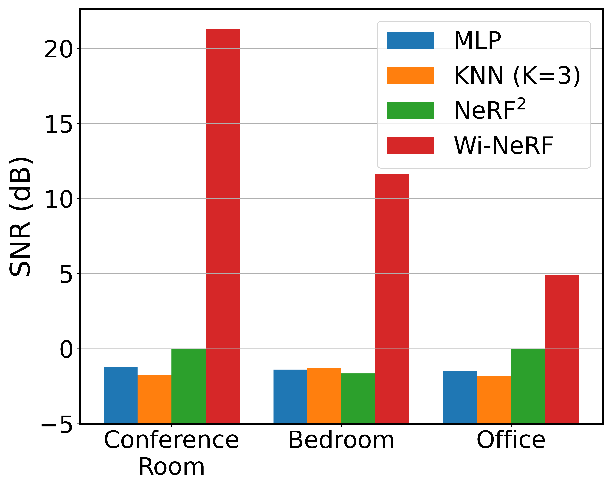
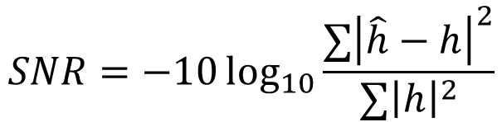
Experiment
NeWRF
$$SNR=−10\log_{10}{\frac{∑{\left|\hat{h}−h\right|}^{2}}{∑{\left|h\right|}^{2}}}$$
Higher SNR → Higher Accuracy
NeWRF outperforms all baseline methods in all three environments
Notes:
Here I am showing you the results. We use SNR as the evaluation metric, and higher SNR indicates higher prediction accuracy.
As you can see. Our algorithm outperforms all the baseline methods including the previous state-of-the-art method under the sparse measurement case

Slide 10


For more results, please refer to our paper:
Thank you!
Paper
Code & Datasets
Notes:
Thank you for listening and welcome to stop by our poster. For more results, please refer to our paper:

Slide 11
NeWRF: Neural Wireless Radiation Fields
First wireless channel prediction framework for sparse measurements
Adapt Neural Radiance Fields (NeRF) to wireless domain and solve the following challenges:
Distinct propagation model
Large room-scale scenes
Direction-of-arrival (DoA) ambiguity
First unsupervised learning-based DoA-finding algorithm for inferencing at unvisited location
Achieve high prediction accuracy with orders of lower measurement density
Notes:
To solve this problem, we present Neural Wireless Radiation Fields (NeWRF), which is the first wireless channel prediction framework for sparse measurements
Our approach is inspired and developed based on the Neural Radiance Fields method originated from computer vision and graphics domain. However in order to bring it wireless, we need to solve a series of challenges, including
Bridging the gap between different propagation model of wireless signals and visible light
Handling large room-scale environments with limited observation data
And Direction-of-arrival (DoA) ambiguity due to the omnidirectionality of wireless antennas
We also present the first unsupervised learning based doa finding algorithm for inferencing wireless signal quality at unvisited locations
Our experiments demonstrate that our algorithm achieves high prediction accuracy with orders of lower measurement density than previous state of the art.

Slide 12




Background on Wireless
$$x$$
$$h$$
Multipath
Interference
$$y=hx$$
Attenuation, Phase shift
Transmitter
Receiver
Reflection
Reflective Surface
Absorption
Wireless channel $h$: a measure of the distortions imposed on wireless signals
Our goal: predict channel with sparse measurements
Notes:
Before I tell you our method, let me first give you a little bit background on wireless.
In a wireless network, you have a transmitter and a receiver. The signals are emitted from the transmitter, propagate over the air and get received by the receiver.
During the propagation, the signal can get attenuated, and its phase gets rotated.
It can also be reflected by an object, where part of it is absorbed. The signal propagate along different paths then adds up at the receiver, they can add up constructively or cancel each other causing interference.
We characterize all these effects with what we call a wireless channel, which is a measure of the distortions imposed on wireless signals.
Technically, our goal is to predict the wireless channel at any locations in the environment.

Slide 13
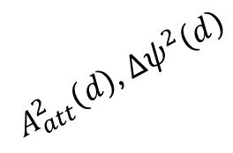
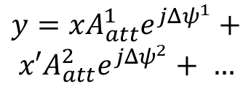



Modeling Wireless Scenes
$$x=Ae^{jψ}$$
$$y=x{A_{att}^{1}e}^{jΔψ^{1}}+$$
$$x′{A_{att}^{2}e}^{jΔψ^{2}}+ …$$
$A_{att}^{1}\left(d\right)$, $Δψ^{1}\left(d\right)$
Transmitter
Receiver
$A_{att}^{2}\left(d\right)$, $Δψ^{2}\left(d\right)$
Virtual Transmitter
Reflective Surface
$$x′=A′e^{jψ′}$$
A wireless scene can be represented by the location of transmitters and the signals they transmit
Notes:
Let’s see how we can achieve that. The first step is to find a proper way to model the wireless scenes.
In a wireless communication system, there is a transmitter that transmit a complex signal, let’s call it x. The signal has amplitude A and phase psi.
As the signal propagates from transmitter to receiver, it experiences amplitude attenuation, and phase rotation, which are functions of propagation distance d.
Since the signal can also be reflected to the receiver, we model the reflector as if there is a virtual transmitter transmits a signal with new amplitude and phase.
This signal also experiences path loss and phase rotation as it propagates to the receiver.
The received signal y, is the sum of transmitter and all virtual transmitter signals weighted by their corresponding attenuation and phase shift
Note that we can abstract this scene with simply the location of the transmitter, including virtual transmitters and their transmitted signals.

Slide 14
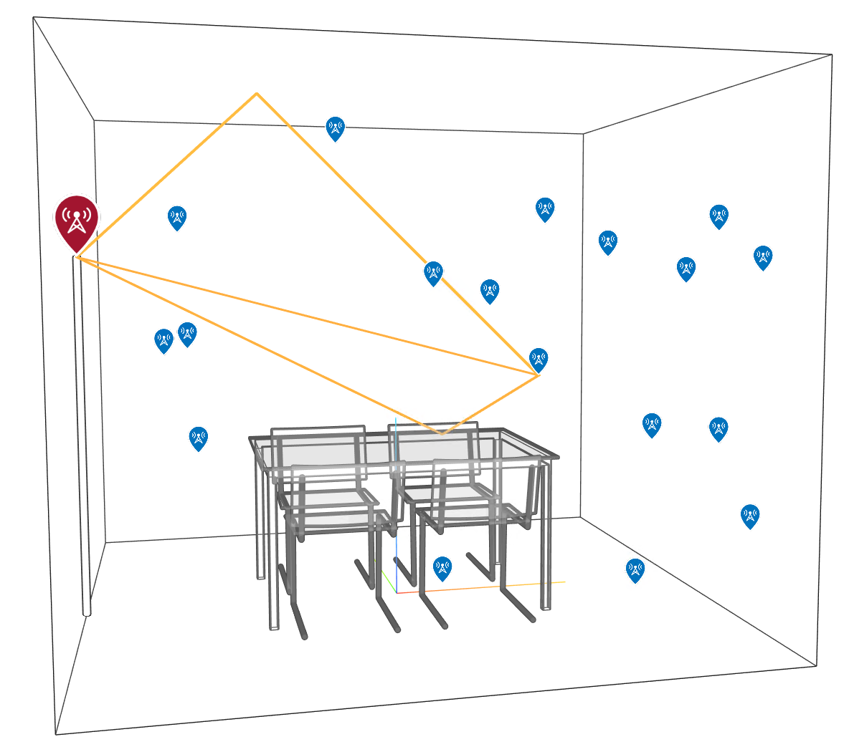
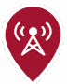

Experiments Setup
Fixed transmitter
Sparse, random receivers
Ray-tracing simulation
Transmitter
Receiver
Propagation Path
Notes:
Now that I have shown you the high-level idea of our algorithm, let me show you how it performs in practice.
We set up a simulation environment, where a transmitter is set at a fixed location. We put the receivers at several sparse and random locations.
We run wireless ray-tracing simulation in MATLAB to obtain the signal quality at each receiver location.

Slide 15
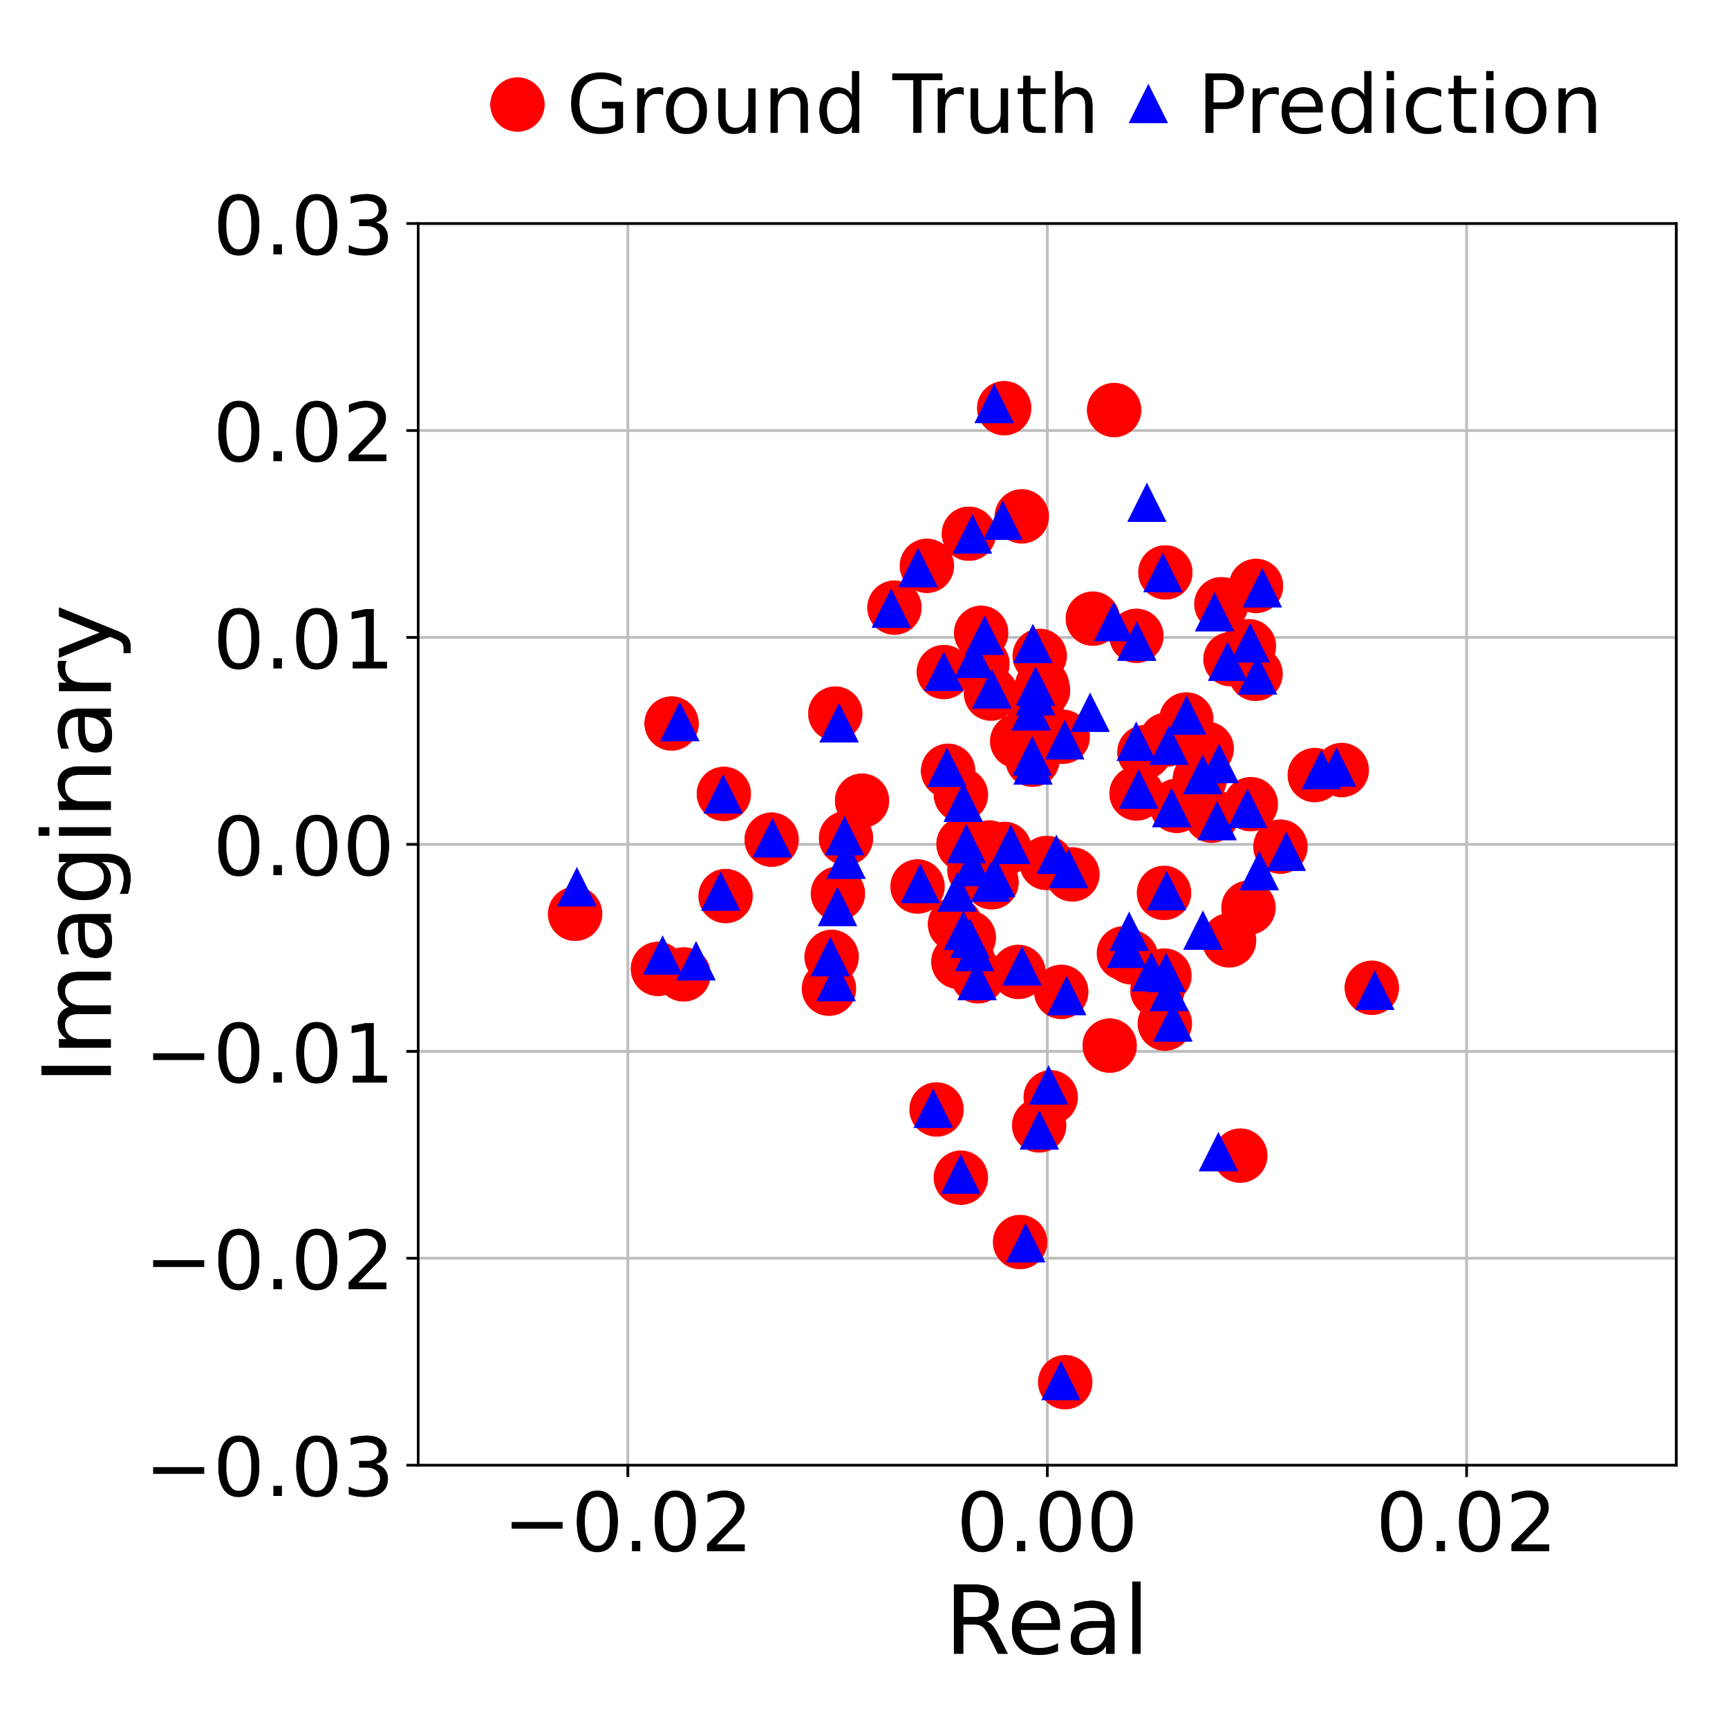
Results: Microbenchmark
Channel prediction for unvisited locations
Notes:
Now let’s see how well we can predict the channel for unvisited locations.
Since the signal is a complex number, I am plotting its real and imaginary parts in x and y axes. And I will show the ground truth in red and prediction in blue
As you can see the prediction results align very well with the ground truth.

Slide 16
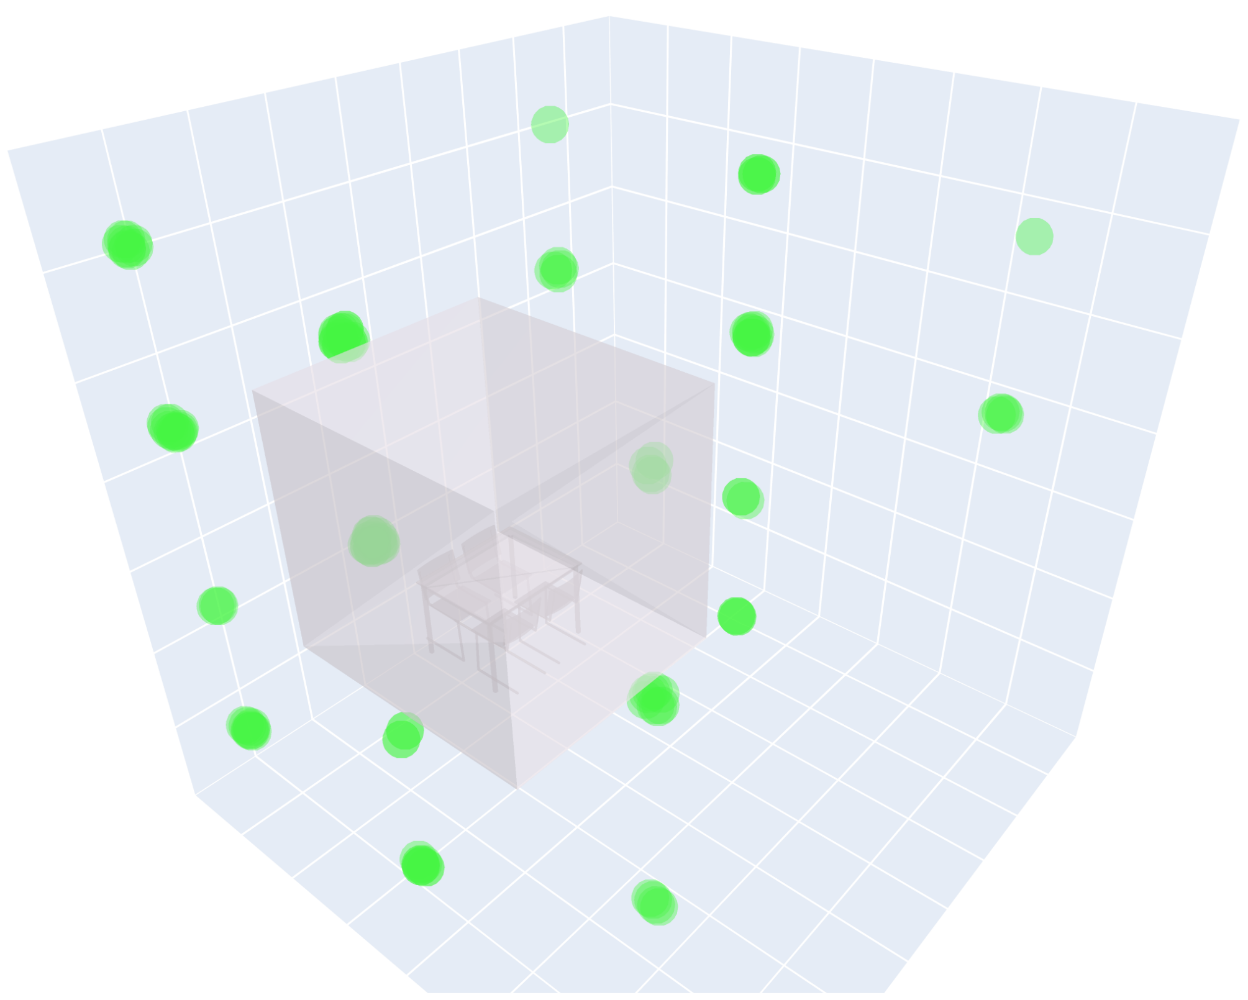
Challenge#2: Large Room-scale Scenes
Wireless scenes usually at room scale but each channel measurement only gives a complex number
Real Transmitter
Virtual Transmitter
Solution: we find a simple while effective representation of the wireless scene
-- virtual transmitters as images of real transmitter against reflector surfaces
Notes:
The next challenge we need to address is the large scene scale. Wireless scenes are usually at the scale of a room, which is known to be challenging even for NeRF in the visible light domain. Additional information such as depth is required to assist the learning.
Unfortunately, such information is hard to obtain in wireless, and each channel measurement only results in a complex number, which provides barely enough information to reconstruct the scene.
Luckily, we find that there is a simple while effective representation of the wireless scene, and our model is able to learn it. Which is virtual transmitters as images of real transmitter against reflector surfaces.
Basically, instead of learning the virtual transmitters on the reflector surfaces, our model identifies that it is more effective to put them on the other side of the surface, at the virtual image of the real transmitter, as shown in here
Let me show you why is that.

Slide 17


Challenge#2: Large Room-scale Scenes
Virtual transmitters as images of real transmitter against reflector surfaces
Reflective Surface
Virtual
Transmitter
Receiver A
Receiver
C
Receiver B
Transmitter
Reflective Surface
Virtual
Transmitter
The intersection of rays gives the model a strong bias to assign high sigma values at these points
Notes:
Let’s consider this simple scenario where there is transmitter and two reflective surfaces. We measure the channel at three receiver locations.
For each receiver, we trace the rays towards their coming directions. Because of the law of reflection, the rays of different receivers intersect at the image of the transmitter location against the reflective surface.
We find this intersection gives the model a strong bias towards assigning high sigma values at these points.

Slide 18
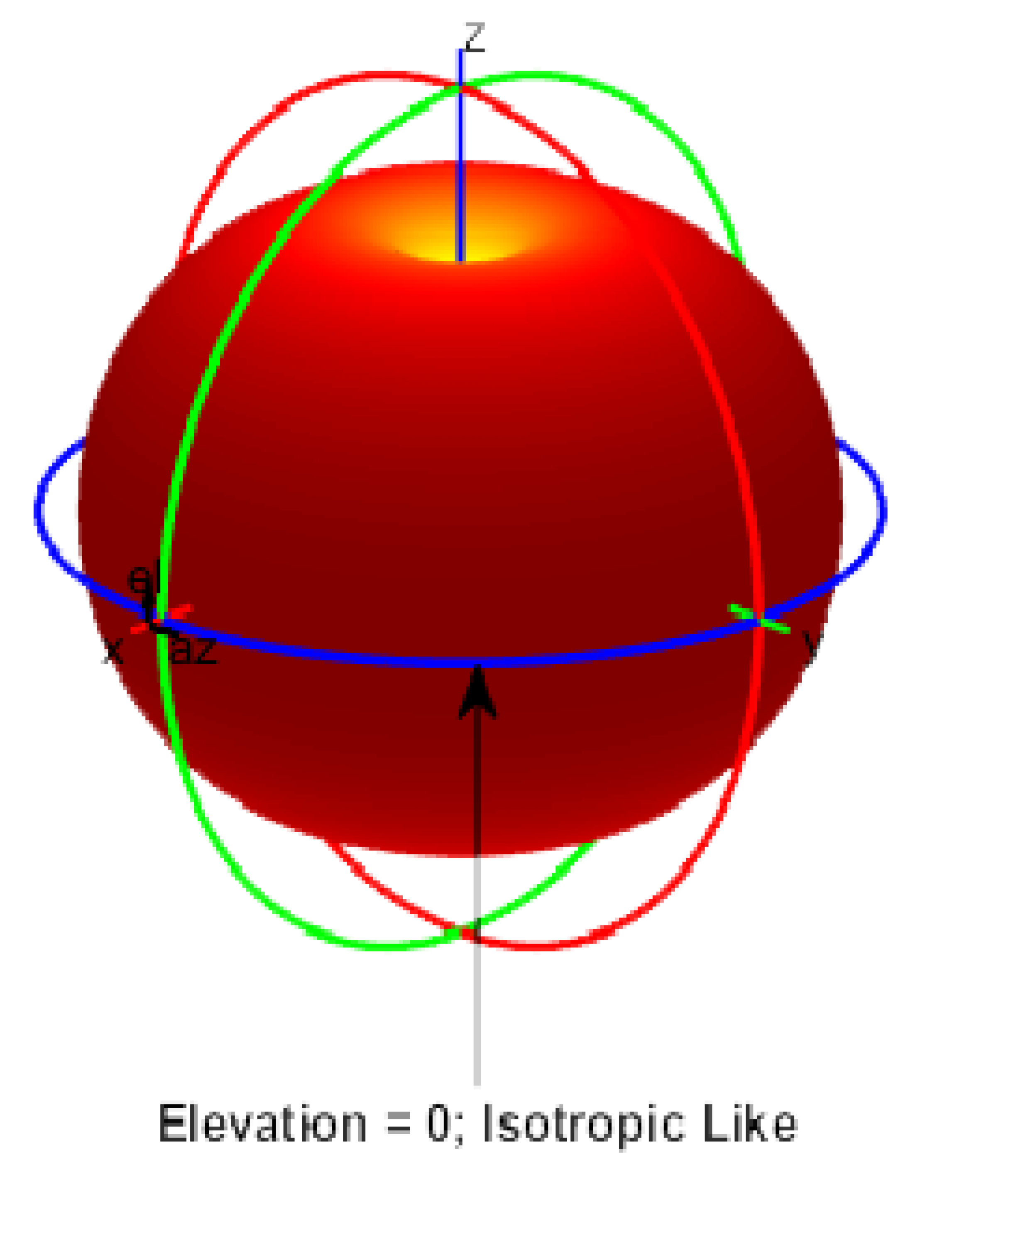
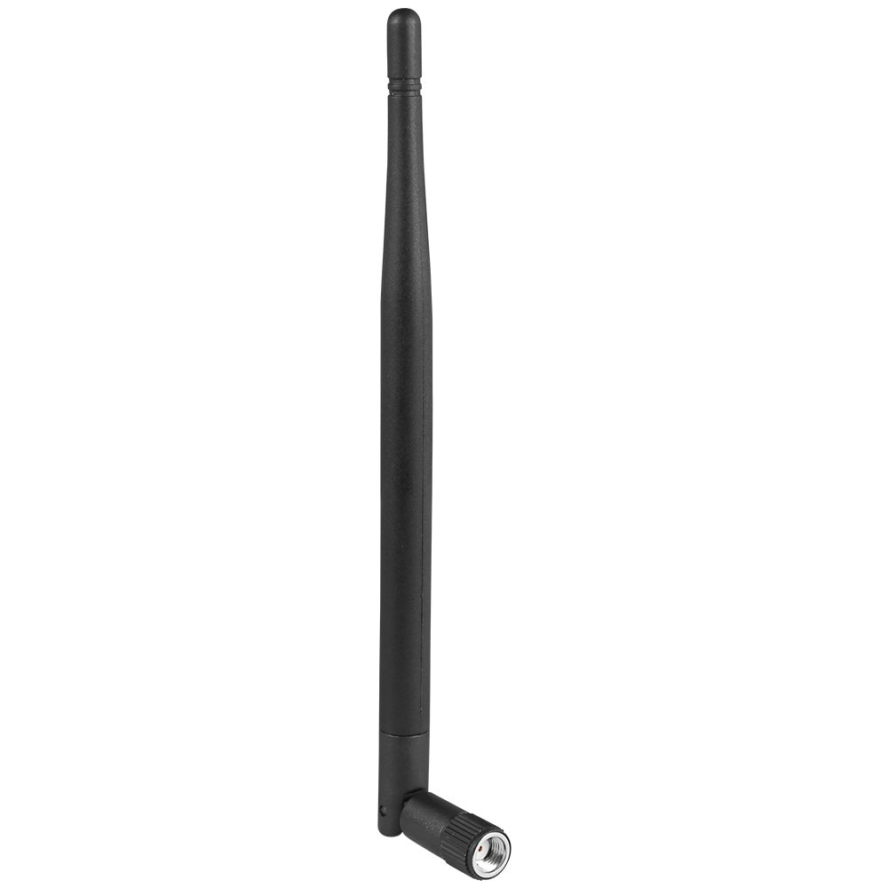

Challenge#3: Unknown DoA
A camera have a clear direction for each light ray
vs
An antenna receives signal from all directions
Camera
Antenna
How to find the direction of rays?
Notes:
To synthesize the channel at a receiver location, we back trace the rays coming to the receiver. Along each ray, we uniformly take samples, as shown with the red dots. Each of these samples can potentially be a transmitter or virtual transmitter, but we don’t make any assumption about it for now. For each location, all we know is its 3D coordinates x, y, z and its emission direction theta and phi. Therefore, we can query the neural network to predict the signal amplitude and phase at this location as well as the probability of this point being a (virtual) transmitter. We can do this for every sample point. If the sample is at the location of a transmitter or virtual transmitter, its sigma prediction will be 1, otherwise it will be 0, we take the weighted sum of all the samples along all rays to synthesize the channel at the receiver.

Slide 19
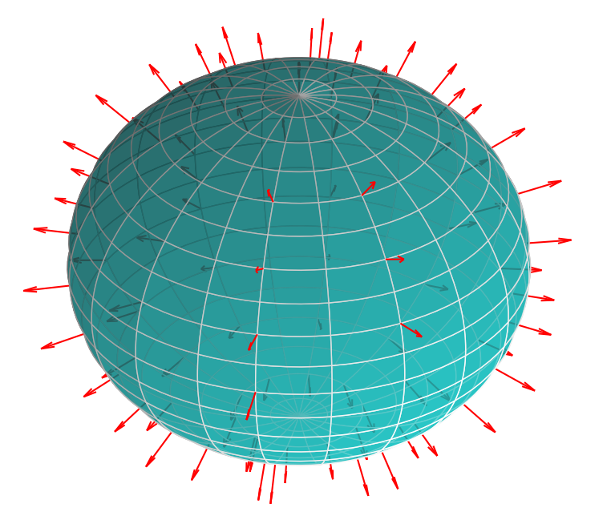
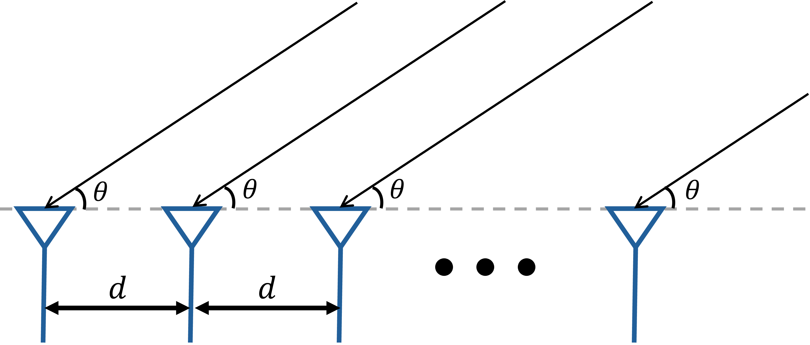
Challenge#3: Unknown DoA
Naïve solution: grid-search all directions
Observation: model unable to converge due to the large search space
Our solution: use antenna array to obtain DoA measurements as prior

Slide 20







Wireless Scene Representation
We represent a wireless scene with a continuous function $f_{Θ}$
$$f_{Θ}:\left(x, y, z\right)→(A, ψ)$$
Spatial Coordinates
Amplitude & Phase
Note 1: not every point in the space emits wireless signal
$$f_{Θ}:\left(x, y, z\right)→(A, ψ, σ)$$
Probability of one point being an emitter
Note 2: the signal emission is direction-dependent
$$x_{1}=A_{1}e^{jψ_{1}}$$
$$f_{Θ}:\left(x, y, z, θ, φ\right)→(A, ψ, σ)$$
$$θ$$
$$φ$$
$$x_{2}=A_{2}e^{jψ_{2}}$$
direction coordinates
Notes:
In fact, we can represent a wireless scene with a continuous function ftheta. This function maps a 3D spatial coordinate x y z to the signal amplitude and phase emitted at the location.
There are two things we need to note: first, not every point in the space emits wireless signal. Most of the points, for example those in air, does not emit any signals. Therefore, we need a way to model the probability of one point being an emitter

Slide 21
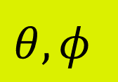


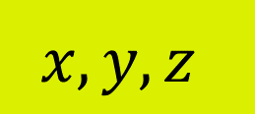
Neural Wireless Scene Representation
We can parameterize a continuous function $f_{Θ}$ with a neural network model
$$σ$$
$$x, y, z$$
$$A,ψ$$
$$θ, φ$$
Notes:
Now we don’t know what this function is for a particular wireless scene. But we can at least parameterize it with a neural network model. Actually, you can use a neural network model to represent any continuous function. In particular, we define our neural network model as below. Here, the x, y, z are the spatial coordinates, theta and phi are the direction coordinates, sigma is the probability of the point (x,y,z) being a wireless emitter, and A and psi are the amplitude and phase of the signal emitted at this location. This neural network model first take input x, y, z and go through several fully connected layers and output the probability sigma. This is because whether a point can be an emitter is independent of the direction. We input the direction arguments theta and phi after we have outputted sigma and use it jointly with this feature vector to predict the amplitude and phase.

Slide 22
How to predict the channel at any locations with only a sparse set of measurements?
1. Represent a wireless scene with a neural network
2. Synthesize a wireless channel at any location with the scene representation
3. Learn the representation from the sparse measurements

Slide 23
How to predict the channel at any locations with only a sparse set of measurements?
1. Represent a wireless scene with a neural network
2. Synthesize a wireless channel at any location with the scene representation
3. Learn the representation from the sparse measurements
Notes:
Let’s recap, so far, I have told you that we represent a wireless scene with a neural network. We can query this network with the coordinates of any point in the space, and it will tell what’s the signal emitted at this point, and what’s probability of this point being a transmitter.
Then I tell you how we can synthesize the wireless channel at any location using the neural network, we basically sample the space and query the network with all the samples and aggregate the predictions.
But I haven’t show you how we can train this network. This is what I am going to do next.

