Slide 1
GAPPS
Alja Eremić, Luka Jack Komljen, Aleksandra Zečević, Vedran Gvozderac
Wizards of OS

Slide 2
Genetic Algorithm for Predicting Performance of Species Glycine Max
and recommending favorable phenotypes
About the name:
aka. soybean

Slide 3
01
GAPPS Idea
Genetic Algorithm
Base Phenotypes
Yearly World Representation
Future Phenotypes
Plant Height
Bio weight
Relative water
Leaf Area Index
Plant Height
Bio weight
Relative water
Leaf Area Index
Soil metrics
Temperature
Wind Speed
fitness

Slide 4
Methodology
Location of our study is in Ottawa Kansas
US
How GAPPS (tries to) Predicts the Future
Steps:
📅 Gather past 15 years of weather & soil data
Simulate 30 years of future climate (linear past trends + randomization)
🌿 Feed into genetic algorithm
🧬 Select most resilient phenotype combinations for a predicted year via fitness function
Output: future-optimized soybean phenotype profile

Slide 5
02
Implementation
Base Phenotypes
World Representation
Fitness Evaluation
Genetic Algorithm

Slide 6
Base Phenotypes
Trait Name | Unit
Plant Height | cm
Number of Pods | count
Biological Weight | g
Sugar Percentage | %
Relative Water Content | %
Chlorophyll A | mg/g
Chlorophyll B | mg/g
Leaf Area Index | m²/m²
Seed Yield per Area | kg/ha
Why start with Soybeans?
Globally crucial: food, feed, fuel
Rich research background & phenotype data
Highly sensitive to environmental changes
Perfect candidate for climate-smart breeding

Slide 7
World Representation
🌦️ Weather Variables Table
Variable Name | Unit | Description
Average Temperature | °C | Daily mean air temperature
Maximum Temperature | °C | Highest recorded temperature in a day
Minimum Temperature | °C | Lowest recorded temperature in a day
Rainfall | mm | Total daily precipitation
Wind Speed | m/s | Average daily wind speed
Relative Humidity | % | Daily average humidity level
Solar Radiation | W/m² | Daily solar energy reaching surface

Slide 8
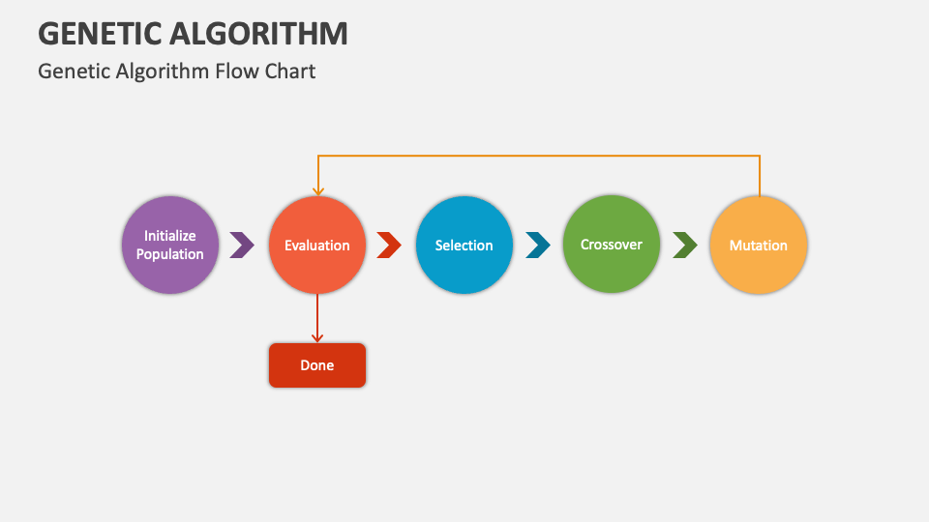
Genetic Algorithm
Different plant phenotypes against changing conditions of future years
LEADSM ( Lightweight Evaluation Algorithm for Data-driven Selection Models)

Slide 9
Fitness Evaluation
Needs to model real world survivability of plants
Implementations
Trained Neural Network (more data the better)
How do world parameters, and the plants phenotype affect its survival

Slide 10
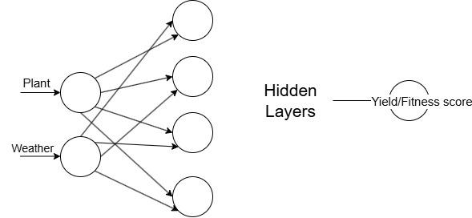
Trained fitness evaluator
AI model trained using Deep Learning Java library with PyTorch as an engine
Training data used plant values and weather conditions in that year as the input and the total yield that year for that plant for the output

Slide 11
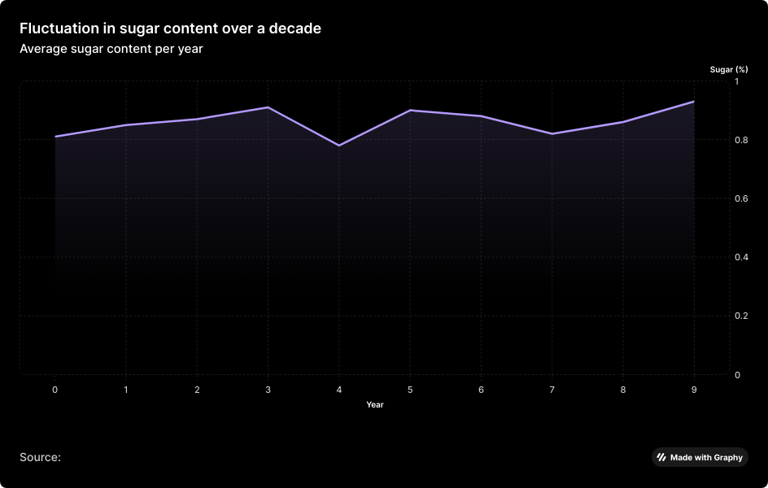
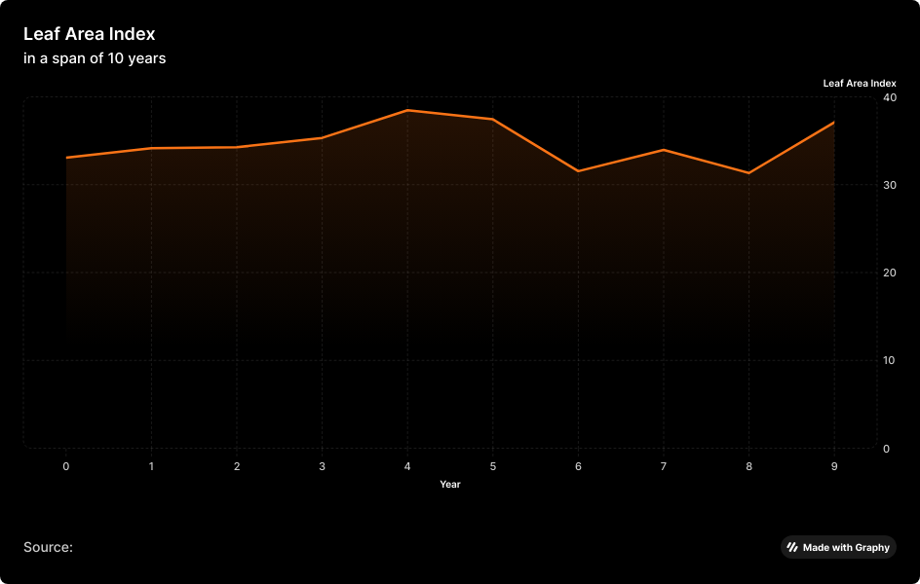
03
Results

Slide 12
Prediction of favorable trades in next 5 years
Year | Plant Height | Number of Pods | Biological Weights | Sugar | Relative Water | Chloro A | ChloroB | Protein Percentage | Leaf Area Index | Seed Yield
0 | 53.3186 | 79.1753 | 227.3939 | 0.9839 | 0.7111 | 4.2415 | 3.7922 | 35.5941 | 39.6696 | 35.2828
1 | 51.6096 | 79.1753 | 227.3939 | 0.9839 | 0.7111 | 2.8579 | 1.8584 | 33.8983 | 39.6696 | 35.2828
2 | 51.6096 | 79.1753 | 233.3068 | 1.0610 | 0.8692 | 2.8579 | 3.3464 | 32.7704 | 39.6696 | 35.1495
3 | 51.6096 | 79.1753 | 227.3939 | 0.9839 | 0.7111 | 2.8579 | 3.7922 | 35.5941 | 32.3354 | 47.9049
4 | 51.6096 | 79.1753 | 227.3939 | 0.9839 | 0.4692 | 2.8579 | 1.8584 | 32.7704 | 39.6696 | 48.4300
5 | 47.0711 | 79.1753 | 227.3939 | 0.3084 | 0.7664 | 2.8579 | 7.0720 | 32.8206 | 39.6696 | 35.2828

Slide 13
04
Conclusion
Over the 30-year period, key plant growth parameters such as Plant Height, Number of Pods, and Biological Weights remained relatively stable, indicating consistent growth conditions.
Plant Height has shown a slight decrease, indicating a possibility that shorter plants may be more favourable in upcoming years.
Relative water has also shown a slight increase overall, indicating that water retention may be a favorable trade in the future as well, which may be caused by raising temperatures.
Seed Yield showed fluctuations, with noticeable peaks around Years 3, 6, and 14, indicating periodic increases in productivity that may relate to optimal weather conditions.

Slide 14
04
Conclusion
Despite these observations, predicting favorable future phenotypes remains challenging. This is primarily due to:
Limited dataset size and duration.
Poor correlation between variables.
Difficulty in accurately simulating fitness evaluations.
Moreover, the relatively stable conditions over this 30-year span may not exert strong selective pressures, thus reducing the need for significant phenotypic shifts (and prediction of them) during this period.

Slide 15
Resources
BMC Plant Biology, 2021
ScienceDirect, 2019
Frontiers, 2020
SoyURT GitHub
Kaggle Dataset (2025)
FAOSTAT
NWS

Slide 16
Thanks!
Does anyone have any questions?

