Slide 1

CP3405 TR2 2026
Group 2
Sprint 9 - W31
Guanyu Lu
Qinyang Wu
Zheng Zaikun
Hamzah Nutt
The Bao Le
Hu Wenhan
Yuchu Lin
Kan Yijie
Swan Htet Zaw
Junwen Lu
Wang Hao

Slide 2
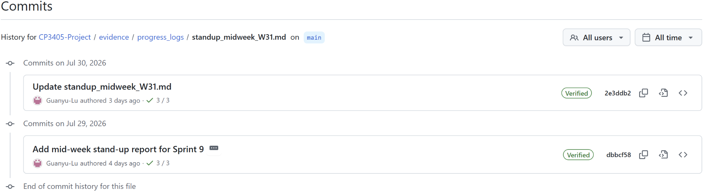
R2 Scrum Master
Sprint control: surface risk before Sunday
Wednesday test passed
Mid-week check-in committed, 2-minute segment and every role status was tracked with next actions.
EVIDENCE
SCRUM RESULT
standup_midweek_W31.md
committed by Wednesday
Risks identified early; recovery task assigned before release day
Notes:
Hi everyone, I’m Qinyang Wu, and my role this week is R2 Scrum Master.
For Sprint 9, my main responsibility was sprint control: making sure risks were surfaced before Sunday, not discovered at the last minute. The key evidence here is that our standup_midweek_W31.md was committed by Wednesday, which means the mid-week check-in was completed on time.
During this check-in, I contacted each role individually, confirmed their current progress, blockers, next actions, and also checked whether they were clear about their two-minute Demo Day segment.
The result was positive. Most risks were identified early, and any recovery actions were assigned before the final release day. Compared with earlier sprints, the team was much more prepared and cooperative. So the main Scrum result this week was not only that tasks were moving forward, but that every role had visibility, accountability, and a clear next step before the weekend.

Slide 3
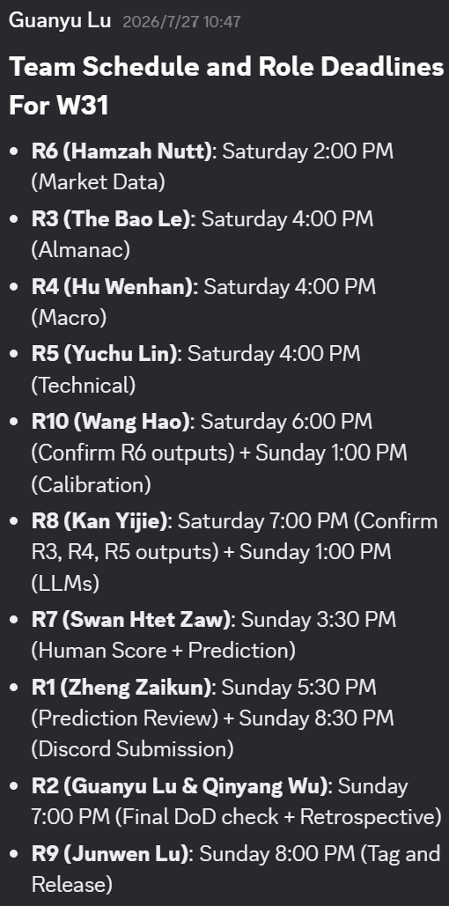
R2 Scrum Master
Dependency chain
The sprint risk was not one person being late; it was one late link blocking every downstream role.
R3
Almanac
Sat.
R7
Human score
Sun.
R5
Technical
Sat.
R8
LLM synthesis
Sat.
R9
Tag + release
Sun.
R4
Macro
Sat.
R10
Calibration
Sun.
R6
Data
Sat.
Mon
Tue–Wed
Fri
Sat
Saturday-Sunday
Sun
Planning
1:1 checks
Merge
Track and handle sudden issues
Tag
Final Team Sync
Notes:
Hello, everyone. I'm Guanyu Lu. This slide shows the dependency chain that I had to protect as Scrum Master.
The key risk in our sprint was not simply one person being late. The real risk was that one delayed output could block every downstream role. For example, R3 Almanac, R4 Macro, R5 Technical, and R6 Data all had to produce their outputs before R8 could complete the LLM synthesis. Then R7 depended on that synthesis for the Human Score, R10 needed the final data for calibration, and R9 needed all completed outputs before the final tag and release.
Because of this, my role was to manage timing and make sure each handoff was clear. On Monday, we confirmed the planning. On Tuesday and Wednesday, I completed one-to-one checks. On Friday, we prepared for merging, and during Saturday and Sunday, I tracked the final automated runs and handled any sudden issues.
The main purpose was to keep the pipeline moving in the correct order, so the team could reach the final vW31 release without a last-minute chain reaction.

Slide 4
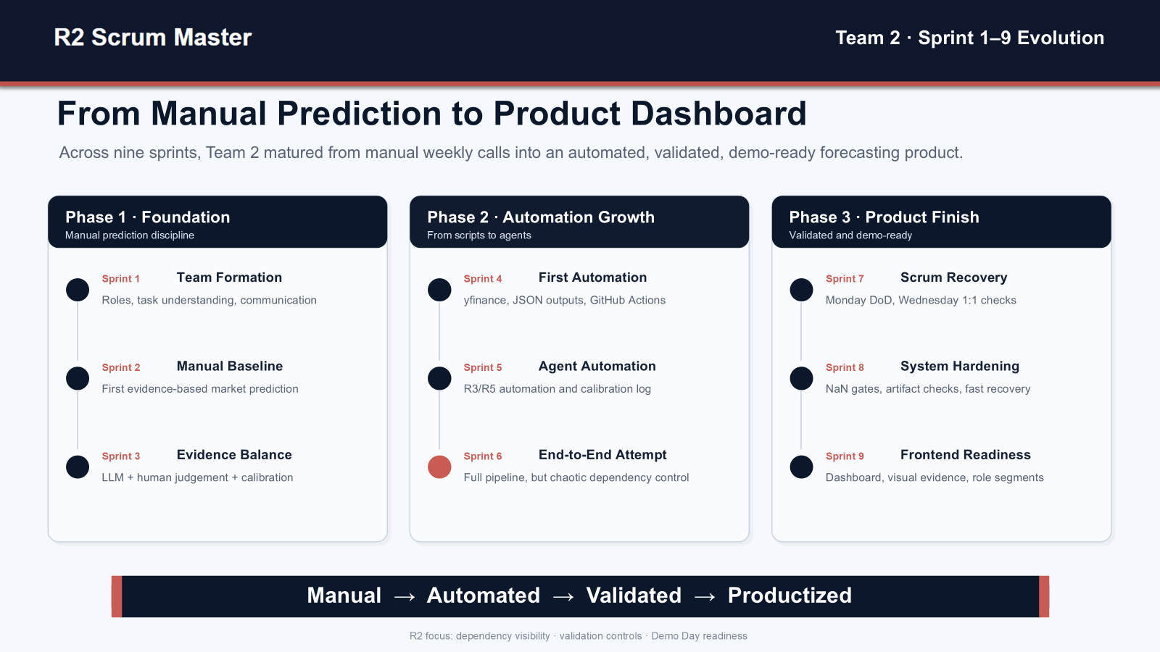
R2 Scrum Master
Notes:
This final slide summarises our whole project journey from Sprint 1 to Sprint 9.
At the beginning, our team was still building its foundation. Sprint 1 was mainly about team formation, understanding the task, and clarifying responsibilities. In Sprint 2 and Sprint 3, our prediction process was still mostly manual. We collected evidence, compared different sources, and started learning how to balance market direction with confidence calibration.
Then, from Sprint 4 to Sprint 6, the project moved into automation. We first automated market evidence collection with Python, yfinance, JSON outputs, and GitHub Actions. After that, we expanded into role-based agent automation. Sprint 6 was our first end-to-end automation attempt, but it also exposed weak dependency control.
The final phase was about maturity. Sprint 7 improved Scrum control, Sprint 8 added validation and system hardening, and Sprint 9 turned the project into a demo-ready product with a front-end dashboard.
So overall, our journey was: manual, automated, validated, and finally productized.

Slide 5
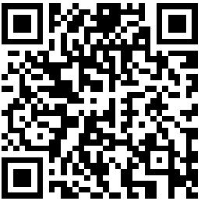
R1 Product Owner
Project demo website：
The .html file implements a unified display interface for integration with automated workflows. The .yml file simplifies pipeline execution and real-time review.
Website link: https://lujunwen212.github.io/CP3405-Project/
Scan QR Code to visit our Live Frontend Page

Slide 6

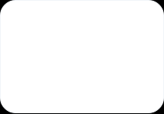
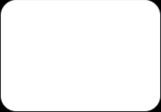

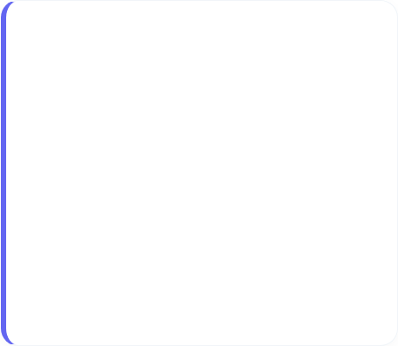
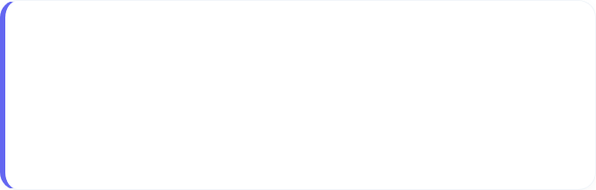
R1 Product Owner
Sprint goal statement
One slide for definition of done, calibration context, and the weekly decision question.
LAST WEEK SCORE
PRIMARY QUESTION
RELEASE NO.
Done Means
+1
Labour
W31
1. All role evidence (R3-R8) submitted & verified. 2. Human Score analysis (R7) finalized. 3. Prediction range override applied. 4. Repository tagged and W31 release deployed.
Sprint Goal
Produce a disciplined market prediction using seasonal, macro, technical, multi-LLM, and human judgment evidence.
*** Target recovery from W30 hit rate (14.3%) by narrowing ranges and prioritizing employment situation data ***

Slide 7
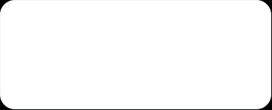
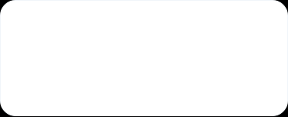
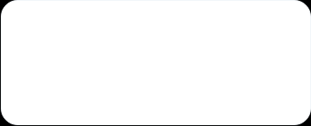
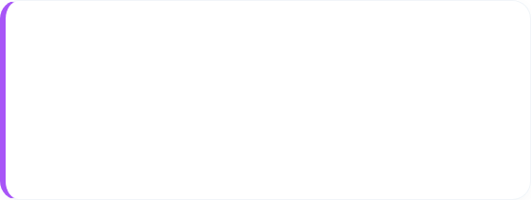
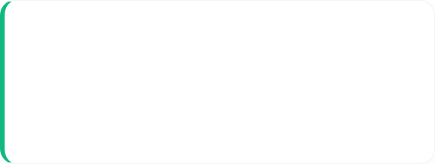
R1 Product Owner
Forecast contract
Use for the final Product Owner statement: what the team is committing to forecast this week.
SPX
NDX
IWM
Direction: Sideways
Direction: Sideways
Direction: Neutral → Down
Range: -0.6% to +0.8%
Range: -0.9% to +0.8%
Range: -1.1% to +0.4%
Confidence: Medium
Confidence: Medium
Confidence: Medium
Assumptions
Definition of done
•
Main macro driver remains U.S. Employment Situation.
All role evidence is submitted, labelled, committed to GitHub, and ready for R10 calibration after market actuals.
•
Technical invalidation level is SPX break above 7,609.78.
•
Human override is applied to narrow wide LLM ranges.

Slide 8
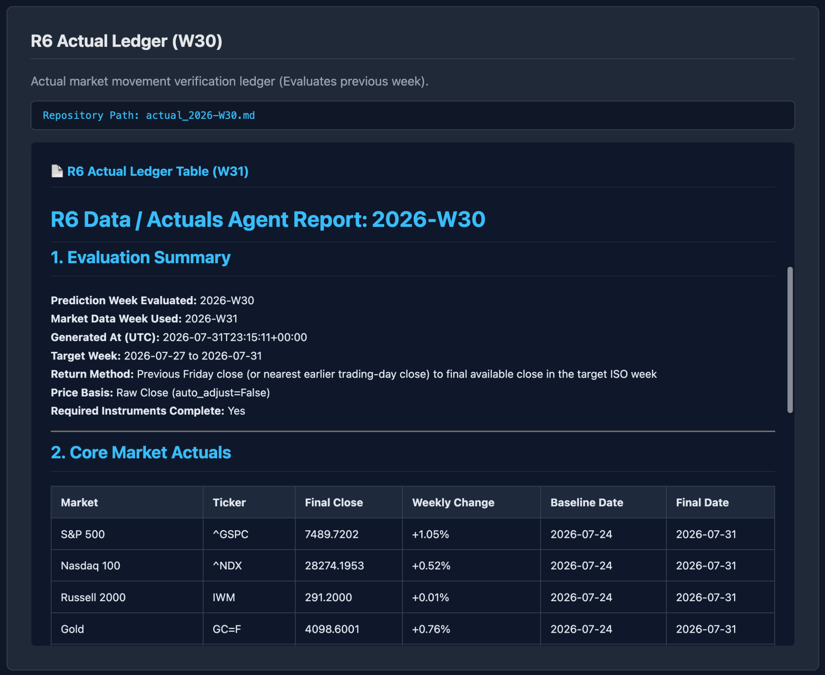
R6 Data Lead
OBJECTIVES
Display markdown output on the website front-end
Recreate market scores grid on the website

Slide 9
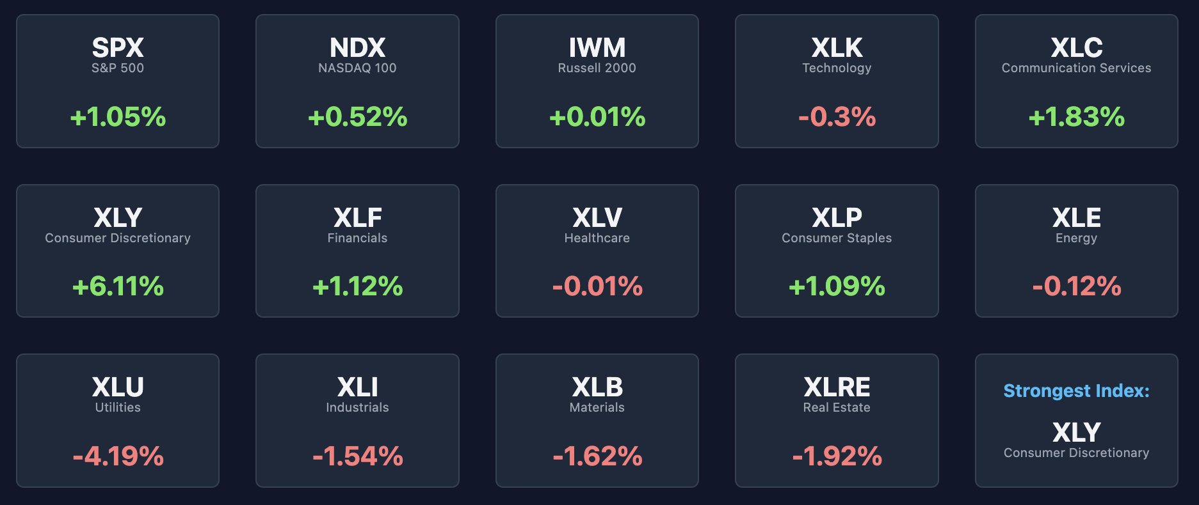
R6 Data Lead
ACTUALS

Slide 10
R3 Almanac Lead
The scheduled pipeline delivered validated outputs
Scheduled execution verified • permanent run time: Saturday 04:13 SGT
AUTOMATED FLOW
Almanac PDF
›
Extract + validate
›
JSON • CSV • MD
›
R8 consumes JSON
Historical source
Reject incomplete data
One report object
W31 seasonal evidence
Validation gate
3 indices • 11 sectors • 3 non-empty files • 0 invalid values
R8 input: outputs/R3/almanac_agent_W31.json
Limitation: NDX uses a NASDAQ Composite proxy; planner evidence is month-context only.

Slide 11
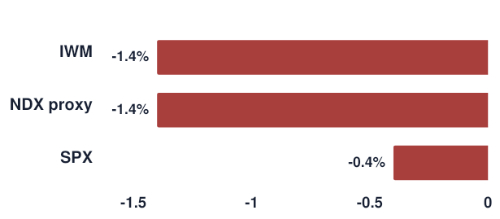
R3 Almanac Lead
W31 seasonal evidence points to a bearish week
Forecast: 3-7 Aug 2026 • U.S. midterm election year • High confidence
ALMANAC BIAS
Midterm-year August average return
COVERAGE
BEARISH
Historical average by index proxy
3
index proxies
All three index proxies show negative midterm-year August averages.
11 / 11
GICS sectors
This is historical context for the downstream forecast, not a standalone trading recommendation.
Source pages 103, 130-131
Key insight: Seasonal weakness is broad-based, with the NDX proxy and IWM each averaging 1.0 percentage point below SPX.

Slide 12
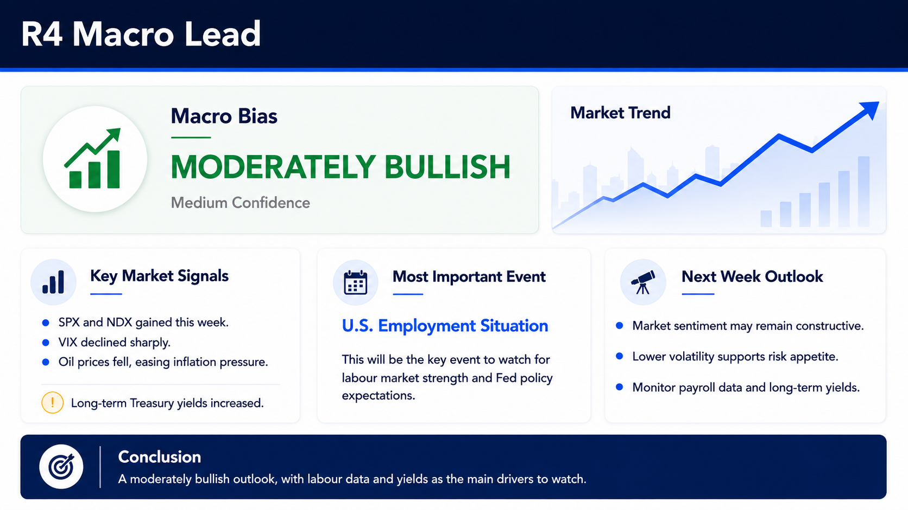
R4 Macro Lead
Notes:
This week, our macro outlook is moderately bullish with medium confidence. The SPX and NDX moved higher, while the VIX and oil prices fell, which supported market sentiment. However, long-term Treasury yields increased and remain a risk. Next week, the U.S. Employment Situation report will be the key event because it may affect expectations for the labour market and future Fed policy.

Slide 13
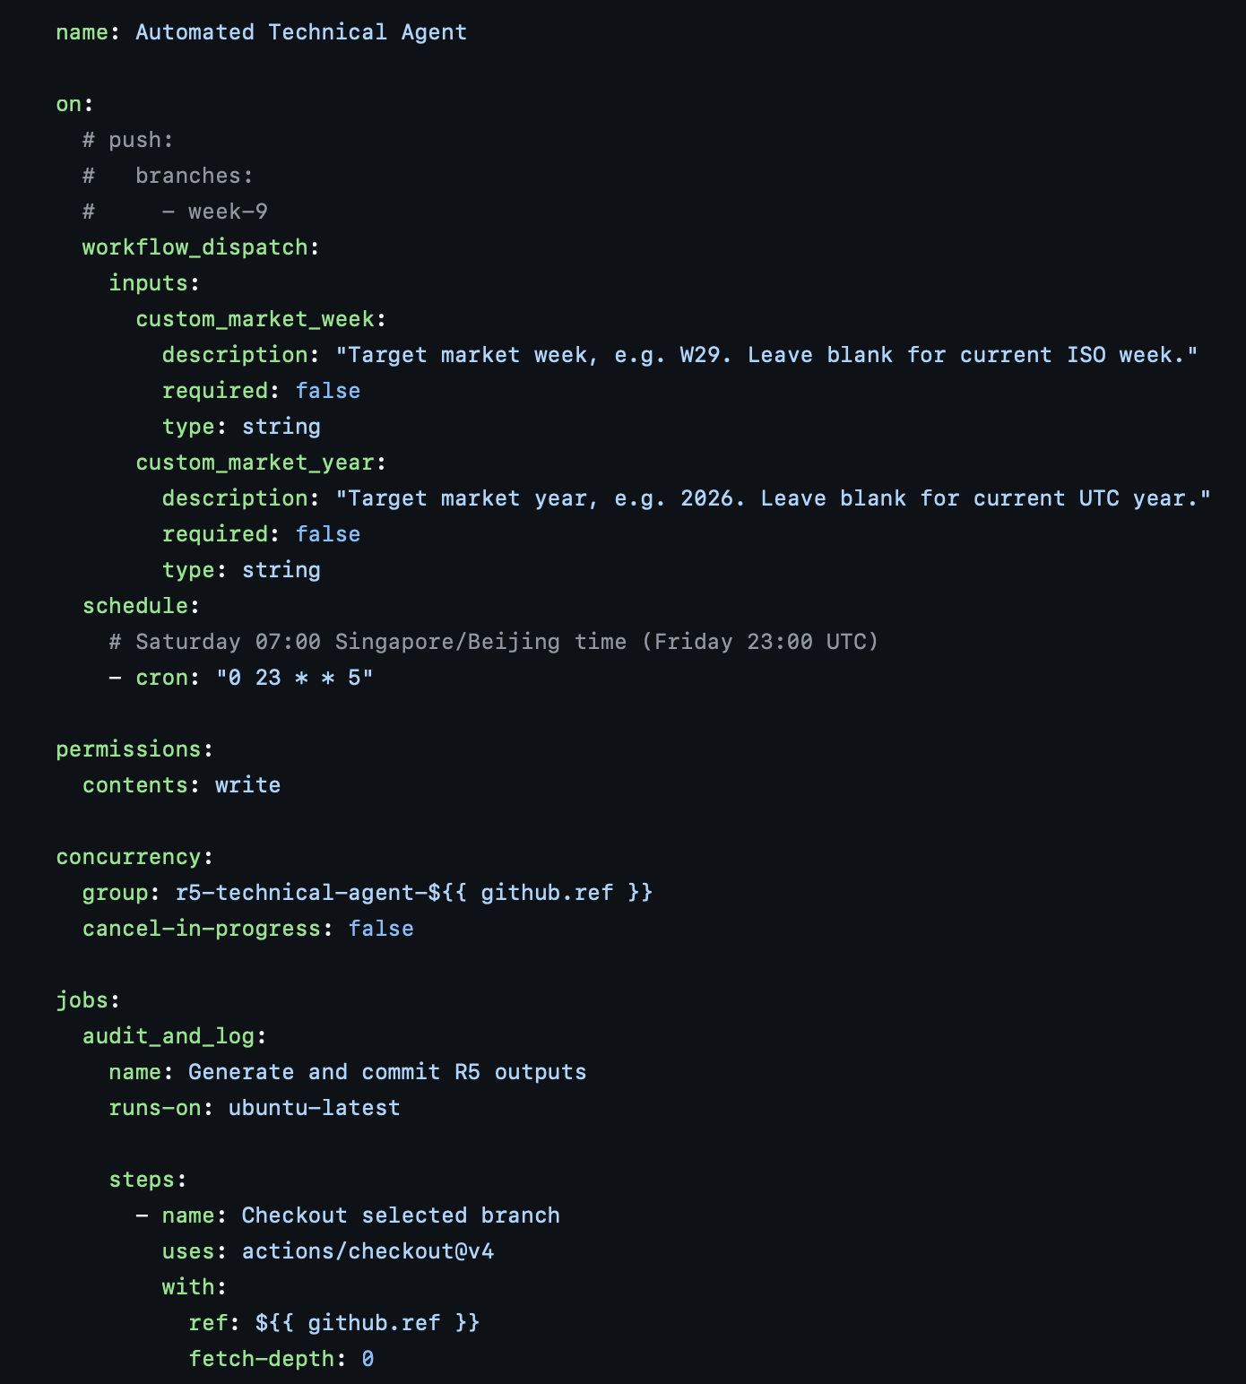
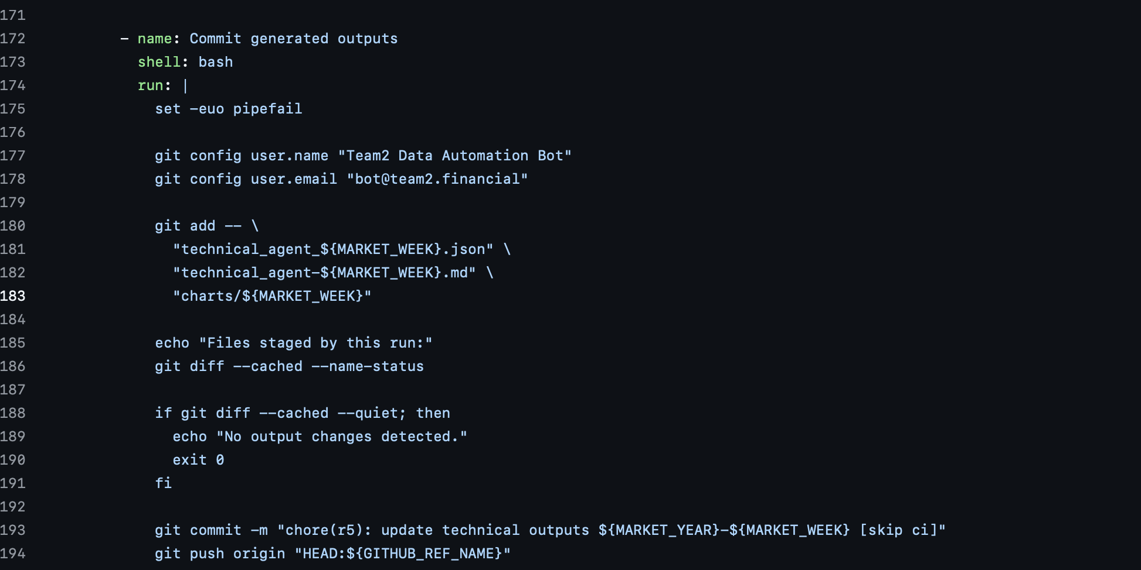
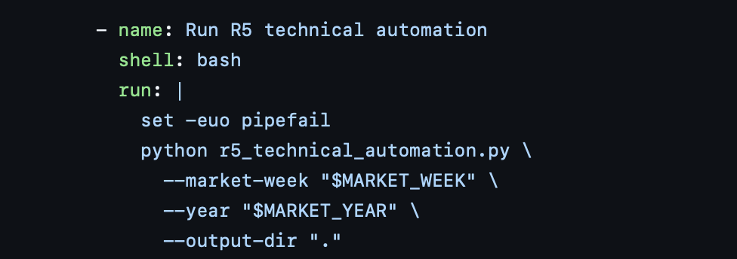
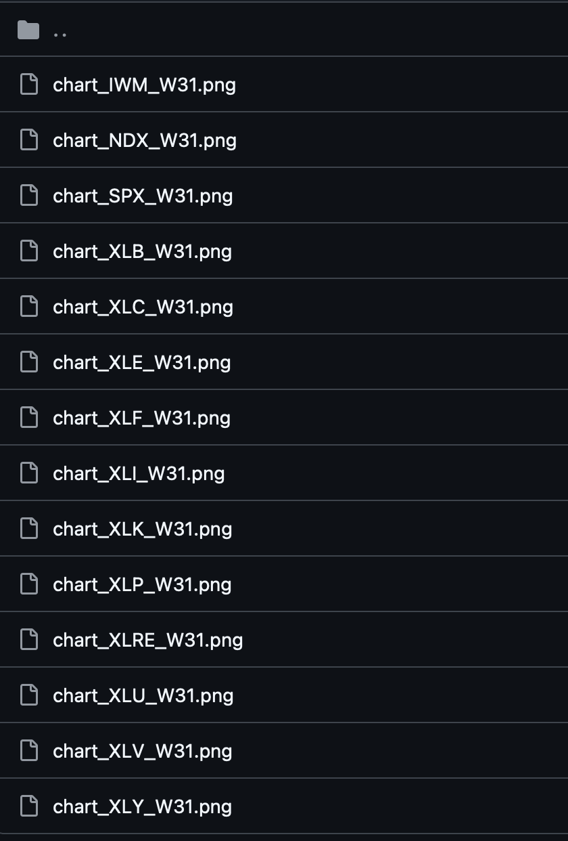
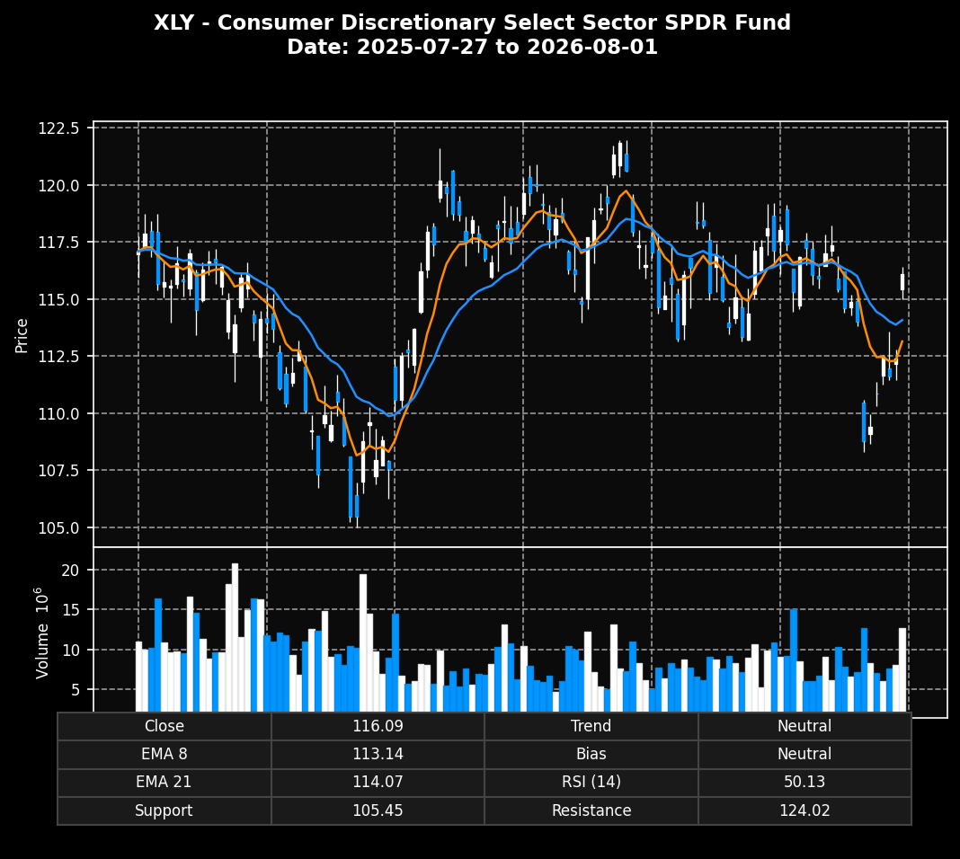
R5 Technical Lead
Orange=EMA 8
Blue = EMA 21

Slide 14
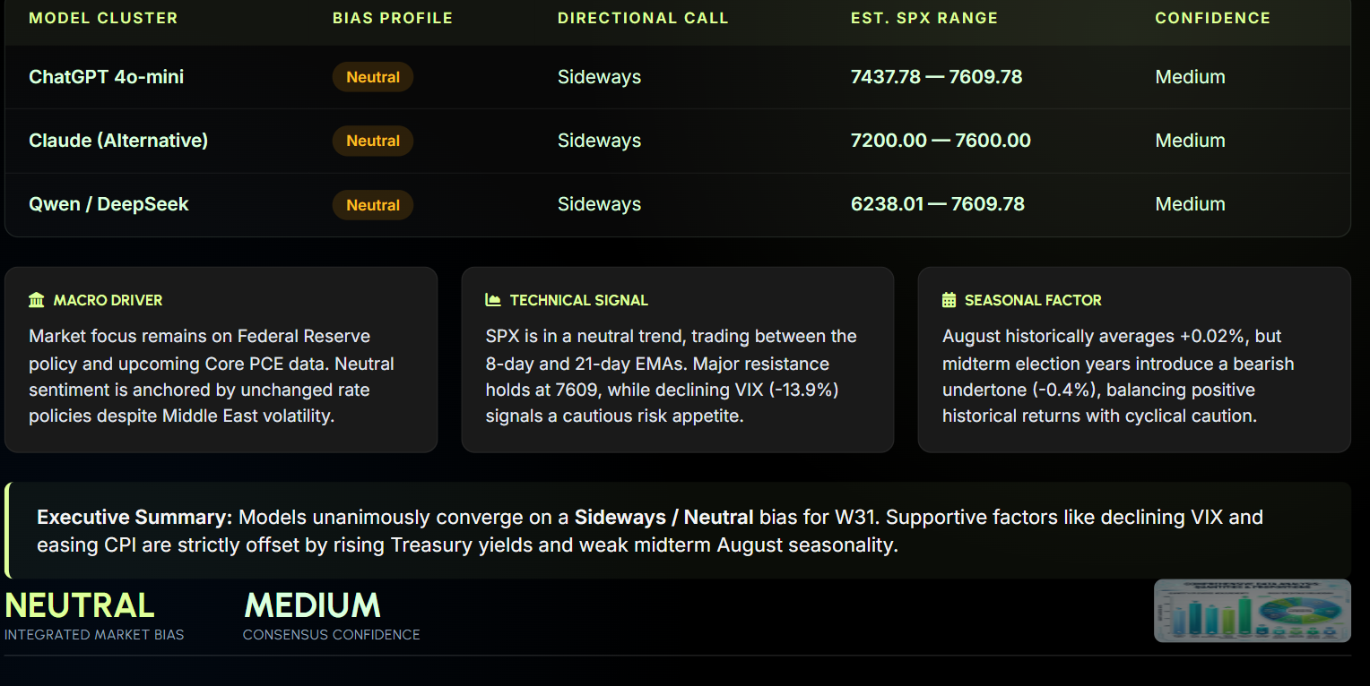
R8 LLM Operator
Notes:
"Hi everyone, here is the W31 Consensus Audit Report from our R8 LLM Operator.
This week, we seamlessly integrated upstream reports from R3 Almanac, R4 Macro, and R5 Technical, while implementing strict pre-flight NaN checks to prevent bad data propagation.
Our pipeline concurrently runs on three flagship models: ChatGPT-4o-mini, Llama 3.1, and DeepSeek-V3. All markdown formatting artifacts are automatically sanitized, delivering 100% plain text, un-truncated analyses.
For W31, the models unanimously converge on a Sideways-Neutral bias with medium confidence.
All W31 assets are archived under outputs/R8/ and ready for execution. Thank you!"

Slide 15
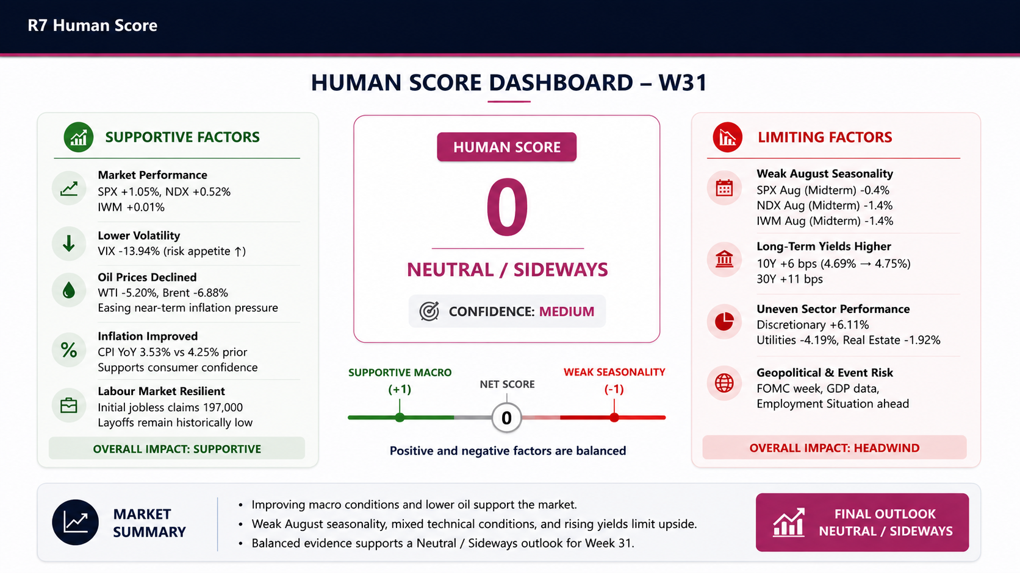
Notes:
This week, our Human Score is Neutral with a score of zero, showing that positive and negative market factors are currently balanced.
On the positive side, macro conditions improved. The S&P 500 and Nasdaq both finished the week higher, market volatility declined as the VIX fell, oil prices eased, and inflation pressures continued to soften. These factors support investor confidence.
However, several risks remain. August is historically one of the weaker months for equities, especially during a U.S. midterm election year. Treasury yields also continued to rise, while technical signals remain mixed, with only limited confirmation across the major indices.
Overall, we believe the market has become more stable than last week, but the evidence is not strong enough to justify a bullish outlook. Therefore, we maintain a Neutral or Sideways view with medium confidence.

Slide 16
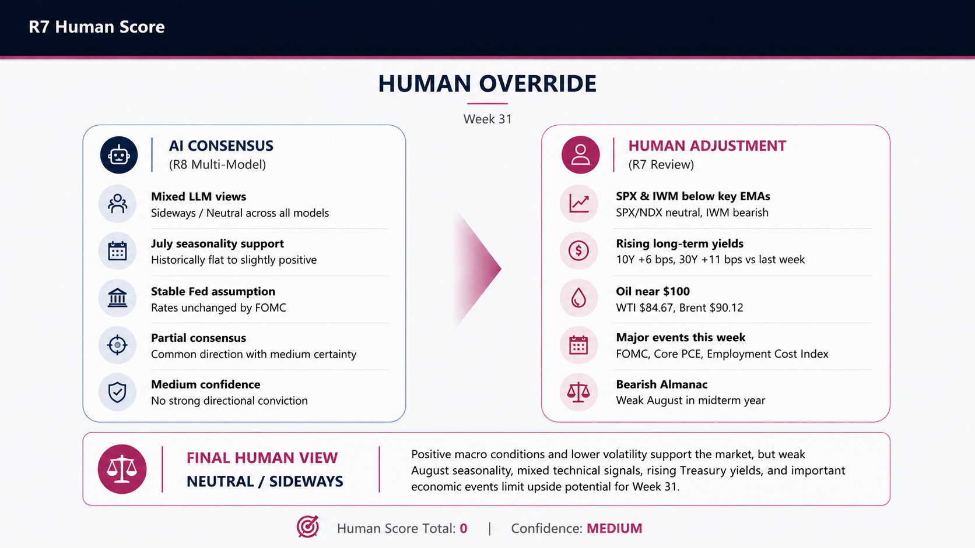
Notes:
The AI models generally reached a similar conclusion by expecting a neutral, sideways market, supported by improving macro conditions, lower volatility, and easing inflation pressures.
Our human review agrees with the overall direction, but we place greater emphasis on several remaining risks. August seasonality has historically been weak during midterm election years, Treasury yields continue to trend higher, and technical signals remain mixed, particularly with the Russell 2000 still showing relative weakness.
We also recognise that upcoming economic data, including employment and inflation releases, could quickly change market sentiment.
Taking all of these factors together, our final assessment remains Neutral or Sideways with medium confidence, as neither the bullish nor bearish evidence is currently dominant.

Slide 17
R9 GitHub Lead
https://github.com/LuJunwen212/CP3405-Project

Slide 18
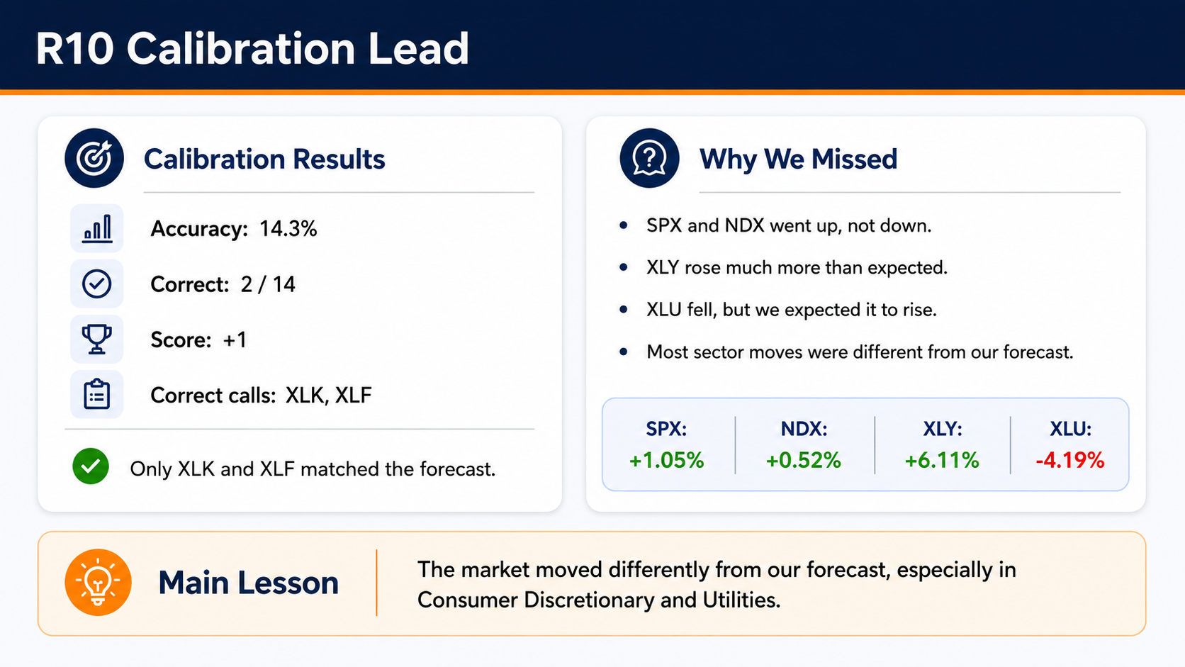
R10 Calibration Lead

Slide 19
Thank you
Any Questions?

