Slide 1

CP3405 TR2 2026
Group 2
Sprint 7 - W29
The Bao Le
Junwen Lu
Guanyu Lu
Zheng Zaikun
Hu Wenhan
Wang Hao
Wu Qinyang
Kan Yijie
Swan Htet Zaw
Yuchu Lin
Hamzah Nutt

Slide 2
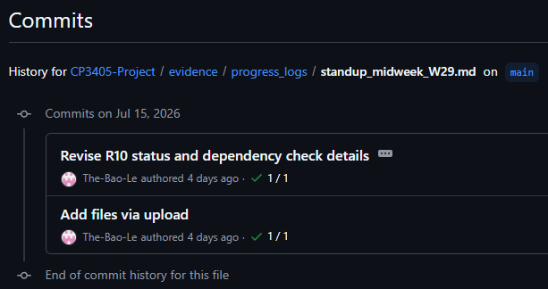
R2 Scrum Master
Sprint control: surface risk before Sunday
Wednesday test passed
Mid-week check-in committed and every role status was tracked with next actions.
EVIDENCE
SCRUM RESULT
standup_midweek_W29.md
committed by Wednesday
Risks identified early; recovery task assigned before release day
Mon
Tue–Wed
Thu
Sat
Sun
Planning
1:1 checks
Gate
Merge
Tag
Notes:
As R2, my main responsibility in Sprint 7 was to maintain visibility across the team and identify risks before they affected the final weekend delivery.
I began with sprint planning on Monday, then conducted individual progress checks on Tuesday and Wednesday. The results were documented in the midweek stand-up report, including each role’s current status, remaining actions, blockers, and dependencies.
The main outcome was that we did not wait until Sunday to discover that someone was behind. For example, the schedule run for R8 was around 9:45 AM so we decided to move R8’s schedule to 4 PM. A recovery task and clear deadlines were assigned before release day.
I also used Thursday as a readiness gate to confirm that upstream roles were progressing and that downstream roles would receive the files they needed. Saturday was reserved for final workflow outputs and integration, while Sunday was reserved for the tag and release.
Overall, the midweek checkpoint passed. Most roles were on track, and the significant risks had owners, deadlines, and follow-up action.
The reason this coordination was important becomes clearer when we look at the dependency chain.

Slide 3
R2 Scrum Master
Dependency chain
The sprint risk was not one person being late; it was one late link blocking every downstream role.
R3
Almanac
R7
Human score
R5
Technical
R8
LLM synthesis
R9
Tag + release
R4
Macro
R10
Calibration
R6
Data
Control actions
• Kept R4 schedule; moved R8 timing to protect the pipeline.
• Confirmed R6 scheduled run instead of asking for unnecessary rework.
• Recorded R10 dependency on complete actual market data.
Notes:
This diagram shows that Sprint 7 was not a set of independent individual tasks. It was a sequential pipeline, so one late or incorrect output could block several downstream roles.
R6 produced the market data required by other agents. R3 produced the Almanac report, R4 produced the Macro report, and R5 produced the Technical analysis. These three reports then became the input for R8’s LLM synthesis.
R7 used the generated evidence to create the human score, while R10 compared predictions with actual market results for calibration. R9 then depended on the completed outputs before creating the final tag and release.
As Scrum Master, I focused on protecting this sequence. One example was the schedule conflict between R4 and R8. Instead of asking R4 to run earlier, when macro data might still be incomplete, we retained R4’s schedule and moved R8 later so it could consume the completed report.
I also confirmed that R6 had already tested the workflow and only needed to monitor the scheduled run, rather than creating unnecessary additional work.
For R10, I documented that final calibration depended on complete actual market data. This prevented an external dependency from being incorrectly treated as a lack of progress.
The key point is that the main sprint risk was not simply one person being late. It was one delayed or invalid link blocking the rest of the pipeline.
Although the dependency risks were monitored, the Sunday incident showed that workflow completion alone was not enough.

Slide 4
R2 Scrum Master
Retrospective: verify artifacts
Sunday lesson: a green workflow is not proof that downstream files are current or correct.
Sunday incident path
R7 review
Investigation
Action
Resolution
R5 Markdown showed NaN closing prices
JSON values valid, Markdown/branch stale
R5 re-ran workflow on Week-07 branch
JSON, Markdown, charts and slides updated
Sprint 8 process change
• Check JSON and Markdown values match before R7/R8 uses them.
• Confirm all expected artifacts were modified by the latest workflow run.
• Force NaN values to fail the workflow instead of publishing them.
Notes:
On Sunday, R7 discovered that the closing prices in R5’s Markdown technical report were displayed as NaN. This temporarily blocked the human-scoring process because the technical evidence could not be trusted.
During the investigation, we found that the JSON file contained valid numerical values. The problem was that the Markdown report being reviewed was outdated or had not been regenerated correctly, and team members were also checking different branches.
R5 re-ran the workflow on the Week-07 branch. After that, the JSON, Markdown report, charts, and presentation materials were updated, and the data become usable again.
The important retrospective lesson is that a green GitHub Actions result only confirms that the workflow completed. It does not prove that every generated artifact is current, consistent, or correct.
For Sprint 8, we should add 3 controls. First, compare key JSON and Markdown values before downstream use. Second, verify that all expected files were modified by the latest run. Finally, make NaN values fail the workflow instead of allowing them to be published.
The incident was resolved, but it exposed a gap in our Definition of Done. Future completion criteria should include artifact validation, not only successful workflow execution.

Slide 5
R1 Product Owner
Sprint 7 goal was substantially achieved
A reliable W29 pipeline now supports SPX, NDX, IWM and all 11 S&P 500 sectors.
SPRINT GOAL
7 / 8
1 / 8
Automate R3–R10 as far as reasonably possible, control dependencies, and retain manual completion where full automation is limited.
FULLY AUTOMATED
PARTIALLY AUTOMATED
R3 • R5 • R6
R7 • R8 • R9 • R10
R4 Macro Agent
API limitation: R4 require external API calls, so partial automation and manual completion are retained. No R3–R10 role is left without an automation path.

Slide 6
R1 Product Owner
W29 outlook shifts to Neutral-Bearish
The team prioritised current market risk over supportive July seasonality.
PRODUCT VALUE
DECISION EVIDENCE
PRODUCT DECISION
A transparent weekly decision
Evidence from macro, technical, seasonal and human review
Uncertainty is visible rather than hidden
Macro: Moderately Bearish
Human Score: -3
All three indices below 8-day and 21-day EMAs
VIX +9.78%; oil prices surged
July seasonality remains supportive
Final bias: Neutral-Bearish
Confidence: Medium
Monitor volatility and oil risk
Prioritise downside risk and improve data reliability
Product Owner takeaway: protect decision quality first, then improve automation and data reliability.

Slide 7
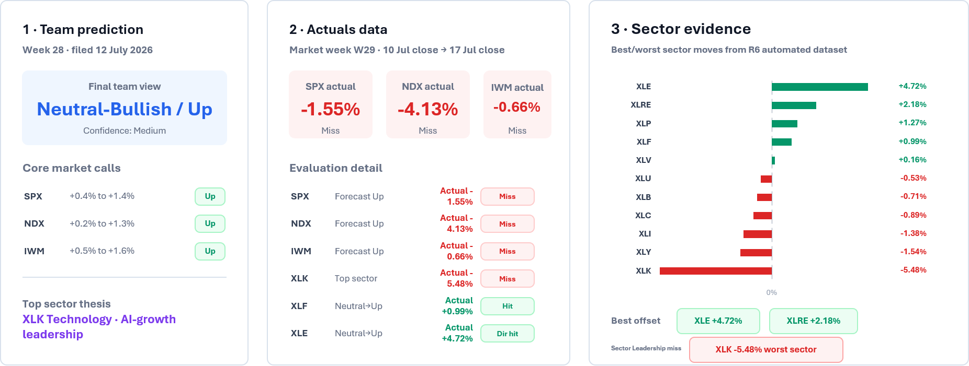
R6 Data Lead
Our team expected a Neutral-Bullish/Up week, but actual data shows all three core indexes fell and XLK Technology became the worst sector.
Notes:
This week, I’m R6 data lead.
The prediction file was produced by R7 for Week 28 and filed on 12 July 2026. The team’s final view was Neutral-Bullish / Up, with positive calls on the three core indexes: SPX, NDX, and IWM. The prediction also identified XLK Technology as the top sector, based on the AI-growth leadership thesis.
My R6 role was to provide the actual market outcome using the automated data pipeline. The pipeline captured the completed market week from 13 July to 17 July, using the 10 July close as the baseline and the 17 July close as the final comparison point.
The actual data shows that the prediction was mostly unsuccessful. SPX fell by 1.55%, NDX fell by 4.13%, and IWM fell by 0.66%, so all three core index direction calls were misses.
The largest issue was the sector leadership call. XLK Technology was predicted as the top sector, but it actually fell 5.48% and became the worst-performing sector in our dataset. Instead, the strongest positive sectors were Energy, up 4.72%, and Real Estate, up 2.18%.
Overall, the automated R6 data shows a clear gap between the Week 28 prediction and the actual market outcome. The market moved against the bullish view, and Technology failed to lead. The strongest support came from Energy and Real Estate instead.

Slide 8




R3 Almanac Lead
W29 R3 Almanac Agent Analysis
July Vital Statistics
Sector Index Seasonality Matrix
Index | Rank | Normal | Midterm
S&P 500 | 4 | +1.3% | +1.3%
NASDAQ | 7 | +0.9% | -0.8%
Russell 2000 | 9 | +0.4% | -2.5%
ETF Proxy | Project Sector | Signal | Window | Avg Ret
XLK | Technology | LONG | Mid Mar - Mid July | +10.87%
XLU | Utilities | LONG | Mid Mar - Oct | +9.32%
XLF | Financials | SHORT | May - July | -6.30%
XLE | Energy | SHORT | June - Aug | -5.67%
XLB | Materials | SHORT | May - Oct | -5.10%
XLI | Industrials | LONG | Oct - May | +11.30%
XLV | Health Care | LONG | Oct - May | +8.74%
XLP | Staples | LONG | Oct - June | +8.47%
Macro Context
Cycle Phase: Midterm Election Year
Pattern: Dynamic Weekly Boundary Matrix (W29)
"Automated structural seasonal pattern mapped successfully for forecast framework."
Strategic Bias
Confidence Level
Quantitative Rationale
Neutral-Bullish
HIGH
Internal data models capture predictive trading matrix signals for target duration 2026-07-20 to 2026-07-24 under July systemic cycles.

Slide 9

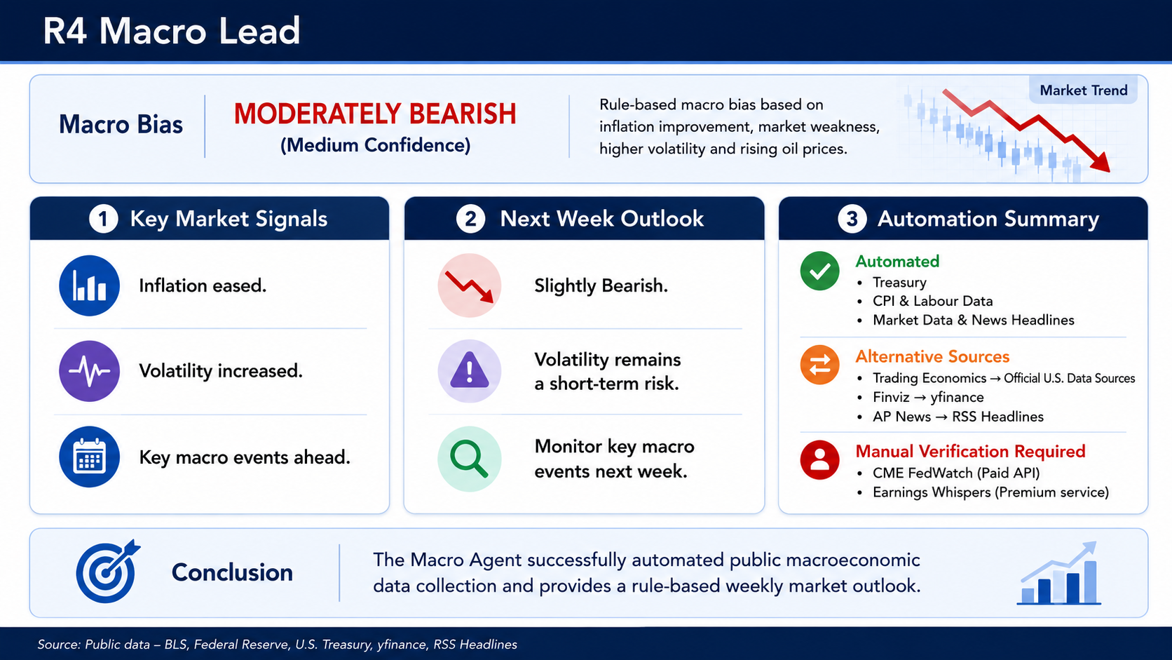
R4 Macro Lead
Notes:
This week, our macro outlook is moderately bearish with medium confidence. Inflation eased, but market volatility increased, and rising oil prices remain a short-term risk. For next week, market sentiment may stay slightly bearish, so we should monitor the main macroeconomic events closely.
The automation successfully collected Treasury yields, CPI and labour data, market data, sector performance, and news headlines. For some sources, we used alternatives: official U.S. data sources instead of Trading Economics, yfinance instead of Finviz, and RSS headlines instead of direct AP News access.
CME FedWatch was not automated because its API is paid, and Earnings Whispers requires a premium service. Overall, the system provides a transparent, rule-based weekly market outlook.

Slide 10
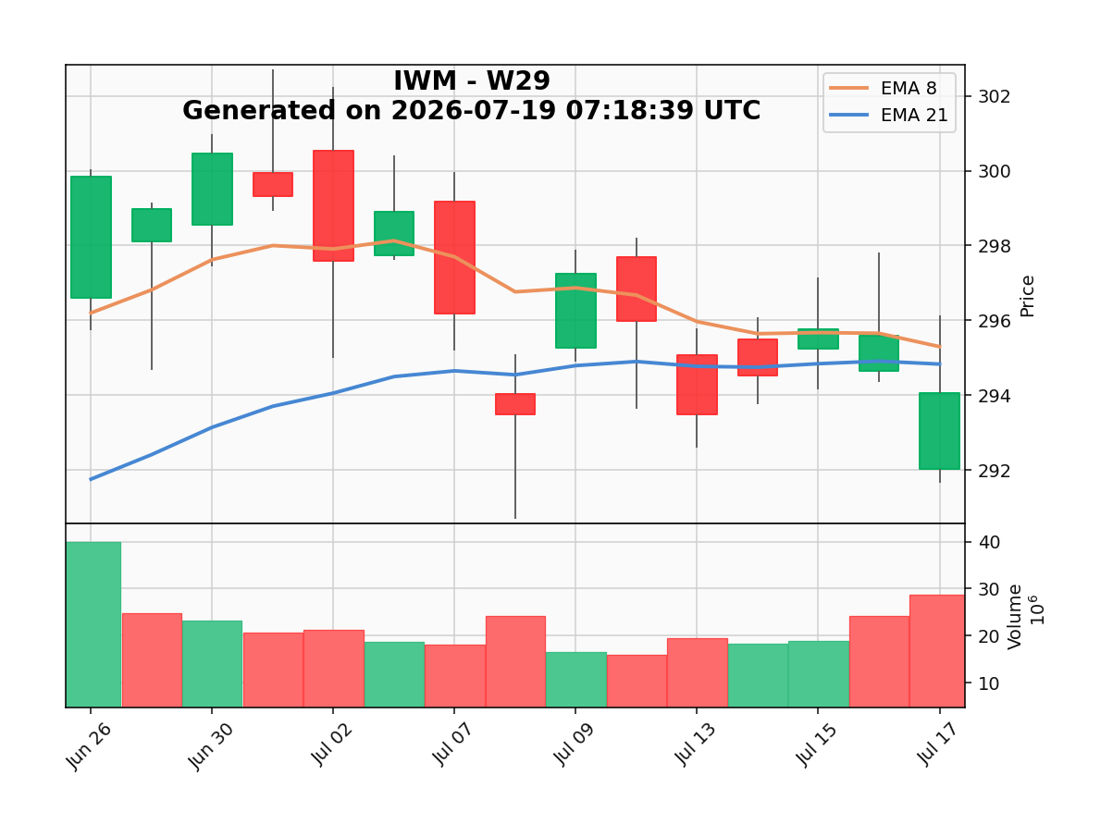
R5 Technical Lead
chart_IWM_W29
Key levels
Current price: 294.04 Resistance: 297.91
Support: 290.68
EMA zone: Below both EMAs
Invalidation: Close below 290.68
Bias: Slightly Bearish

Slide 11
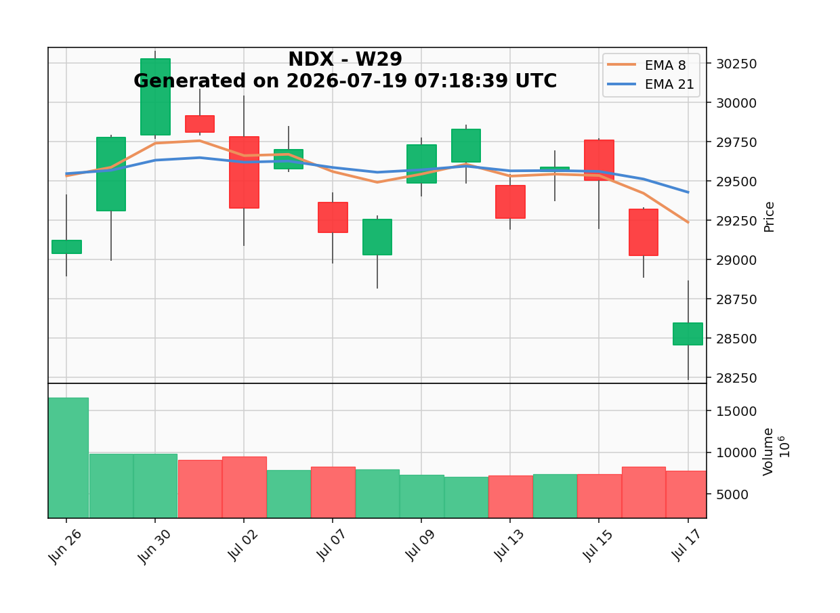
R5 Technical Lead
chart_NDX_W29
Key levels
Current price: 28,592.66 Resistance: 29,678.89 Support: 28,567.16
EMA zone: Below both EMAs
Invalidation: Close below 28,567.16
Bias: Bearish

Slide 12
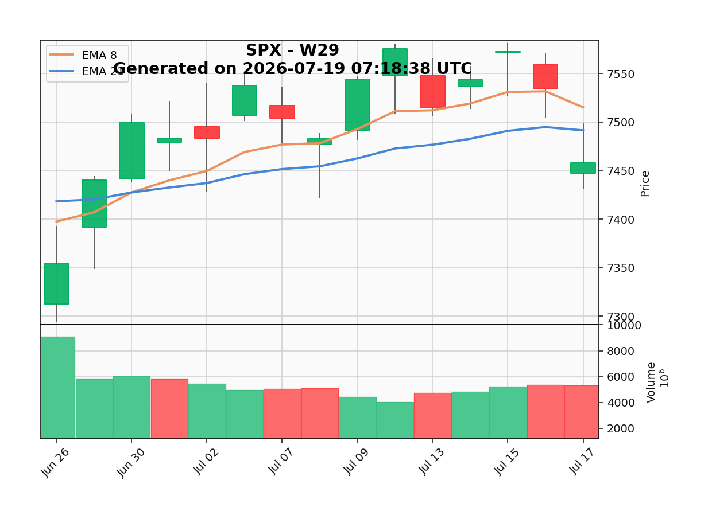
R5 Technical Lead
chart_SPX_W29
Key levels
Current price: 7,457.69 Resistance: 7,517.12 Support: 7,421.82
EMA zone: Below both EMAs
Invalidation: Close below 7,421.82
Bias: Slightly Bearish

Slide 13
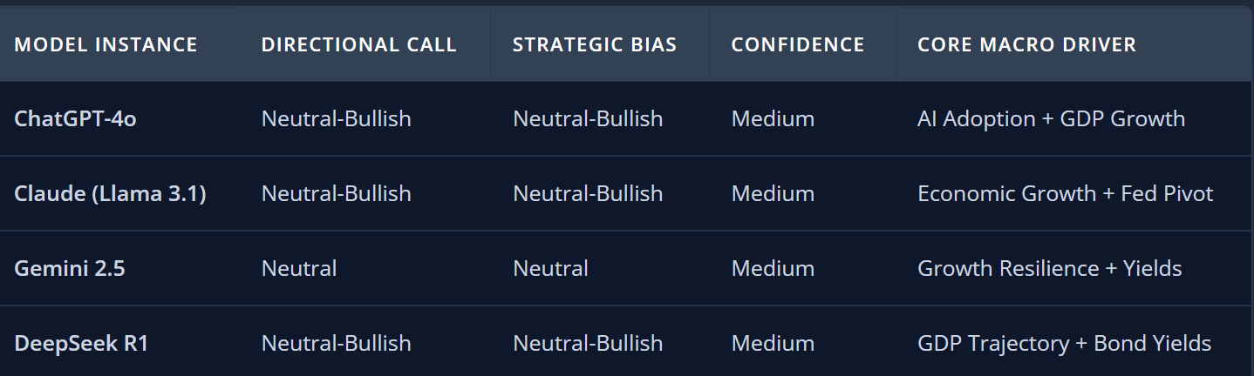
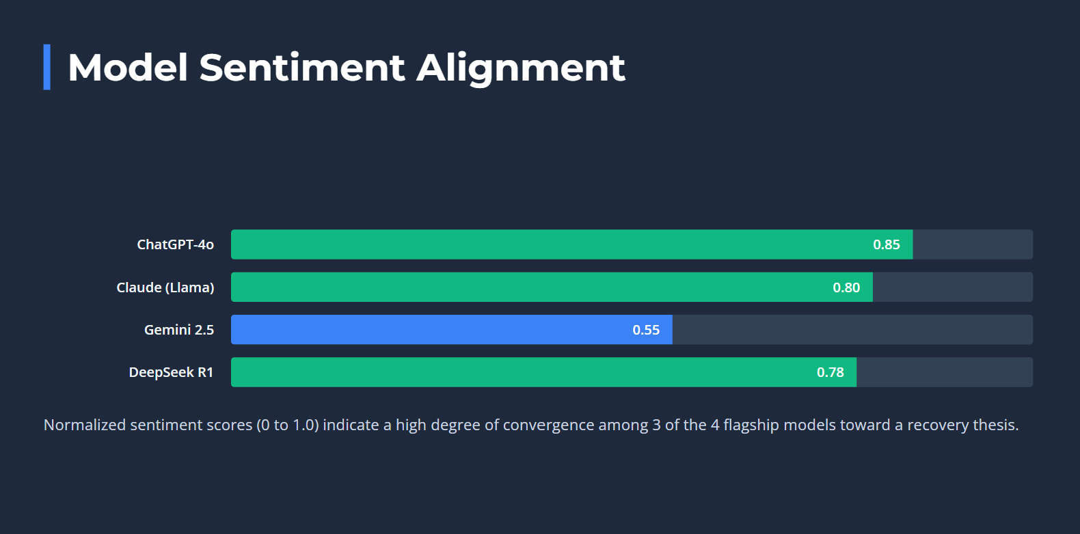
R8 LLM Operator
Notes:
Hi everyone, today I’m pleased to present the W29 Consensus Audit Dashboard from our R8 LLM Operator.
This week, we successfully established a seamless data pipeline by synthesizing seasonal patterns from R3 Almanac and trend indicators from R5 Technical.
To ensure maximum reliability and cost-efficiency, we upgraded our LLM cluster to three flagship models: ChatGPT-4o-mini, Llama 3.1, and the high-stability Qwen 2.5. By shifting Qwen to the standard paid tier, we achieved 100% operational success with zero cloud latency.
Furthermore, we resolved the previous character truncation issue. The console now outputs full, uncut qualitative analyses, preserving complete audit trails for our evidence ledger.
For the upcoming trading week (July 20 to 24), the consensus converges on a Neutral-Bullish bias for SPX and NDX, with a solid 7.5 out of 10 confidence score, driven by tech sector strength despite minor pullbacks in Energy.
The strategy dashboard is fully deployed and ready for execution. Thank you, and I’m open to any questions."

Slide 14
R7 Human Score
Human Score Dashboard
Macro / News
( -1 )
-Moderately Bearish
-Indices declined
-VIX increased
-Oil prices surged
-Softer CPI helped
Technical
(-1)
-Below 8 & 21 EMA
-SPX weakening
-NDX bearish
-IWM weakening
-Momentum weaker
Almanac
(+1)
-July seasonality
-SPX still positive
-XLK still LONG
-Mixed midterm data
-Neutral-Bullish
AI Agreement
(-1)
-Partial agreement
-SPX constructive
-NDX mixed views
-IWM mixed views
-Moderate confidence
Wild Card
(-1)
-Oil price surge
-VIX increased
-Inflation risk
-Geopolitical risk
-Risk sentiment weaker
TOTAL SCORE: -3 (NEUTRAL-BEARISH )
The W29 Human Score fell to -3 as weaker macro conditions, bearish technical momentum, rising volatility, and higher oil prices outweighed the supportive July seasonal backdrop, resulting in a Neutral-Bearish outlook.
Notes:
This week, our Human Score decreased from +4 to -3, showing that market conditions have become more cautious than last week. The main negatives were weaker market performance, rising volatility, and a sharp increase in oil prices, which increased inflation and geopolitical concerns. While July seasonality and softer CPI inflation continued to provide some support, the major indices still declined during the week. Technical conditions also weakened, with the S&P 500, Nasdaq 100, and Russell 2000 all closing below their 8-day and 21-day EMAs, indicating weaker market momentum. Taking everything together, we adopted a Neutral-Bearish outlook for Week 29.

Slide 15
R7 Human Score
HUMAN OVERRIDE
AI CONSENSUS
• Neutral-Bullish SPX
• Mixed NDX outlook
• July seasonality
• Softer CPI
• Moderate confidence
HUMAN ADJUSTMENT
• SPX below EMAs
• NDX bearish
• VIX increased
• Oil prices surged
• Geopolitical risk
FINAL VIEW: Although July seasonality and softer CPI continue to provide some support, the team places greater weight on weakening technical momentum, rising market volatility, higher oil prices, and geopolitical uncertainty. These factors support a more cautious Neutral-Bearish outlook for Week 29.
Notes:
Overall, the AI models maintained a generally Neutral-Bullish outlook, mainly because of supportive July seasonality and softer inflation data. However, our team placed greater weight on the recent decline in the major indices, the rise in the VIX, the sharp increase in oil prices, and the weaker technical picture. The S&P 500, Nasdaq 100, and Russell 2000 all closed below their short-term moving averages, suggesting that market momentum has weakened despite the positive seasonal backdrop. Although July seasonality continues to provide support, we believe the current macro and technical risks outweigh those positives. For that reason, our final team view is Neutral-Bearish for Week 29.

Slide 16
R9 GitHub Lead
https://github.com/LuJunwen212/CP3405-Project

Slide 17
R10 Calibration Lead
Scoreboard
SPX
NDX
IWM
XLK
XLC
MISS
MISS
MISS
MISS
MISS
Actual: -1.55%
Actual: -4.13%
Actual: -0.66%
Actual: -5.48%
Actual: -0.89%
XLY
XLP
XLE
XLF
XLV
MISS
MISS
HIT
HIT
MISS
Actual: -1.54%
Actual: +1.27%
Actual: +4.72%
Actual: +0.99%
Actual: +0.16%
XLI
XLB
XLRE
XLU
HITS
MISS
MISS
MISS
MISS
2 / 14
Actual: -1.38%
Actual: -0.71%
Actual: +2.18%
Actual: -0.53%
Score: +2

Slide 18
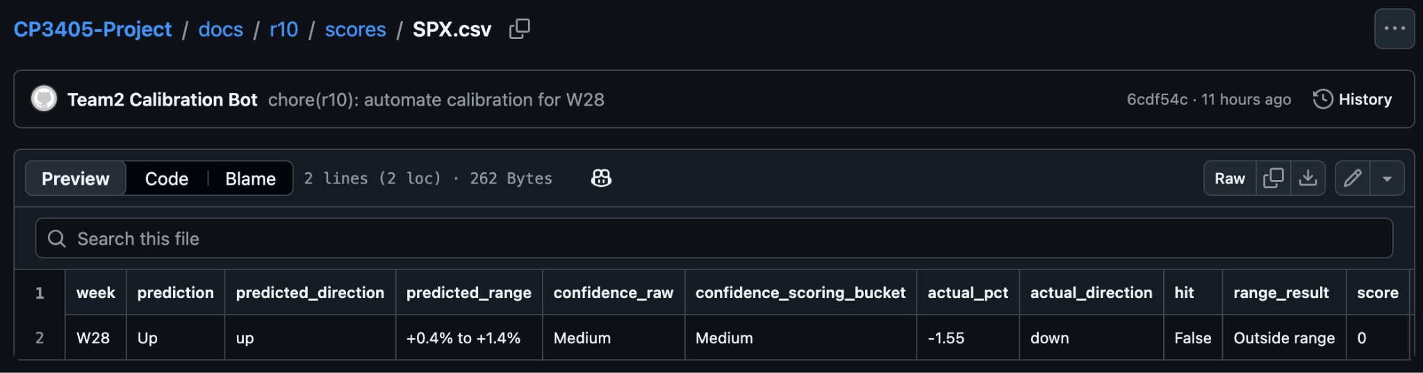
R10 Calibration Lead
Review
What went wrong?
What are we changing?
Expected an up week, but all three core indexes fell
Expected XLK to lead, but it fell to the weakest sector
Thesis about AI-growth fuelling an XLK lead was wrong, failed to account for fears about an AI bubble
Implemented saving of weekly scores for each market to a .csv file, allowing for analysis of our predictions over time
Paying closer attention to news about the tech sector, especially due to fears about the AI bubble “popping”

Slide 19
Thank you
Any Questions?

