Slide 1

CP3405 TR2 2026
Group 2
Sprint 8 - W30
Guanyu Lu
Qinyang Wu
Zheng Zaikun
Hamzah Nutt
The Bao Le
Hu Wenhan
Yuchu Lin
Kan Yijie
Swan Htet Zaw
Junwen Lu
Wang Hao

Slide 2
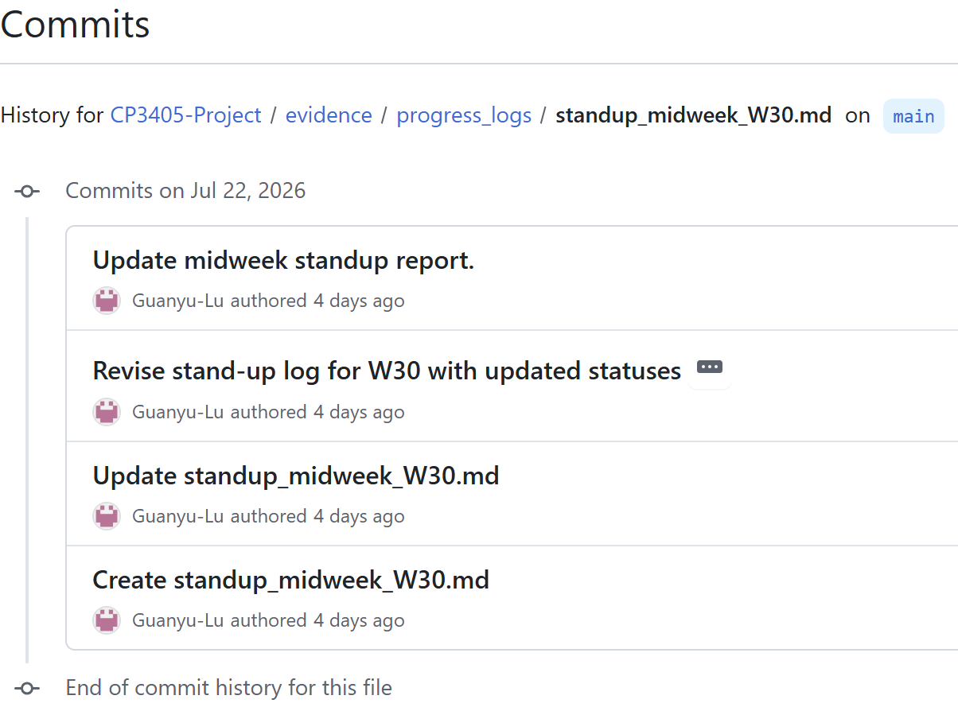
R2 Scrum Master
Wednesday test passed
Sprint control: surface risk before Sunday
Mid-week check-in committed and every role status was tracked with next actions.
EVIDENCE
SCRUM RESULT
standup_midweek_W30.md
committed by Wednesday
Risks identified early; recovery task assigned before release day
Mon
Tue–Wed
Fri
Saturday-Sunday
Sun
Planning
1:1 checks
Merge
Track and handle sudden issues
Tag
Notes:
Starting with Sprint Control, our core objective as R2 Scrum Master is to surface risks before Sunday. As highlighted in our commit history, we passed our Wednesday checkpoint by committing standup_midweek_W30.md on time. Following Monday's planning and Tuesday-to-Wednesday one-on-one checks, every role's status was actively tracked with clear next actions. Identifying these risks midweek allowed us to assign recovery tasks well before release day and effectively prepare for weekend execution.

Slide 3
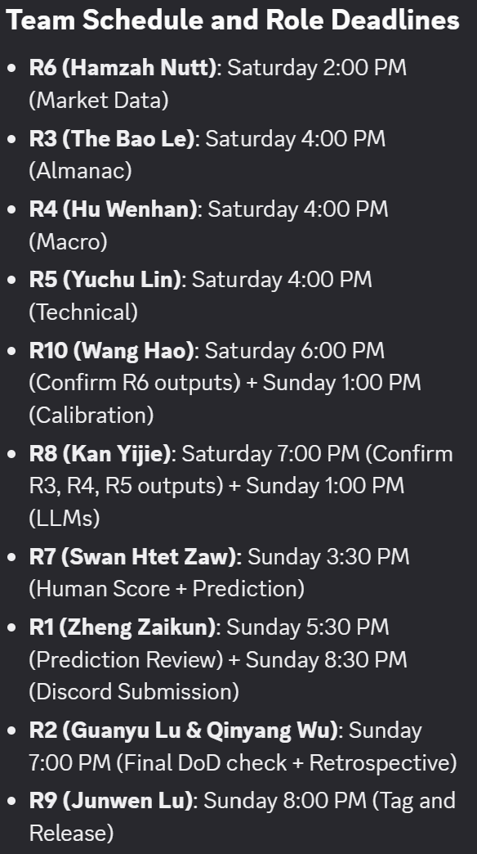
R2 Scrum Master
Dependency chain
The sprint risk was not one person being late; it was one late link blocking every downstream role.
R3
Almanac
R7
Human score
R5
Technical
R8
LLM synthesis
R9
Tag + release
R4
Macro
R10
Calibration
R6
Data
Control actions
• Force Workflow Failures on NaN Values instead of publishing them.
• Standardize LLM output formats via automatic plain-text conversion.
• Confirm all expected artifacts were modified by the latest workflow run.
Notes:
Next is our Dependency Chain. The fundamental risk here isn't just one person being late, but one delayed link blocking every downstream role. As shown in the pipeline, R6 Data feeds into Macro and Calibration, while Almanac, Macro, and Technical feed directly into R8 LLM synthesis, leading to Human Score, Calibration, and finally R9 for release. To protect this chain, we enforced strict role deadlines from Saturday 2:00 PM through Sunday 8:00 PM, and implemented three key control actions: forcing workflow failures on NaN values, standardizing LLM outputs into plain text, and verifying that all expected artifacts are updated by the latest run.

Slide 4
R2 Scrum Master
Retrospective: Sprint 9 Review
Sunday lesson: A successful branch test is not a guarantee of safe execution on main.
Saturday incident path
7:00 AM
9:30 AM
Action
11:10 AM
R5 failed to auto-generate expected results.
R2 detected that R5 did not generate the results automatically.
Guanyu Lu (R2) and Zaikun Zheng (R1) fixed the code.
The problem was resolved and the result was automatically generated.
Sprint 9 process change
• Ensure weekend automated output on main, following successful automated tests on week 9.
•.Finalize Demo Day task Assignments
Notes:
Finally, looking at our Retrospective, our main lesson is that a successful branch test does not guarantee safe execution on main. During Saturday’s pipeline, R5 failed to auto-generate results at 7:00 AM. At 9:30 AM, R2 detected the failure, and R2 Guanyu Lu alongside R1 Zaikun Zheng intervened to fix the code. By 11:10 AM, the issue was fully resolved, and results were automatically generated. For Sprint 9, our process changes focus on ensuring weekend automated outputs run reliably on main after week 9 branch tests, and finalizing our Demo Day task assignments.

Slide 5
R1 Product Owner
Sprint goal statement
One slide for definition of done, calibration context, and the weekly decision question.
Last Week Score
Primary Question
Release no.
-5
[Bearish]
W30
Sprint Goal
Done Means
Deliver a reliable, clean, and properly synchronized W30 forecasting pipeline covering SPX, NDX, IWM, and all 11 sector ETFs. Fix R8/R7 logical conflicts and enforce hard NaN validation to ensure data integrity.
R3-R8 evidence submitted & labelled.
All NaN values strictly fail workflow.
R8 synthesis template standardized.
Human override confirmed by PO.

Slide 6
R1 Product Owner
Forecast contract
Use for the final Product Owner statement: what the team is committing to forecast this week.
SPX
NDX
IWM
Direction: Down
Direction: Down
Direction: Down
Range: 6238.01 - 7609.78
Range: 22763.31 - 30660.60
Range: 212.71 - 300.45
Confidence: Medium
Confidence: Medium
Confidence: Medium
Assumptions
Definition of done
1. Main macro driver remains Rising Oil & Treasury Yields.
All role evidence is submitted, labelled, committed to GitHub, and ready for R10 calibration after market actuals.
2. Technical invalidation level is Price cross above EMA 21.
3. Human override is applied (Overriding AI Sideways Bias).
[vW30 RELEASE LOCKED]

Slide 7
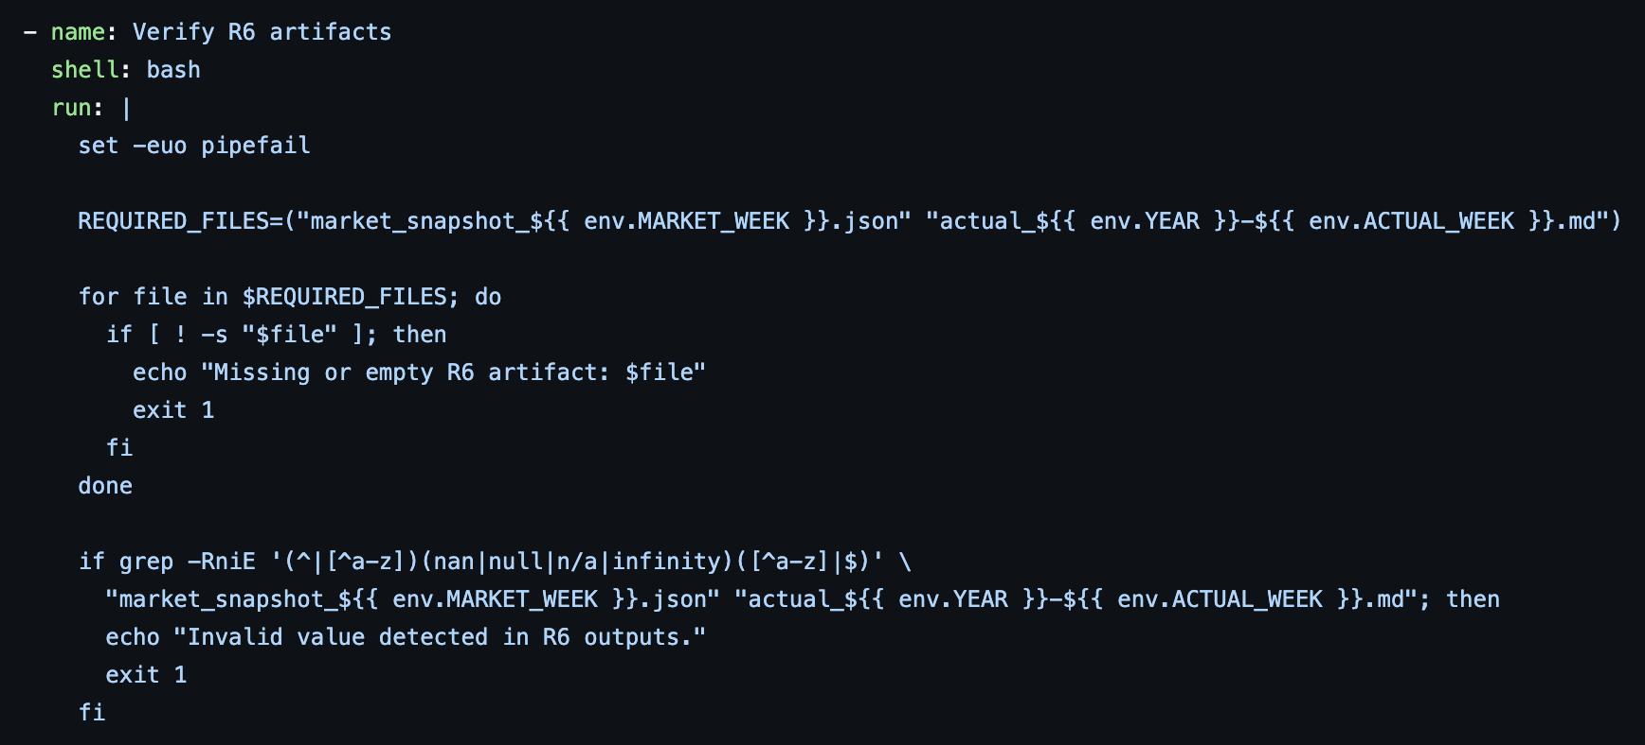
R6 Data Lead
OBJECTIVES
Implement validation of output files
Ensure that the pipeline can run properly with minimal (or no) human intervention

Slide 8
R6 Data Lead
ACTUALS
SPX
NDX
IWM
XLK
XLC
S&P 500
NASDAQ 100
Russell 2000
Technology
Communication Services
-0.61%
-1.62%
-0.98%
+0.17%
-3.93%
XLY
XLP
XLE
XLF
XLV
Consumer Discretionary
Consumer Staples
Energy
Financials
Healthcare
-5.22%
-1.24%
+3.36%
+0.09%
+0.92%
XLI
XLB
XLRE
XLU
TOP SECTOR
Industrials
Materials
Real Estate
Utilities
XLF
+1.81%
+1.44%
+1.17%
+2.48%
Financials

Slide 9
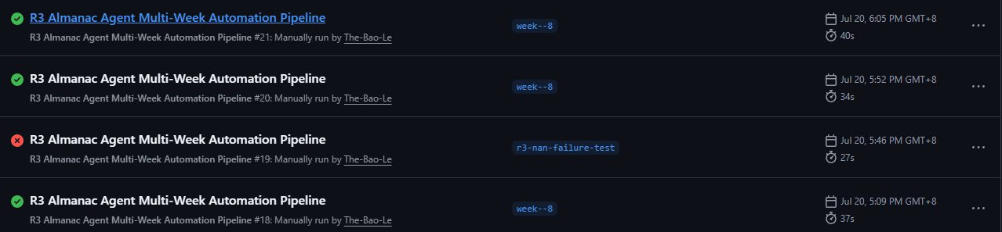
R3 Almanac Lead
OBJECTIVE
Deliver a clean W30 Almanac pipeline that validates seasonal evidence before downstream use.
• Extract SPX, NDX proxy, IWM and all 11 sector rows from the Almanac PDF.
• Fail the workflow on NaN, null, invalid dates, missing sectors or extraction errors.
• README updated

Slide 10
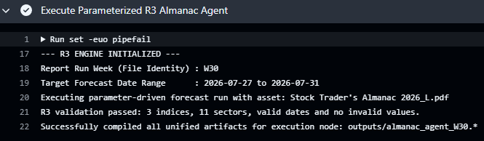
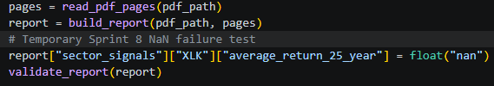
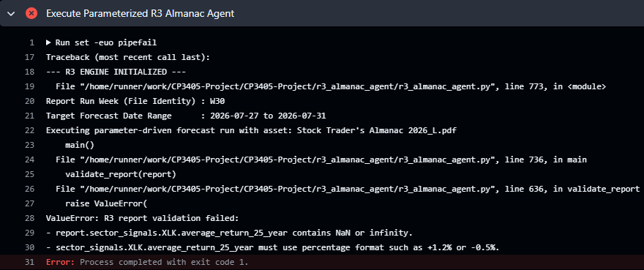

R3 Almanac Lead
VALID RUN
FAILURE TEST
Successful W30 run generated all three artefacts after validation passed.
• 3 indices: SPX, NDX proxy, IWM
• 11 sector ETF categories
Expected result: workflow fails before writing or committing bad output.
• Valid week and Monday-Friday forecast range

Slide 11
R3 Almanac Lead
FORECAST CONTEXT
SECTOR MATRIX
W30 forecast range: 2026-07-27 to 2026-07-31
Month baseline: July · U.S. midterm election year
Long seasonal rows
Short seasonal rows
XLY +13.11%
XLI +11.30%
XLK +10.87%
XLRE +10.66%
XLU +9.32%
XLV +8.74%
XLP +8.47%
XLC +5.13%
XLF -6.30%
XLE -5.67%
XLB -5.10%
Overall index bias: Bearish · Confidence: Medium
INDEX MIDTERM RETURNS
SPX
+1.3%
NDX proxy
-0.8%
IWM
-2.5%
Interpretation: SPX is positive, but NDX proxy, and IWM are negative in July midterm-year averages, so the derived index outlook is bearish with medium confidence.
Source: July Vital Statistics page 92; Sector Index Seasonality pages 130-131.

Slide 12
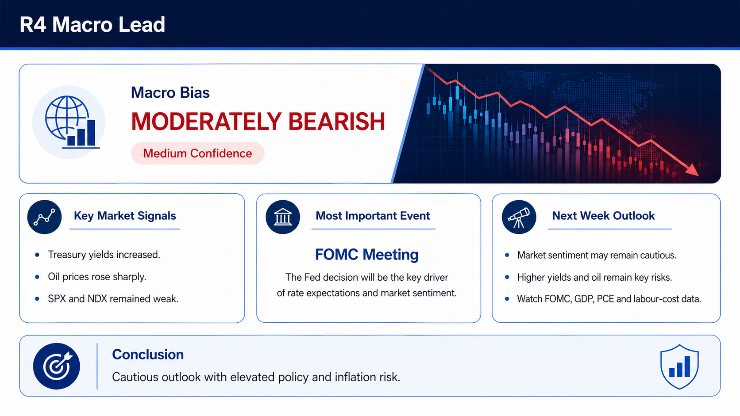
R4 Macro Lead
Notes:
This week, our macro outlook is moderately bearish with medium confidence. Treasury yields and oil prices both increased, while the SPX and NDX remained weak, suggesting market sentiment is still cautious. Looking ahead, the FOMC meeting will be the most important event, together with GDP and PCE data. Overall, we expect a cautious market and will continue to monitor these key economic events.

Slide 13
R5 Technical Lead
Invalidation playbook
Use this when the data pipeline needs to be precise and strictly validated.
1
Setup
2
Invalidation trigger
3
Action if triggered
The Python script fetches market data via yfinance, calculates technical indicators (EMA, RSI), and generates JSON, Markdown, and chart outputs for 14 assets.
Missing core assets (SPX, NDX, IWM) or detection of any NaN / Infinity values during the strict metrics validation phase.
Immediately abort the GitHub Actions workflow, block file generation and commit, and log detailed errors instead of publishing bad data.
Strict Validation Rule
The R5 pipeline output is valid as long as all core metrics are finite numbers. If NaN or Inf is detected in any field, the setup is invalidated and the workflow strictly fails to prevent bad output files.

Slide 14
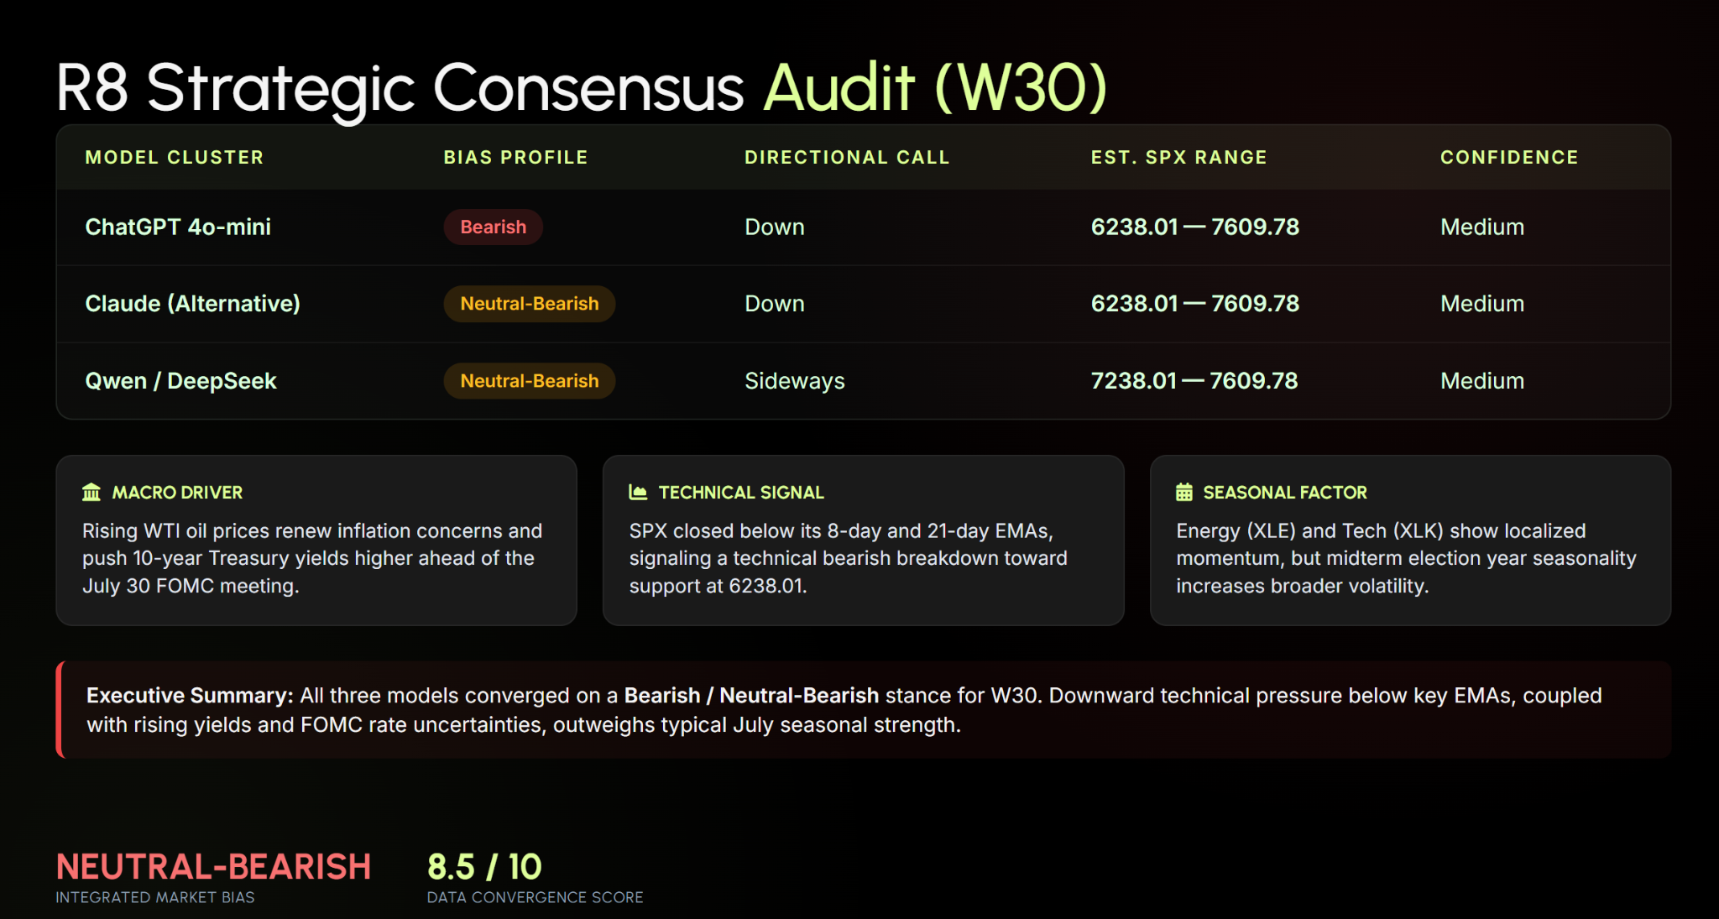
R8 LLM Operator
Notes:
"Hi everyone, here is the W30 Consensus Report from our R8 LLM Operator.
This week, we fully integrated upstream reports from R3 Almanac and R5 Technical, while enforcing strict NaN checks to ensure absolute data quality.
We optimized our pipeline to run on three flagship models: ChatGPT-4o-mini, Llama 3.1, and Qwen 2.5. By migrating Qwen to the high-speed paid tier and removing response character limits, all analyses are generated 100% complete and un-truncated.
For W30, the consensus converges on a Neutral-Sideways bias for SPX with medium confidence.
Our pipeline is fully automated and ready for deployment. Thank you!"

Slide 15
R7 Human Score
Human Score Dashboard
Macro / News
( -1 )
-Moderately Bearish
-Indices declined
-Oil near $100
-Treasury yields ↑
-CPI improved
Technical
(-1)
-Below 8 & 21 EMA
-SPX bearish
-NDX bearish
-IWM bearish
-Momentum weakening
Almanac
(-1)
-Strategic Bearish
-July late cycle
-NDX weaker
-IWM weaker
-Midterm effect
AI Agreement
(0)
-Mixed LLM views
-Sideways vs Up
-Partial consensus
-Human verification
-Medium confidence
Wild Card
(-1)
-Oil near $100
-FOMC week
-GDP release
-Tariff risk
-Geopolitics
TOTAL SCORE: -5 (BEARISH)
The W30 Human Score fell to -5 as bearish macro conditions, weakening technical momentum, a bearish seasonal outlook, and major economic events outweighed the remaining positive inflation data, resulting in a Bearish outlook.
Notes:
This week, our Human Score decreased from -3 to -5, indicating that market conditions have become more bearish than last week. Rising Treasury yields, higher oil prices, weaker market momentum, and a bearish strategic Almanac outlook all contributed to the lower score. Although inflation continued to improve, the positive impact was outweighed by bearish technical signals and increasing macroeconomic risks. As a result, our team adopted a Bearish outlook for Week 30.

Slide 16
R7 Human Score
HUMAN OVERRIDE
AI CONSENSUS
• Mixed LLM views
• Sideways / Neutral
• July seasonality
• Stable Fed assumption
• Medium confidence
HUMAN ADJUSTMENT
• SPX below EMAs
• NDX bearish
• Oil near $100
• Rising Treasury yields
• Bearish Almanac
Although July seasonality and lower CPI provide some support, the team gives greater weight to the bearish technical structure, rising Treasury yields, higher oil prices, a bearish strategic Almanac outlook, and major economic events including the FOMC meeting. These factors support a Bearish outlook for Week 30.
Notes:
The AI models generally produced mixed Neutral or Sideways forecasts, mainly because they placed greater emphasis on July seasonality and stable monetary policy assumptions. However, our team identified several logical conflicts between the LLM outputs and the verified R5 Technical Agent report. All three major indices remain below their 8-day and 21-day EMAs, the Macro Agent maintains a Moderately Bearish outlook, and the Almanac Agent also assigns a Bearish strategic bias. Considering these factors together, we concluded that the downside risks outweigh the remaining positive signals and therefore adopted a Bearish outlook for Week 30.

Slide 17
R9 GitHub Lead
https://github.com/LuJunwen212/CP3405-Project

Slide 18
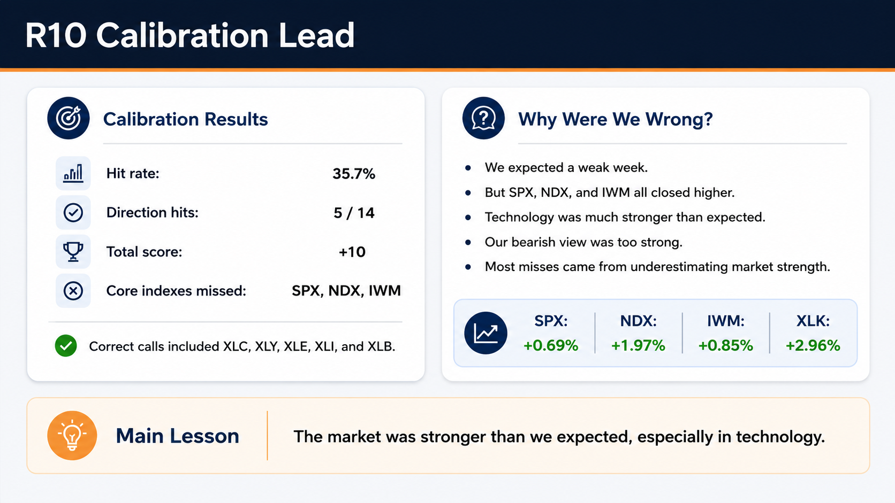
R10 Calibration Lead
Notes:
This week, five of fourteen predictions were correct.
Our accuracy was 35.7 percent.
The main problem was that the major indices went up instead of down.
Technology was also much stronger than expected.
These changes caused most of our misses.

Slide 19
Thank you
Any Questions?

