Slide 1
Paradoxes of Material Implication
Peter Suber, Philosophy Department, Earlham College
By：Chenhao Rao，Guanbo Wang and Mingjia Zuo.

Slide 2
Ⅰ. Introduction
Ⅱ. The price of truth-functionality
Directory
Ⅲ. Only somewhat counter-intuitive
Ⅳ. Application to arguments
Ⅴ. Question and answer session

Slide 3
Ⅰ. Introduction
Page 1

Slide 4

Ⅰ. Introduction
Peter Suber
·Earlham College，Dept. of Philosophy
·Harvard University
Harvard U. Berkman Center for Internet & Society
Harvard Open Access Project
Harvard Office of Scholarly Communication
·http://cyber.Law.Harvard.edu/~psuber/wiki/Peter_Suber
Page 2

Slide 5
Ⅰ. Introduction
There are many kinds of implication. We may use the ‘if..., then...’construction to indicate definitional, causal, or logical relations.
——Peter Suber
Page 3

Slide 6
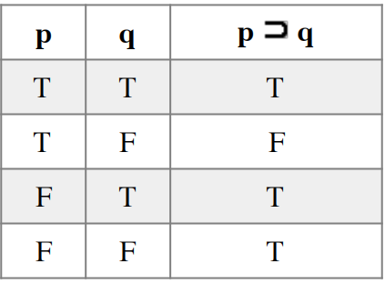
Ⅰ. Introduction
Table 1：Truth-table for material implication
Page 4

Slide 7
Ⅰ. Introduction
If the moon is made of green cheese, then life exists on other planets.
If life exists on other planets, then life exists on earth.
Page 5

Slide 8
Ⅱ. The price of truth-functionality
Page 6

Slide 9
Ⅱ. The price of truth-functionality
Why would we adopt a type of implication with such counter-intuitive results？
Because we want a truth-functional kind of implication.
But what is a truth function kind of implication? What's the use of it then?
Page 7

Slide 10
Ⅱ. The price of truth-functionality
Key point：What is the price of truth-functionality?
The price of truth-functionality is that the relevancy between the antecedent and the consequent will be lost. If all that matters about a statement is its truth value, then all content is disregarded.
Page 8

Slide 11
Ⅱ. The price of truth-functionality
The paradoxes disturb us because the truth-value of one component can determine the truth-value of the whole compound, regardless of the truth-value or content of the other. That is, they disturb us precisely because of this loss of mutual relevancy. This state of affairs disturbs some logicians too. They have developed so-called“relevance logics”in which the antecedent and consequent of conditionals must somehow bear on the same subject.
Page 9

Slide 12
Ⅱ. The price of truth-functionality
1.1 p is“It rained yesterday.”q is“The ground outside was wet yesterday.”p entails q.
1.2 p is“It rained yesterday.”q is“The ground outside is wet today. ”p does not entail q.
Page 10

Slide 13
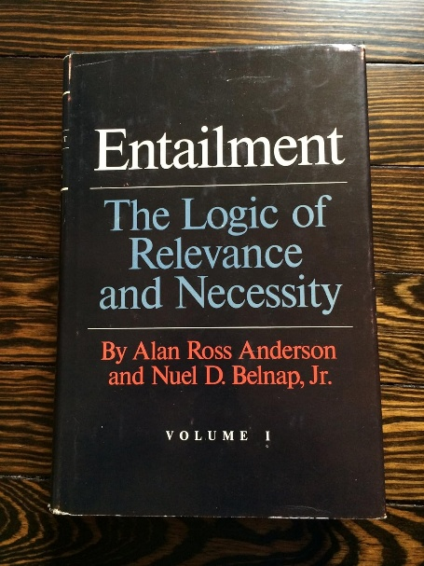
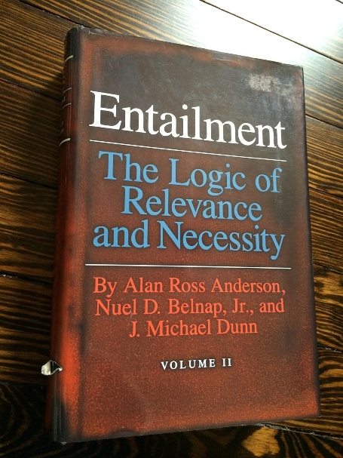
Ⅱ. The price of truth-functionality
Entailment: The Logic of Relevance and Necessity.
By Alan Ross Anderson and Nuel D.Belnap,Jr.,Princeton University Press, Vol. 1, 1975；Vol. 2 (with J. Michael Dunn), 1993.
Page 11

Slide 14
Ⅲ. Only somewhat counter-intuitive
Page 12

Slide 15
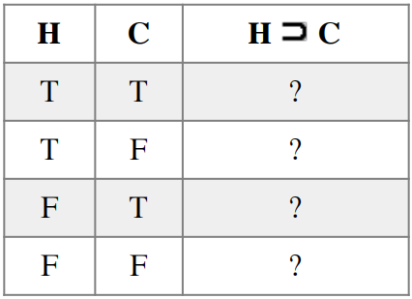
Ⅲ. Only somewhat counter-intuitive
Page 13

Slide 16
Ⅲ. Only somewhat counter-intuitive
• In case 1, I am healthy and I come to class. I have clearly kept my promise; the conditional is true.
• In case 2, I am healthy, but I have decided to stay home and read magazines. I have broken my promise; the conditional is false.
• In case 3, I am not healthy, but I have come to class anyway. I am sneezing all over you, and you're not happy about it, but I did not violate my promise; the conditional is true.
• In case 4, I am not healthy, and I did not come to class. I did not violate my promise; the conditional is true.
Page 14

Slide 17
Ⅲ. Only somewhat counter-intuitive
If n is a perfect square, then n is not prime.
If 3 is a perfect square, then 3 is not prime.
Page 15

Slide 18
Ⅲ. Only somewhat counter-intuitive
（1）The perversity of material implication is deliberate, for it is the only way to get truth-functionality.
（2）The perversity violates only our ordinary expectations, not any logical principles.
（3）For material implication, despite its perversity, suffices to capture the logically essential core of meaning in ordinary uses of implication.
（4）The counter-intuitive material implication distorts nothing essential and, because it is truth-functional, allows us to test the validity of arguments that contain implication statements.
Page 16

Slide 19
Ⅳ. Application to arguments
Page 17

Slide 20
Ⅳ. Application to arguments
Conditional statements have corresponding arguments, just as arguments have corresponding conditionals.
Argument:
Premise 1: All humans will die.
Premise 2: Socrates is a human.
Conclusion: Socrates will die.
Corresponding conditional statement: If a person is a human, then that person will die.
Page 18

Slide 21
Ⅳ. Application to arguments
Argument:
Premise 1: If A and B, then C.
Premise 2: Both A and B have occurred.
Conclusion: C will occur.
Corresponding conditional statement: If A and B, then C.
Page 19

Slide 22
Ⅳ. Application to arguments
How far do the paradoxes of material implication carry over to the corresponding arguments?
The answer is that they carry over only in a special sense, and not in a simple or straightforward way. The specific meaning here refers to the meaning of truth functions, while the simple or direct approach is meant for the general case or in everyday language.
Page 20

Slide 23
Ⅳ. Application to arguments
（1）If the conjunction of the premises of an argument is a contradiction, then the argument will be valid. = If the premises are necessarily false, then the argument will be valid.
（2）If the conclusion is a tautology, then the argument will be valid. = If the conclusion is necessarily true, then the argument will be valid.
Page 21

Slide 24
Ⅴ. Question and answer session
Page 22

Slide 25
Ⅴ. Question and answer session
We know that simple material implication cannot fully convey the entailment relationships in natural language. So, can natural language be completely expressed by some other logical system?
Page 23

Slide 26
Ⅴ. Question and answer session
Audience Questioning Session
Page 24

Slide 27

Thank you!

