Slide 1

Carthafind

Slide 2
Introduzione
1

Slide 3
Ordine, velocità ed efficienza.

Slide 4

CONCETTO
Luogo comune
Progetti passati
Ricerca di informazioni
Gestibilità

Slide 5
Specifiche
Creazione e privilegi utenti
Inserimento, modifica ed eliminazione
Ricerca per campi e parole chiave

Slide 6
3070 CHF
76 Ore
80%

Slide 7
Pianificazione
2

Slide 8
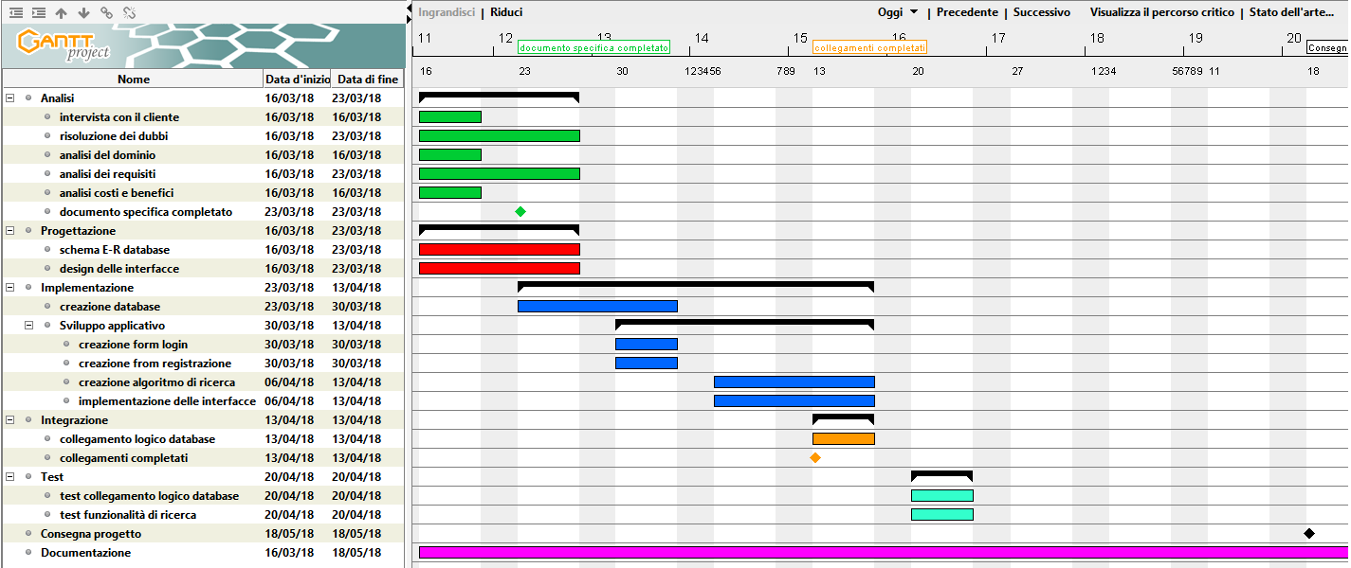
Gantt preventivo

Slide 9
Progettazione
3

Slide 10
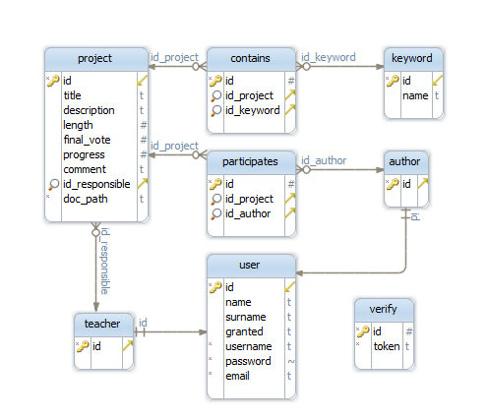
Design database

Slide 11
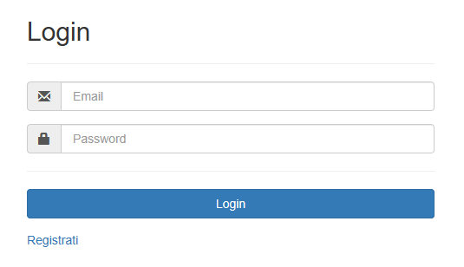
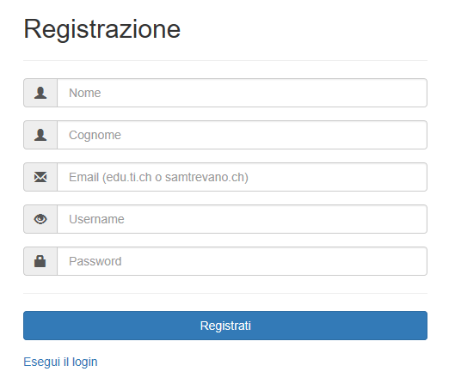
Interfacce - 1

Slide 12
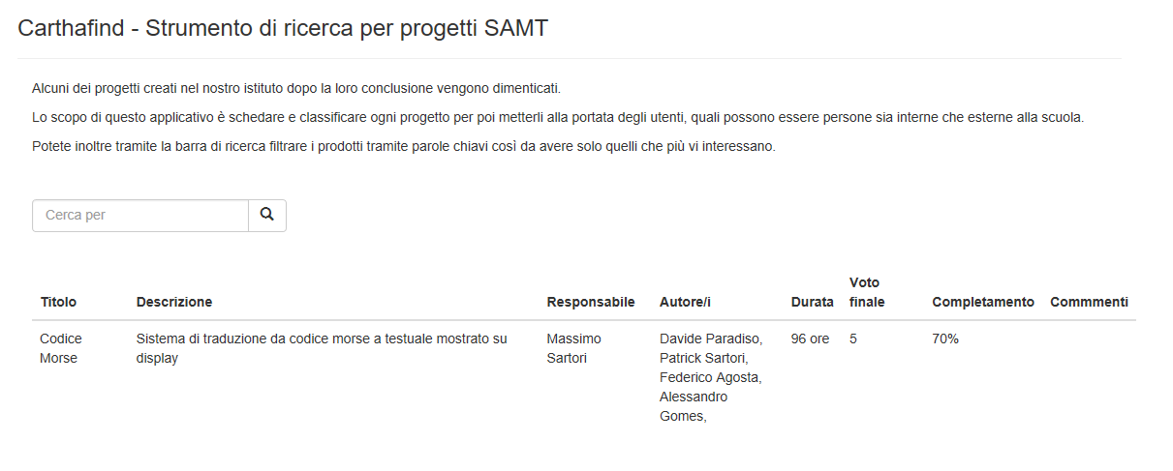
Interfacce - 2

Slide 13
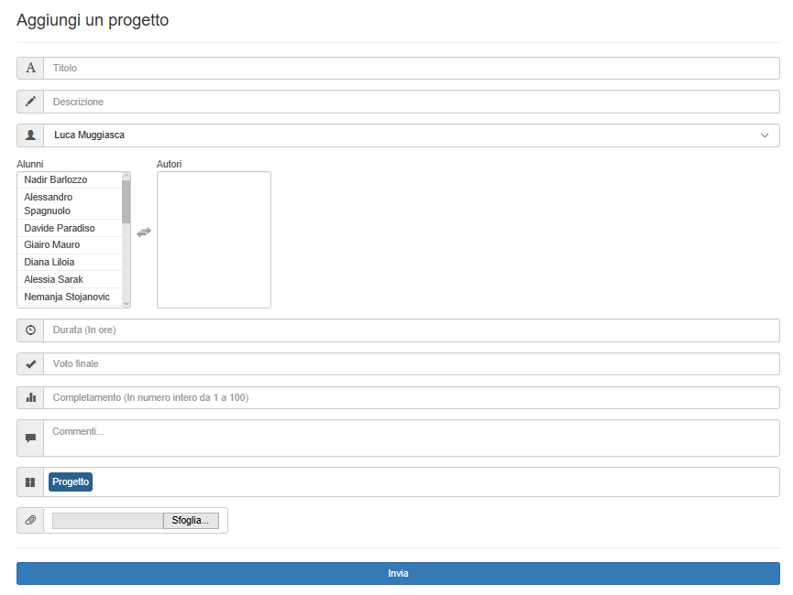
Interfacce - 3

Slide 14
You can also split your content
White
Is the color of milk and fresh snow, the color produced by the combination of all the colors of the visible spectrum.
Black
Is the color of coal, ebony, and of outer space. It is the darkest color, the result of the absence of or complete absorption of light.

Slide 15
In two or three columns
Yellow
Is the color of gold, butter and ripe lemons. In the spectrum of visible light, yellow is found between green and orange.
Blue
Is the colour of the clear sky and the deep sea. It is located between violet and green on the optical spectrum.
Red
Is the color of blood, and because of this it has historically been associated with sacrifice, danger and courage.

Slide 16
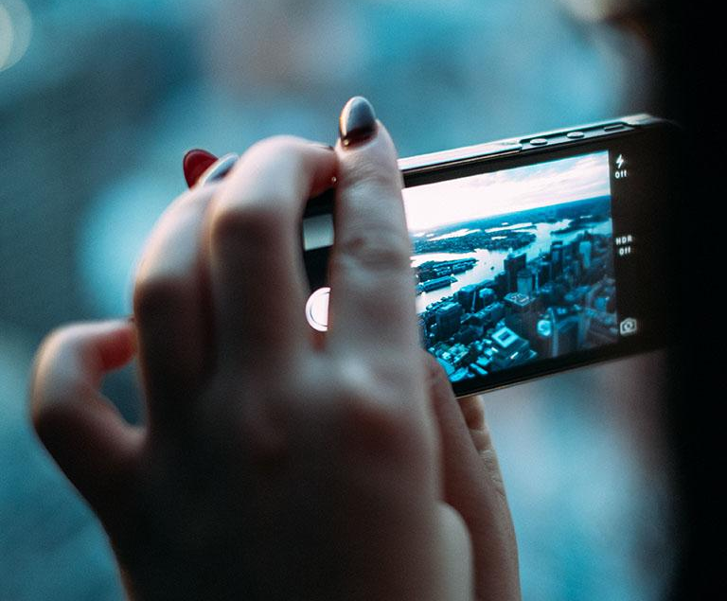
A picture is worth a thousand words
A complex idea can be conveyed with just a single still image, namely making it possible to absorb large amounts of data quickly.

Slide 17
Use charts to explain your ideas
White
Gray
Black

Slide 18
Or use diagrams to explain complex ideas
01
Text Title
Place your own text here
02
Text Title
Place your own text here
03
Text Title
Place your own text here
04
Text Title
Place your own text here
Diagram featured by http://slidemodel.com

Slide 19
And tables to compare data
 | A | B | C
Yellow | 10 | 20 | 7
Blue | 30 | 15 | 10
Orange | 5 | 24 | 16

Slide 20
Maps
our office

Slide 21
89,526,124
Whoa! That’s a big number, aren’t you proud?

Slide 22
Our process is easy
first
second
last

Slide 23
Let’s review some concepts
Yellow
Is the color of gold, butter and ripe lemons. In the spectrum of visible light, yellow is found between green and orange.
Blue
Is the colour of the clear sky and the deep sea. It is located between violet and green on the optical spectrum.
Red
Is the color of blood, and because of this it has historically been associated with sacrifice, danger and courage.
Yellow
Is the color of gold, butter and ripe lemons. In the spectrum of visible light, yellow is found between green and orange.
Blue
Is the colour of the clear sky and the deep sea. It is located between violet and green on the optical spectrum.
Red
Is the color of blood, and because of this it has historically been associated with sacrifice, danger and courage.

Slide 24
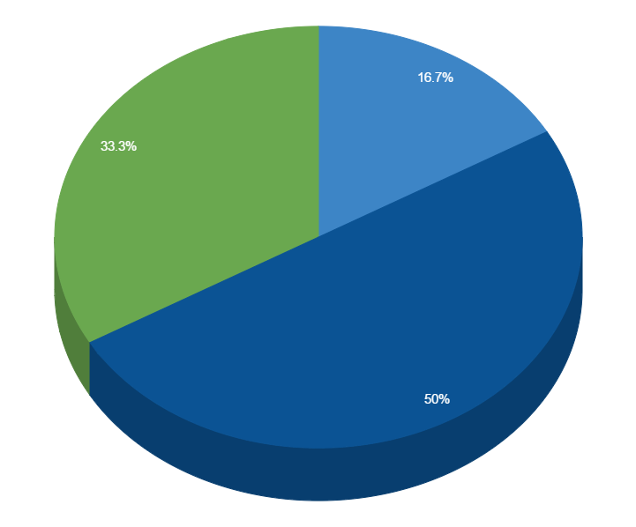
You can copy&paste graphs from Google Sheets

Slide 25
Android project
Show and explain your web, app or software projects using these gadget templates.
Place your screenshot here

Slide 26
iPhone project
Show and explain your web, app or software projects using these gadget templates.
Place your screenshot here

Slide 27
Tablet project
Show and explain your web, app or software projects using these gadget templates.
Place your screenshot here

Slide 28
Desktop project
Show and explain your web, app or software projects using these gadget templates.
Place your screenshot here

Slide 29
Crediti
Template ed icone messe a disposizione da SlidesCarnival.
Progetto creato da Nadir Barlozzo sotto la proprietà dell’istituto Scuola Arti e Mestieri di Trevano.
Supervisione del docente Luca Muggiasca

Slide 30
Grazie dell’ascolto!
Domande?

Slide 31
SlidesCarnival icons are editable shapes.
This means that you can:
Resize them without losing quality.
Change line color, width and style.
Isn’t that nice? :)
Examples:

Slide 32
😉
Now you can use any emoji as an icon!
And of course it resizes without losing quality and you can change the color.
How? Follow Google instructions https://twitter.com/googledocs/status/730087240156643328
✋👆👉👍👤👦👧👨👩👪💃🏃💑❤😂😉😋😒😭👶😸🐟🍒🍔💣📌📖🔨🎃🎈🎨🏈🏰🌏🔌🔑 and many more...

