Slide 1
GraphINVENT
Thien Lu

Slide 2
1. Intro to GNNs
What is Machine Learning, Deep Learning
What is GNNs (message passing)
2. Application of AI in drug discovery
3. GraphINVENT
Architecture
Input and output
Training
Generation process
Discussion, pros and cons
Repository

Slide 3
1
Machine learning and drug discovery

Slide 4
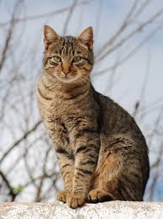

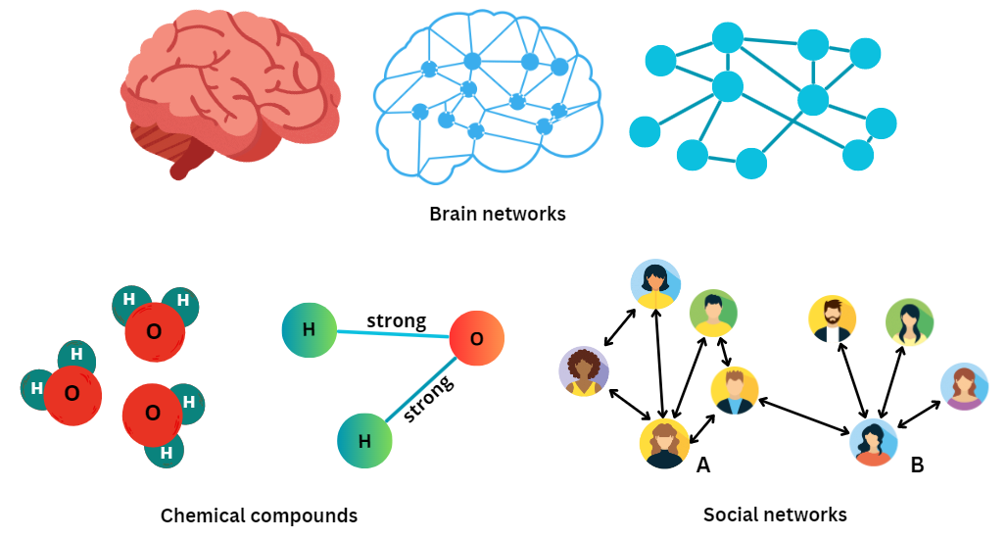
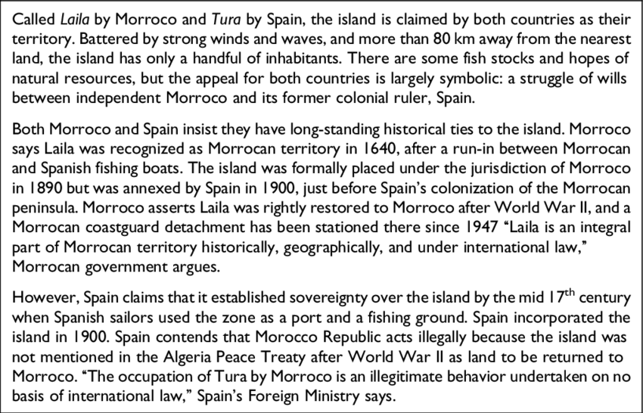
Supervised Machine Learning
Target prediction
f(x)
Model of problem
Input data x
- Cat
- Toxic compounds
- Recommended friends
- Sequences
- Code generation
...

Slide 5
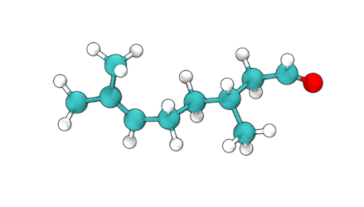
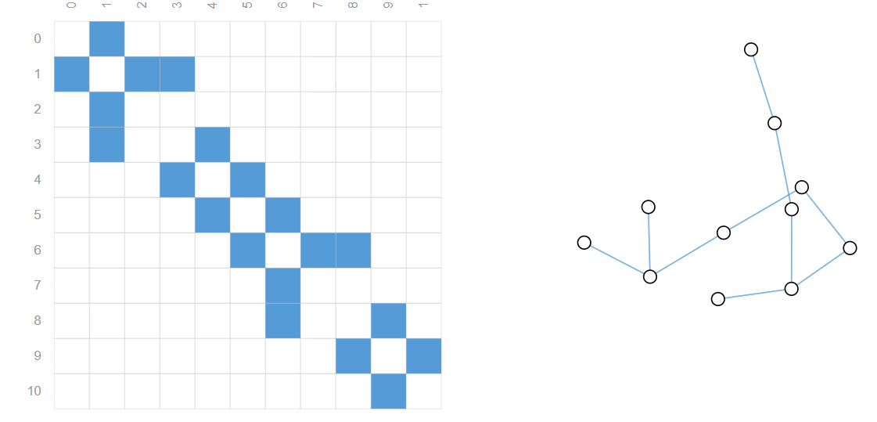
Graph neural network
Node (vertices)
Level | Task Type | Examples
Graph | Classification, Regression | Solubility, toxicity, bioactivity, ...
Edge | Prediction | Bond type, reaction prediction, …
Node | Classification, Regression | Atom charges, type, …
Edge
Graph
G = (E, V)

Slide 6
Message Passing Neural Network
Distributed Vector Representations
Vocab size
D
Type | Based on
MPNN | Message passing
GCN | Convolution
GAT | Attention
… | …
C
…
C
O
…
O
Xe
…
Xe
GNNs
Readout
Initial Representations
Output representations
Predictions
Neural Message Passing for Quantunm Chemistry: https://arxiv.org/pdf/1704.01212v2

Slide 7
Application of ML in molecular design

Slide 8
2
GraphINVENT
https://github.com/MolecularAI/GraphINVENT
https://chemrxiv.org/engage/chemrxiv/article-details/60c74f19ee301c084fc7a627
https://www.youtube.com/watch?v=fzSL7MWfXtQ&t

Slide 9
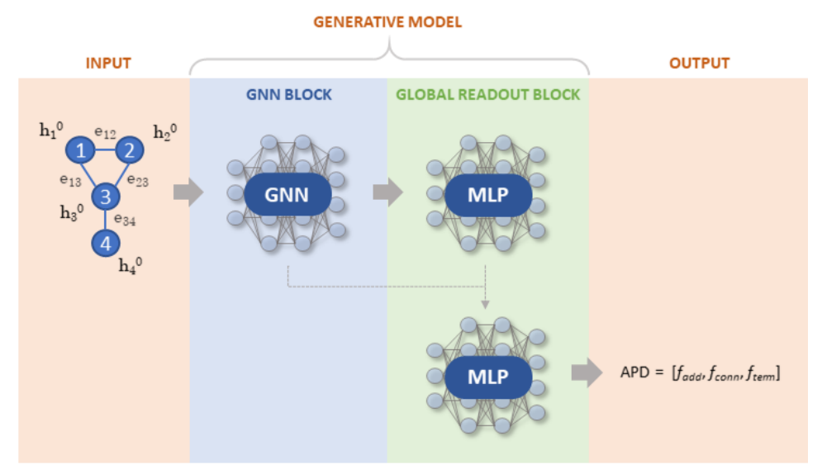
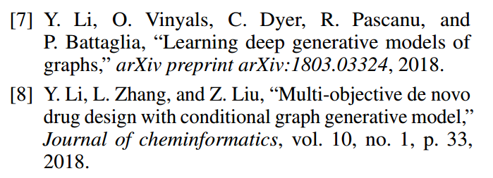
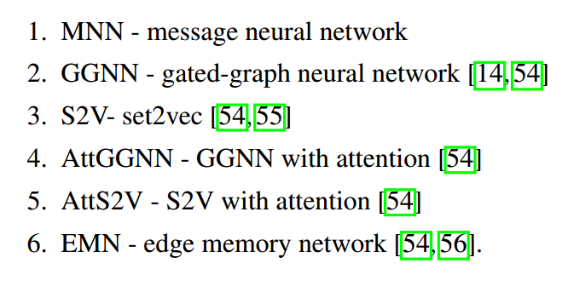


GraphINVENT - overview
- Input: molecular graph
+ Node feature matrix X
+ Adjacency tensor E
- Output: ADP
+ Append/Add
+ Connect
+ Terminate

Slide 10
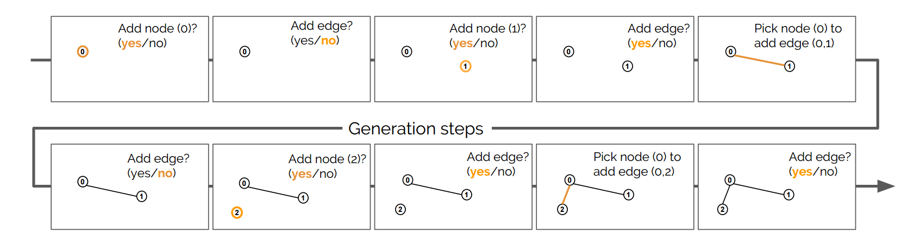
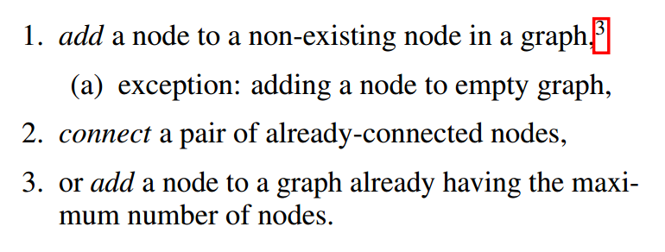
GraphINVENT - generation
Learning Deep Generative Models of Graphs: https://arxiv.org/abs/1803.03324

Slide 11
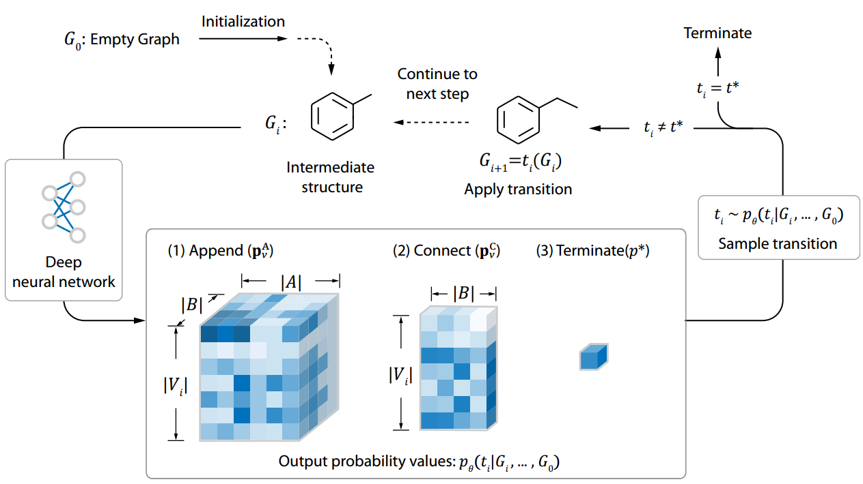
GraphINVENT - generation
Multi-Objective De Novo Drug Design with Conditional Graph Generative Model: https://arxiv.org/abs/1801.07299

Slide 12
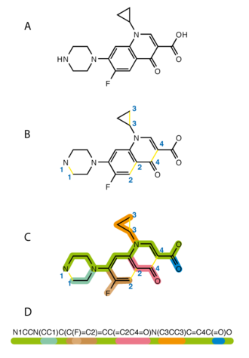
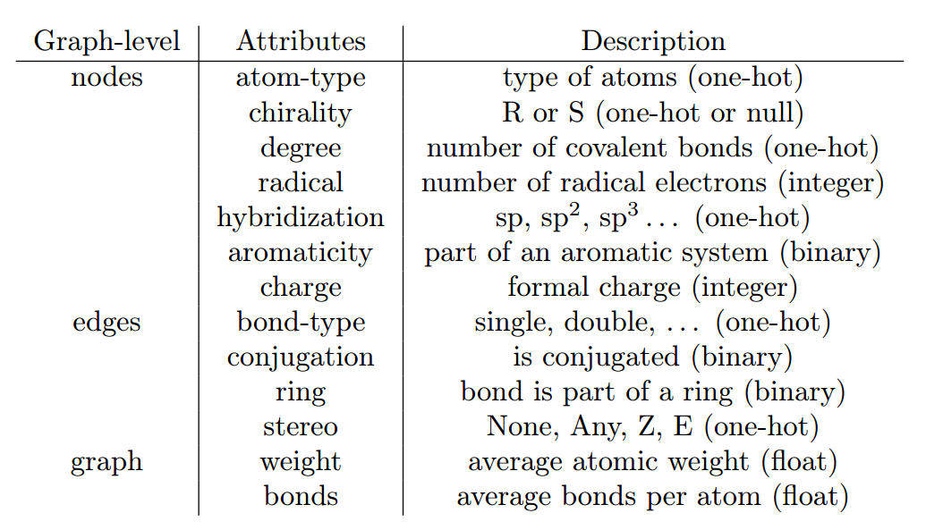
GraphINVENT – molecular graph
One-hot encoding
SMILES (Simplified Molecular Input Line Entry System)
Atom types: C, H, O, N, S
(0) (1) (2) (3) (4)
C
[1, 0, 0, 0, 0]
H
[0, 1, 0, 0, 0]
S
[0, 0, 0, 0, 1]
Graph neural networks for materials science and chemistry: https://arxiv.org/abs/2208.09481
https://en.wikipedia.org/wiki/Simplified_Molecular_Input_Line_Entry_System

Slide 13
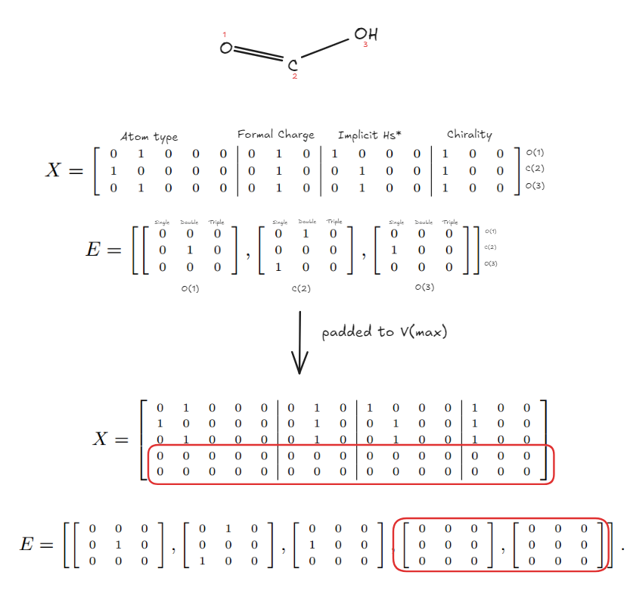
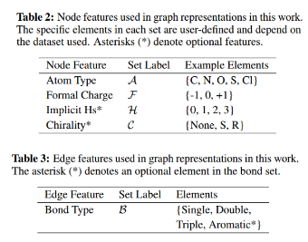
GraphINVENT – molecular graph
X: [B, V_{max}, C] → Example: [B, V_{max}, 15]
E: [B, V_{max}, V_{max}, B] → Example: [B, V_{max}, V_{max}, 3]
Adjacent matrix
C
C
O
C
C
C
O
C
C₂H₅OH
O

Slide 14
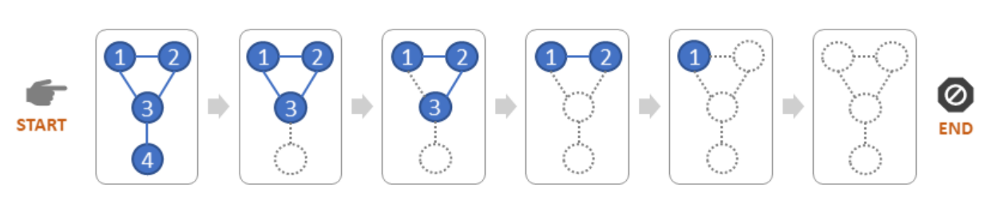
GraphINVENT – Training
Training set preprocess
The GDB-13 1K subsets each consist of 1000 randomly selected structures from the full GDB-13 dataset
Small organic molecules
Up to 13 atoms of C, N, O, S and Cl
1. Assign rank (random/canonical)
Link
2
3
1
C
C
O
G_{n}
2. Transverse graph using modified BFS
C
Model
C
C
O
2
C
ADP_{n-1}
ADP_{n-1}:
Add O atom
Connect to C2
1
C
G_{n-1}
G_{n}
C
G_{n-1}
3. Destruct until reach G₀, ADP₀
4. Repeat for all graphs

Slide 15
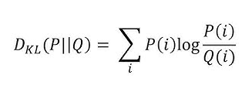
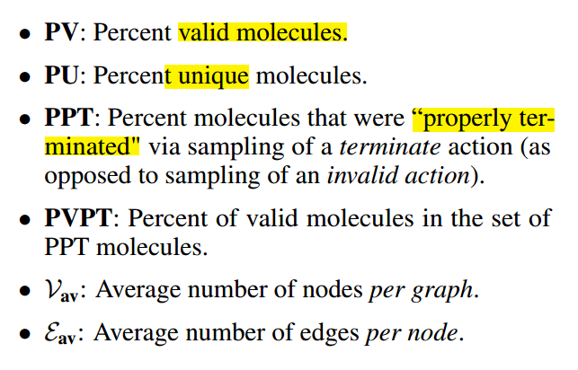
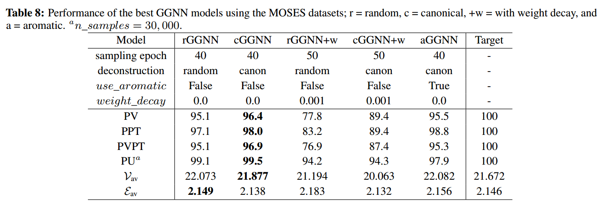
GraphINVENT – Evaluation
Training Loss: Kullback-Leibler (KL) divergence

