Slide 1
Week 6

Slide 2

Input Scaling

Slide 3
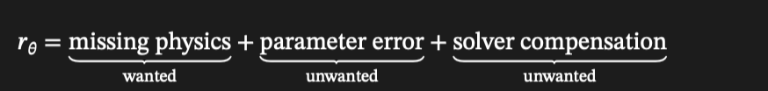
parameter error

Slide 4

amount of initial points

Slide 5

Lotka-voterra experiments

Slide 6
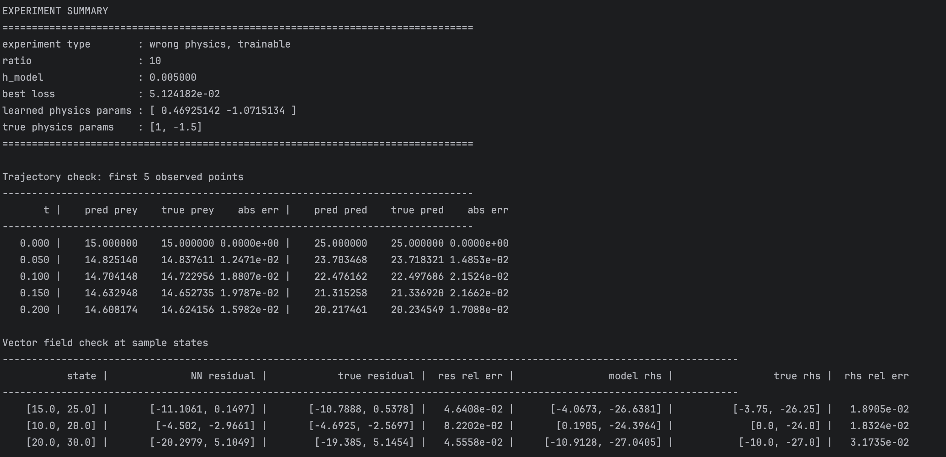

Slide 7
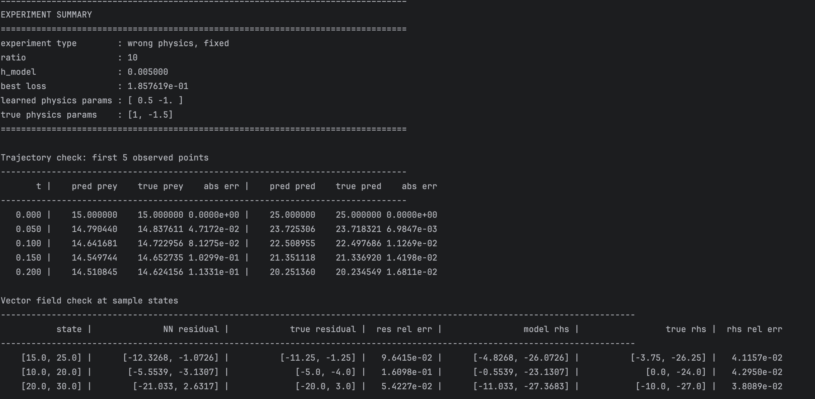

Slide 8
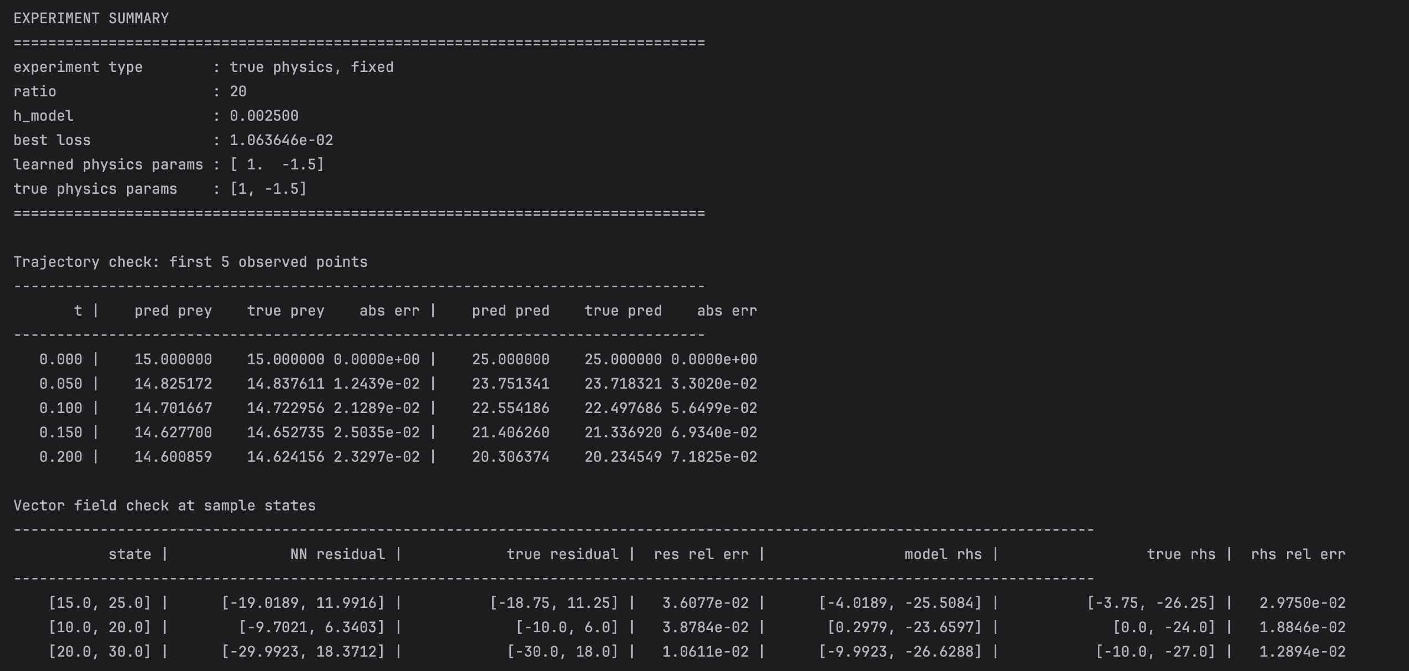

Slide 9
Duffering Oscillator

Slide 10
