Slide 1
Week 5

Slide 2
Advantage of Residual Neural ODE
If we just want to fit the trajectory, why residual neural ode?
Extrapolation ( parameter recovery helps)

Slide 3
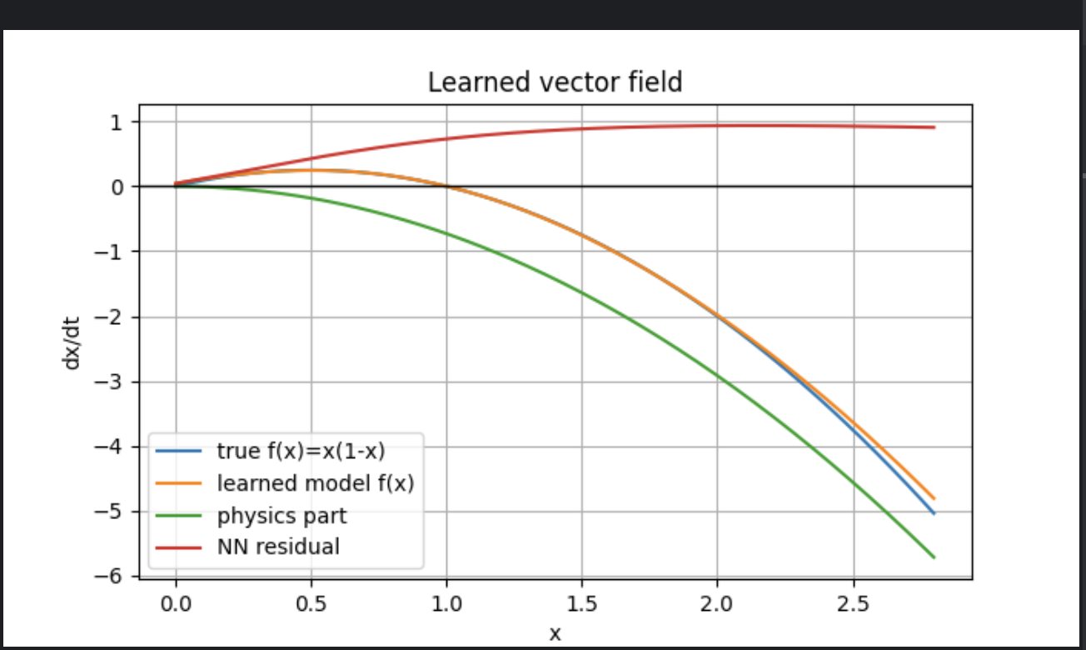
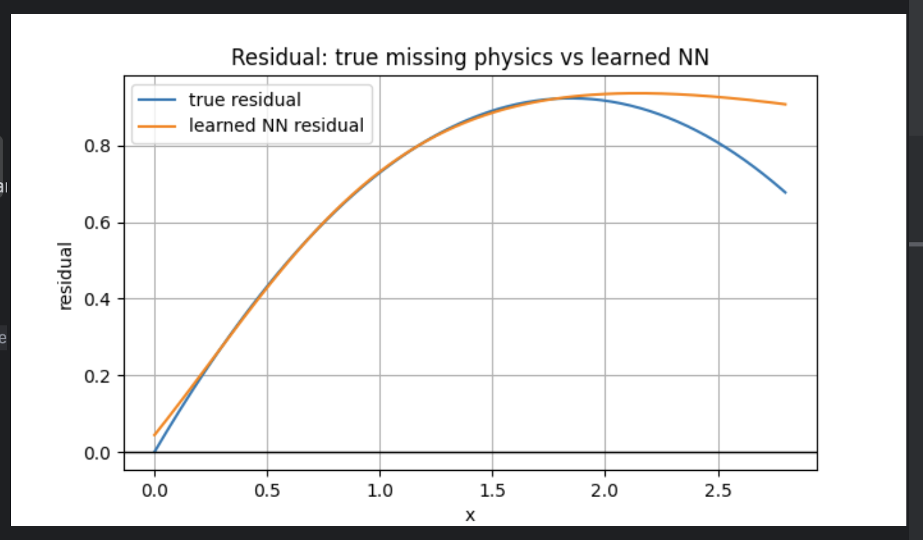
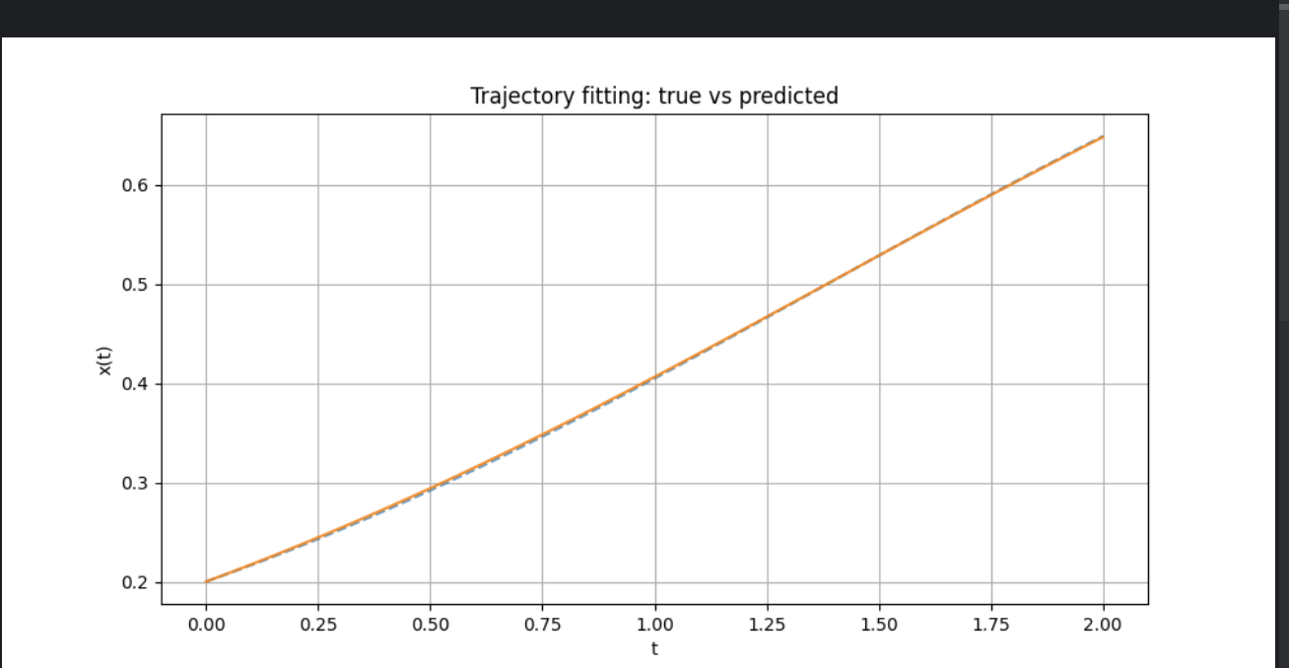
Visualization

Slide 4
Mask and multi-transformation

Slide 5
Code Walkthrough

