Slide 1
CODE >install.packages("RJSONIO) >library(rjson) > bodylength<-c(188,152,201,165) >bodyfeature<-c("tall","short","very tall","normal" ) > individualfeature<-data.frame(bodylength,bodyfeature) > data<-as.matrix( individualfeature) >cat(toJSON(data))

Slide 2
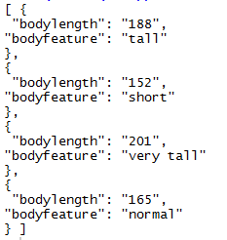
CONCLUSION

