Slide 1
Javascript面向对象原理与实现

Slide 2
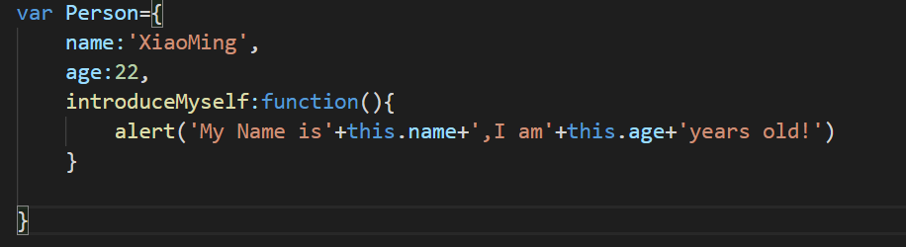
Javascript对象

Slide 3
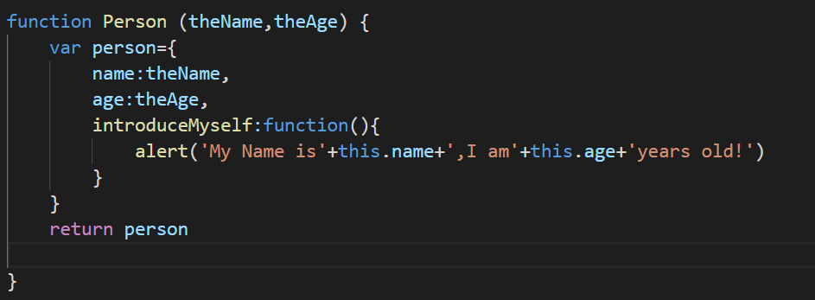

Javascript的“类”—工厂模式

Slide 4


Javascript的“类”—工厂模式
弊端：1、资源浪费
2、实例对象间缺乏内在联系
xiaoMing
xiaoQiang
name:’xiaoming’
name:’xiaoqiang’
age:22
age:23
introduceSelf:F...
introduceSelf:F...
=!

Slide 5
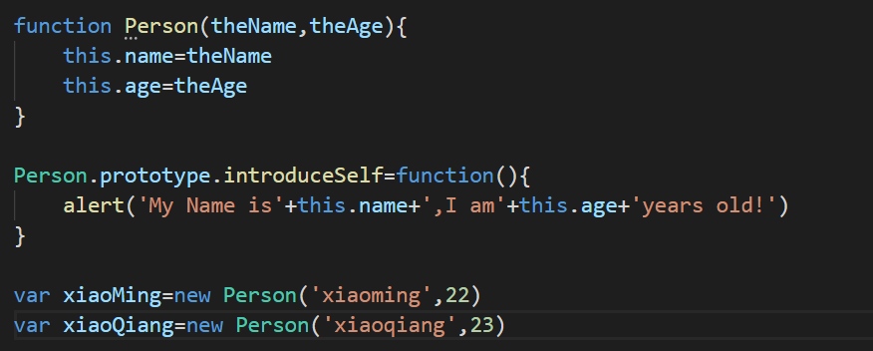
Javascript的“类”—原型

Slide 6
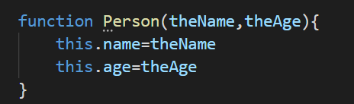
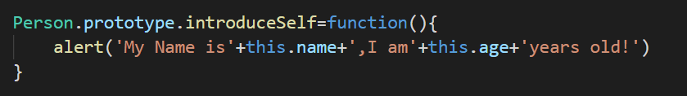

Javascript的“类”—原型
Person
Person.prototype
prototype
Constructor
introduceSelf:F...
xiaoQiang
xiaoMing
name:’xiaoqiang’
name:’xiaoming’
age:23
age:22
_proto_
_proto_

Slide 7
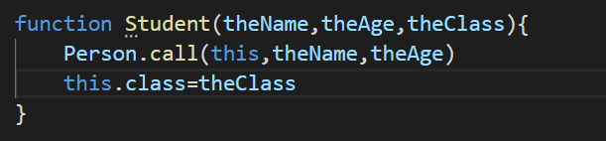

Javascript实现继承
Person
Person.prototype
prototype
Constructor
introduceSelf:F...
Student
Student.prototype
prototype
Constructor
_proto_
xiaoMing
name:’xiaoming’
_proto_
age:22
grade:’senior’

Slide 8

Javascript实现继承
Person
Person.prototype
prototype
Constructor
introduceSelf:F...
Student
Student.prototype
prototype
Constructor
_proto_
xiaoMing
name:’xiaoming’
_proto_
age:22
grade:’senior’

Slide 9
Javascript实现多态
Person
Person.prototype
prototype
Constructor
introduceSelf:F...
Student
Student.prototype
prototype
Constructor
_proto_
introduceSelf:F...

Slide 10
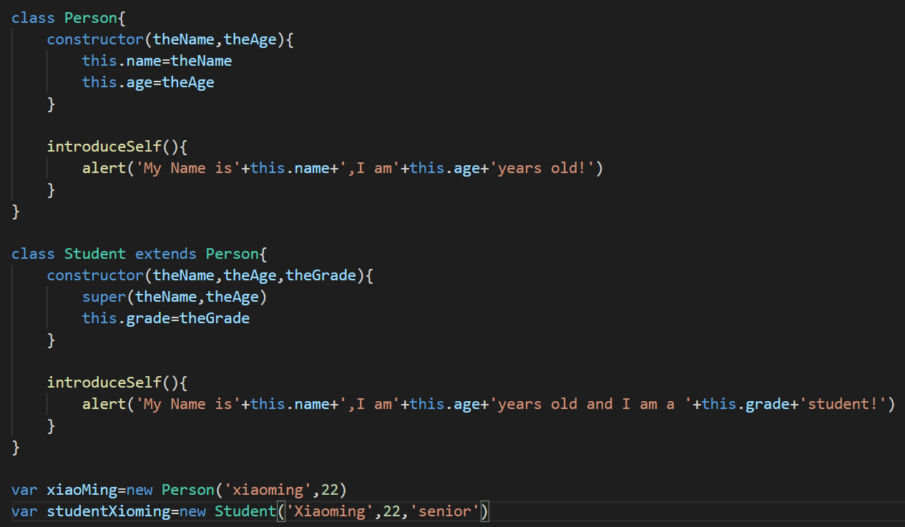
ES6新语法

