Slide 1

DL_FinalProject
Kidney Cancer
Group 6:
111522065 張文彥
112582006 林亭延
113522133 王昱翔
113526017 呂昀叡

Slide 2
CONTENTS
01
The purpose of model training
02
Data preprocessing
03
Selection and definition of the model architecture
04
Training results and presentation
05
Q&A

Slide 3

01
PART
The purpose of model training

Slide 4
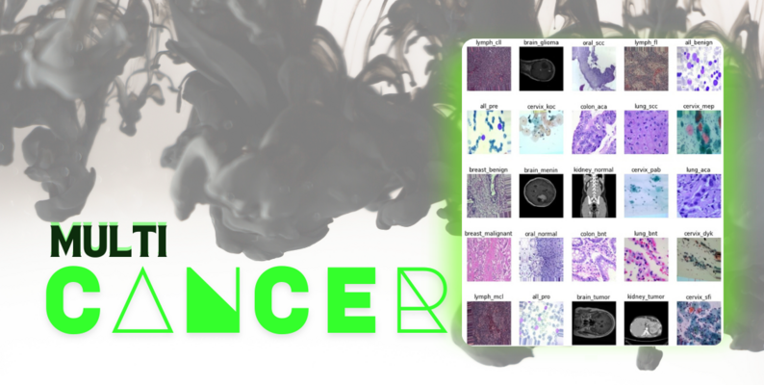
The purpose of model training
Introduction
The Multi-Cancer dataset provides a comprehensive resource for analyzing patterns across eight different cancer types, enabling researchers to uncover insights into cancer biology, early detection, and personalized treatment strategies.
01
Objective
02
Significance
Analyze and compare data across eight cancer types to identify unique patterns in kidney cancer.
Develop predictive models based on patients' X-ray images to detect the presence of tumors, enhancing early detection and improving patient outcomes.
Enhance early diagnosis of kidney cancer, significantly improving survival rates and quality of life.
Drive advancements in personalized medicine by identifying unique genetic and molecular markers.
Notes:
Introduction：
多癌症數據集為分析八種不同癌症類型的模式提供了全面的資源，讓研究人員能夠深入了解癌症生物學、早期檢測以及個性化治療策略。 Objective： 分析並比較八種癌症類型的數據，以識別腎癌中的獨特模式。
開發基於患者X光圖片的預測模型來檢測腫瘤的存在，以加強早期檢測並改善患者治療效果。
Significance： 加強腎癌的早期診斷，顯著提高生存率並改善生活品質。
透過識別獨特的基因和分子標記，推動個人化醫療的進展。

Slide 5
Dataset Overview
Data Source:
https://www.kaggle.com/datasets/obulisainaren/multi-cancer
Dataset includes:
8 Types of Cancer Images
→We selected the kidney cancer dataset as the target for training.

Slide 6
02
PART
Data preprocessing

Slide 7
Data preprocessing
Normalization and Label Encoding
Data Splitting
Step 1
Step 2
Step 3
Step 4
Step 5
Image Loading and Resizing
Shuffling the Data
Data Visualization
Notes:
1. Image Loading and Resizing
2. Normalization and Label Encoding
3. Shuffling the Data
4. Data Splitting
5. Data Visualization

Slide 8

Image Loading and Resizing
Images are read using OpenCV (cv2), a powerful library for image processing.
Each image is resized to a fixed size of 128x128 pixels to ensure uniformity and compatibility with the model's input requirements.
The processed image data is stored in X, while the corresponding labels are stored in y.
Notes:
使用 OpenCV (cv2) 這個強大的圖像處理庫來讀取圖片。 每張圖片都被調整為固定的 128x128 像素大小，以確保一致性並符合模型的輸入需求。 處理後的圖片數據儲存在 X 中，而對應的標籤則儲存在 y 中。

Slide 9
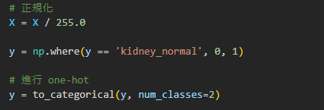
Normalization and Label Encoding
Normalization:
The pixel values of the images are scaled from the range [0, 255] to [0, 1]. This helps in reducing computation complexity and improving the training stability of the model.
Neural networks perform better with normalized inputs as it ensures uniformity and avoids potential biases caused by large pixel values.
Label Encoding:
Text labels ("kidney_normal" and "kidney_tumor") are mapped to numerical values (0 and 1) for machine readability.
One-hot encoding is applied to convert these numerical labels into binary vector form ([1, 0] for normal, [0, 1] for tumor.
Notes:
正規化： 將圖片的像素值從範圍 [0, 255] 縮放至 [0, 1]。這有助於降低計算複雜度並提高模型訓練的穩定性。
對於神經網路而言，正規化的輸入能確保數據的一致性，並避免因像素值過大而導致潛在偏差。
標籤編碼： 將文字標籤（"kidney_normal" 和 "kidney_tumor"）映射為數值（0 和 1），以供機器識別。 接著，應用獨熱編碼（One-hot Encoding）將這些數值標籤轉換為二元向量形式（正常：[1, 0]，腫瘤：[0, 1]）。這對於多類別分類任務至關重要。

Slide 10

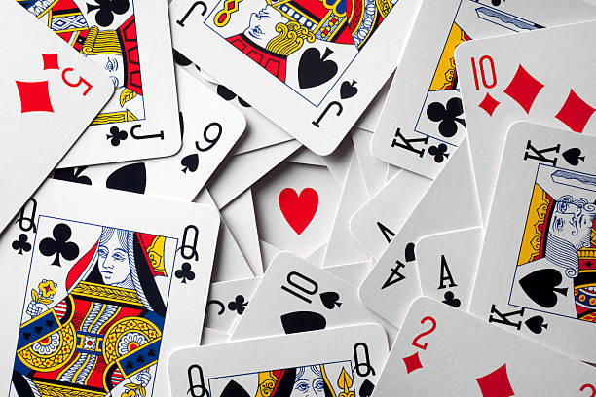
Shuffling the Data
The dataset is shuffled using the shuffle function, which randomly rearranges the order of images (X) and their corresponding labels (y). This ensures that the distribution of data is not influenced by the order in which it was loaded.
Code：
A random_state is set for reproducibility, ensuring that the shuffle produces consistent results across runs.
Notes:
使用 shuffle 函數對數據集進行隨機重排，將圖片（X）及其對應的標籤（y）打亂順序。這樣可以確保數據的分布不會受到加載順序的影響。
設置 random_state 參數以確保結果的可重現性，使得每次執行打亂操作時都能產生一致的結果。

Slide 11
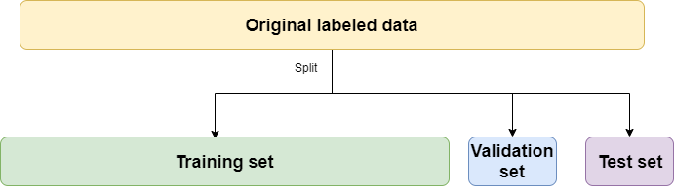
Normalization and Label Encoding
Training Set:
70% of the data is used for training the model, allowing it to learn patterns from the images and labels.
Validation Set:
15% of the data is used to tune hyperparameters and evaluate model performance during training.
Testing Set:
The remaining 15% is reserved for final evaluation to measure how well the model generalizes to unseen data.
70%
15%
15%
Notes:
訓練集： 70% 的數據用於訓練模型，讓模型從圖片和標籤中學習模式。
驗證集： 15% 的數據用於調整超參數，並在訓練過程中評估模型性能。
測試集： 剩下的 15% 用於最終評估，測量模型對未見數據的泛化能力。

Slide 12
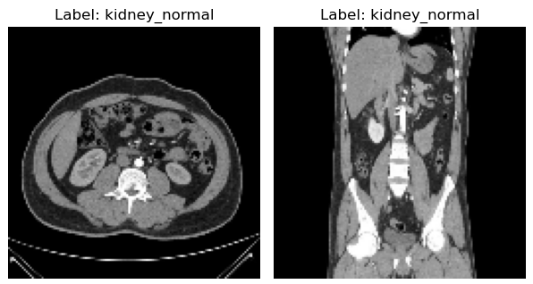
Data Visualization
A subset of the dataset is visualized to inspect the correctness and integrity of the data after preprocessing.
Images are displayed using Matplotlib, showing the raw image along with its corresponding label.
This step helps verify that the images are resized correctly and the labels match the corresponding images.
label
128 pixels
128 pixels
Notes:
對數據集的一部分進行視覺化，以檢查數據在預處理後的正確性和完整性。 使用 Matplotlib 顯示圖片，呈現原始圖像及其對應的標籤。 此步驟有助於確認圖片已正確調整大小，且標籤與圖片匹配。

Slide 13
03
PART
Selection and definition of the model architecture

Slide 14


Model Selection：ResNet50
Why Choose ResNet50?
Handles Complex Features:
ResNet50’s deep architecture effectively captures intricate patterns in medical images, crucial for distinguishing kidney tumors from normal tissue.
Pre-trained Efficiency:
Leveraging ImageNet weights accelerates training and improves performance, especially with limited data in this dataset.
Optimized Performance:
ResNet50 balances accuracy and computational cost, making it suitable for kidney cancer classification tasks.
Notes:
為什麼選擇 ResNet50？
處理複雜特徵 ResNet50 的深度架構能有效捕捉醫學圖像中的複雜模式，這對於區分腎腫瘤和正常組織至關重要。
預訓練的高效性 利用 ImageNet 的預訓練權重加速訓練，並在數據集有限的情況下提升模型性能。
優化的效能 ResNet50 在準確率和計算成本之間取得平衡，使其成為腎癌分類任務的理想選擇。

Slide 15
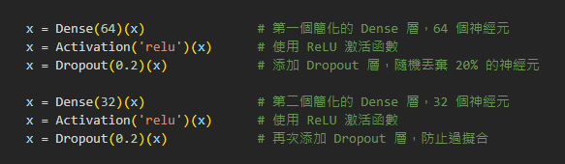
Avoid Overfitting
Dropout Layers: Introduced after each dense layer to randomly drop 20% of neurons, enhancing generalization by preventing reliance on specific neurons.
Simplified Dense Layers: The fully connected layers are kept minimal (64 and 32 neurons), reducing the model's complexity to better fit the limited dataset.
Frozen Pre-trained Layers: The ResNet50 base layers are frozen, reducing the risk of overfitting on the small dataset by utilizing pre-learned features from ImageNet.
Notes:
Avoid Overfitting 隨機失活層 (Dropout Layers)： 在每個全連接層後加入隨機失活層，隨機丟棄 20% 的神經元，通過防止模型依賴特定神經元來增強泛化能力。
凍結預訓練層： 凍結 ResNet50 的基礎層，利用 ImageNet 的預學習特徵，降低在小數據集上過擬合的風險。
簡化全連接層： 全連接層設置為簡化結構（64 和 32 個神經元），降低模型的複雜性，使其更適合有限的數據集。

Slide 16
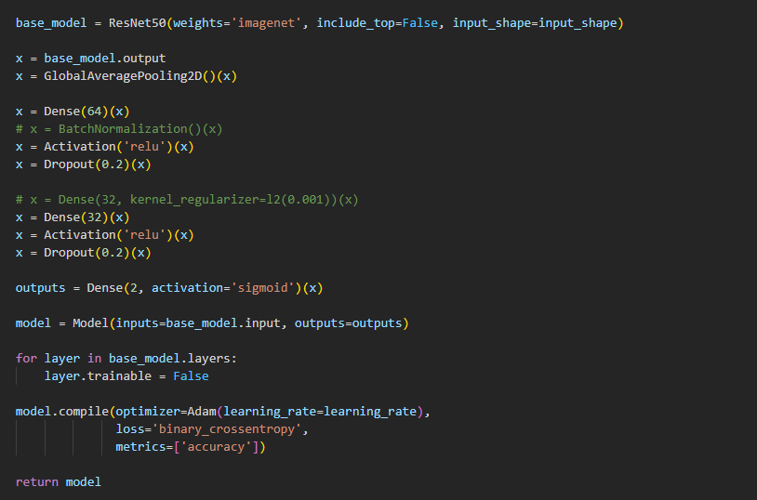
Optimizing Training Efficiency
Loading ImageNet pre-trained weights enables the model to quickly extract image features, avoiding the need to train all layers from scratch.
Freezing all the base convolutional layers of ResNet50 ensures that only the newly added dense layers are trained, preventing redundant optimization of already learned general features.
The Adam optimizer, an adaptive learning rate algorithm, dynamically adjusts the learning rate based on gradient changes.
Notes:
Optimizing Training Efficiency 加載 ImageNet 預訓練權重，使模型能快速提取影像特徵，避免從零開始訓練所有層。 冻结 ResNet50 的所有基础卷积层，仅训练新增的全连接层。这避免了重复优化已学到的通用特征。 Adam 优化器 是自适应学习率优化算法，可以根据梯度变化动态调整学习率。

Slide 17
04
PART
Training Results and Presentation

Slide 18
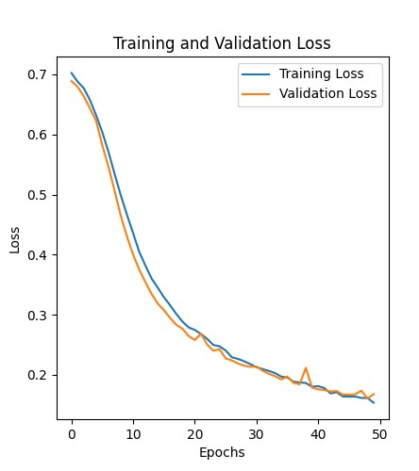
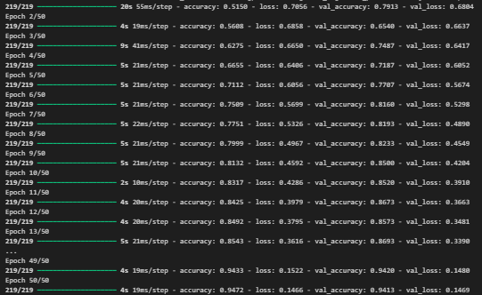
Training Results
The train loss effectively decreases through training.

Slide 19
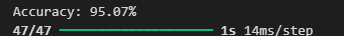
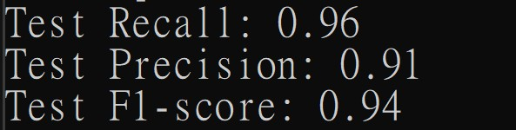
Training Results
1. Accuracy: 95.07%
In the test dataset, the model achieved an accuracy of 95.07%, indicating that its overall predictions for distinguishing between normal and tumor kidney samples are highly accurate.
2. Recall: 0.96(96%)
A high recall suggests that the model effectively identifies tumor samples, with very few tumor cases missed (False Negatives).
2. Precision: 0.91(91%)
A high precision indicates that the model rarely misclassifies normal samples as tumors (False Positives).
4. F1-Score: 0.94(94%)
An F1 score close to 1 demonstrates that the model strikes a good balance between precision and recall.
Notes:
準確率 (Accuracy)：95.07% 在測試數據集中，模型的準確率達到 95.07%，表明其在區分正常和腫瘤腎樣本的整體預測上具有很高的準確性。
精確率 (Precision)：95.07% 較高的精確率表明模型很少將正常樣本錯誤分類為腫瘤（假陽性）。
召回率 (Recall)：95.07% 較高的召回率顯示模型能有效識別腫瘤樣本，漏檢腫瘤病例（假陰性）的情況非常少。
F1-分數 (F1-Score)：0.95 接近 1 的 F1 分數表明模型在精確率與召回率之間達到良好的平衡。

Slide 20
05
PART
Q&A

Slide 21
THANKS

