Slide 1
GROUP 8
Group Members
Deng Lual - Sct221-0458/2020
Faiso Abdirisak – Sct221-0673/2022
Epiphany Kiruri – Sct221-0603/2021
Samuel Kanyi – 0666/2021
Nasra Kassim – Sct221-0732/2021

Slide 2
Ingesting data into hadoop
Prepare Data: Organize and clean data for ingestion.
Set Up Hadoop Cluster: Install Hadoop and configure HDFS.
Choose Ingestion Method: Select the appropriate method (e.g., Hadoop CLI, Sqoop, Kafka).
Ingest Data: Execute the chosen method to move data into Hadoop.
Verify Data: Check data presence in HDFS.
Process Data: Use Hadoop or other frameworks for analysis.
Backup & Monitoring: Implement backup and monitor cluster health.
Documentation: Create documentation for reference.

Slide 3
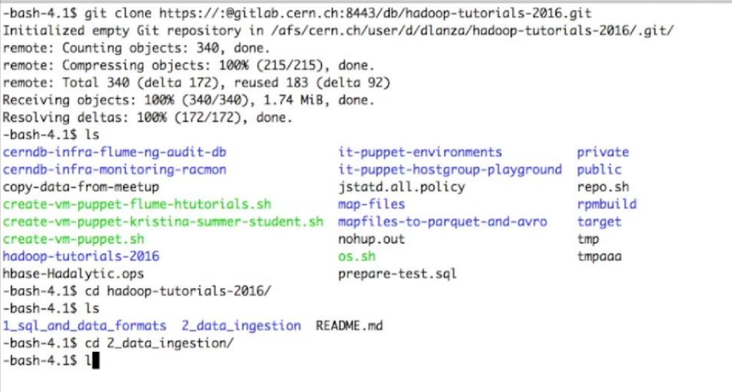

Slide 4
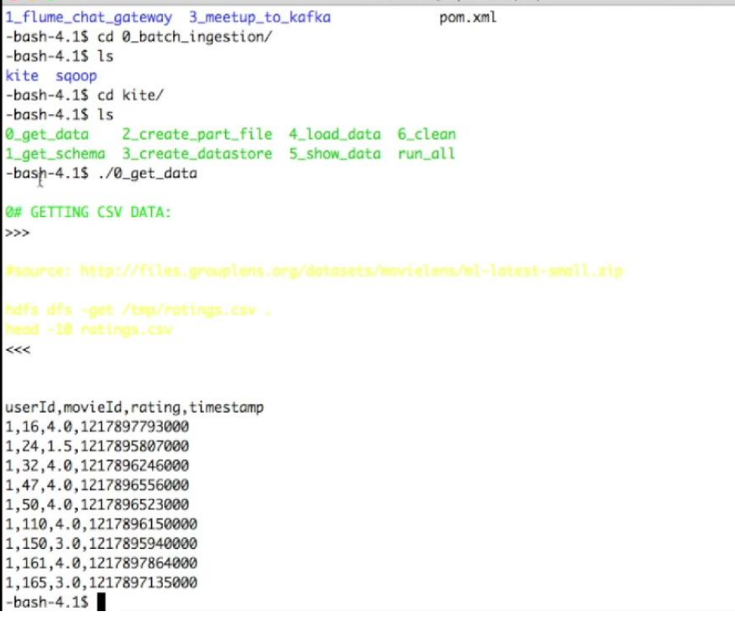

Slide 5
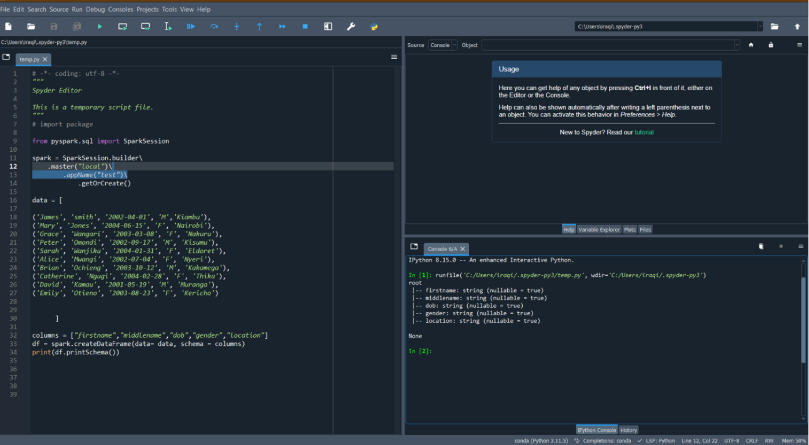

Slide 6
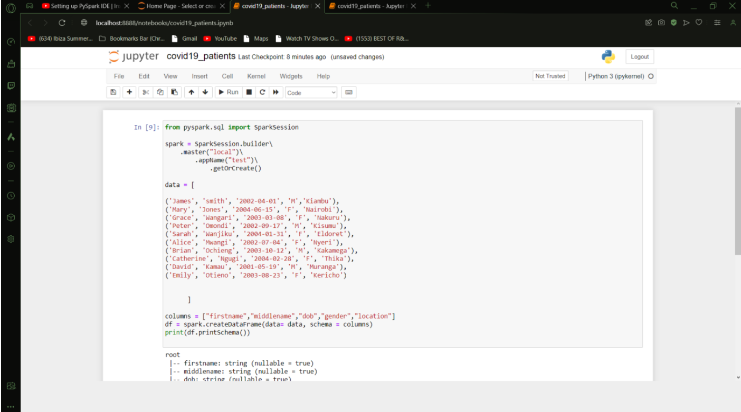

Slide 7
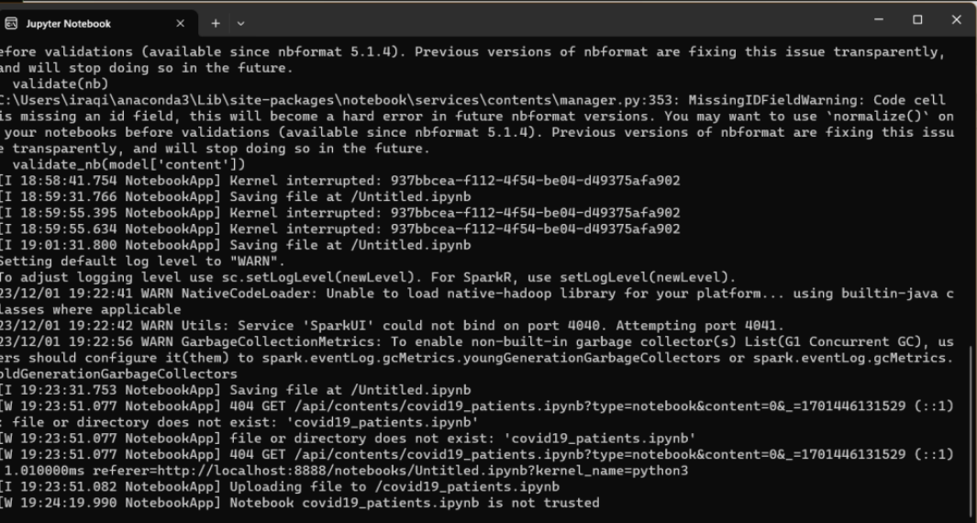

Slide 8
Pre-processing tasks/techniques used to prepare the data:
Handle Missing Data: Use PySpark functions like na.drop() or na.fill() to handle missing values.
Data Cleaning and Transformation: Remove irrelevant columns or rows using PySpark DataFrame operations.
Use functions like filter() or drop(). Feature Engineering: Create new features or modify existing ones based on domain knowledge. Use PySpark DataFrame transformations.
Scaling/Normalization: If your algorithm requires it, use PySpark's StandardScaler or MinMaxScaler for feature scaling.
Reasoning: The choice of pre-processing tasks depends on the characteristics of your data and the requirements of your predictive model. Handling missing data is crucial to avoid biases in your analysis. Data cleaning and transformation ensure that the data is in a suitable format for analysis. Feature engineering enhances the model's ability to capture patterns. Scaling is essential for algorithms sensitive to the scale of features

