Slide 1
MUX Circuit for Electrical Impedance Tomography (EIT) System
Weekly report – W1

Slide 2
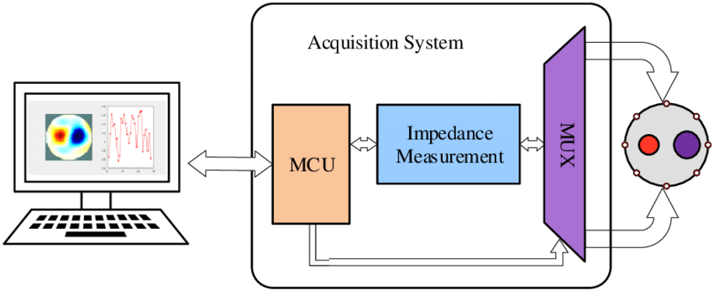
System overview
Fig 1. Block diagram of Electrical impedance tomography (EIT) system (5)
Notes:
Mainly consists of 3 main parts: Acquisition system, phantom, host system
Acquisition system includes an MCU, an impedance measurement module and multiplexer circuit.

Slide 3
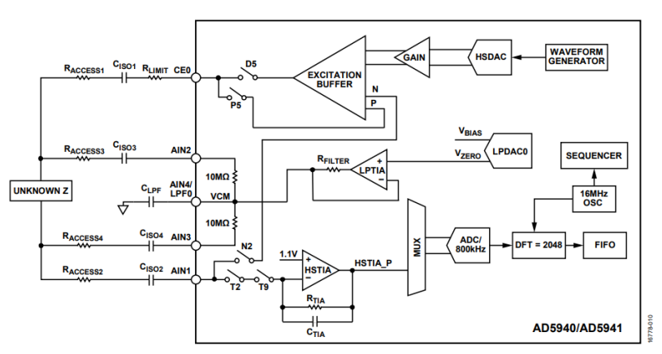
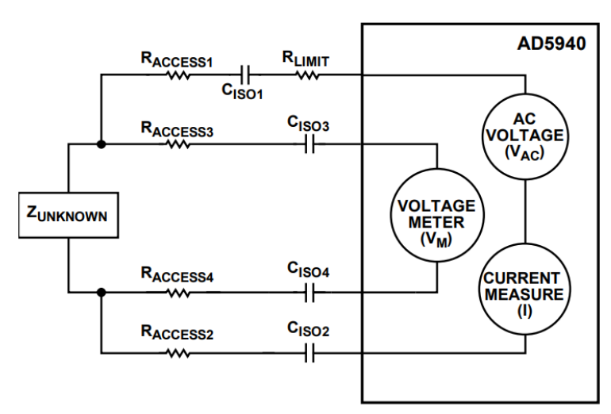
Drive pattern: 4-wire measurement using AD5941

Slide 4
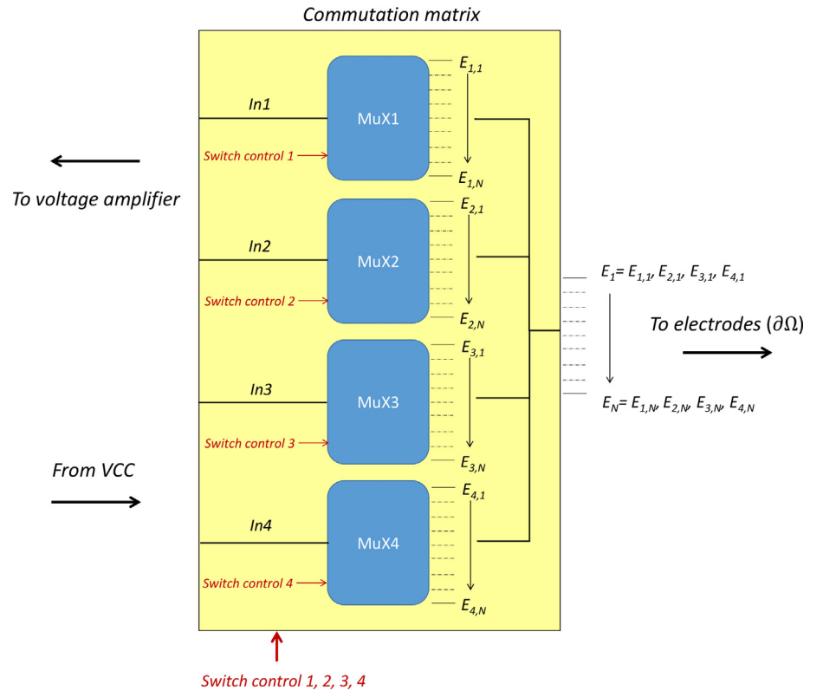
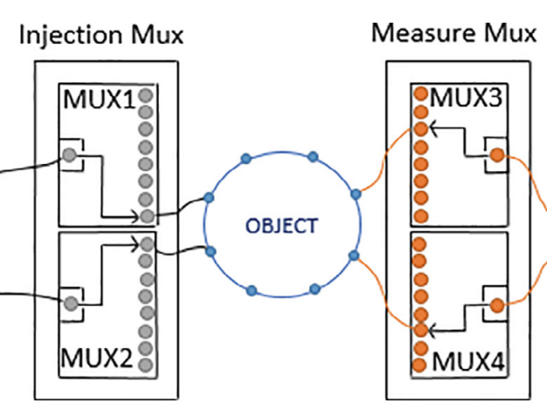
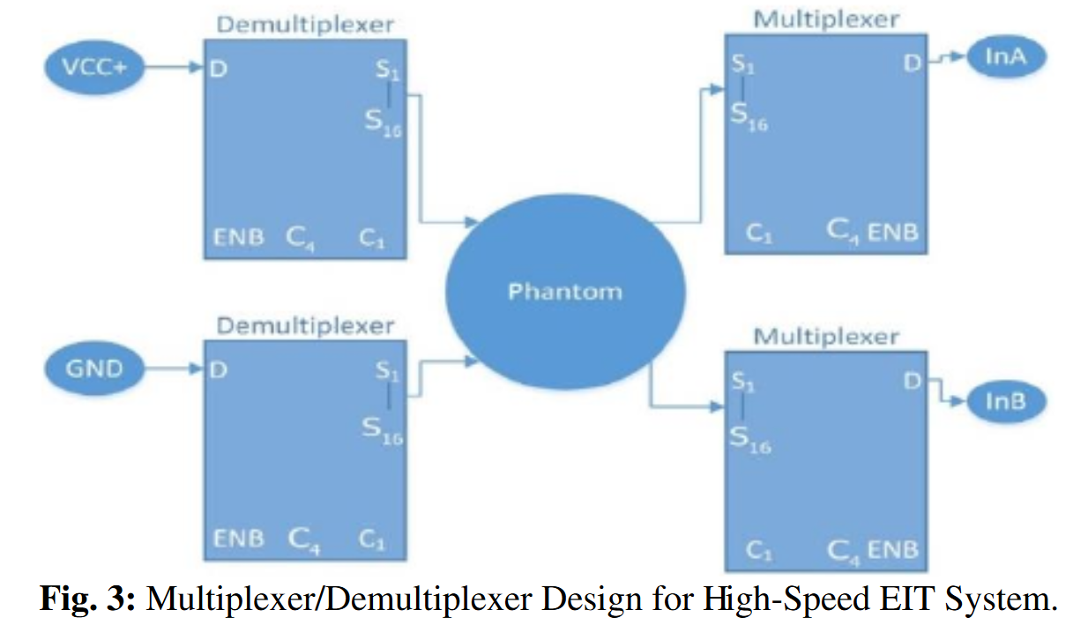
Multiplexer (MUX) circuit
-> Require 4 MUX as analog switches
Controlled by Arduino Mega (1)
74HC4067 – 8 channel
Controlled by Raspberry Pi (2)
ADG506AKNZ – 16 channel
1ms/data -> 4s/measurement
Controlled by Arduino Mega (4)
ADG506AKRZ – 16 channel
Switching time: <1us
Notes:
100us

Slide 5
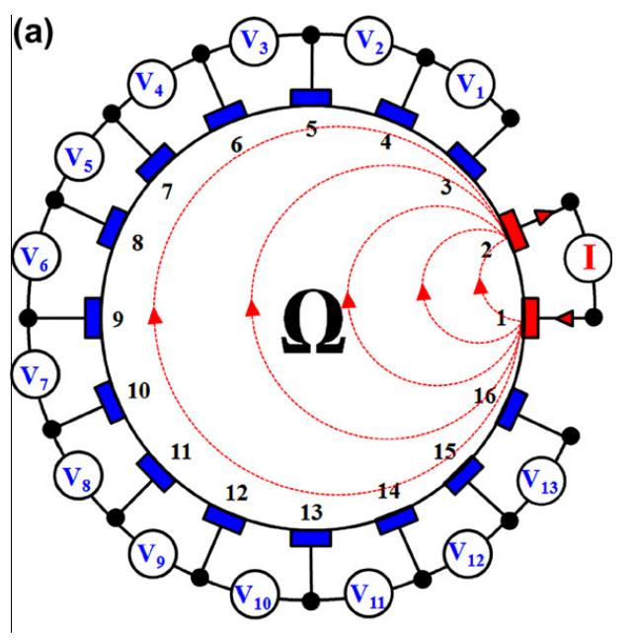
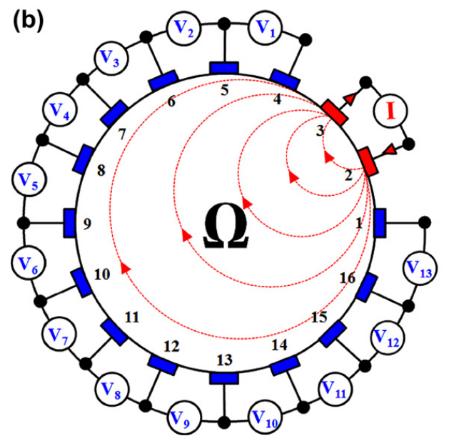
4 Current injection methods - Neighboring
Red: current electrodes
Blue: voltage electrodes
the differential potentials are measured across the different electrodes, excluding the current electrodes
208 voltage measurement
104 independent data

Slide 6
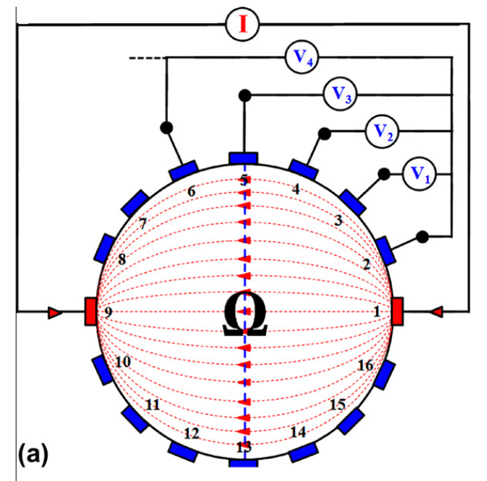
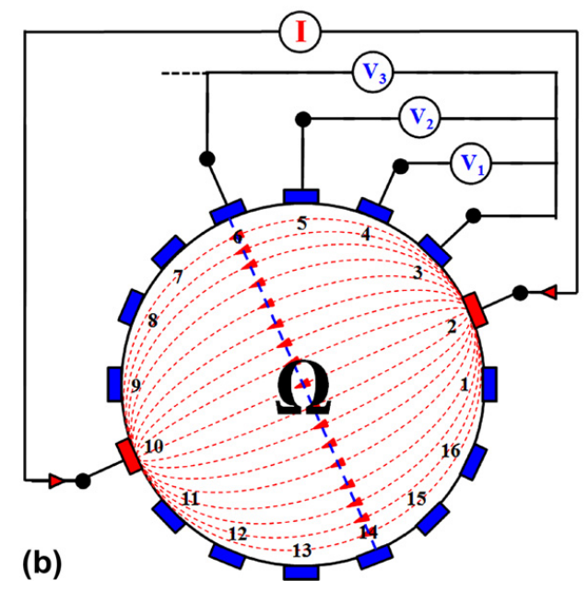
4 Current injection methods - Opposite
Red: current electrodes
Blue: voltage electrodes
Differential potentials are measured on the voltage electrodes with respect to the electrode (called as the voltage reference electrode) adjacent to the current-injecting electrode.
208 voltage measurement
104 independent data
current distribution is more uniform and, therefore, has a good sensitiviy

Slide 7
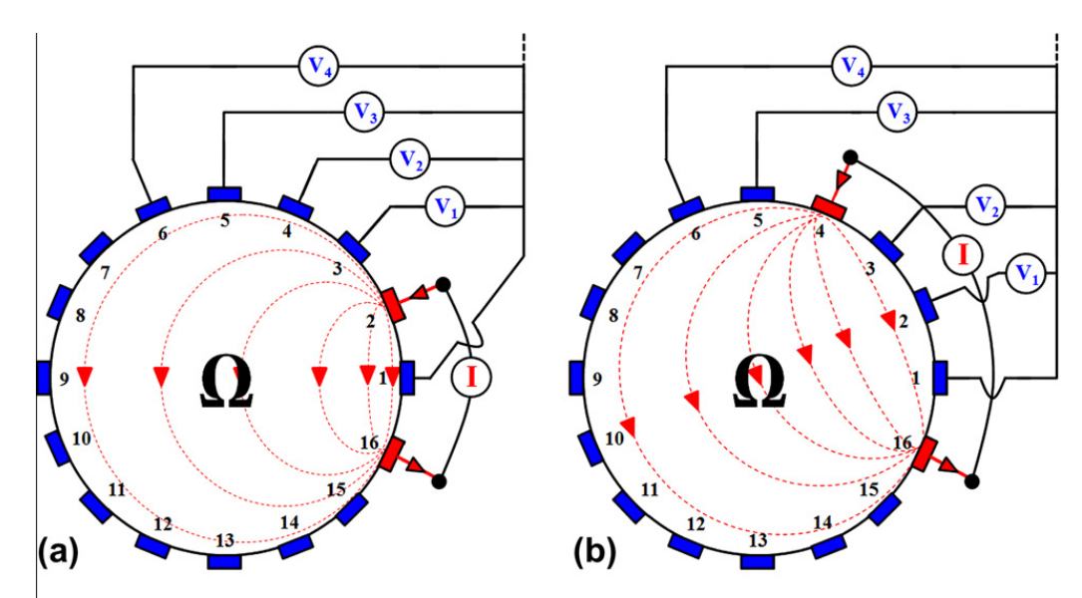
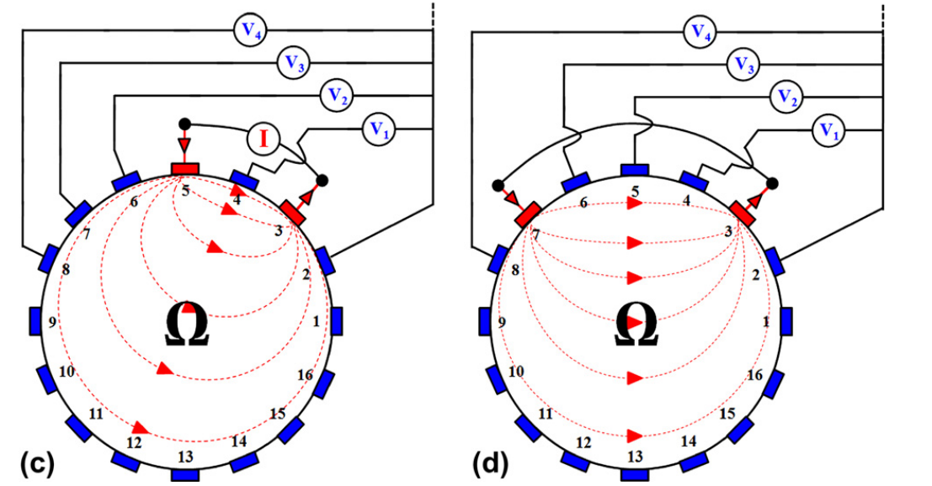
4 Current injection methods - Cross
Red: current electrodes
Blue: voltage electrodes
182 voltage measurement
104 independent data
Does not have as good a sensitivity in the periphery as does the neighboring method, but has better sensitivity over the entire domain under test

Slide 8
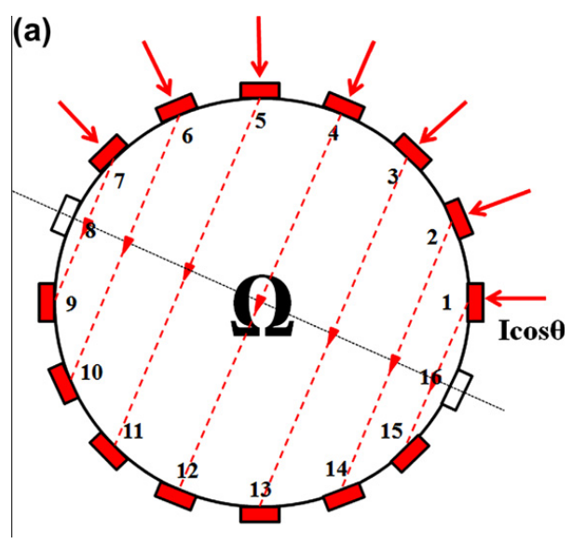
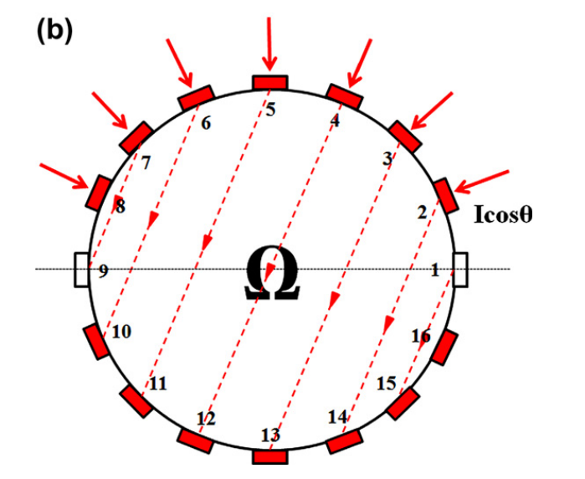
4 Current injection methods - Adaptive
Red: current electrodes
Blue: voltage electrodes
the boundary potentials are measured with respect to a single grounded electrode
102 independent data

Slide 9
Future planning
Research more about the speed for data acquisition -> to select MUX and MCU to control the MUX

Slide 10
Reference
https://www.sciencedirect.com/science/article/pii/S2468067222000190
(PDF) Design of low-cost and high-speed portable two-dimensional electrical impedance tomography (EIT) (researchgate.net)
Studying the resistivity imaging of chicken tissue phantoms with different current patterns in Electrical Impedance Tomography (EIT) – ScienceDirect
An open-source and easily replicable hardware for Electrical Impedance Tomography – ScienceDirect
Deep learning scheme PSPNet for electrical impedance tomography (researchgate.net)

Slide 11
Microcontroller - Requirement
Have enough GPIO pins to control 4 muxes
Each mux requires 4 control pins (INH, A, B, C) -> Require at least 16 pins + 2 pins for I2C communication
Have I2C communication
Low-cost
Notes:
Toc do i2c

