Slide 1
MUX Circuit for Electrical Impedance Tomography (EIT) System
Weekly report – W3

Slide 2
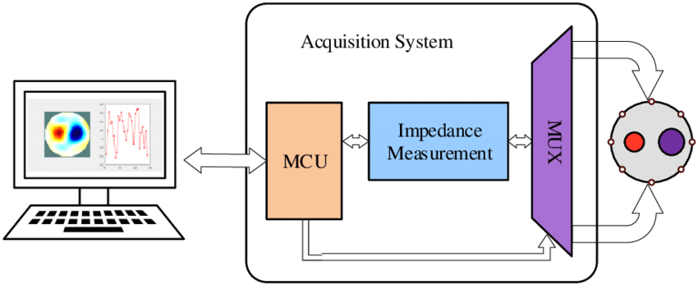
System overview
Fig 1. Block diagram of Electrical impedance tomography (EIT) system (5)
Notes:
Mainly consists of 3 main parts: Acquisition system, phantom, host system
Acquisition system includes an MCU, an impedance measurement module and multiplexer circuit.

Slide 3
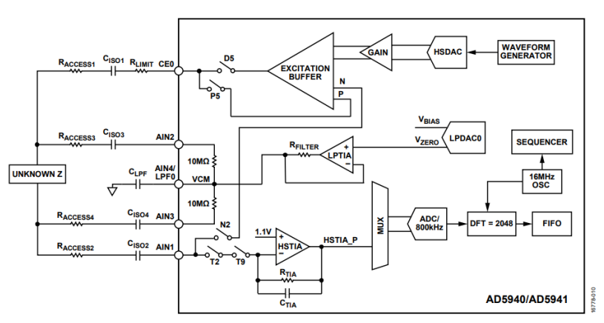
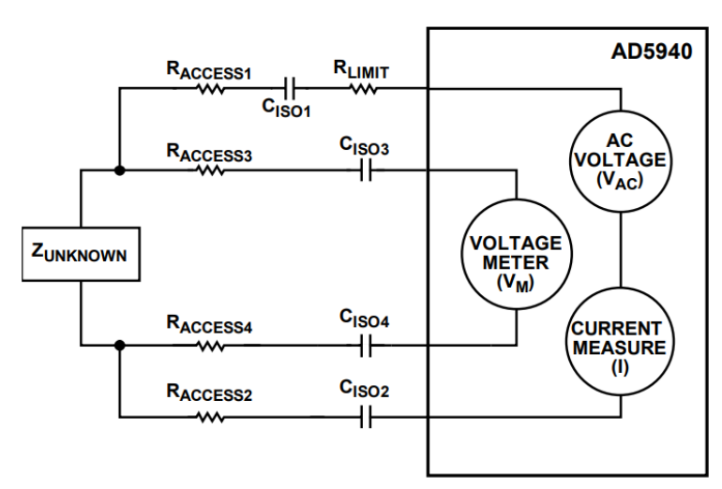
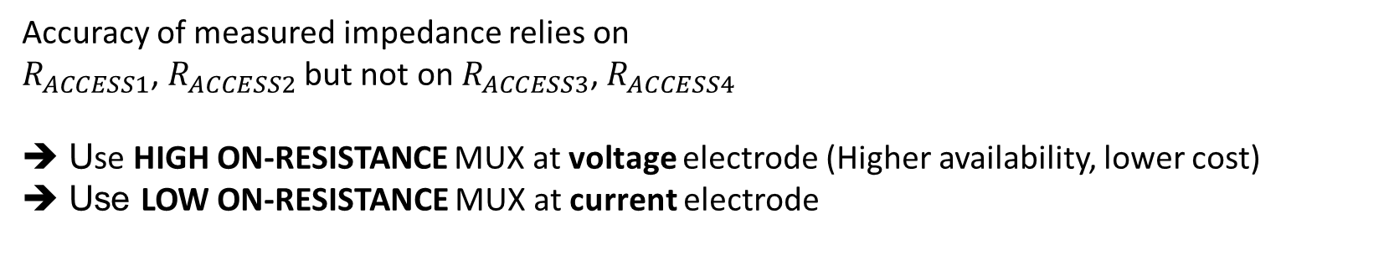
Drive pattern: 4-wire measurement using AD5941
Accuracy of measured impedance relies on
$R_{ACCESS1}$, $R_{ACCESS2}$ but not on $R_{ACCESS3}$, $R_{ACCESS4}$
Use HIGH ON-RESISTANCE MUX at voltage electrode (Higher availability, lower cost)
Use LOW ON-RESISTANCE MUX at current electrode

Slide 4
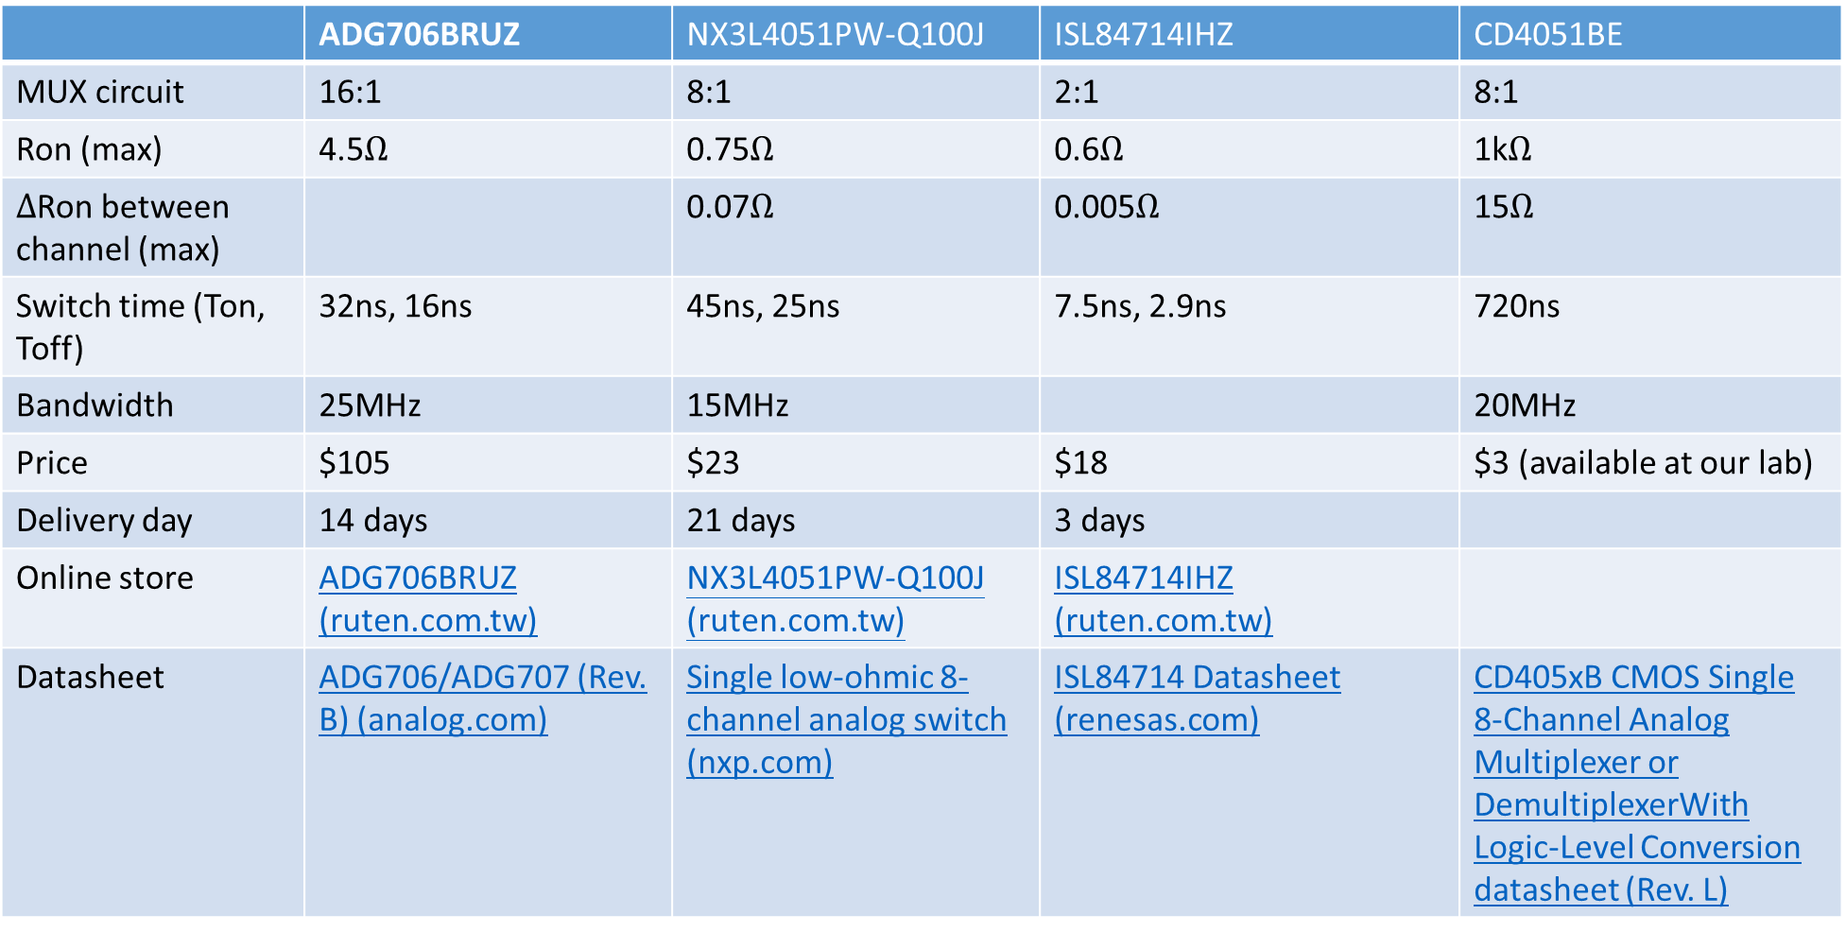
Market research
 | ADG706BRUZ | NX3L4051PW-Q100J | ISL84714IHZ | CD4051BE
MUX circuit | 16:1 | 8:1 | 2:1 | 8:1
Ron (max) | 4.5$Ω$ | 0.75$Ω$ | 0.6$Ω$ | 1k$Ω$
$Δ$Ron between channel (max) |  | 0.07$Ω$ | 0.005$Ω$ | 15$Ω$
Switch time (Ton, Toff) | 32ns, 16ns | 45ns, 25ns | 7.5ns, 2.9ns | 720ns
Bandwidth | 25MHz | 15MHz |  | 20MHz
Price | $105 | $23 | $18 | $3 (available at our lab)
Delivery day | 14 days | 21 days | 3 days
Online store | ADG706BRUZ (ruten.com.tw) | NX3L4051PW-Q100J (ruten.com.tw) | ISL84714IHZ (ruten.com.tw)
Datasheet | ADG706/ADG707 (Rev. B) (analog.com) | Single low-ohmic 8-channel analog switch (nxp.com) | ISL84714 Datasheet (renesas.com) | CD405xB CMOS Single 8-Channel Analog Multiplexer or DemultiplexerWith Logic-Level Conversion datasheet (Rev. L)

Slide 5
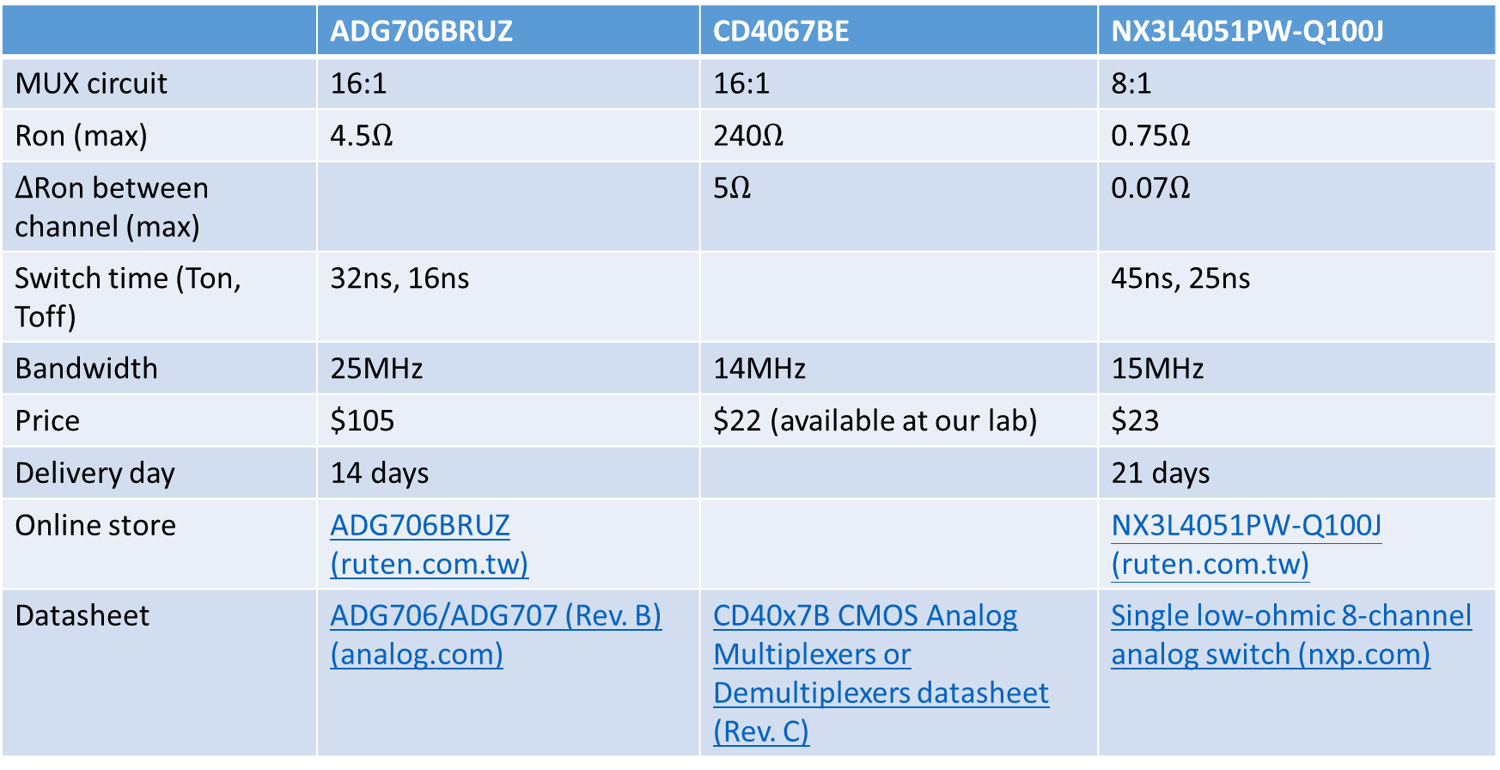
Market research
 | ADG706BRUZ | CD4067BE | NX3L4051PW-Q100J
MUX circuit | 16:1 | 16:1 | 8:1
Ron (max) | 4.5$Ω$ | 240$Ω$ | 0.75$Ω$
$Δ$Ron between channel (max) |  | 5$Ω$ | 0.07$Ω$
Switch time (Ton, Toff) | 32ns, 16ns |  | 45ns, 25ns
Bandwidth | 25MHz | 14MHz | 15MHz
Price | $105 | $22 (available at our lab) | $23
Delivery day | 14 days |  | 21 days
Online store | ADG706BRUZ (ruten.com.tw) |  | NX3L4051PW-Q100J (ruten.com.tw)
Datasheet | ADG706/ADG707 (Rev. B) (analog.com) | CD40x7B CMOS Analog Multiplexers or Demultiplexers datasheet (Rev. C) | Single low-ohmic 8-channel analog switch (nxp.com)

Slide 6
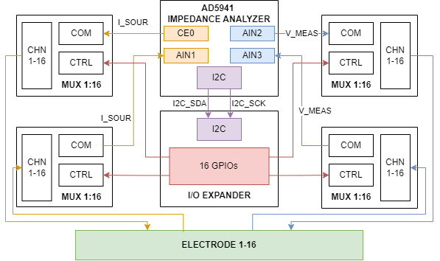
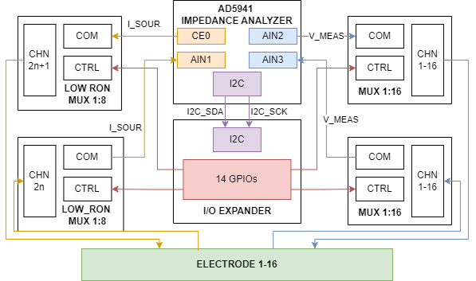
Proposed design: 16-electrode EIT system
Common MUX solution:
4 1:16 mux
Neighboring method [1,2,3]
Proposed MUX solution:
2 1:16 mux, 2 low Ron 1:8 mux
Cross method, combine both neighboring and opposite method

Slide 7
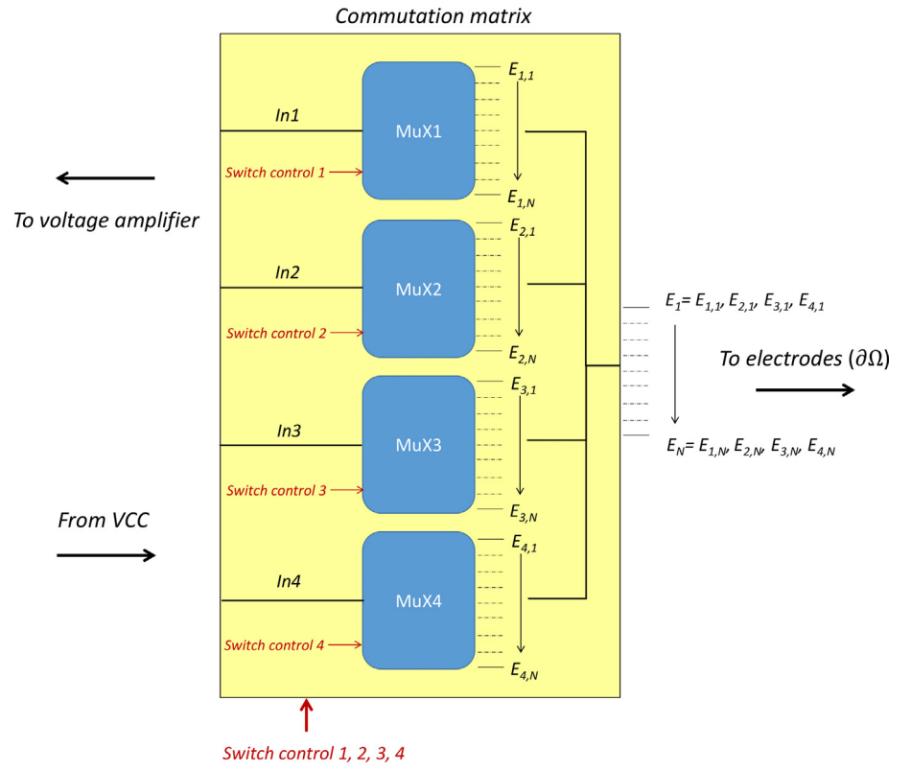
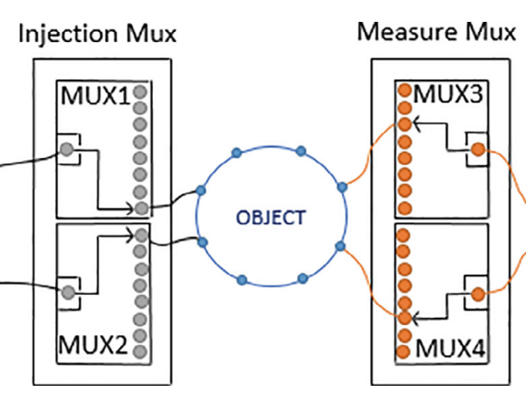
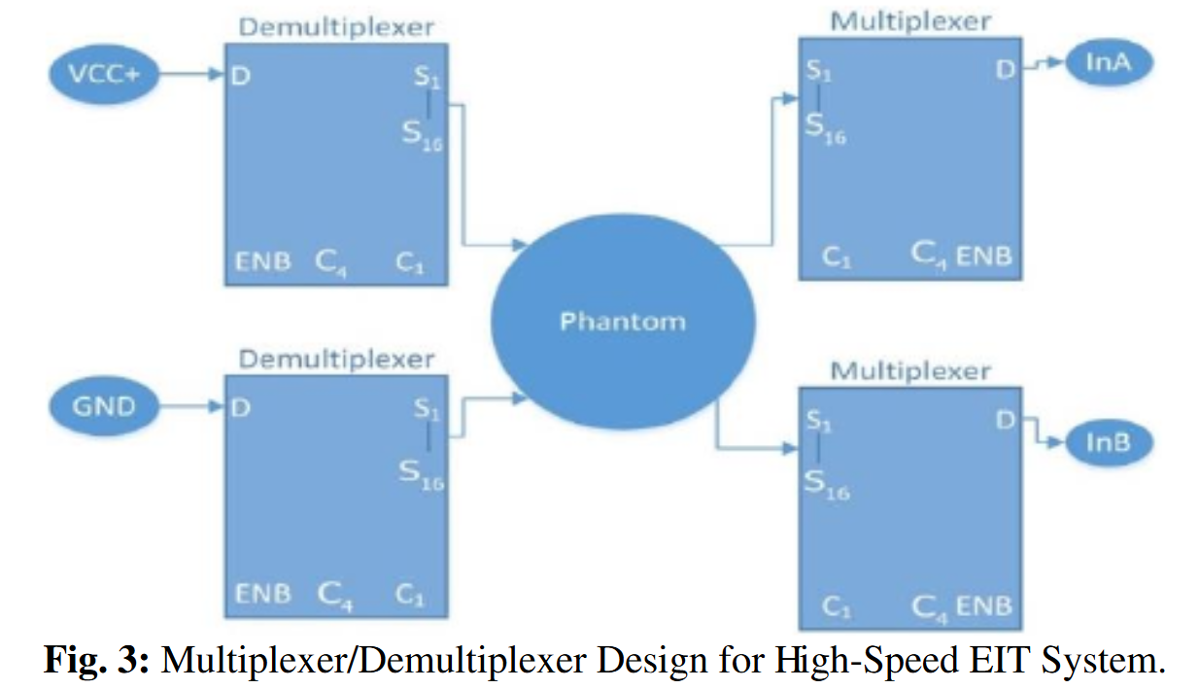
Multiplexer (MUX) circuit
-> Require 4 MUX as analog switches
Controlled by Arduino Mega (1)
74HC4067 – 8 channel
Controlled by Raspberry Pi (2)
ADG506AKNZ – 16 channel
1ms/data -> 4s/measurement
Controlled by Arduino Mega (4)
ADG506AKRZ – 16 channel
Switching time: <1us
Notes:
100us

Slide 8
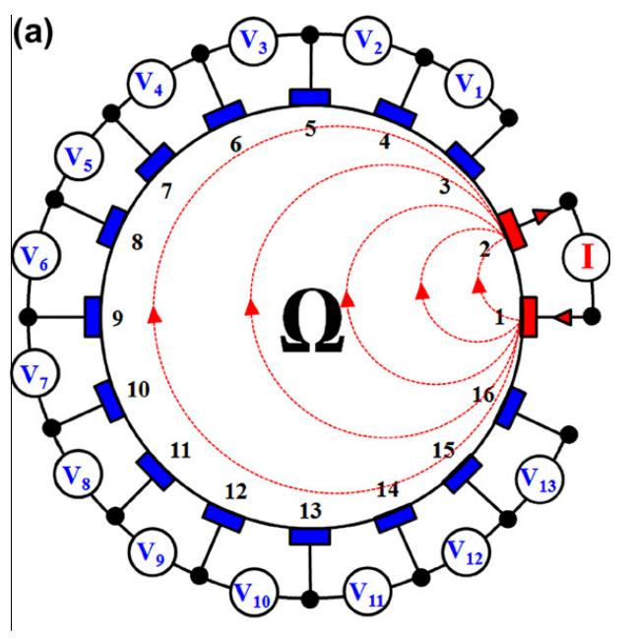
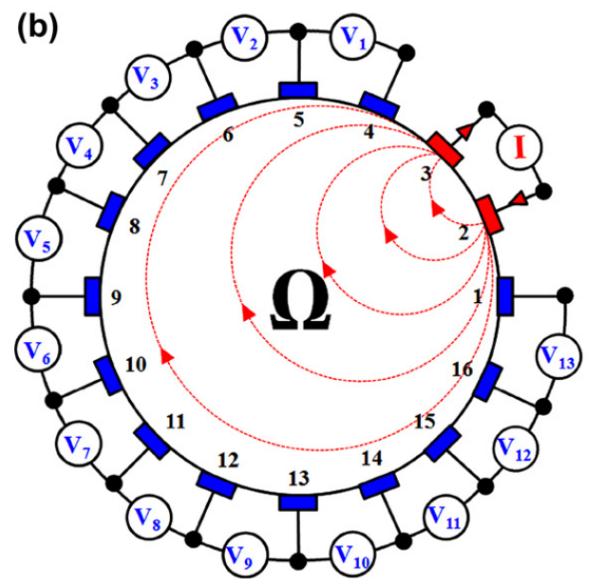
Current injection – Neighboring method
Red: current electrodes
Blue: voltage electrodes
the differential potentials are measured across the different electrodes, excluding the current electrodes
208 voltage measurement
104 independent data

Slide 9
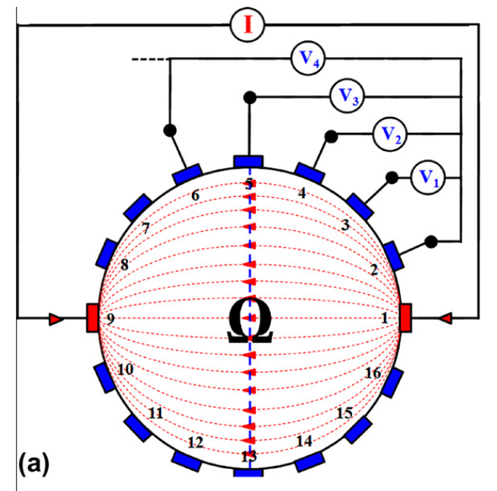
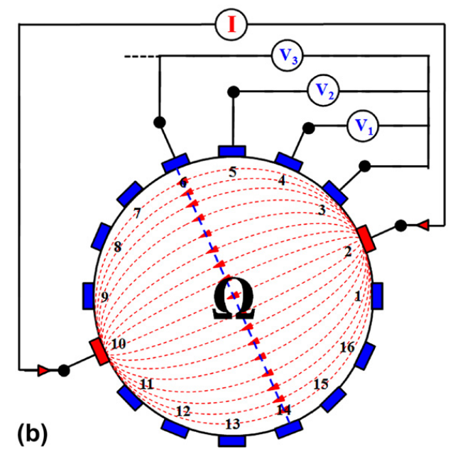
Current injection – Opposite method
Red: current electrodes
Blue: voltage electrodes
Differential potentials are measured on the voltage electrodes with respect to the electrode (called as the voltage reference electrode) adjacent to the current-injecting electrode.
208 voltage measurement
104 independent data
current distribution is more uniform and, therefore, has a good sensitivity

Slide 10
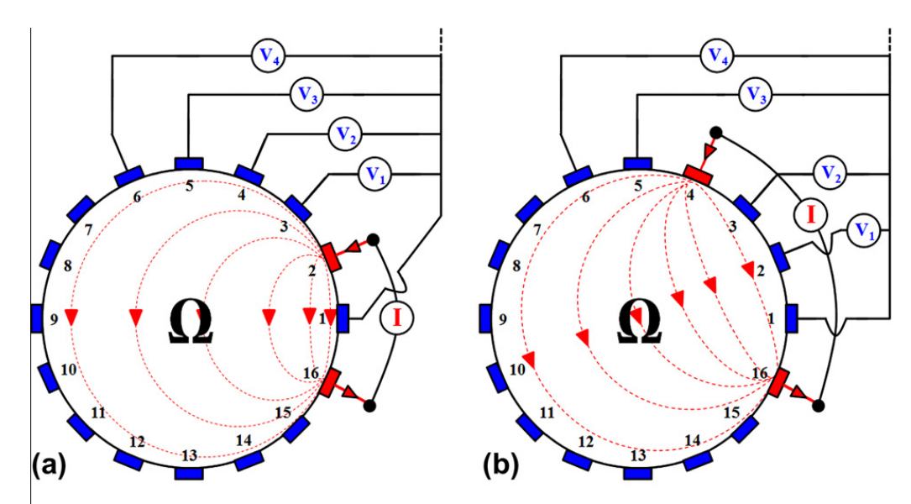
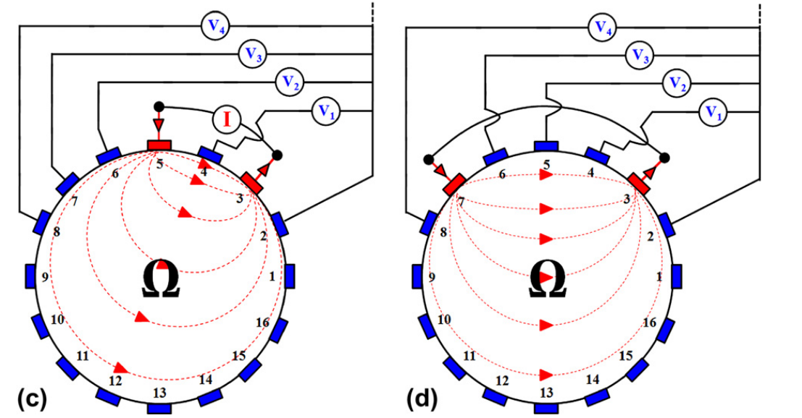
Current injection – Cross method
Adjacent electrodes E16 and E1 are first selected for current and voltage reference electrodes. The 13 voltage data are measured successively for all other 13 electrodes starting from E3. The next 13 voltage data are obtained by injecting by injecting the positive current through E4, keeping E16 as the current reference. The cycle repeats with E3 and E2 as current and voltage reference electrodes.
Red: current electrodes
Blue: voltage electrodes
182 voltage measurement
104 independent data
Does not have as good a sensitivity in the periphery as does the neighboring method, but has better sensitivity over the entire domain under test

Slide 11
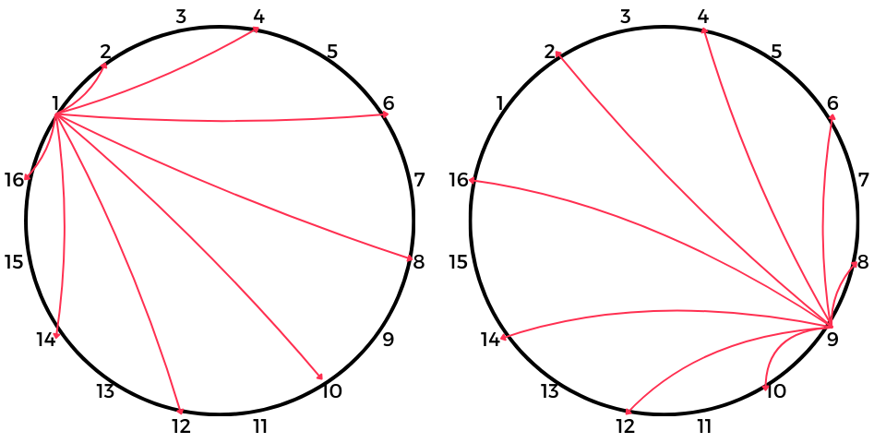
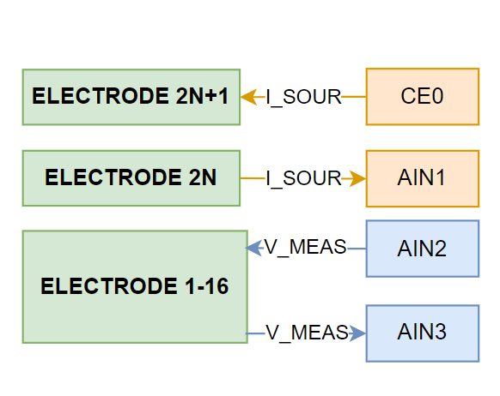
Current injection – Another cross method
Red: current electrodes
Odd-number electrodes are selected for the positive current-injecting electrode (CE0) while even-number electrodes are selected for the negative current-injecting electrode (AIN1). This method requires two 1:8 mux to drive the current electrodes, unlike other method with two 1:16 mux.
8 x 16 x 13 = 1664 voltage measurement
Good sensitivity measuring peripheral impedance
Uniform current distribution

Slide 12
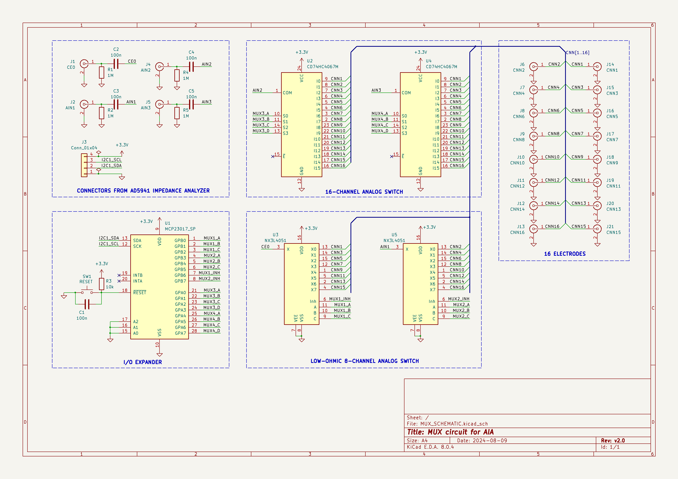
Proposed schematics

Slide 13
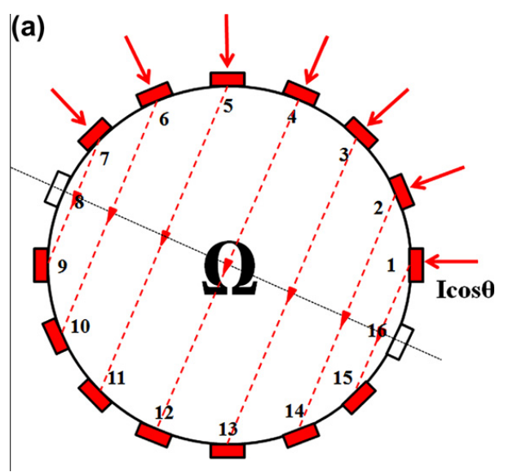
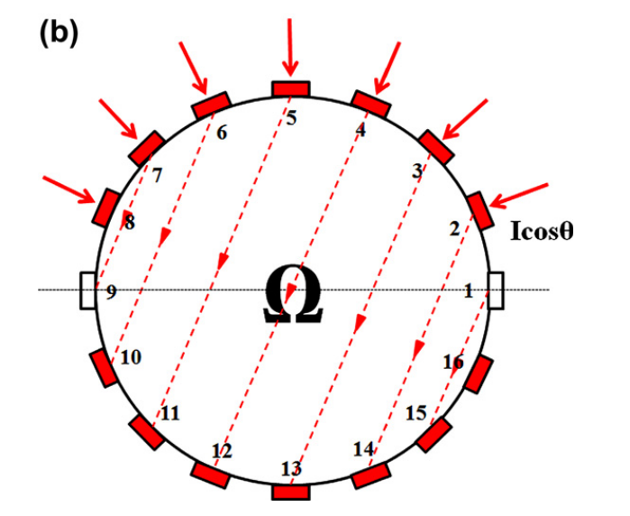
4 Current injection methods - Adaptive
Red: current electrodes
Blue: voltage electrodes
the boundary potentials are measured with respect to a single grounded electrode
102 independent data

Slide 14
Future planning

Slide 15
Reference
(PDF) Design of low-cost and high-speed portable two-dimensional electrical impedance tomography (EIT) (researchgate.net)
Studying the resistivity imaging of chicken tissue phantoms with different current patterns in Electrical Impedance Tomography (EIT) – ScienceDirect
An open-source and easily replicable hardware for Electrical Impedance Tomography – ScienceDirect
Deep learning scheme PSPNet for electrical impedance tomography (researchgate.net)

Slide 16
Microcontroller - Requirement
Have enough GPIO pins to control 4 muxes
Each mux requires 4 control pins (INH, A, B, C) -> Require at least 16 pins + 2 pins for I2C communication
Have I2C communication
Low-cost
Notes:
Toc do i2c

