Slide 1

Explaining Biomarker Response to Anticoagulant Therapy in Atrial Fibrillation:
A Study of Warfarin and Rivaroxaban with Machine Learning Models
Luan Sena
luanborges@ufmg.br
18/11/2024

Slide 2
Contextualization
Atrial Fibrillation is a common form of arrhythmia, affecting approximately 10% of individuals by the age of 80.
Disrupts blood flow, causing stasis and increasing the risk of thromboembolic events such as ischemic stroke and systemic embolism.
To prevent such events anticoagulant therapy is used. Warfarin, a traditional anticoagulant, and direct oral anticoagulants (DOACs), such as rivaroxaban are commonly used medications in AF treatment.

Slide 3
Motivation
Create models capable of identifying if a patient had AF via biomarker data.
Create models capable of identifying the medicine the patients with AF were using.
Learn how different was the biomarker response from the use of different anticoagulants, given a small dataset of patients.
Separate relevant biomarkers in order to learn how they influence the model.

Slide 4
Used Data
195 individuals, including 109 in the control group (without AF) and 86 patients with AF. Among the AF patients, 47 were using warfarin and 39 were using rivaroxaban.
The biomarkers used comprise patient data from characterization, blood count, lipid profile, coagulation, inflammatory and cardiac diseases of the individuals.

Slide 5
Relevant Biomarkers
Some relevant biomarkers in the context of atrial fibrillation are:
Inflammatory: Interleukins (IL-2, IL-4, IL-8, IL-10).
Coagulation: Peak, Microparticles (MPE, MPP), Prothrombin Fragment 1+2, ETP (Endogenous thrombin potential).
Lipid Profile: Total Cholesterol.
Characterization: Dyslipidemia (hypercholesterolemia).
Blood Count: PLT (Platelets).
Cardiac Diseases: sICAM-1 (Soluble Intercellular Adhesion Molecule).

Slide 6
Synthetic Data Generation
To further enhance the visualization and analyses of the importance of different features in model predictions. We amplify our dataset via generated synthetic data.
Synthetic data refers to artificial data generated by algorithms that mimic the statistical properties of real-world data.
We used both statistical methods (Gaussian Copula), as well as generative methods (Tabular Variational Autoencoder).

Slide 7
Model
For building our classifiers we utilized an implementation of the LightGBM (Light Gradient Boosting Machine) algorithm.
Boosting algorithms consist of iteratively learning weak classifiers with respect to a distribution and adding them to a final strong classifier.
LightGBM uses tree based algorithms in order to build predictions.

Slide 8
Results and Ablations
Predicting AF vs Control
Predicting Rivaroxaban vs Warfarin
Feature Group | ROC AUC Average ± STD
Full Dataset | 0.999 ± 0.001
Without Coagulation Biomarkers | 0.989 ± 0.017
Without Inflammation Biomarkers | 0.981 ± 0.023
Feature Group | ROC AUC Average ± STD
Full Dataset | 0.986 ± 0.027
Without Coagulation Biomarkers | 0.945 ± 0.029
Without Inflammation Biomarkers | 0.971 ± 0.036

Slide 9
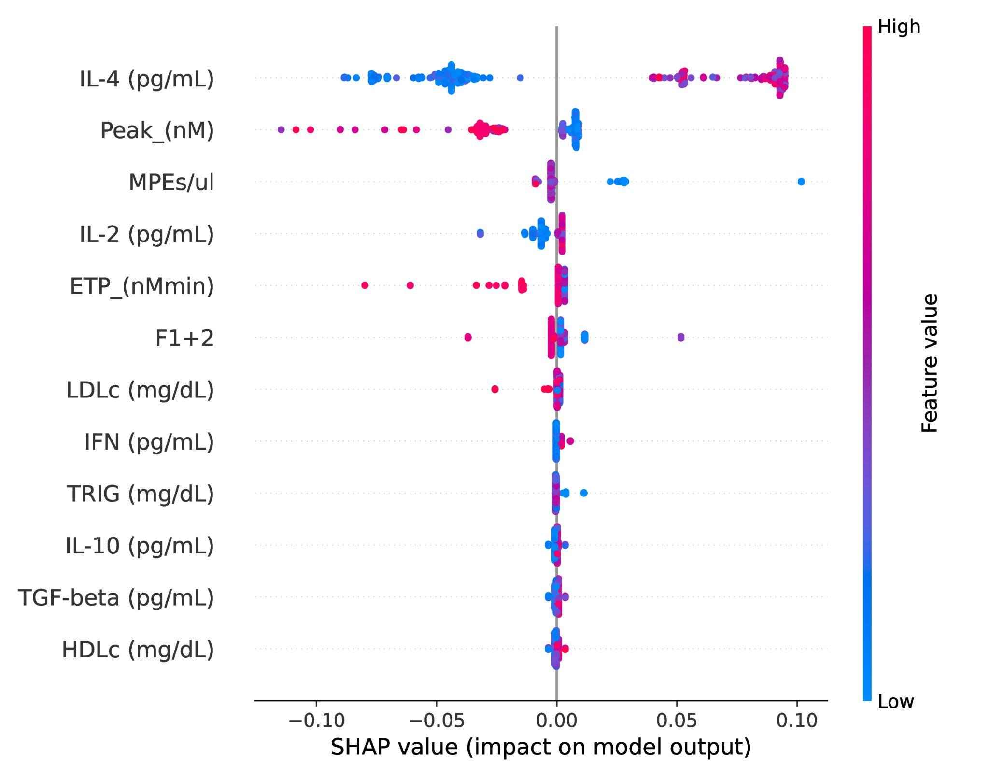
Explainability - Control vs AF - Full Dataset

Slide 10
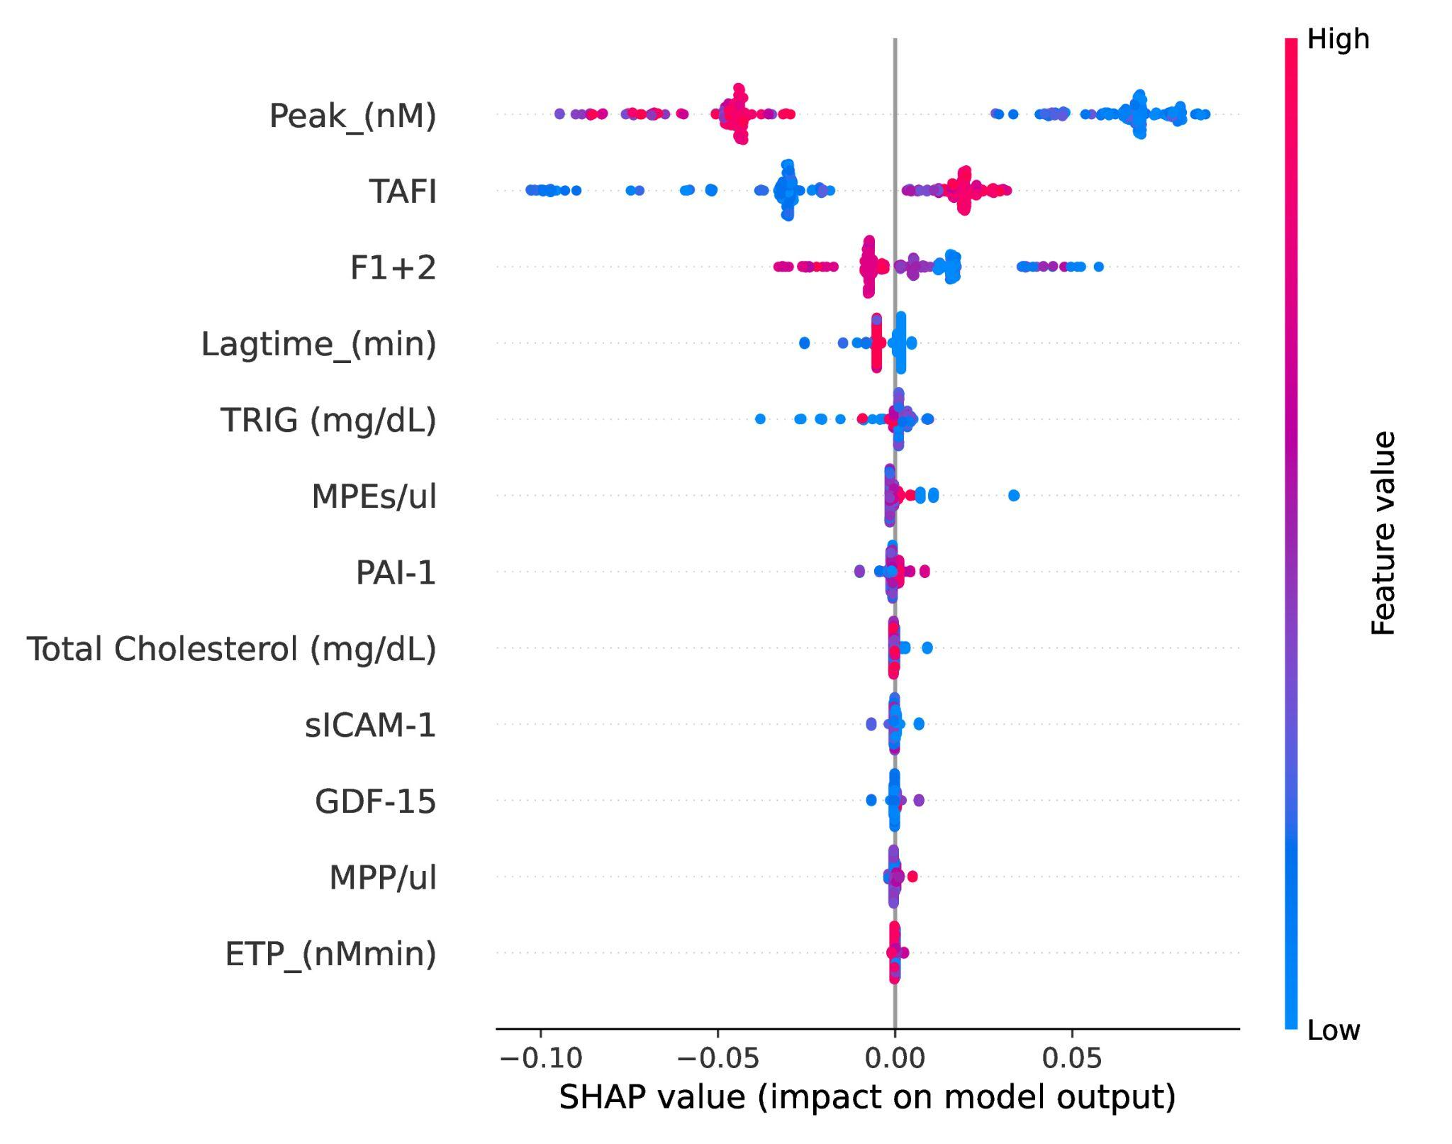
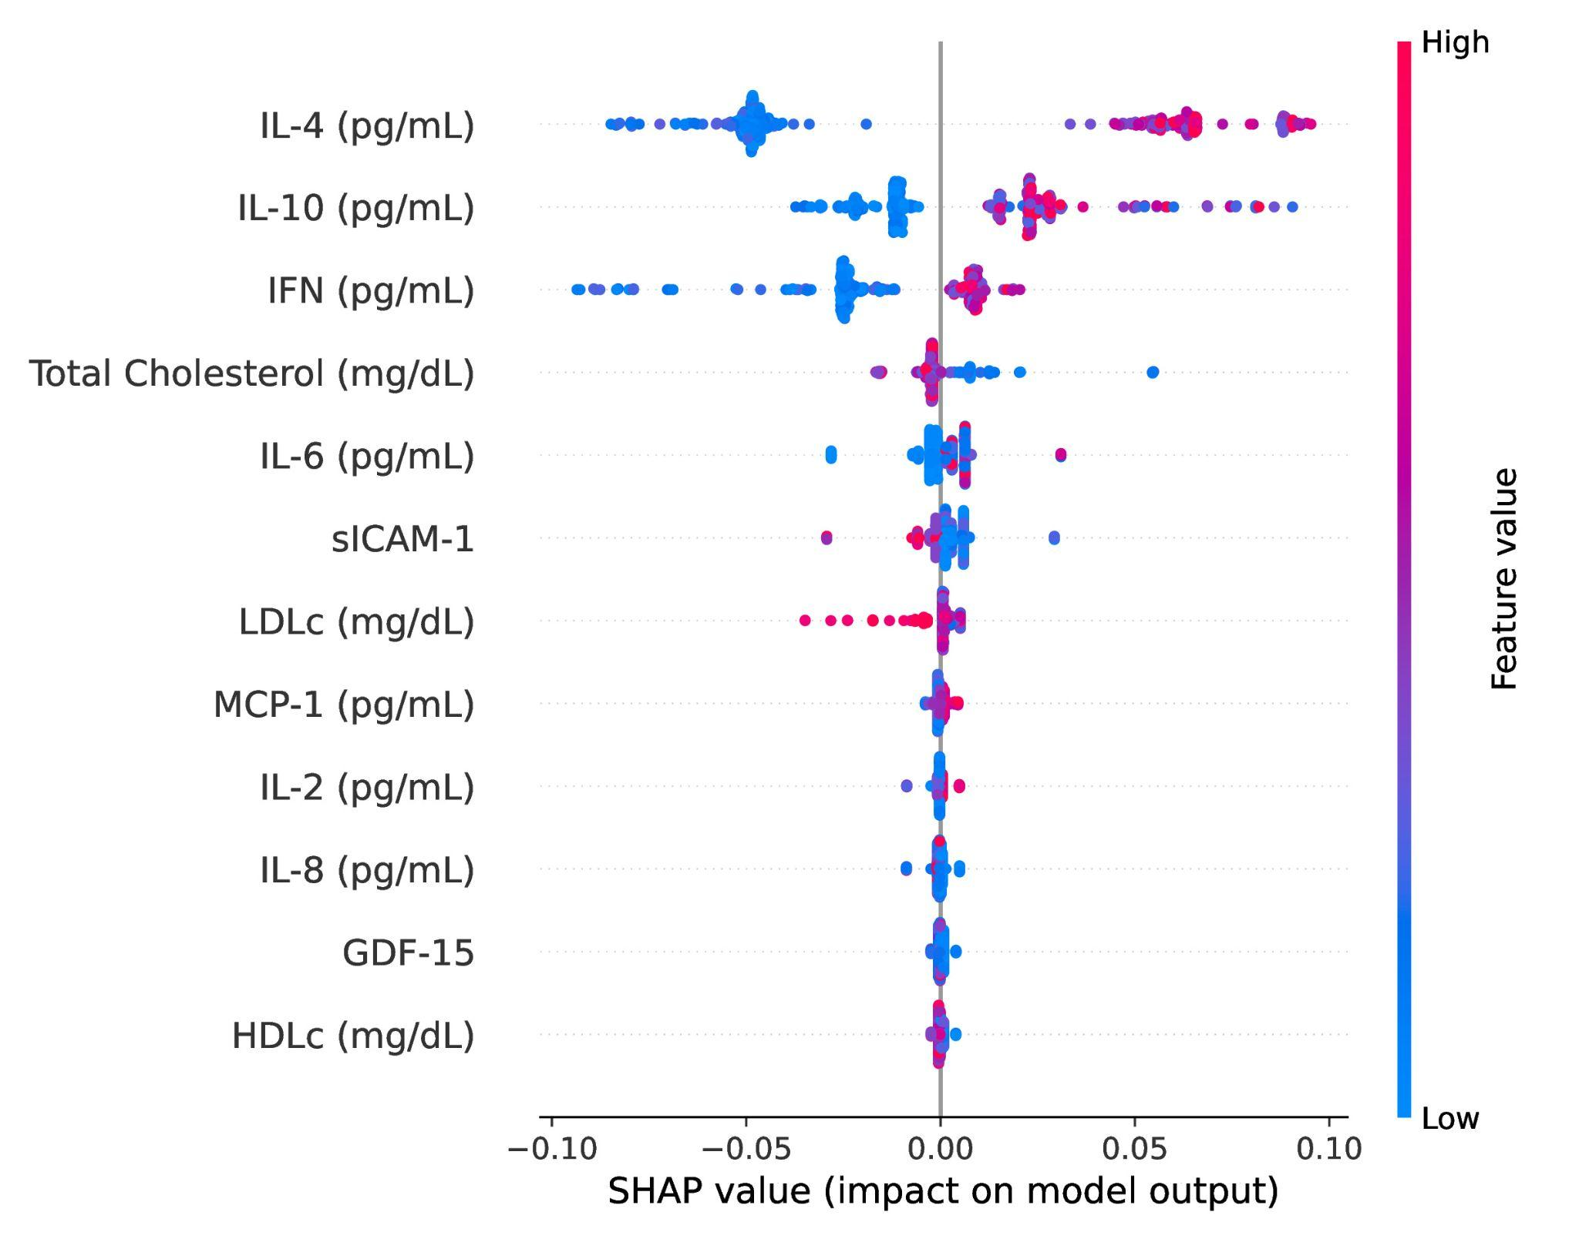
Explainability - Control vs AF - Ablations
Without inflammatory markers
Without coagulation markers

Slide 11
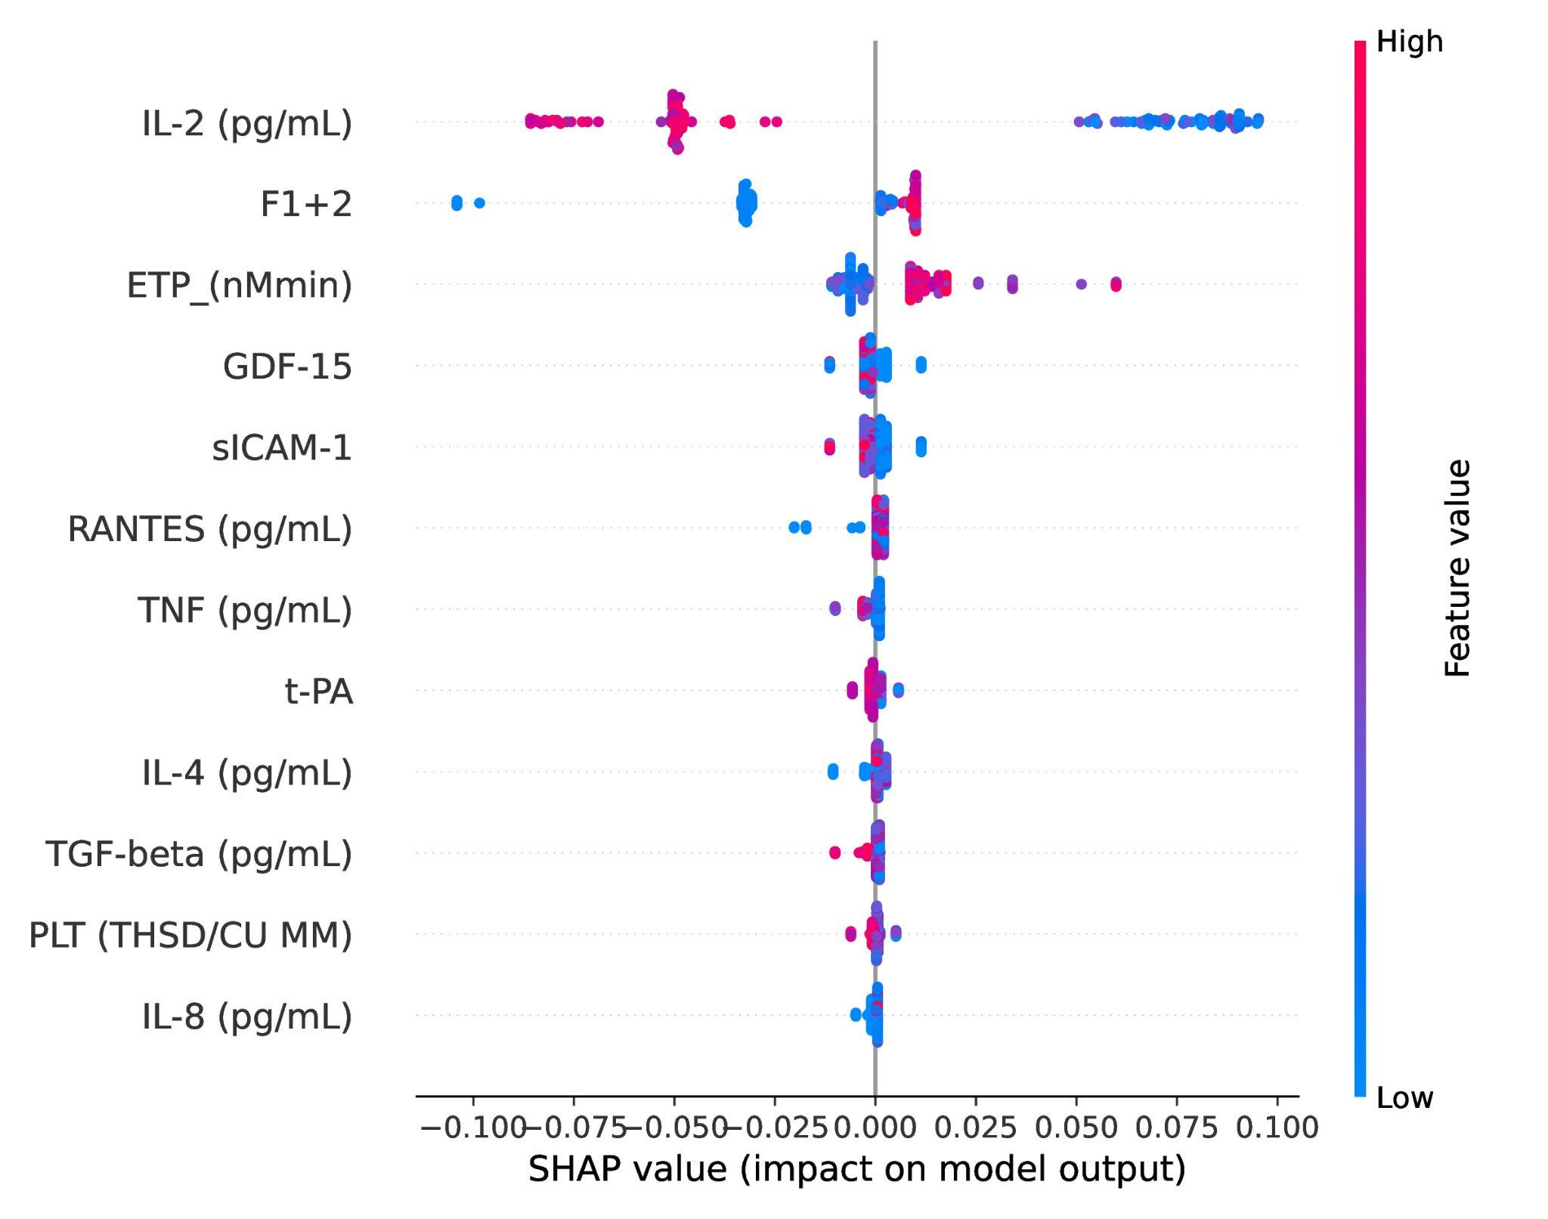
Explainability - Warfarin vs Rivaroxaban - Full Dataset

Slide 12
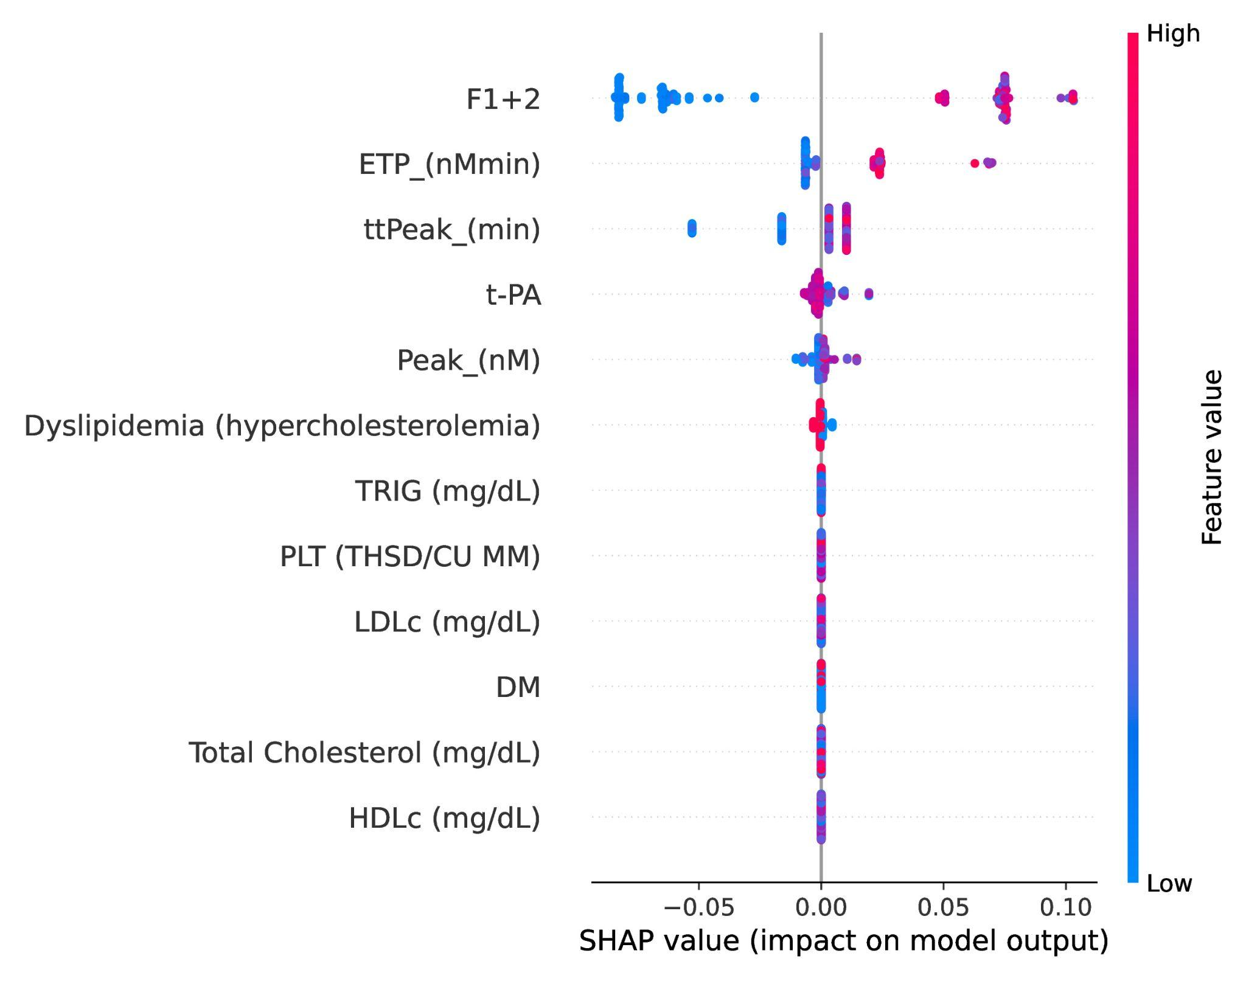
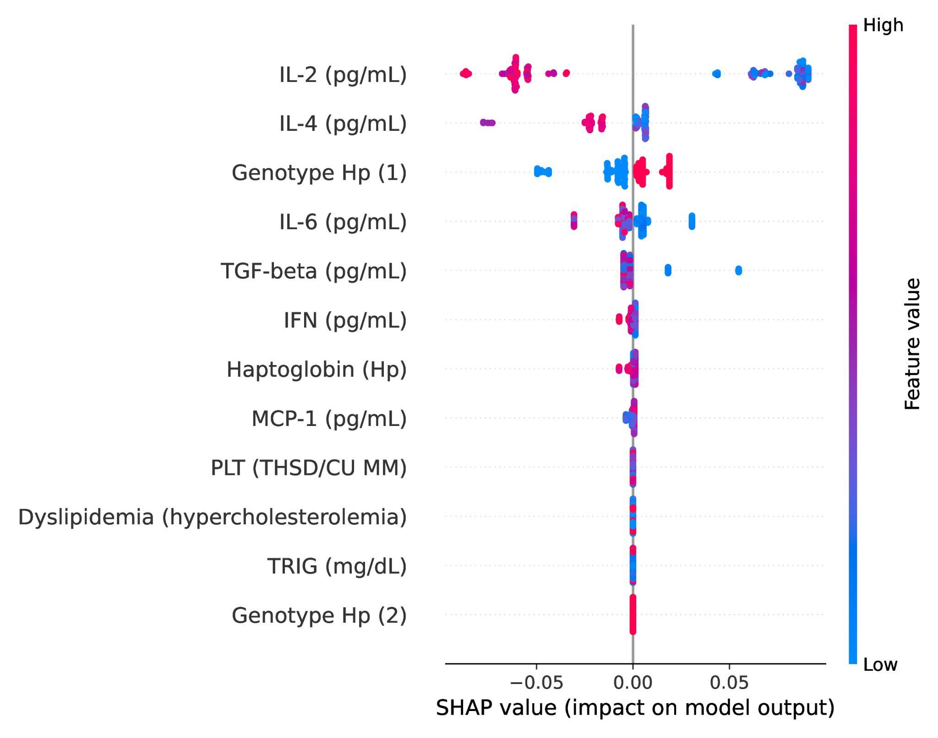
Explainability - Warfarin vs Rivaroxaban - Ablations
Without inflammatory markers
Without coagulation markers

Slide 13
Conclusion
Some contributions of our work were:
We were able to build high precision models for predicting AF, and medication used on patients using machine learning models.
Via explainability we showed which parameters were influencing patients using different medications.
Explored the area of atrial fibrillation in order to further research how machine learning can be used to improve the prediction and treatment of this condition.

Slide 14
Explaining Biomarker Response to Anticoagulant Therapy in Atrial Fibrillation:
A Study of Warfarin and Rivaroxaban with Machine Learning Models
Luan Sena
luanborges@ufmg.br
18/11/2024

