Slide 1
7zip
Javacard Security implementation
Grup E:
Bau Pericón, Agustí
Obrátil, Ľubomír
Mmokwa, Aobakwe Alloycius

Slide 2
Our contribution
Allow to encrypt and decrypt files using key from Javacard (communication via PC/SC)
Key is derived from master key (stored in card) and a counter (stored in the filename of the file)
Each file is encrypted with unique password
We can mitigate:
Keylogger attacks
Easy passwords

Slide 3
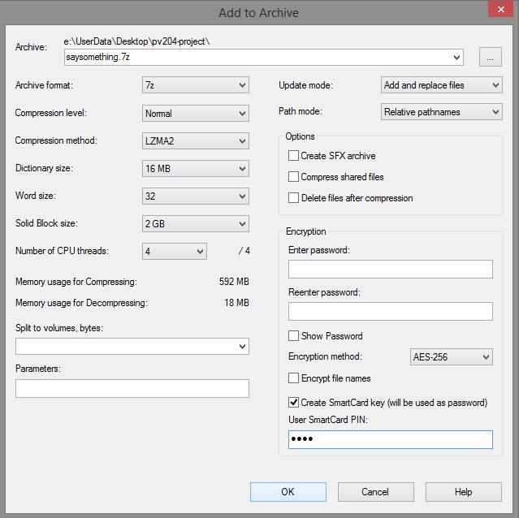
UI changes

Slide 4
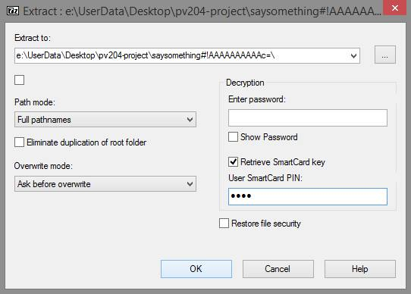
UI changes

Slide 5
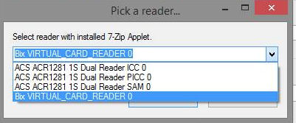
UI changes

Slide 6
Code Overview
7-Zip written C++/C and ASM code
Main functionality in C++
FileManager – executes GUI binary
GUI – reads user settings and de/compress
Specific DLL’s for every
Compression method
Packing method
One Visual Studio project for each binary
Visual Studio Projects are old -> we had to configure them
Hopefully cloning our repository will be enough (build for MSVC2015)
All of our work is within the GUI project
Hard to debug
Many executables and our projects aren’t 100% correctly configured
Bad or non-existent documentation

Slide 7
Our Code overview
SmartCardManager.cpp/.hpp
C++ Interface with card
ExtractDialog.cpp / CompressDialog.cpp
Calls from the UI to the SmartCardManager
Basically in onOk()
Sets password from the card
ExtractDialog.rc / CompressDialog.rc
UI changes (those are not shown in the VS project)

Slide 8
Javacard Code
File: Javacard/AppletTester/src/applet/Applet7Zip.java
Generate master key once
Derive keys to encrypt/decrypt files from master key and counter
Secured with user pin and admin pin
Utility for Javacard applet management:
Project 7ZipAppletUtility
Change of user and admin pin
Possible generation of new master key on card

