Slide 1
OpenEMS Simulation Creator
FreeCAD + openEMS
Microwave simulations
by Lubomir Jagos
May 2024

Slide 2
Installation
openEMS
  https://www.openems.de/
FreeCAD
  Use version 0.20 which is tested to work with this as this GUI application was developed with this one
  During writing this was tried 0.21 version but there is ERROR with STL export when parts are moved (is fixed in 0.22 which will be released soon)
OpenEMS Simulation Creator
  GUI addon to FreeCAD to generates openEMS scripts
  https://github.com/LubomirJagos/FreeCAD-OpenEMS-Export/releases
  Examples at https://github.com/LubomirJagos/FreeCAD-OpenEMS-Export-Plugin-Documentation
Octave
  https://octave.org/
  Set directory to openEMS/matlab to be able run scripts
Python: install version 3.11.6
  https://www.python.org/downloads/release/python-3116/
  Install wheels for CSXCAD and openEMS included in downloaded zip folder
  Install pylab
    pip install matplotlib
  It’s good to have some python IDE ie. Spyder
    https://www.spyder-ide.org/
    Set in Preferencies python interpreter to installed 3.11.6 version, don’t use spyder included interpreter
Paraview – for result fields evaluation and doing nice images or animations
  https://www.paraview.org/download/

Slide 3
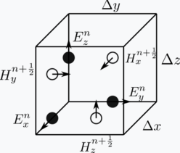
FDTD algorithm
electric and magnetic field is evaluated over rectangular cells (simulation grid)
E and H field are complex 3D vectors
  When complex vector is decomposed into x,y,z parts these are also complex (this is just to realize when simulation results are used to calculate something else in scripts)
  Units for E field are V/m
  Units for H field are A/m
  Scalar voltage V is result of curve integral in space between 2 points (voltage probe is in openEMS line)
  Scalar current A is result of surface integral (at least in openEMS current probe is some surface)
slower than MoM but can compute structures with dielectric material
calculates fields in time therefore it evaluate on some frequency band
  FEM method evaluate structrues on single one frequency for some band evaluation it must be calculate for each frequency separately (but FEM is faster than FDTD)

Slide 4
FreeCAD
open-source 3D CAD
actively developed
using python scripting, can be easily extended using python scripts macros
also when Qt used then GUI app can be added
good cooperation with KiCAD
fully scriptable using python
can run in command line without gui – could be use for parametric simulation scripted in python

Slide 5
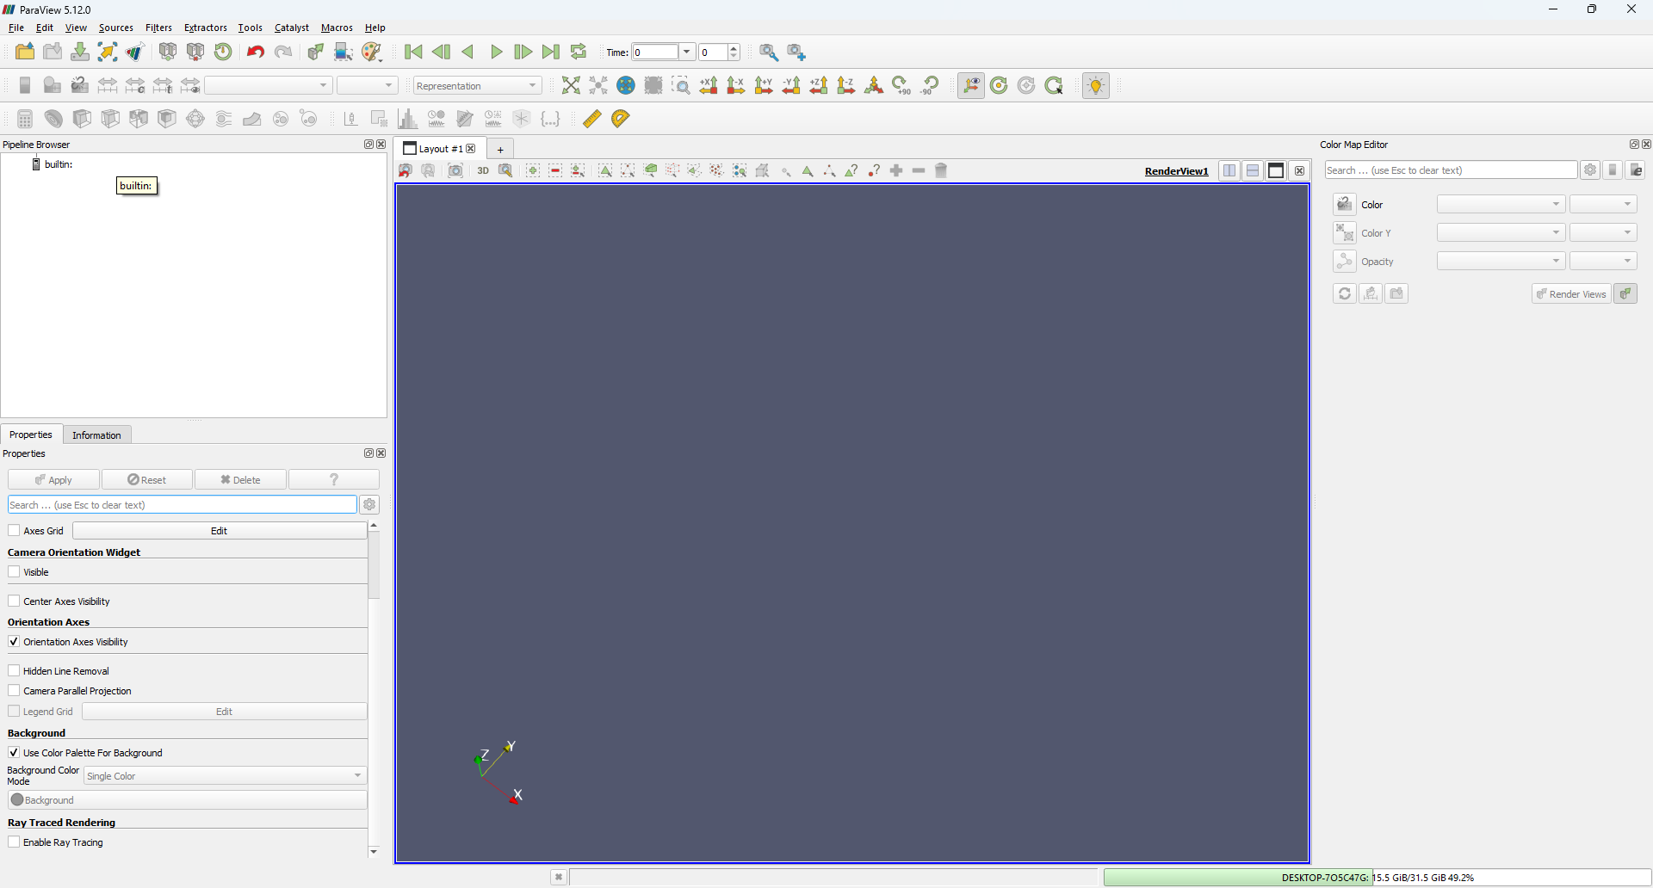
Paraview
general software to visualise scientific data
can display broad formats
can be used for EM simulation results (openEMS), fluid simulations results (openFOAM) or else

Slide 6
openEMS
open-source FDTD EM solver
developed by Thorsten Liebig
started in 2010
there is quite active "community" on github forum
  https://github.com/thliebig/openEMS-Project/discussions
available scripting:
  Octave interface (GUI addon was developed with this interface, this is for sure running right)
    Generates xml structure definition with simulation settings
  Python interface (missing some high-level function to create different ports, but these could be easily modelled in FreeCAD)
    generates xml just for structure
    uses cython C++ function call directly openEMS core
FreeCAD GUI addon is capable to generate python and octave script

Slide 7
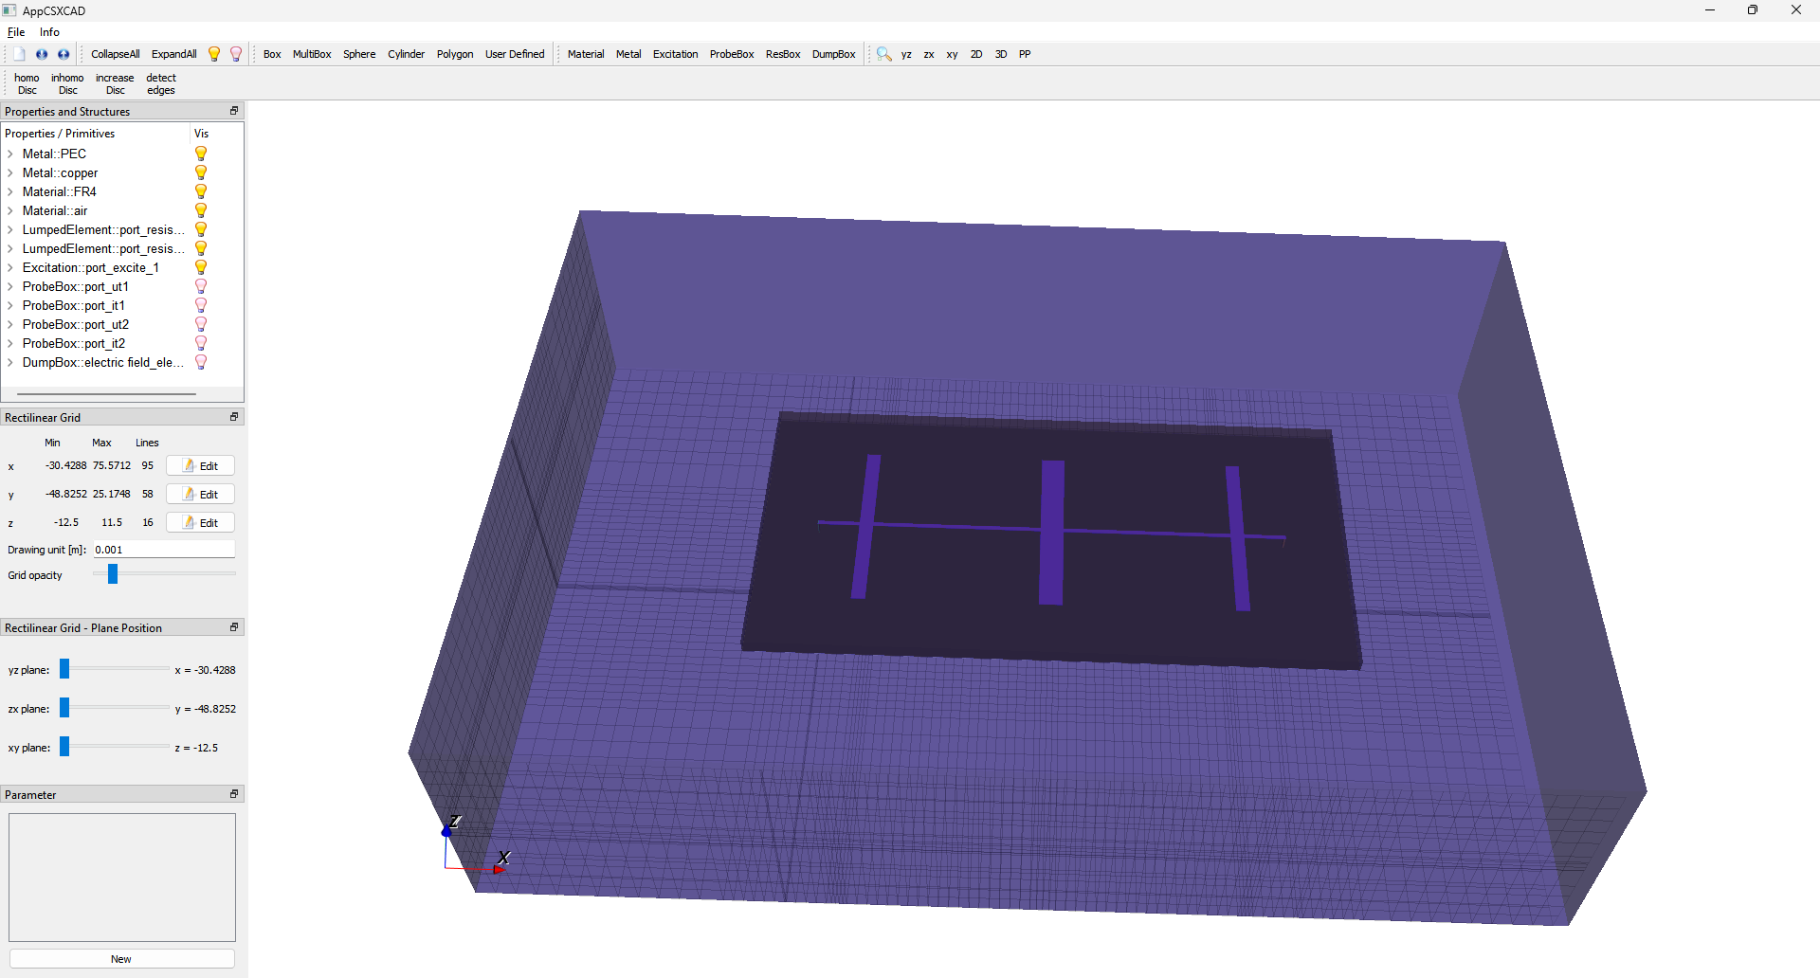
CSXCAD
part of openEMS
CAD from Thorsten to visualise structure from XML
define XML file to describe structure and simulation
easy
few geometry primitives (box, cylinder, polygon, ...)
can be used to display structure and also to modify
it's possible to create whole simulation in CSXCAD but probably it's easier use scripting approach

Slide 8
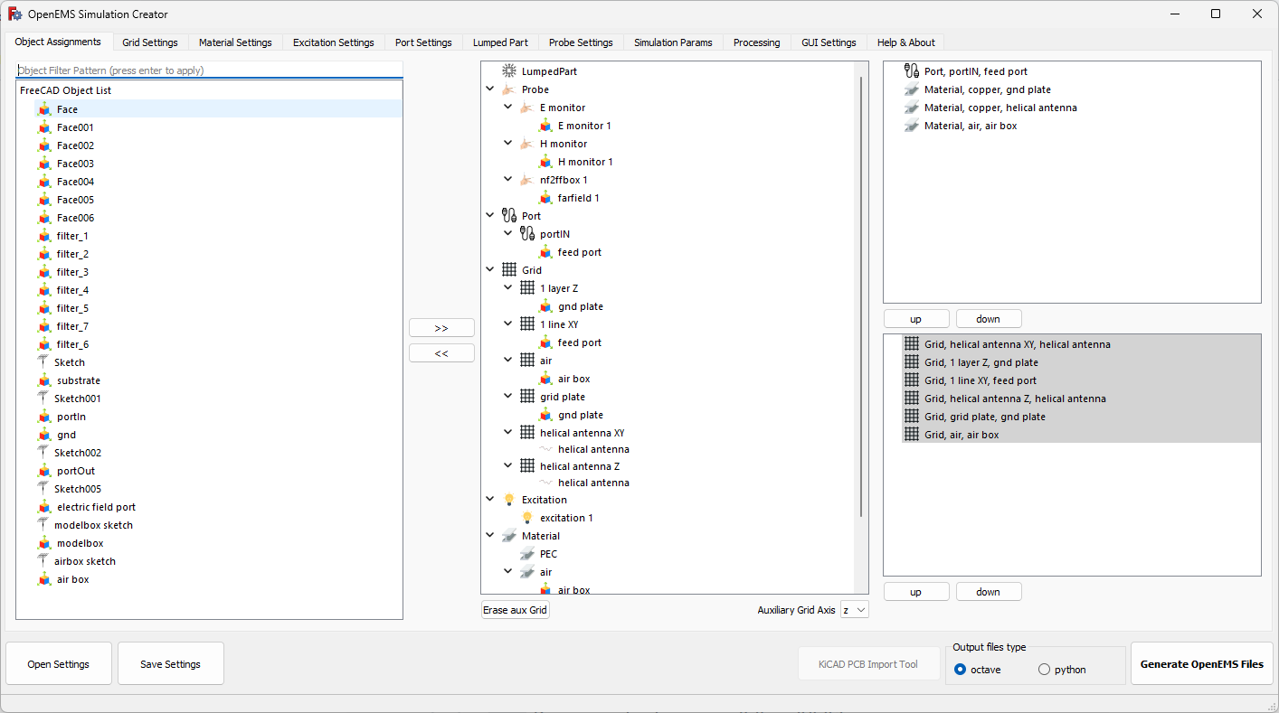
OpenEMS Simulation Creator
GUI addon for FreeCAD or Blender to create openEMS script, simple IDE similar to CST Studio or Ansys HFSS

Slide 9
Simulation setup
Need to set:
  Excitation for ports
    Sinusodial – one frequency
    Gaussian – range of frequncies
    User defined E field function – equation is using fparser functions http://warp.povusers.org/FunctionParser/fparser.html#functionsyntax
  Simulation input port
  Grid:
    Rectangular
    Cylindircal – this is unique feature of openEMS could be used to simulate bend patch antennas or MRI coils
  Materials:
    PEC – perfect electric conductor
    User defined - permitivity, permeability, loss
    Conducting sheet – same as PEC but on computational C++ code there is some special faster implementation
    Lorentz material – NOT IMPLEMENTED in GUI but there is scripting interface so could be added into script
    Debeye material – NOT IMPLEMENTED in GUI but there is scripting interface so could be added into script
  Ports
    Passive – to sense E, H fields to be used to evaluate or calculate ie. S params or whatever needed
    Active – these are wrapping grid nodes where is injected values of excitation, there is excitation common for all ports there could be defined just different time delay for each active port, DIFFERENT EXCITATION FOR PORTS NOT IMPLEMENTED IN openEMS
  E or H probes
    Raw values of E or H could be dumped into binary .h5 file
  Simulation parameters
    End condition – energy level when in simulation decreas under this level simulation is stopped
    Maximum number of timesteps – when reached simulation is aborted

Slide 10
Notes to simulation – user experience
simulation is ideal model
reality and simulation could differs
  if too much then model needs to include more real world features
sometimes results seems wrong but they are right – expectation are wrong and manual study should be done again
GRID is the MOST IMPORTANT to set
  it defines calculation nodes
FR4 is unpredictable material, it's epoxy resin with no exactly defined permitivity, it's like 4.2 – 4.7 no one knows
don't mix octave and python files, there are little differencies in API like output file naming which can cause that scripts will not run
  there will be exception thrown in output
materials in openEMS have priority parameter in case of overlapping material with highest priority is used for node material definition
if model is done right, slight change of grid shouldn't affect results
S parameters are independent from excitation port amplitude, so if just S params are object of interest amplitude magnitude of excitation doesn't matter
try to left lambda/4 space around model, this is common mistake
MAKE SURE THERE ARE LINES CROSSING PORTS, common mistake
TOO COARSE MESH can cause numerical instabilities (it's visible when visualise E-field it's values are over 1e6 V/m what is total nonsense)
SPENT SOME TIME TO LEARN PYTHON doesn't need to be expert but IT WILL CHANGE YOUR LIFE (openEMS, GnuRadio, numpy, sympy, Blender, ...)

Slide 11
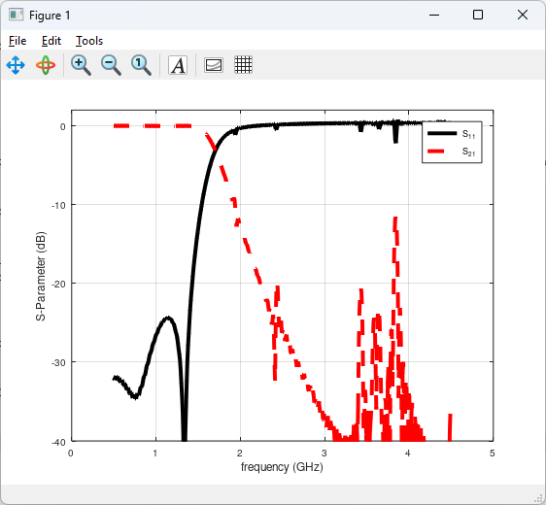
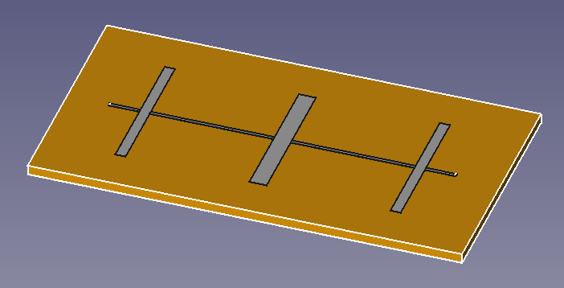
Low pass filter
example of planar low pass filter

Slide 12
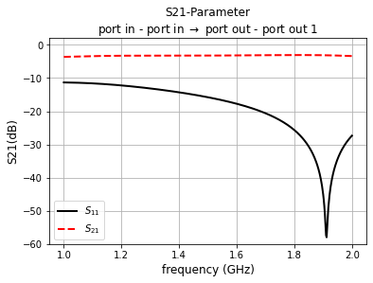
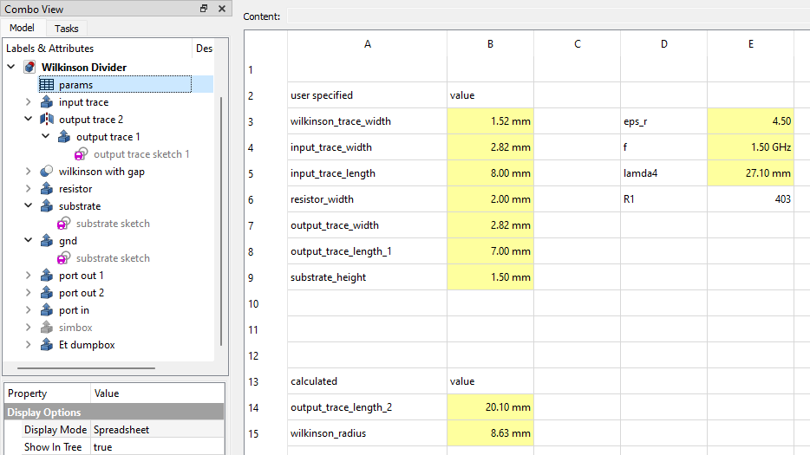
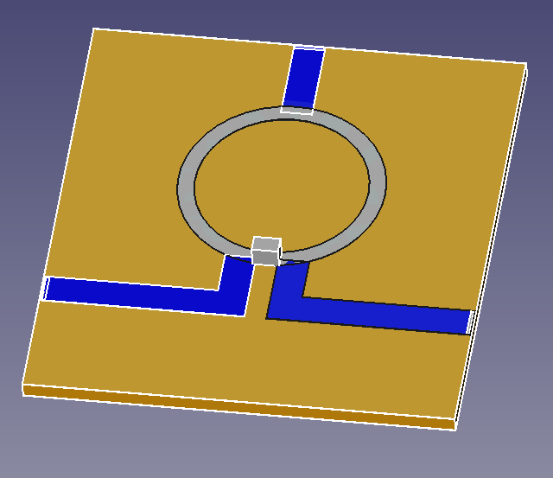
Wilkinson divider
there is example of usage of parameters from table in FreeCAD

Slide 13
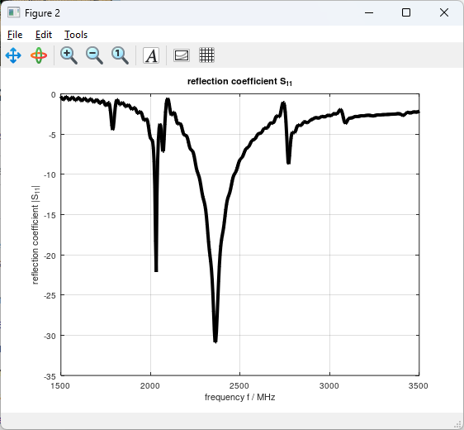
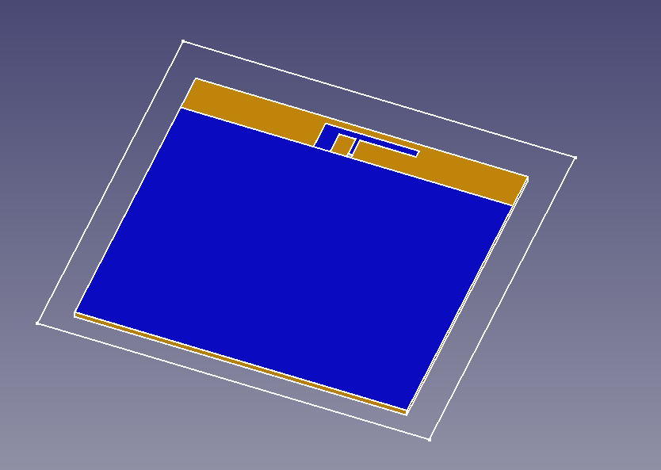
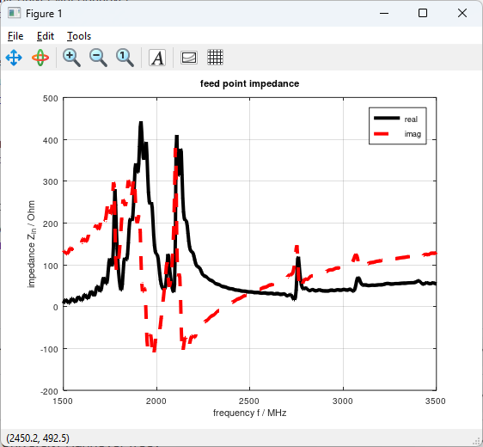
Inverted F antenna
small antenna doesn't require bottom ground patch

Slide 14
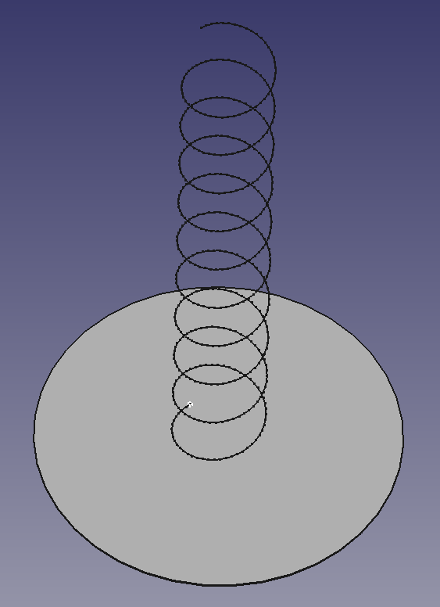
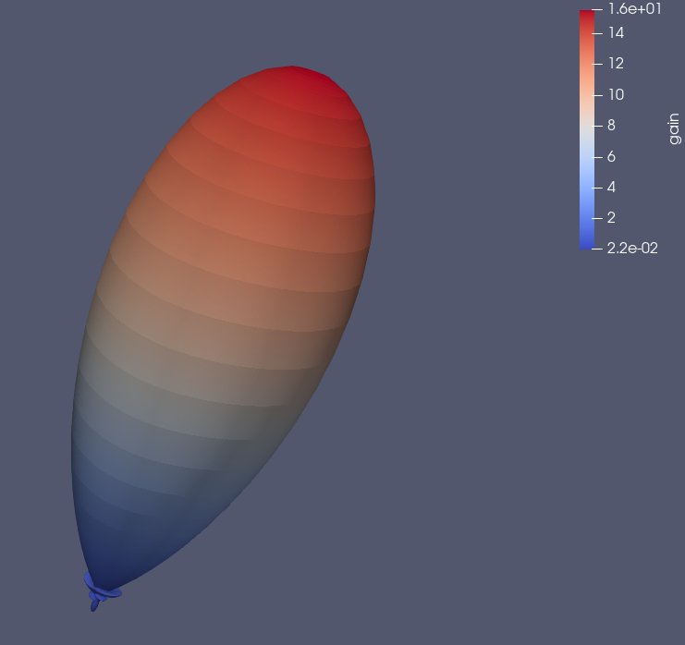
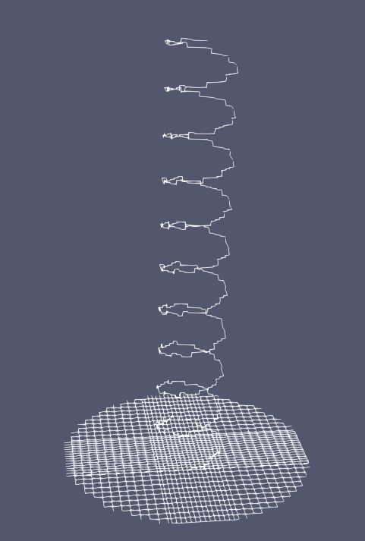
Helical antenna
wire structure could be also simulated in openEMS but wires must aligned with grid
contains example of far field diagram generate and evaluate
for farfield NF2FF probe is used, there is openEMS application which calculate far field from near field
  antenna phase center should be in middle of NF2FF box probe (but in example it's not)

Slide 15
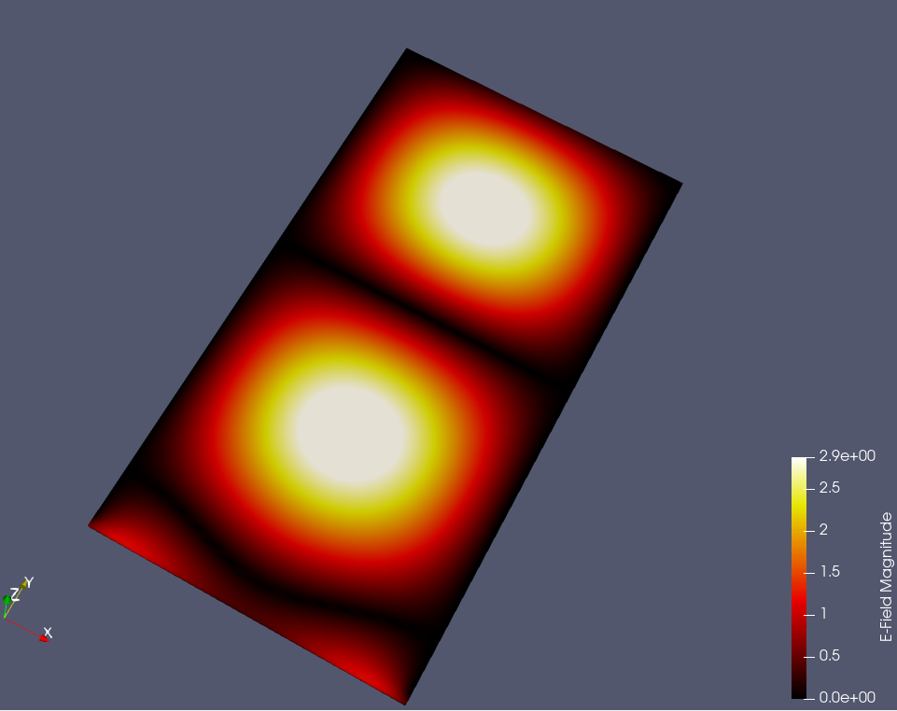
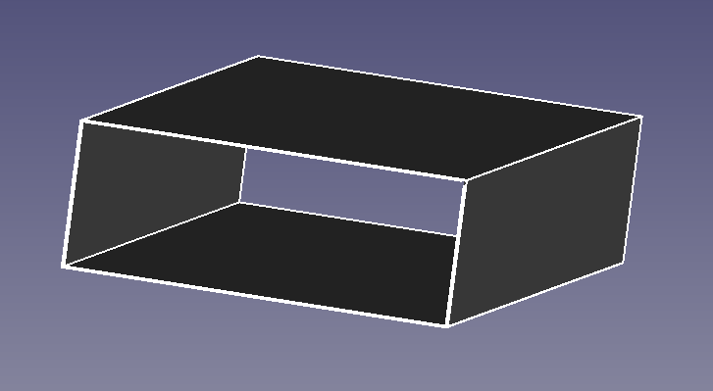
Rectangular waveguide
great example to visualize E-field
input ports are excited by modes Texx
  in GUI in list they are ordered from lowest energy to highest – TE10, TE20, TE01, TE11, TE21, TE30, TE31, TE40, TE02

Slide 16
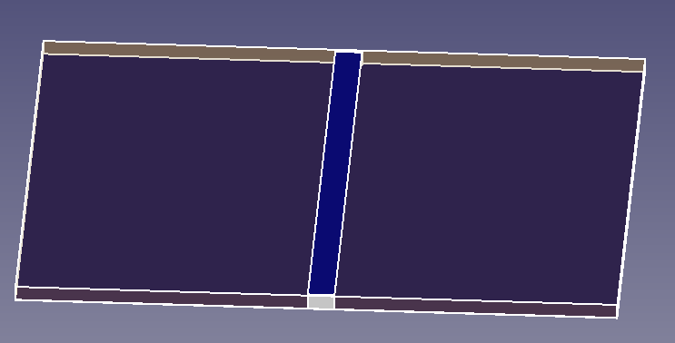
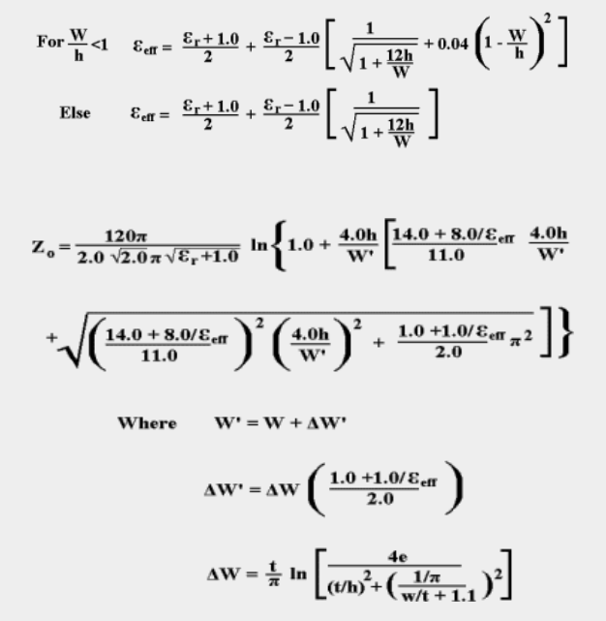
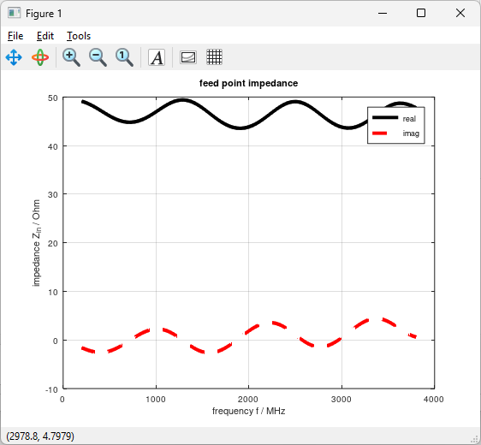
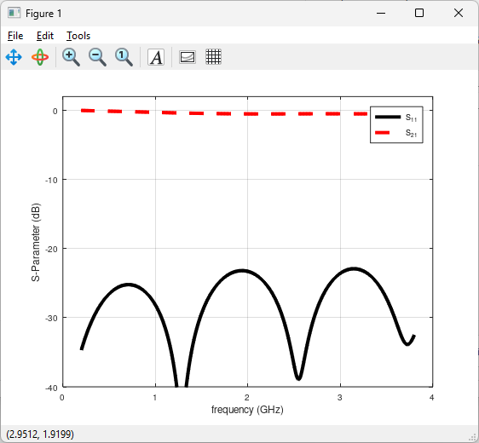
Microstrip simulation
microstrip dimensions are frequency independent
dimensions (width) depends on requested characteristic impedance
it has same impedance over every frequency

Slide 17
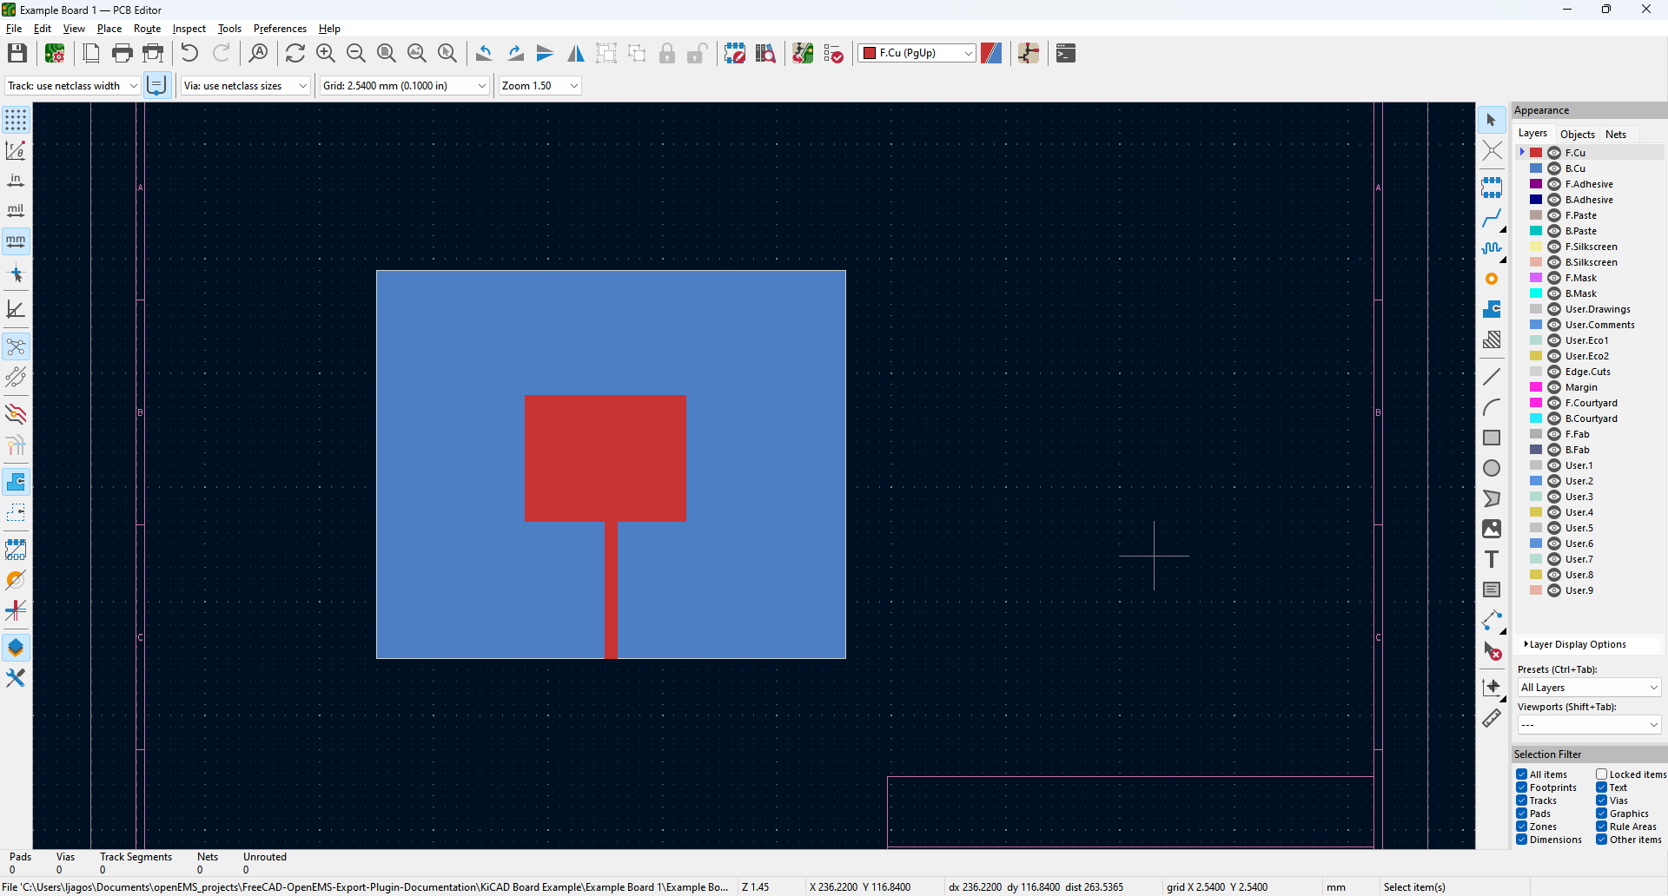
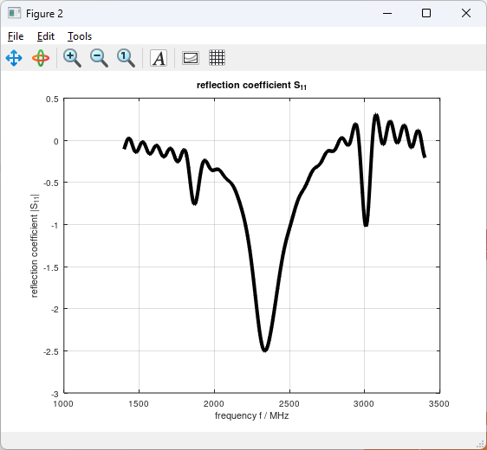
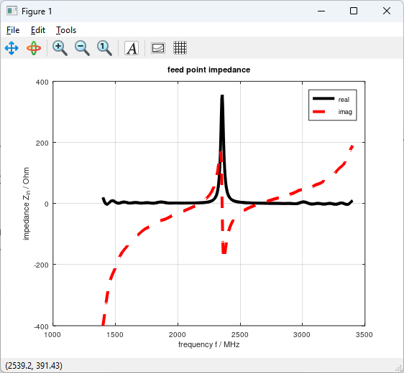
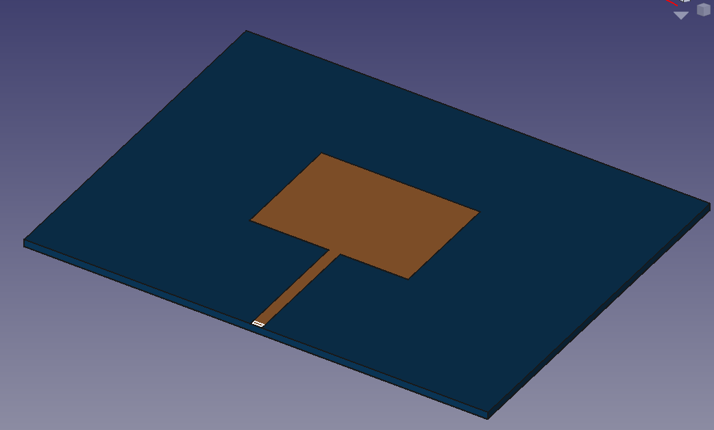
KiCAD board import
use polygons
DON’T USE RECTANGLES they are not imported
there is tool accesible from main GUI window for KiCAD board importer using fcad_pcb python library
  https://github.com/realthunder/fcad_pcb
this one example was random drawn patch antenna in KiCAD therefore S11 is bad (really bad), microstrip should be improved

Slide 18
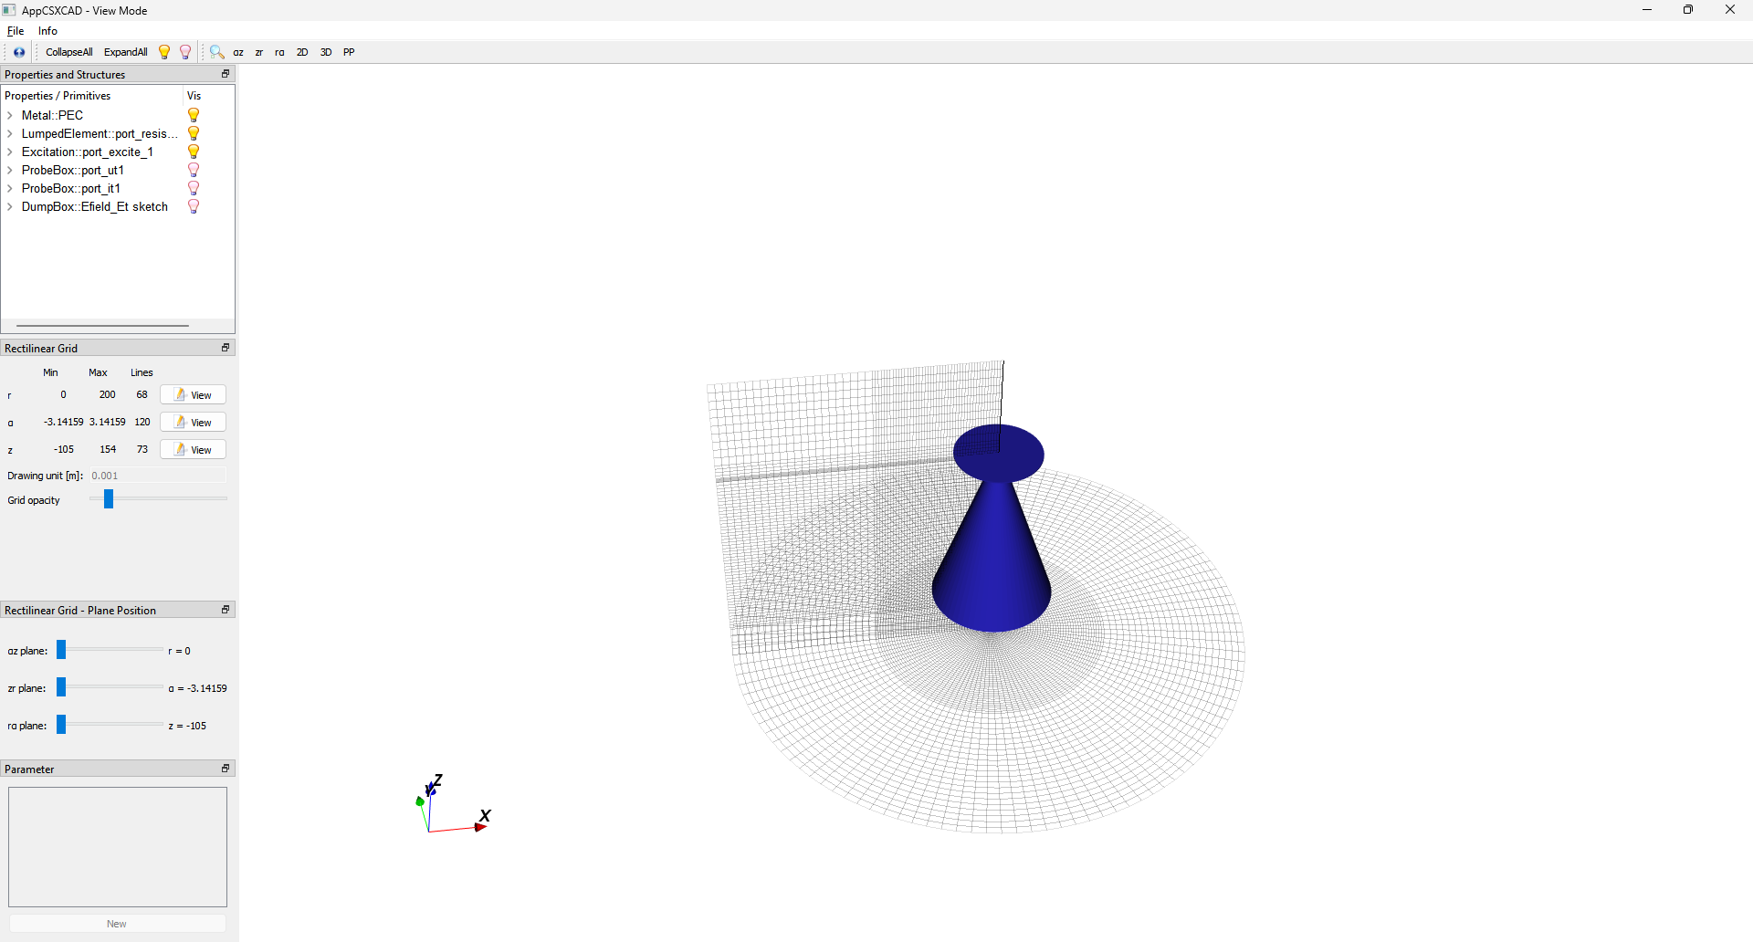
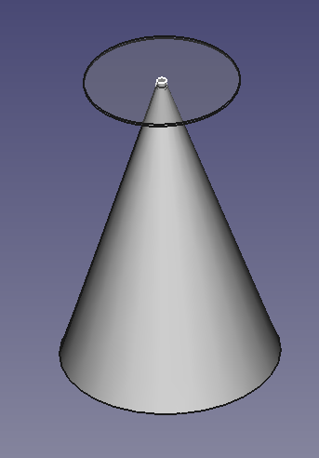
Discone antenna example
example of cylindrical coordinate system
there is something wrong and numerical instability occurs – EXAMPLE NOT FINISHED

Slide 19
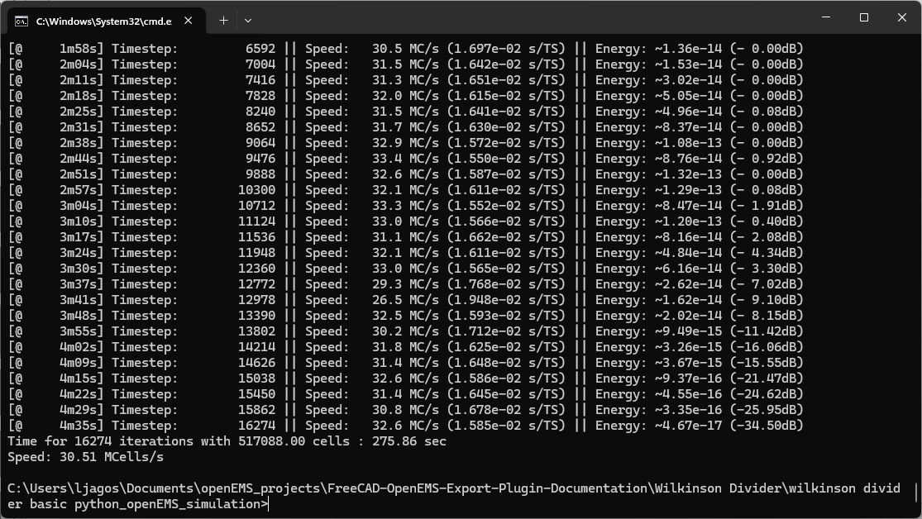
Simulation process
energy should be continualy decreasing
if energy is not decreasing or not changing there is probably something wrong in simulation
if energy is still from beginning 0.00dB most likely source port is not excited or connected to strcuture – good check model

Slide 20
Simulation start
simulation start, there is information about calculated timestep and also how long is excitation signal in timesteps, it's important to have at least maximum number of timesteps 2x greater than excitation signal
number of cells is also important information, more cells means looong simulation
Create FDTD operator (compressed SSE + multi-threading)
FDTD simulation size: 181x152x82 --> 2.25598e+06 FDTD cells
FDTD timestep is: 2.12825e-12 s; Nyquist rate: 460 timesteps @5.10729e+08 Hz
Excitation signal length is: 13461 timesteps (2.86483e-08s)
Max. number of timesteps: 30000 ( --> 2.22866 * Excitation signal length)
openEMS::SetupFDTD: Warning, max. number of timesteps is smaller than three times the excitation.
You may want to choose a higher number of max. timesteps...
Create FDTD engine (compressed SSE + multi-threading)
Warning: No primitives found in property: PEC!
Running FDTD engine... this may take a while... grab a cup of coffee?!?
[@ 13s] Timestep: 115 || Speed: 18.8 MC/s (1.197e-01 s/TS) || Energy: ~7.72e-19 (- 0.00dB)
[@ 22s] Timestep: 230 || Speed: 31.2 MC/s (7.241e-02 s/TS) || Energy: ~1.19e-18 (- 0.00dB)

Slide 21
Model check
there is switch for openEMS -debug-PEC which generate PEC material into file then structure could be checked using Paraview, good to debug when something is wrong with model
also possible to export other dielectric materials to see how it looks like in grid

Slide 22
Noticebly people using openEMS
Thorsten Liebig – author of openEMS
Gadi Lahav – israeli RF designeer, he added inductance lumped element support to openEMS
Apostolos Spanakis Misirlis – greek RF engineer
Samer Aldhaher – UK electrical engineer, great electronics animation creator
Volker Mühlhaus – german RF Specialist
Leibniz University Hannover – students using openEMS for semestral projects

Slide 23
Thanks for attention.

Slide 24
Following slides are about usage of GUI addon in FreeCAD

Slide 25
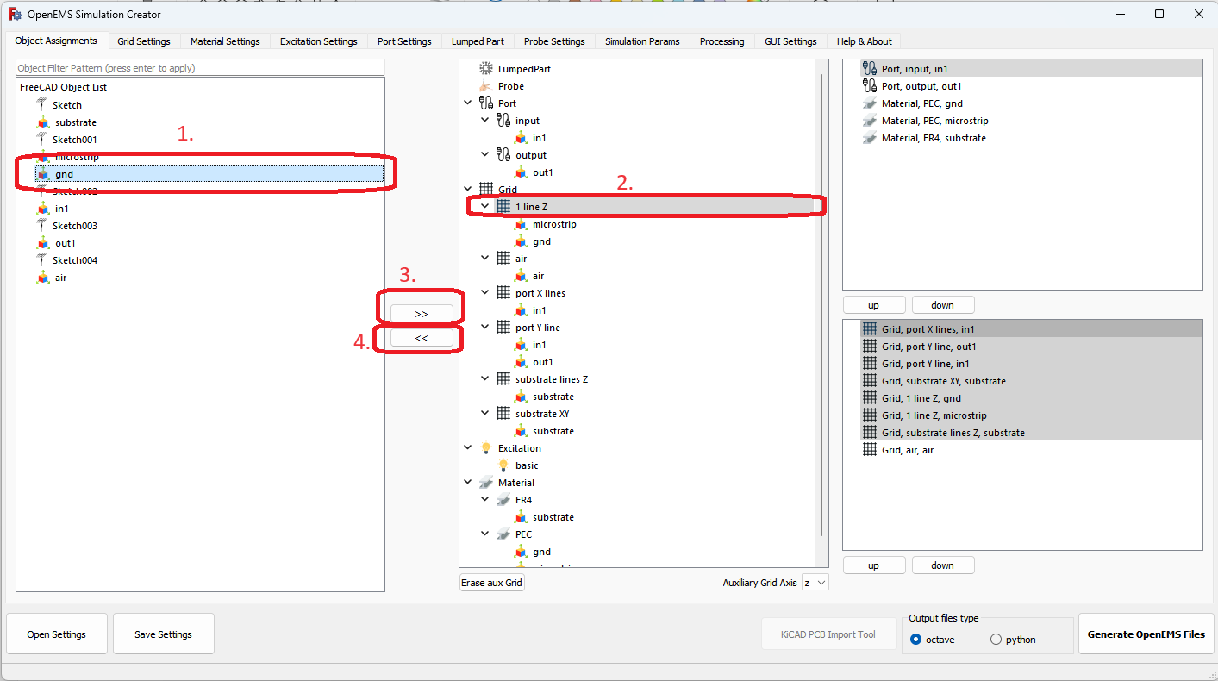
GUI addon – object assignment
select object
select category (grid, material, port, probe or lumped part)
use assign button (>>) to add object under some category (if it’s not possible to add object to some category or there is some problem there is error message)
if object should be unassigned select object in category and click on unassign button (<<)

Slide 26
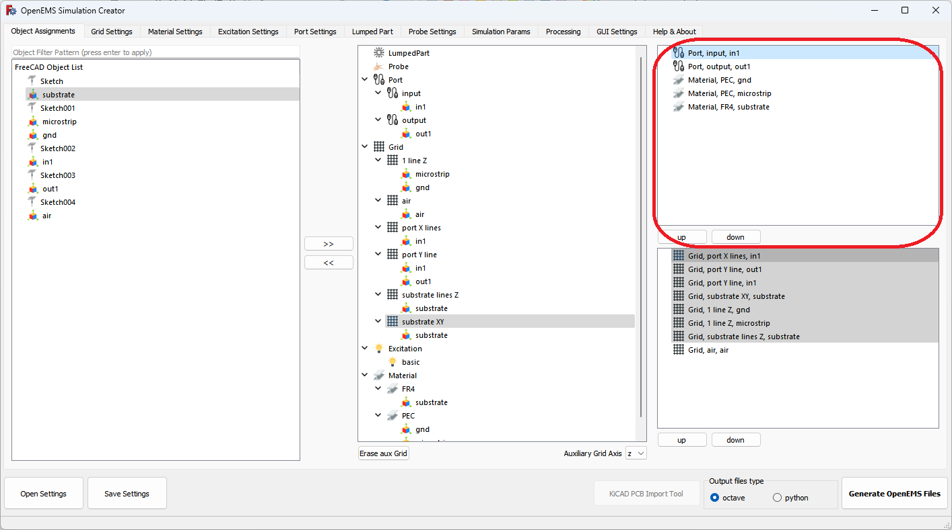
GUI addon – material priorities
if two objects with different material properties overlapped material with higher priority is used for nodes which lay inside object
good practice is to have ports at top to be sure that excited port is really used

Slide 27
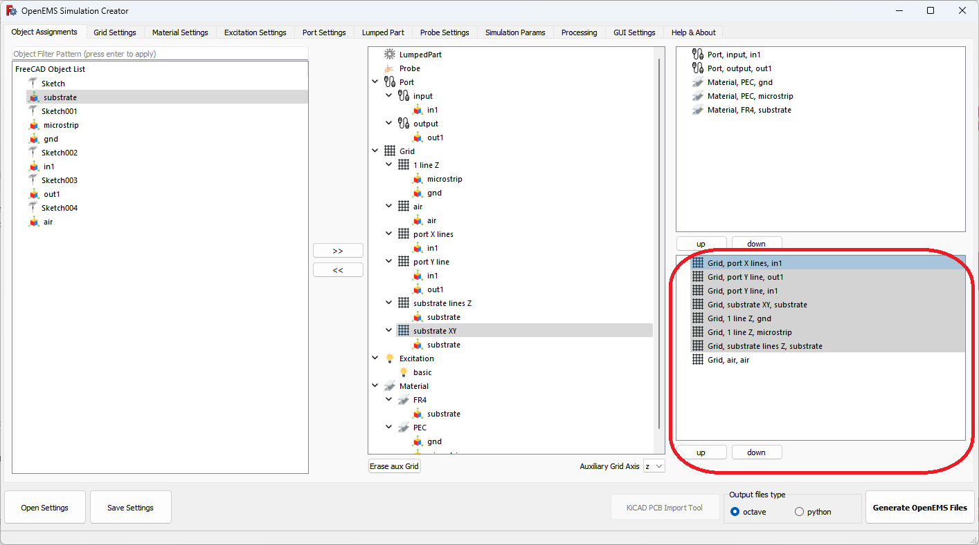
GUI addon – gridlines priorities
gray grid items are deleting gridlines inside object boundaries, evaluation is going from bottom to top so first bottom items delete gridlines and add their gridlines and after it’s going to item up, again delete gridlines and add lines
therefore top items are last applied
white grid items are not deleting gridlines inside assigned object boundaries and are just adding lines
grid item can be selected and moved up and down using buttons under it
good practice is to hav air gridlines which are most coarse at the bottom

Slide 28
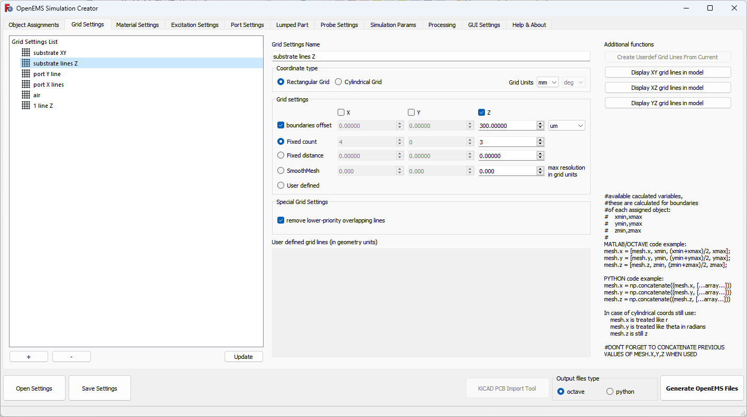
GUI addon – grid
boundaries offset – moves gridlines inside object boundaries, by specified distance, this is to ensure that lines will be inside STL imported object due there is some rounding defined in GUI addon on 14 decimal places, so STL boundaries are evaluated in GUI addon to picometer precision
smooth mesh creates gridlines how it should be disperzed into defined boundaries used in lot of orignal script openEMS examples
this is little different as all object assigned into smoot mesh item are evaluated together
smooth mesh is good to try to see what it’s doing
code from user defined is directly inserted into script therefore octave or python code must be used if choosed

Slide 29
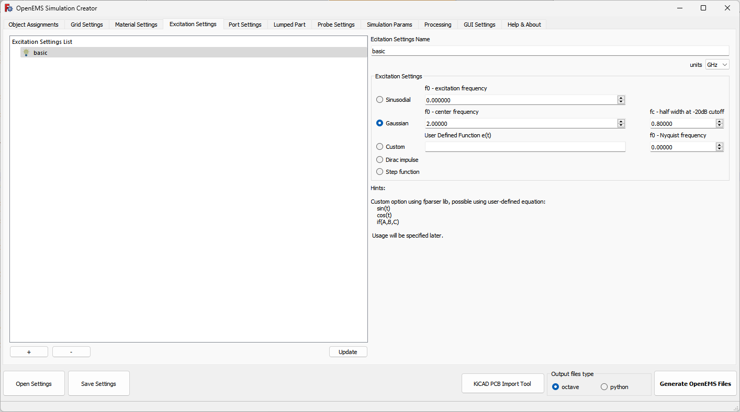
GUI addon – excitation
only one excitation allowed in openEMS simulation
port delay excitation not implemented in GUI, must be done in script manualy if needed

Slide 30
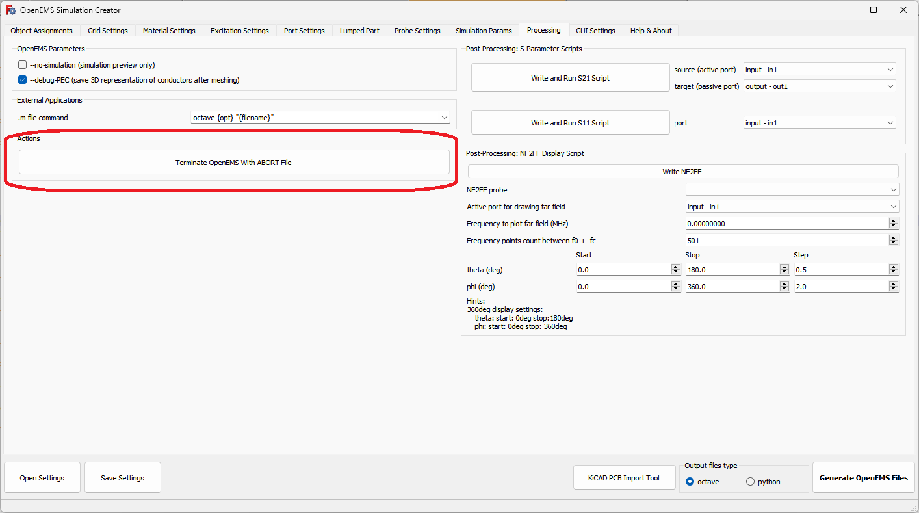
GUI addon – abort simulation
when simulation is running it could be aborted by adding file named ABORT into simulation folder
this is done by clicking on button in GUI

Slide 31
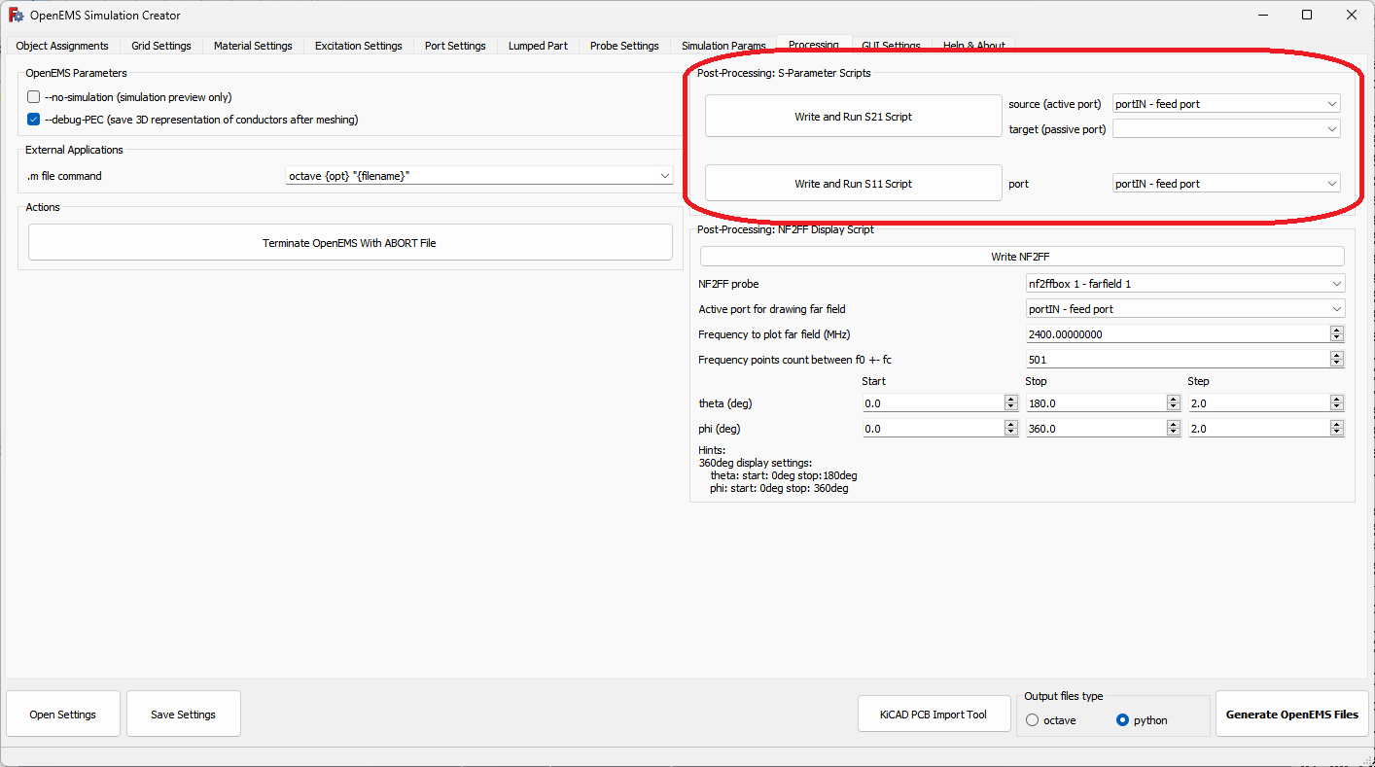
GUI addon – S11, S21 scripts
on postprocessing tab there are buttons to generate S11 and S21 evaluate scripts, they display graph
S11 for some port also draw input impedance
could be used to inspire how to evaluate results from openEMS result files

Slide 32
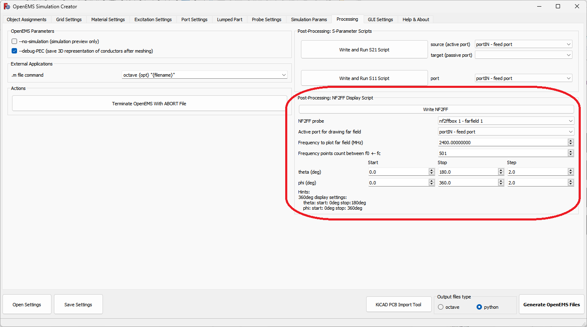
GUI addon – far field display script
there is in postprocessing button to generate far field script
it uses NF2Ff (near field to far field) application which is part of openEMS
it calculates far field from E, H fields on NF2FF box which is defined around structure

