Slide 1
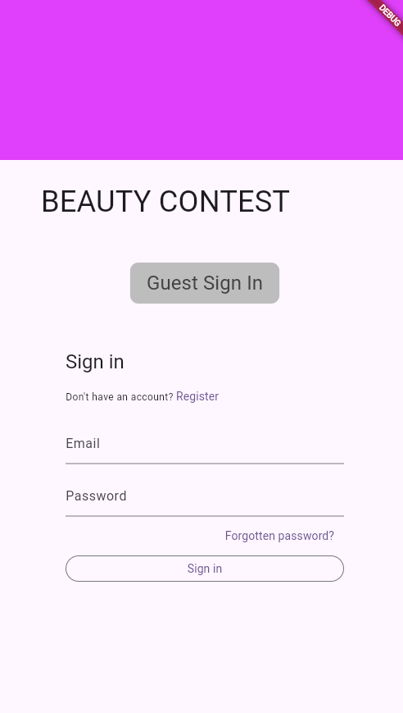
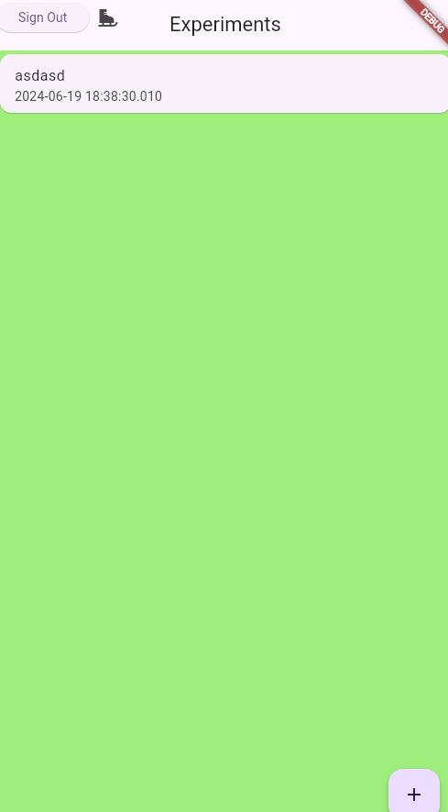
Experiment XYZ
START
12 participants logged in
BAR CODE
8/12 have voted
FINISH

Slide 2
admins
ex-periments
name
location
status
participantCount
voteCount
adminUID123
experimentXYZ
isAnonymous
experiments: [experimentXYZ, …]
users
users
If status == inProgress
userUID467
userUID467
number
experimentDocID: experimentXYZ

Slide 3
Only admin with same UID can read, update and delete
Only if createdExperimentCount < freeExperimentCount they can also create
ex-periments
admins
adminUID123
experimentXYZ
createdBy: adminUID123
name
location
status
bool isAnonymous
int createdExperimentCount
Only admin with same UID can read and write
users
If status == inProgress
Allow to add user docs
settings
Everyone signed in can
userUID467
number
generalSettings
int freeExperimentCount
Only admin with same UID can read and write
Everyone signed in can read

Slide 4
Only admin with same UID can read, update and delete
Only if createdExperimentCount < freeExperimentCount they can also create new experiments
admins
Only admin with same UID can read and write
experiments
String createdBy: adminUID123
String name
String location
String status (enum)
adminUID123
bool isAnonymous
int createdExperimentCount
experimentXYZ
settings
status
admin of experiment can update
Everyone signed in can read, nobody can write
users can read
generalSettings
status
bool isOpen
int winningNumber
List<String> winnerUIDs
int freeExperimentCount
users
Signed in users can create if isOpen
Users can only update their own document if isOpen and number == null
userUID456
int number
Class Vote {
String userUid;
Int guessedNumber;
}

Slide 5
admins
adminUID123
isAnonymous
ex-periments
experimentXYZ
name
location
status
participantCount
voteCount
users
If status == inProgress
userUID467
int number

