Slide 1
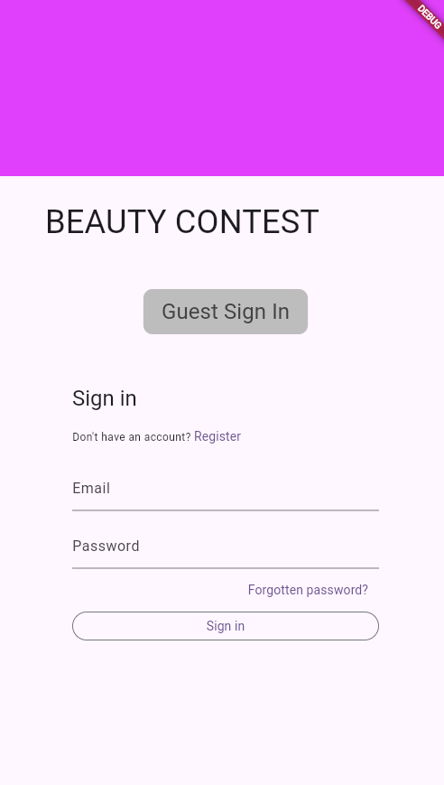
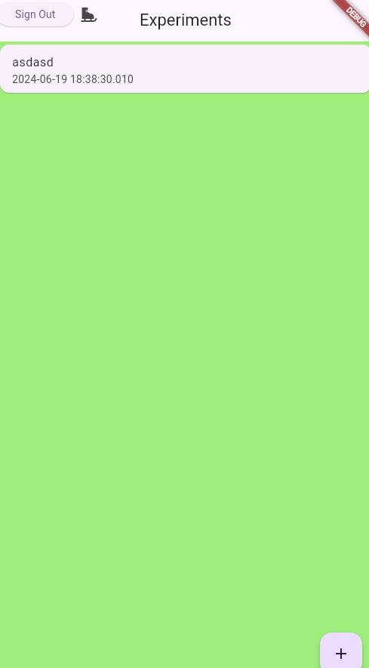
Experiment XYZ
START
12 participants logged in
BAR CODE
8/12 have voted
FINISH

Slide 2
admins
ex-periments
name
location
status
participantCount
voteCount
adminUID123
experimentXYZ
isAnonymous
experiments: [experimentXYZ, …]
users
users
If status == inProgress
userUID467
userUID467
number
experimentDocID: experimentXYZ

