Slide 1

UNDERSTANDING DISEASE TRANSMISSION AND MODELLING
Presented by :
Agbatan Fiacre Luc KOUDERIN (Benin)
Salam MUSA (Sudan)
Peter ABUGRI (Ghana)
Vicky CHUKWUDI (Nigeria)

Slide 2
Disease Transmission
Model Selection
01
04
Role of Mathematical Models
Challenges in Modeling
02
05
Assessing Interventions
Conclusions
03
06
Factors and modes of disease transmission
General criteria for Model Selection and Application to Cholera
Using of Mathematical Models in description of transmission and dynamics of diseases
Key Challenges faced in disease modeling
Using Models in the prediction of interventions impacts

Slide 3
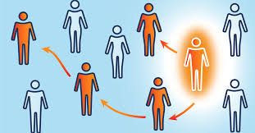
Introduction
Disease transmission describes how infectious agents spread through populations via contact, airborne, or vector-borne modes. Mathematical models help understand these dynamics and guide public health actions. They assess interventions like vaccination and quarantine for effective disease control.

Slide 4
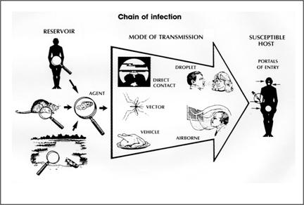
01
Disease Transmission
Disease Transmission Factors
Disease Transmission Modes

Slide 5
Disease Transmission Factors
Disease transmission refers to the process by which a pathogen spreads from an infected host to a susceptible individual.
The efficiency of transmission depends on two factors:
Infectiousness: The ability of the infected individual to spread the pathogen
Susceptibility: The likelihood of uninfected individuals becoming infected after exposure.
Each of these factors has a biological, behavioral, and environmental component.

Slide 6
Disease Transmission Factors: Infectiousness
Biological Infectiousness :
Depends on the excretion of infectious pathogens and pathogen life cycle
Examples:
Malaria: Periodic release of Plasmodium gametocytes during human infection
HIV: Viral load determines infectiousness during sexual transmission
Influenced by:
Host immunity (innate and acquired)
Pathogen characteristics (e.g., replication rate, virulence factors)
Interaction between host and pathogen genetics

Slide 7
Disease Transmission Factors: Infectiousness
Behavioral Infectiousness :
Dependent on contact patterns of infected individuals
Examples:
Sexually Transmitted Infections (STIs): Intimate contact with highly dispersed frequencies (few individuals have multiple partners, while most have few)
Respiratory Infections (e.g., influenza): More casual contact like handshakes or conversational interactions, with frequencies clustering around an average

Slide 8
Disease Transmission Factors: Infectiousness
Environmental Infectiousness :
Influenced by conditions such as temperature, humidity, and airflow, which affect pathogen survival outside the host.
Examples:
Cholera: Seasonal outbreaks driven by rainfall and temperature variations
Severe Acute Respiratory Syndrome (SARS) : Superspreading events due to airflow dynamics (e.g., Hong Kong's Amoy Gardens estate in 2003)

Slide 9
Disease Transmission Factors: Susceptibility
Biological Factors :
Immune memory from past infections or vaccinations (e.g., resistance to influenza)
Presence of comorbidities (e.g., ulcerative STIs increase HIV transmission risk)
Behavioral Factors :
Personal hygiene and protective behaviors (e.g., condom use, handwashing)
Environmental Factors :
Living conditions (e.g., crowded areas favor respiratory infections)
Seasonal patterns (e.g., flu spikes in winter)

Slide 10
Disease Transmission Modes
Airborne Infections: Transmitted through respiratory droplets or aerosols, e.g., tuberculosis and COVID-19.
Vector-Borne Infections: Spread through vectors like mosquitoes or ticks, as seen in malaria, dengue, and Lyme disease.
Food and Waterborne Infections: Contracted by consuming contaminated food or water, including cholera and food poisoning
Sexually Transmitted Infections (STIs): Transmitted through sexual contacts, such as HIV, syphilis, and gonorrhea
Direct Contact Infections: Passed from person to person through physical contact, like skin infections (e.g., cellulitis) and some STIs.
Zoonotic Infections: Originating from animals, transferred to humans, for instance, rabies and Ebola.

Slide 11
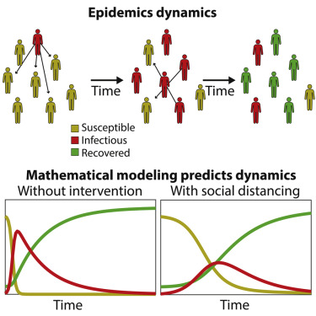
02
Role of Mathematical Models
Describing Transmission Processes
Understanding Disease Dynamics

Slide 12
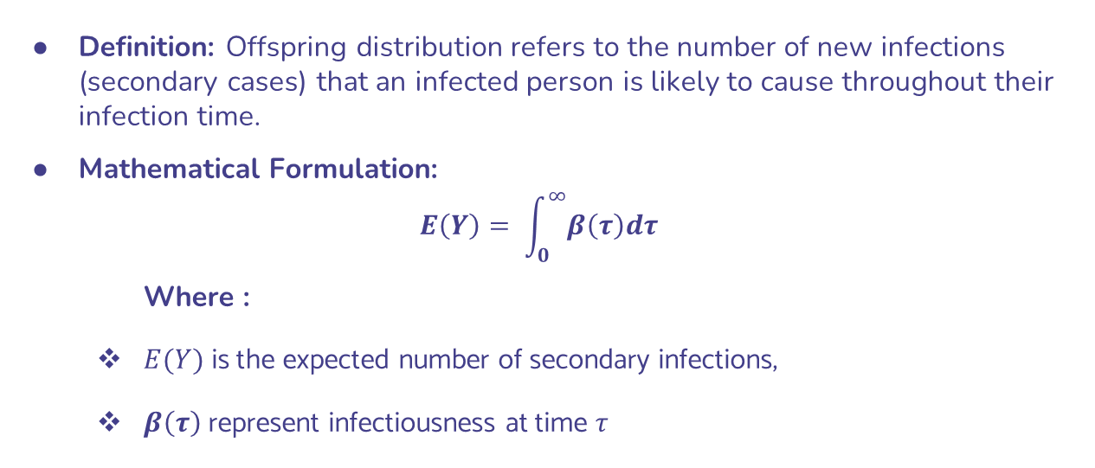
Describing Transmission Processes: Offspring distribution
Definition: Offspring distribution refers to the number of new infections (secondary cases) that an infected person is likely to cause throughout their infection time.
Mathematical Formulation:
$$E\left(Y\right)= \int_{0}^{∞}{β\left(τ\right)dτ}$$
Where :
$E(Y)$ is the expected number of secondary infections,
$β\left(τ\right)$ represent infectiousness at time $τ$

Slide 13
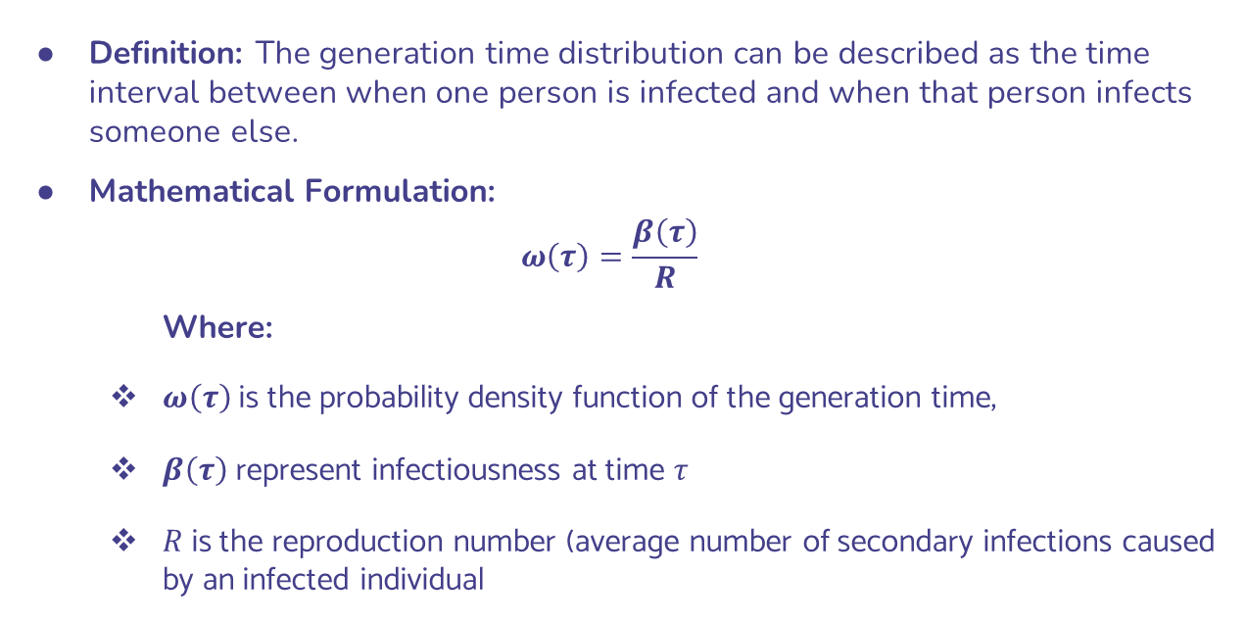
Describing Transmission Processes: Generation time distribution
Definition: The generation time distribution can be described as the time interval between when one person is infected and when that person infects someone else.
Mathematical Formulation:
$$ω\left(τ\right)=\frac{β\left(τ\right)}{R}$$
Where:
$ω\left(τ\right)$is the probability density function of the generation time,
$β\left(τ\right)$ represent infectiousness at time $τ$
$R$ is the reproduction number (average number of secondary infections caused by an infected individual

Slide 14
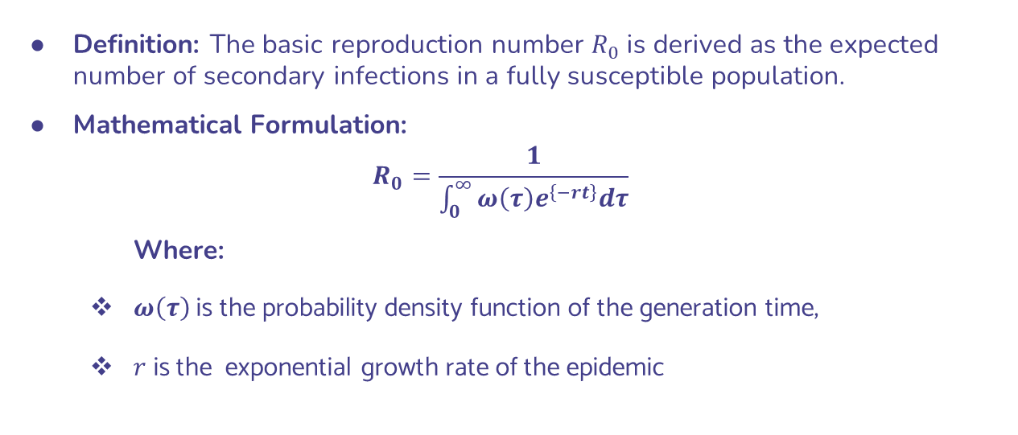
Understanding Disease Dynamics: Estimating the Basic Reproduction Number
Definition: The basic reproduction number $R_{0}$ is derived as the expected number of secondary infections in a fully susceptible population.
Mathematical Formulation:
$$R_{0}=\frac{1}{\int_{0}^{∞}{ω\left(τ\right)e^{\left\{−rt\right\}}dτ}}$$
Where:
$ω\left(τ\right)$is the probability density function of the generation time,
$r$ is the exponential growth rate of the epidemic

Slide 15
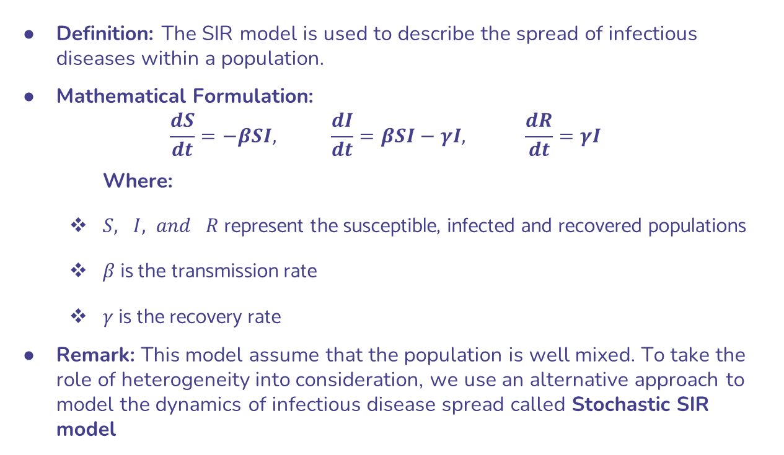
Understanding Disease Dynamics: SIR Compartmental model
Definition: The SIR model is used to describe the spread of infectious diseases within a population.
Mathematical Formulation:
$$\frac{dS}{dt}=−βSI, \frac{dI}{dt}=βSI−γI, \frac{dR}{dt}=γI$$
Where:
$S, I, and R$ represent the susceptible, infected and recovered populations
$β$ is the transmission rate
$γ$is the recovery rate
Remark: This model assume that the population is well mixed. To take the role of heterogeneity into consideration, we use an alternative approach to model the dynamics of infectious disease spread called Stochastic SIR model

Slide 16
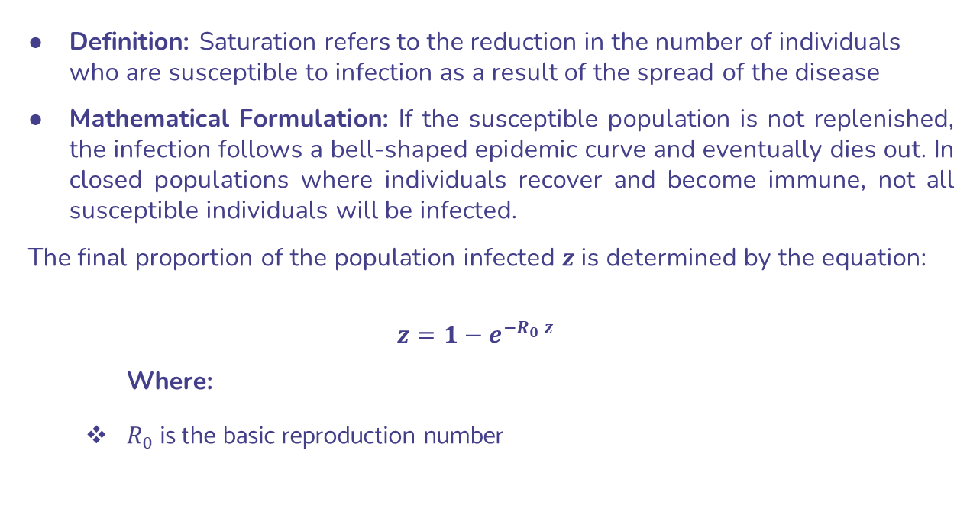
Understanding Disease Dynamics: Exploring Complex Dynamics (Saturation)
Definition: Saturation refers to the reduction in the number of individuals who are susceptible to infection as a result of the spread of the disease
Mathematical Formulation: If the susceptible population is not replenished, the infection follows a bell-shaped epidemic curve and eventually dies out. In closed populations where individuals recover and become immune, not all susceptible individuals will be infected.
The final proportion of the population infected $z$ is determined by the equation:
$$z=1−e_{ }^{−R_{0} z}$$
Where:
$R_{0}$ is the basic reproduction number

Slide 17
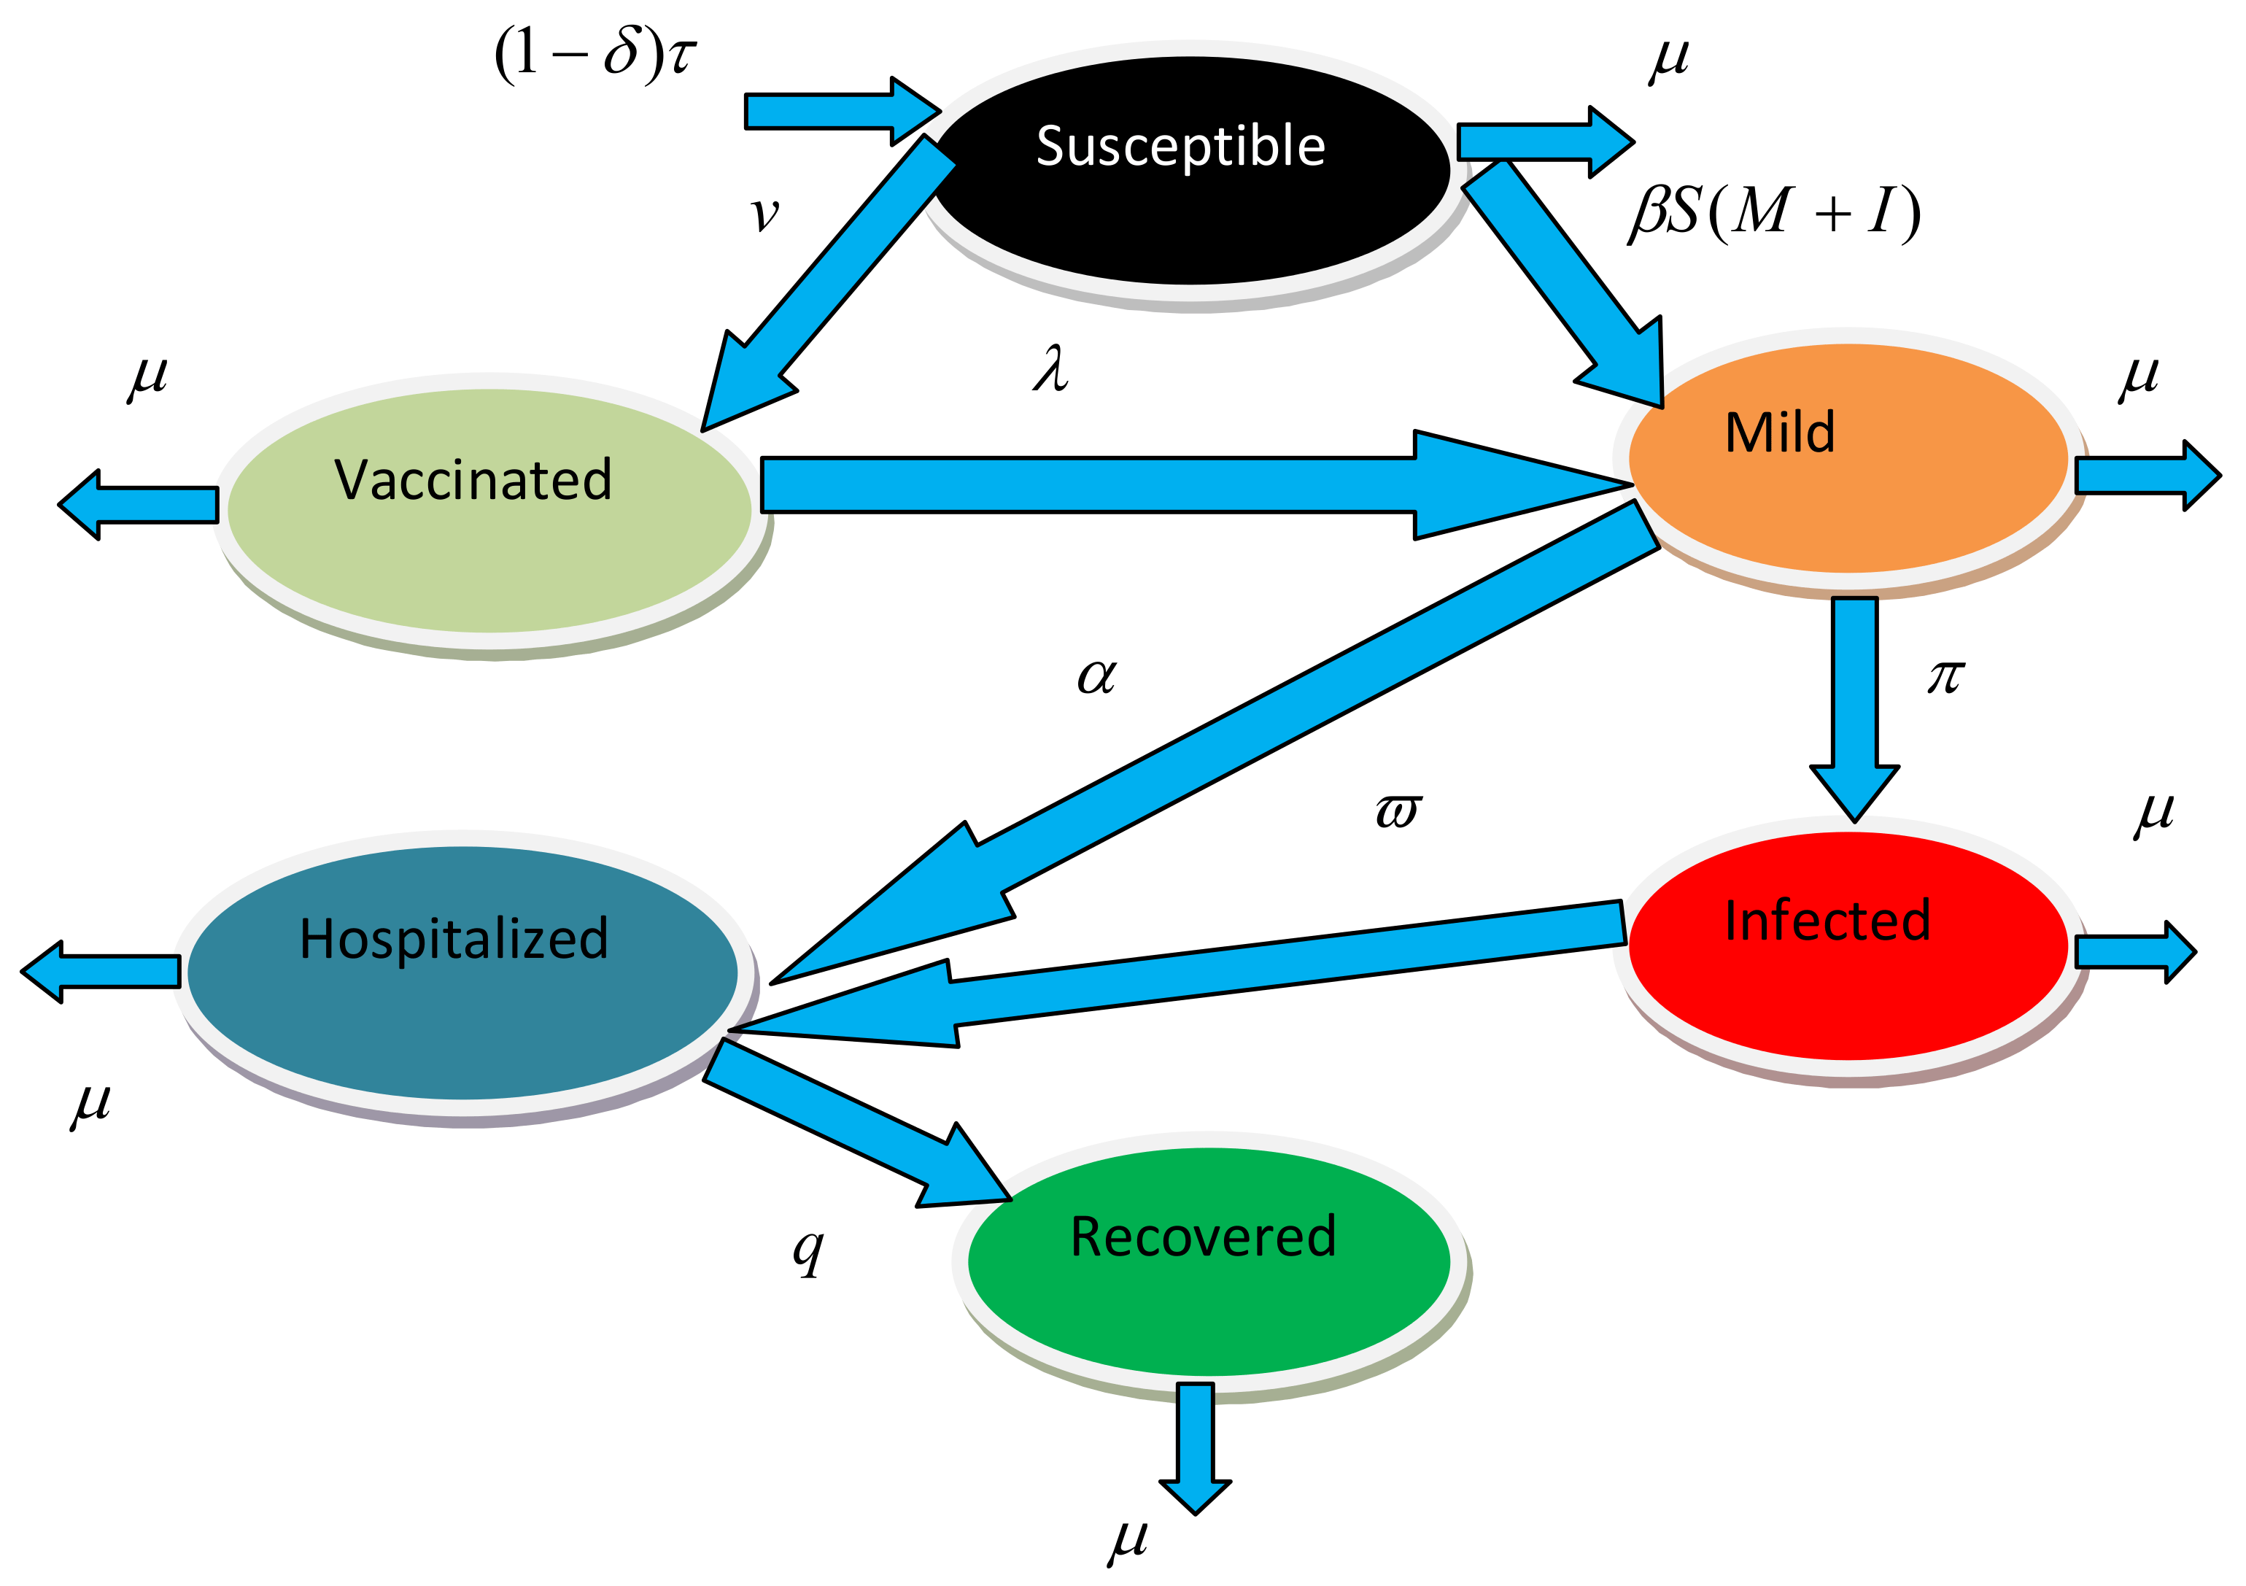
03
Assessing Interventions
Reproduction number and critical thresholds
Predicting the Effectiveness of Interventions
Timing of Interventions and Pre-Symptomatic Transmission

Slide 18
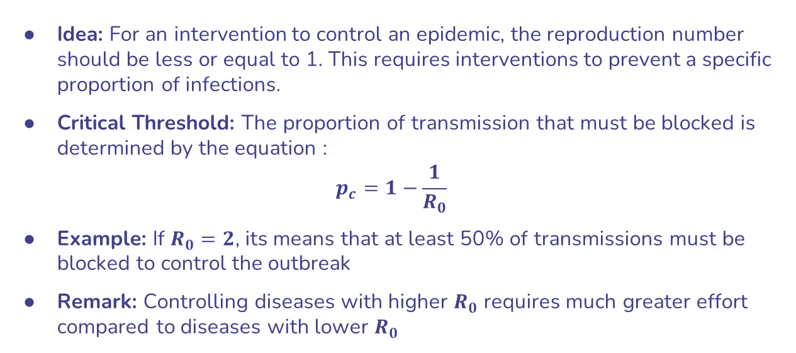
Reproduction number and critical thresholds
Idea: For an intervention to control an epidemic, the reproduction number should be less or equal to 1. This requires interventions to prevent a specific proportion of infections.
Critical Threshold: The proportion of transmission that must be blocked is determined by the equation :
$$p_{c}=1−\frac{1}{R_{0}}$$
Example: If $R_{0}=2$, its means that at least 50% of transmissions must be blocked to control the outbreak
Remark: Controlling diseases with higher $R_{0}$ requires much greater effort compared to diseases with lower $R_{0}$

Slide 19
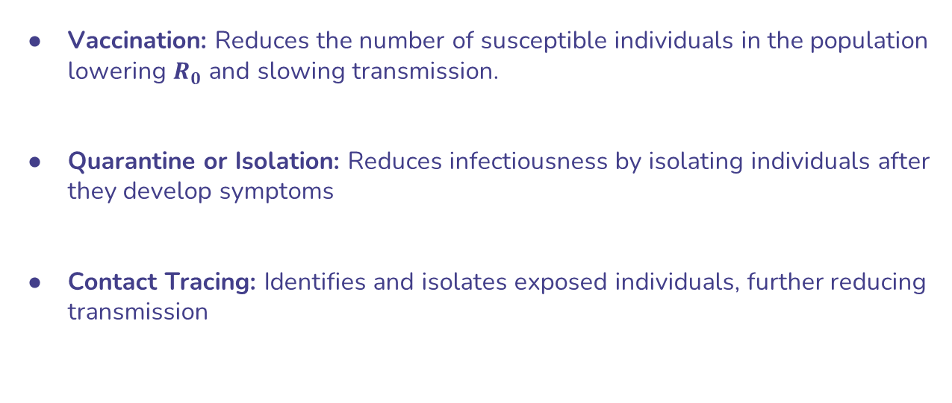
Predicting the Effectiveness of Interventions
Vaccination: Reduces the number of susceptible individuals in the population lowering $R_{0}$ and slowing transmission.
Quarantine or Isolation: Reduces infectiousness by isolating individuals after they develop symptoms
Contact Tracing: Identifies and isolates exposed individuals, further reducing transmission

Slide 20
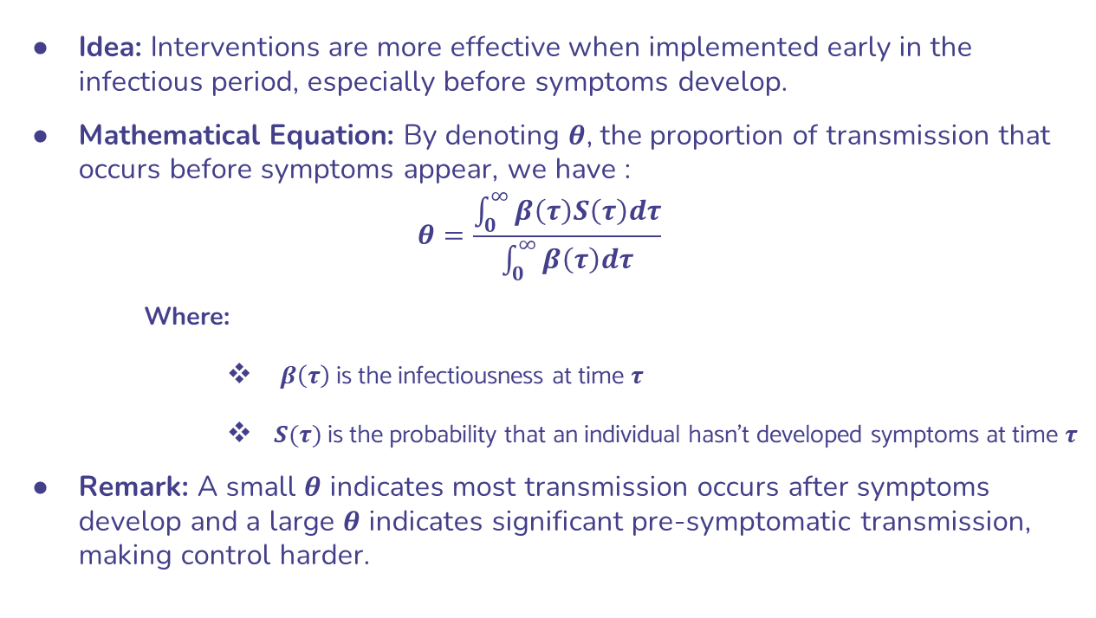
Timing of Interventions and Pre-Symptomatic Tranmission
Idea: Interventions are more effective when implemented early in the infectious period, especially before symptoms develop.
Mathematical Equation: By denoting $θ$, the proportion of transmission that occurs before symptoms appear, we have :
$$θ=\frac{\int_{0}^{∞}{β\left(τ\right)S\left(τ\right)dτ}}{\int_{0}^{∞}{β\left(τ\right)dτ}}$$
Where:
$β\left(τ\right)$ is the infectiousness at time $τ$
$S(τ)$ is the probability that an individual hasn’t developed symptoms at time $τ$
Remark: A small $θ$ indicates most transmission occurs after symptoms develop and a large $θ$ indicates significant pre-symptomatic transmission, making control harder.

Slide 21
04
Model Selection
Mains Criteria for Model Selection
Application to Cholera

Slide 22
Main Criteria for Model Selection: Simplicity (Parsimony)
Principle: Choose the simplest model that explains the data and addresses the scientific question. .
Reasoning: A simple model minimizes unnecessary complexity, making it easier to interpret and apply while still capturing essential dynamics
Example: For early epidemic stages, a basic SIR (Susceptible-Infectious-Recovered) model may suffice instead of adding unnecessary compartments

Slide 23
Main Criteria for Model Selection: Fit the Question of Interest
Principle: The model must be capable of answering the specific research or policy question.
Reasoning: Different diseases and interventions require tailored models (e.g., models with vaccination compartments for vaccine-preventable diseases).
Example: For HIV modeling, a model might include long-term compartments like latency, while for influenza, models often emphasize short-term transmission dynamics.

Slide 24
Main Criteria for Model Selection: Handling Stochasticity (Randomness)
Principle: Choose a model that accounts for randomness in disease spread and observation processes.
Reasoning: Stochastic models better reflect real-world variability, especially when case numbers are low.
Example: Random events early in an epidemic can drastically influence its trajectory, which deterministic models may fail to capture.

Slide 25
Main Criteria for Model Selection: Adaptability to New Data
Principle: A good model should be flexible enough to evolve as new observations or data become available.
Reasoning: Epidemic dynamics often change over time due to interventions or evolving pathogen characteristics.
Example: Revising a model to include vaccination rollout during an outbreak.

Slide 26
Main Criteria for Model Selection: Balancing Complexity and Accuracy
Principle: Evaluate whether added complexity improves the model enough to justify the extra parameters.
Method: Use tools like likelihood ratios, Akaike Information Criterion (AIC), or Bayesian Information Criterion (BIC) to compare models.
Example: Adding more compartments to represent latent stages or pre-symptomatic phases must improve predictions significantly to warrant inclusion. .

Slide 27
Main Criteria for Model Selection: Ability to Explain Data
Principle: The model should match observed data and explain trends or outcomes effectively.
Method: Use statistical inference methods (frequentist, Bayesian, or information-theoretic approaches) to evaluate how well the model fits the data.

Slide 28
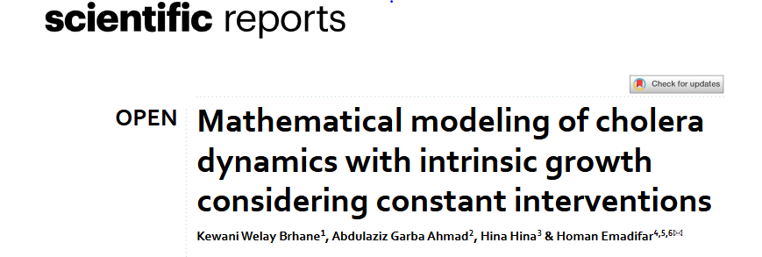
Application to Cholera: Using Paper of Kewani & al.

Slide 29
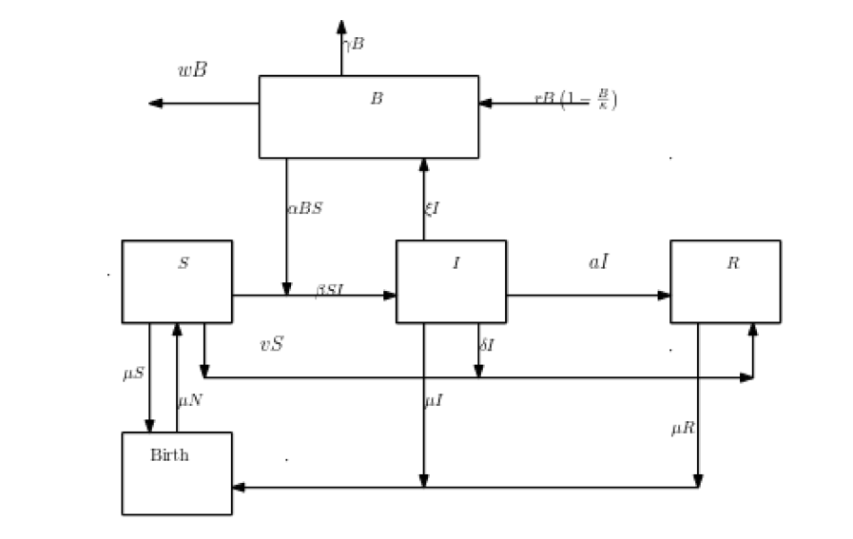
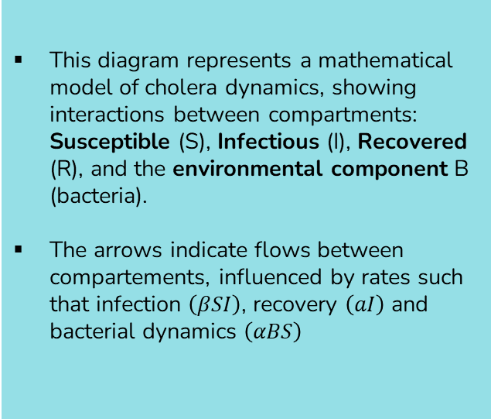
Application to Cholera: Mathematical Model Diagram
This diagram represents a mathematical model of cholera dynamics, showing interactions between compartments: Susceptible (S), Infectious (I), Recovered (R), and the environmental component B (bacteria).
The arrows indicate flows between compartements, influenced by rates such that infection $\left(βSI\right)$, recovery $\left(aI\right)$ and bacterial dynamics $\left(αBS\right)$

Slide 30
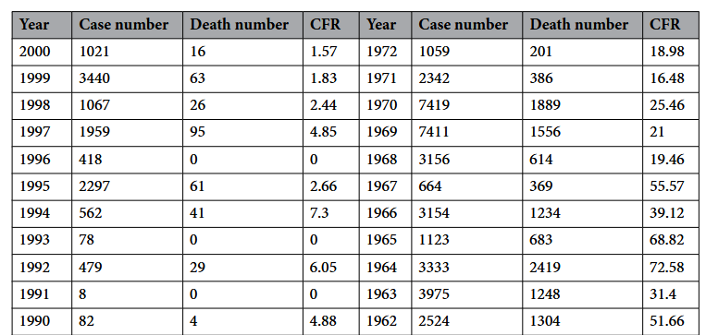
Application to Cholera: Data Used for the Paper
The data used for the research is from WHO cholera data for Bangladesh
It is a time series data with variables likes: death number, CFR, etc.

Slide 31
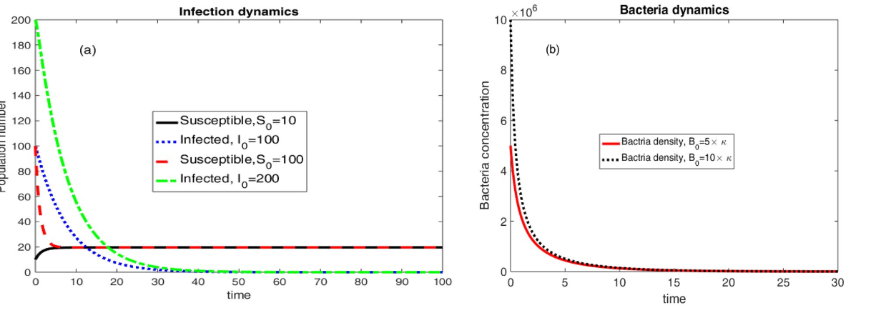
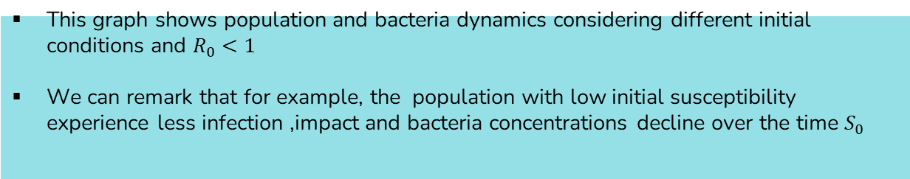
Application to Cholera: Infection and Bacteria Dynamics
This graph shows population and bacteria dynamics considering different initial conditions and $R_{0}<1$
We can remark that for example, the population with low initial susceptibility experience less infection ,impact and bacteria concentrations decline over the time $S_{0}$

Slide 32
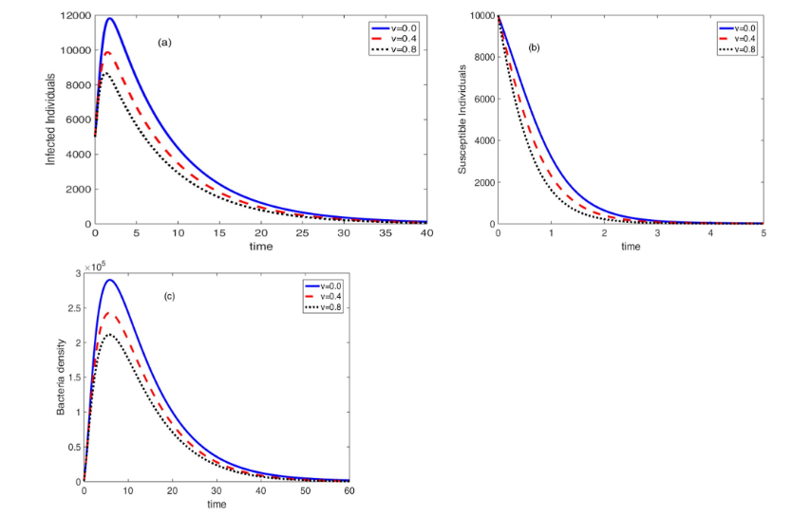
Application to Cholera: Effect on one Intervention on the Dynamics
This graphs shows the effect of Vaccine on the Infected Individuals, Succeptible Individuals and Bacteria density, with respect to time
We can generally remark, as time increases, all of these indicators go to zero

Slide 33
05
Challenges in Modeling
Pathogen Evolution
Missing or Incomplete Data
How People Interact
Pathogen Ecology
Complex Dynamics

Slide 34
Challenge in Modeling : Pathogen Evolution
Problem: Germs (like viruses and bacteria) evolve to survive, especially when faced with vaccines or drugs. This makes them harder to predict and control.
Explanation:
Vaccines targeting only certain types of a germ may cause other types to become more common
Fast-changing germs like the flu make it tough to create vaccines that work well.
Why It Matters : By studying how germs change, we can make better vaccines and treatments.

Slide 35
Challenge in Modeling : Missing or Incomplete Data
Problem: We don’t always know everything about how a disease spreads or how many people it affects because not all cases are reported or tracked.
Explanation:
Sometimes, we don’t have enough information about things like immunity levels in a population.
Data collected over time or in different locations may not fit well together, making it hard to create accurate models.
Why It Matters : Better tools to handle missing or tricky data would help us understand diseases better and make better predictions.

Slide 36
Challenge in Modeling: How People Interact
Problem: Models often assume that people mix randomly, but in real life, people’s interactions are much more complex.
Explanation:
Some people have more interactions (e.g., social butterflies), while others have fewer. This affects how diseases spread.
To improve models, we need to gather better information, like travel patterns or social behaviors.
Why It Matters: Understanding real-world interactions helps predict how diseases move through communities and how to stop them.

Slide 37
Challenge in Modeling: Pathogen Ecology
Problem: The dynamics of a single pathogen can be influenced by interactions with other pathogens, hosts, or population changes
Explanation:
For example, measles mortality historically influenced whooping cough cycles by altering population density.
Co-infections (e.g., bacterial and viral STIs) can amplify transmission dynamics (e.g., HIV-1)
Why It Matters: Understanding ecological interactions can improve control measures and lead to holistic policies for managing infectious diseases.

Slide 38
Challenge in Modeling: Complex Dynamics
Problem: Epidemics often involve emergent behaviors due to stochastic processes, which are difficult to predict.
Explanation:
Epidemic curves can be affected by multiple, interacting variables like host behavior, pathogen evolution, and intervention strategies.
Why It Matters: A better understanding of these processes can help identify the rules governing epidemic behavior and improve control program outcomes.

Slide 39
Conclusions
Mathematical models are essential for predicting disease spread and evaluating interventions. Their success relies on selecting the right model and addressing challenges like data quality and uncertainty. Despite limitations, they remain vital for public health decision-making.

Slide 40
References
Nicholas C. Grassly & Christophe Fraser (2008). Mathematical models of infectious disease transmission. Nature Publishing Group
Kewani Welay Brhane et al. (2024). Mathematical modeling of cholera dynamics with intrinsic growth considering constant interventions. Scientific Reports
Antonovics et al. (2017). The evolution of transmission mode. Philosophical Transactions of the Royal Society B: Biological Sciences
Cascio, A. et al. (2011). The socio-ecology of zoonotic infections. Clinical Microbiology and Infection.
Svensson, A. (2007). A note on generation times in epidemic models. Mathematical Biosciences
Ji, C. and Jiang, D. (2014). Threshold behavior of a stochastic SIR model. Applied Mathematical Modelling
Lessler, J. et al. (2015). Seven challenges for model-driven data collection in experimental and observational studies. Epidemics.
Chao, D. L., Longini, I. M. Jr. & Glenn Morris, J. Jr. (2014). Modeling cholera outbreaks. Curr. Top. Microbiol. Immunol.
Tian, J. P. & Wang, J. (2011).Global stability for cholera epidemic models. Math. Biosci.

Slide 41
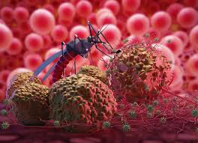
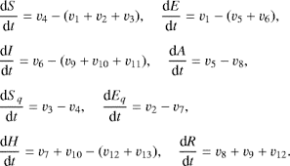
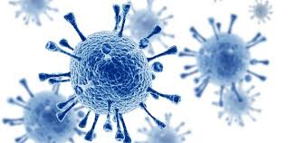
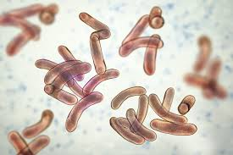
THANK YOU FOR YOUR ATTENTION

