Slide 1
HI² Hypervisor international /In-House
28/11/2025

Slide 2
Hardware architecture Current situation in Italy Current situation in France
Overview
HI² Benefits
In Italy
deployment to production Adaptation to France
Planning previw

Slide 3
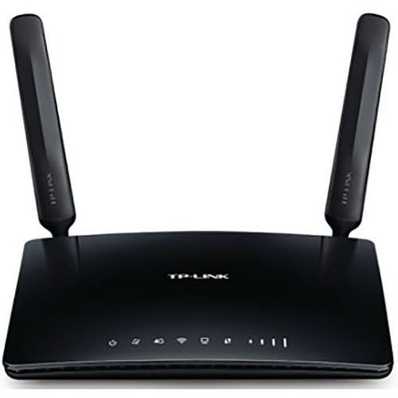

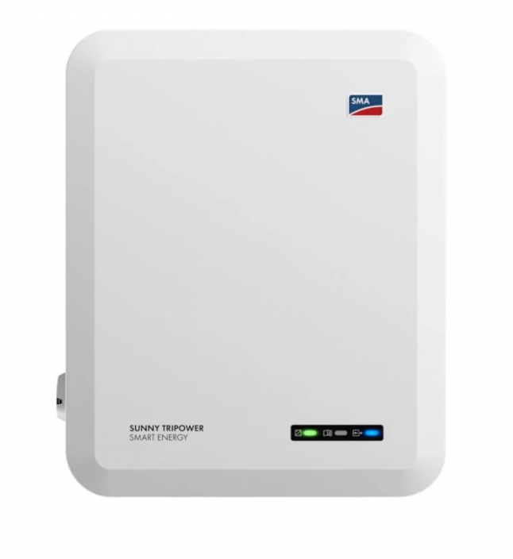
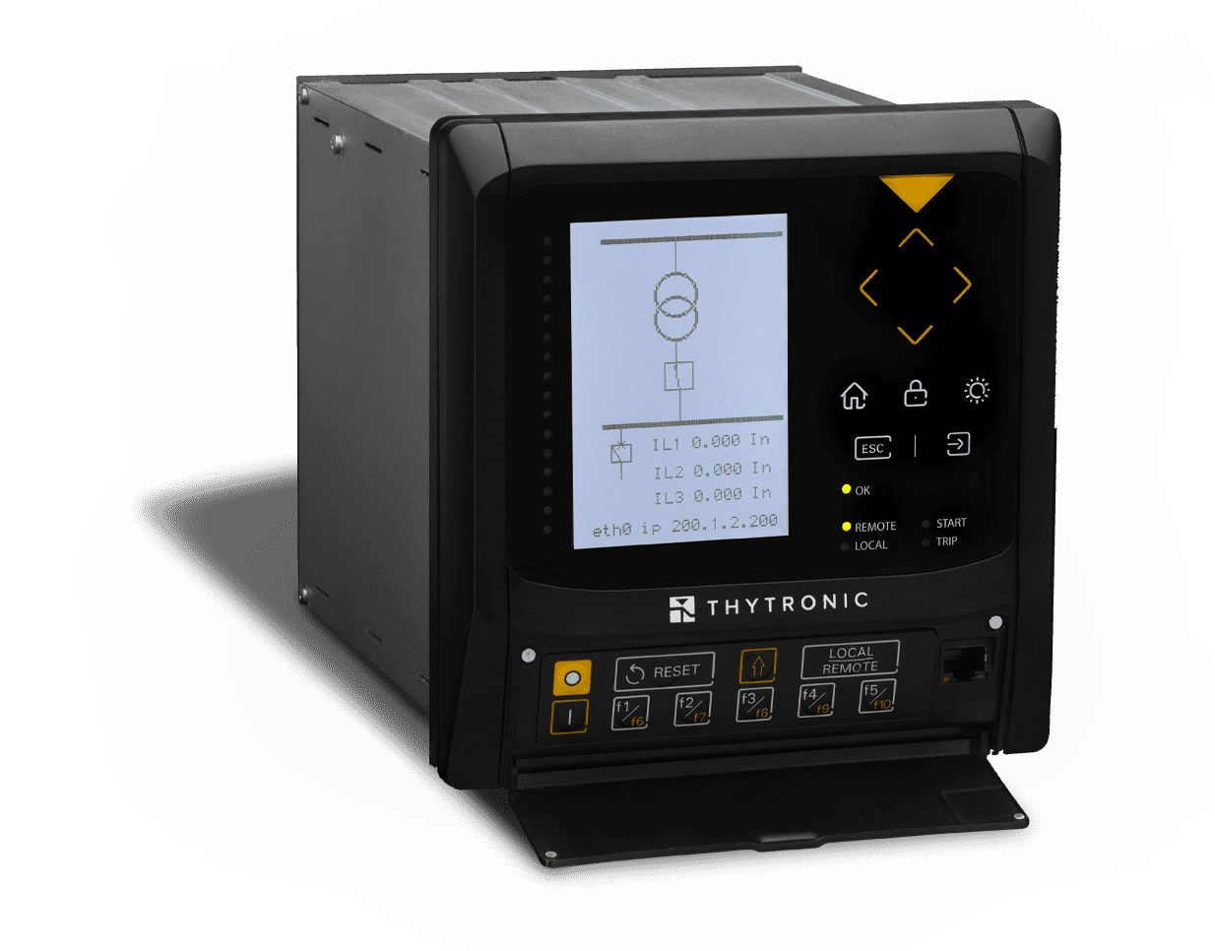

Hardware architecture
VPN Access Integration
Current situation in Italy
…
…
Modem
Network 2
Router
In order to get secure remote access a vpn
could be installed in the router
Network 1
Currently, Thytronics are monitoring
the plant automatically with a threshold on the meter.
Thytronic
Thytronic
Thytronic
If any issue occurs, the Thytronic must be reset
and the plant manually reconnected.
Inverters
Circuit breaker
Circuit breaker
Circuit breaker
Plant

Slide 4
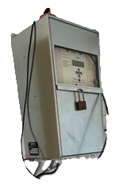
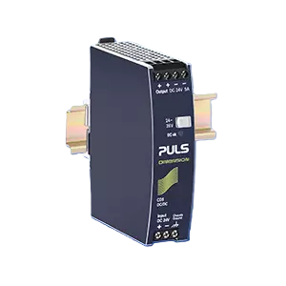
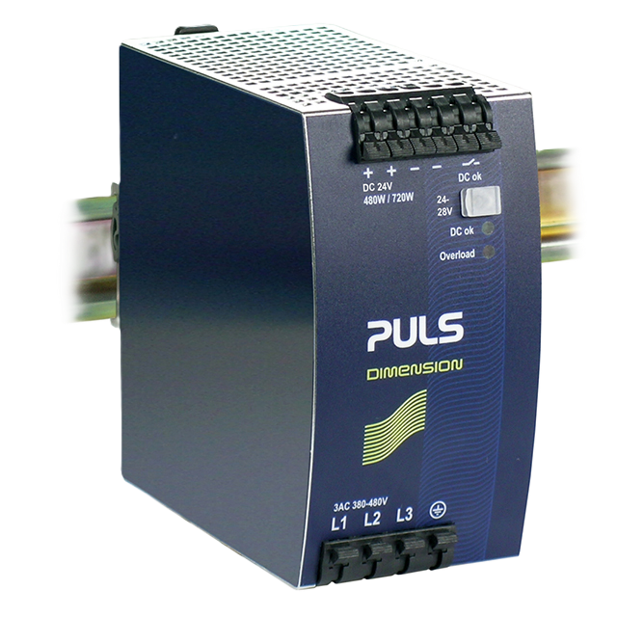
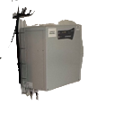

Hardware architecture
Current situation in France
Alim 230V
PDL
PTR
Enedis
Automate slave
DEIE
Mini-PC
Modem 3G/4G
Antena
RJ45
48V
Coaxial
12V/24V
standard Wire
230/24V
Switch
Alim
48V
Automate Master
24V
12V
Frontiere
box
12V
Alim 230V
Switch
Battery au Pb 12V
24V
48V
Battery 12V
Cell
protection
Motor

Slide 5





Hardware architecture
Current situation in France
MQTT
MQTT
Server Broker
Powered by
DEIE
Hyperviseur
Modem 3G/4G
192.168.1.1
Mini-PC
192.168.1.30
PC
Automate slave
Automate Master
192.168.1.17 (wago) 192.168.1.4(siemens)
Smartlogger
(192.168.1.100)
Inverter
(192.168.1.101
192.168.1.102
…
192.168.1.110
…)

Slide 6
HI² Hypervisor in house

Slide 7


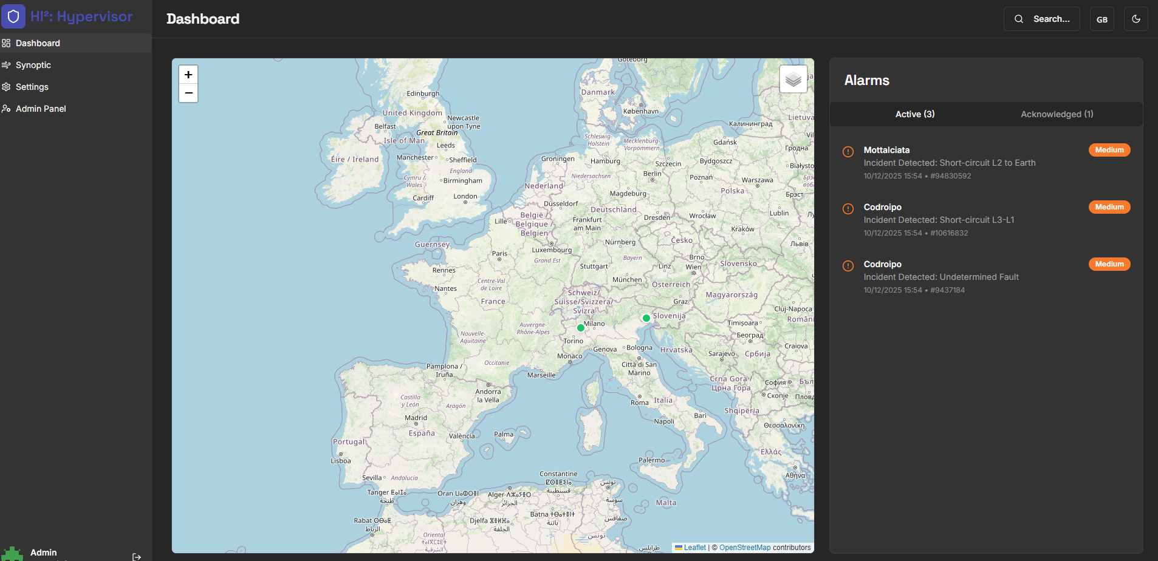


HI²
Benefits
Cost-free, fully developed in-house
Secured by credentials, Microsoft Entra, and VPN
Access can be easily granted to the O&M contractor.
They will be able to give feedback on their action.
And recouple instantly managing the error at distance,

Slide 8
HI²
In Italy
Navigateur web
HTTPS : Port 3000
Front: Next.js
API : Port 3001
Backend: Node/Express
Control
Base de données: SQL Lite
Thytronics
Polling service: Node.js
Modbus/TCP

Slide 9
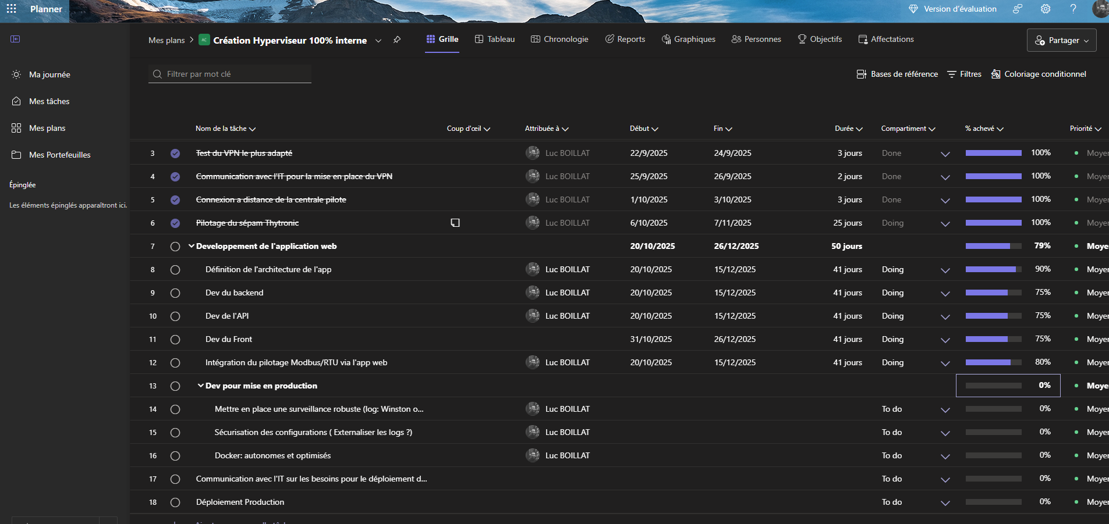
HI²
In Italy (what’s next ?)
Next development:
Modbus Reading Siprotec 7SJ80
Alarm to be sent via email
or SMS
Final solution expected to be delivered in February/March 2026

Slide 10
HI²
deployment to production
Run logic on Virtual machine (the same that it used to host VPN for plant):
Managed by IT. It will be in charge to maintain server launch relaunch web app
Accessible by VPN
HI² will be deployed and update/upgrade by IoT team because it will be simple it will be deployed under docker

Slide 11


HI²
In France
MQTT
MQTT
Server Broker
Modem 3G/4G
192.168.1.1
DEIE
MQTT
Mini-PC
192.168.1.30
Inverter data
PC
Automate slave
Automate Master
192.168.1.17 (wago) 192.168.1.4(siemens)
Smartlogger
(192.168.1.100)

Slide 12
HI²
In France
HTTPS : Port 3000
Navigateur web
Front: Next.js
Server Broker
Backlog to be defined
Development to be planned for Operations
Modification of the Synoptic Menu
Modification of the Inverter Menu
Creation/Modification of plant declarations
API : Port 3001
Backend: Node/Express
Base de données: MongoDB
OU
Polling service: Node.js

Slide 13
HI²
deployment to production
Feb-Mar 2026
Retrofit ending, deplyement of the inhouse hypervisor
Q4 2025
Feb-Mar 2026
Current testing and validation phase in Italian pilot sites, gathering operational data and refining core functionality.
Final solution delivery for Italy with full remote management capabilities and production-ready status.
1
2
3
4
5
Q1 2026
Q2 2026
Development completion with Thytronic reset, circuit breaker monitoring, and alarm system implementation.
Adaptation and deployment planning for French operations, leveraging lessons learned from Italian rollout.

