Slide 1

Path Planning
By: Luc, Tomi, Vik & Karman

Slide 2
Introduction
Problem
Solution
Implementation

Slide 3
Input Example

Slide 4
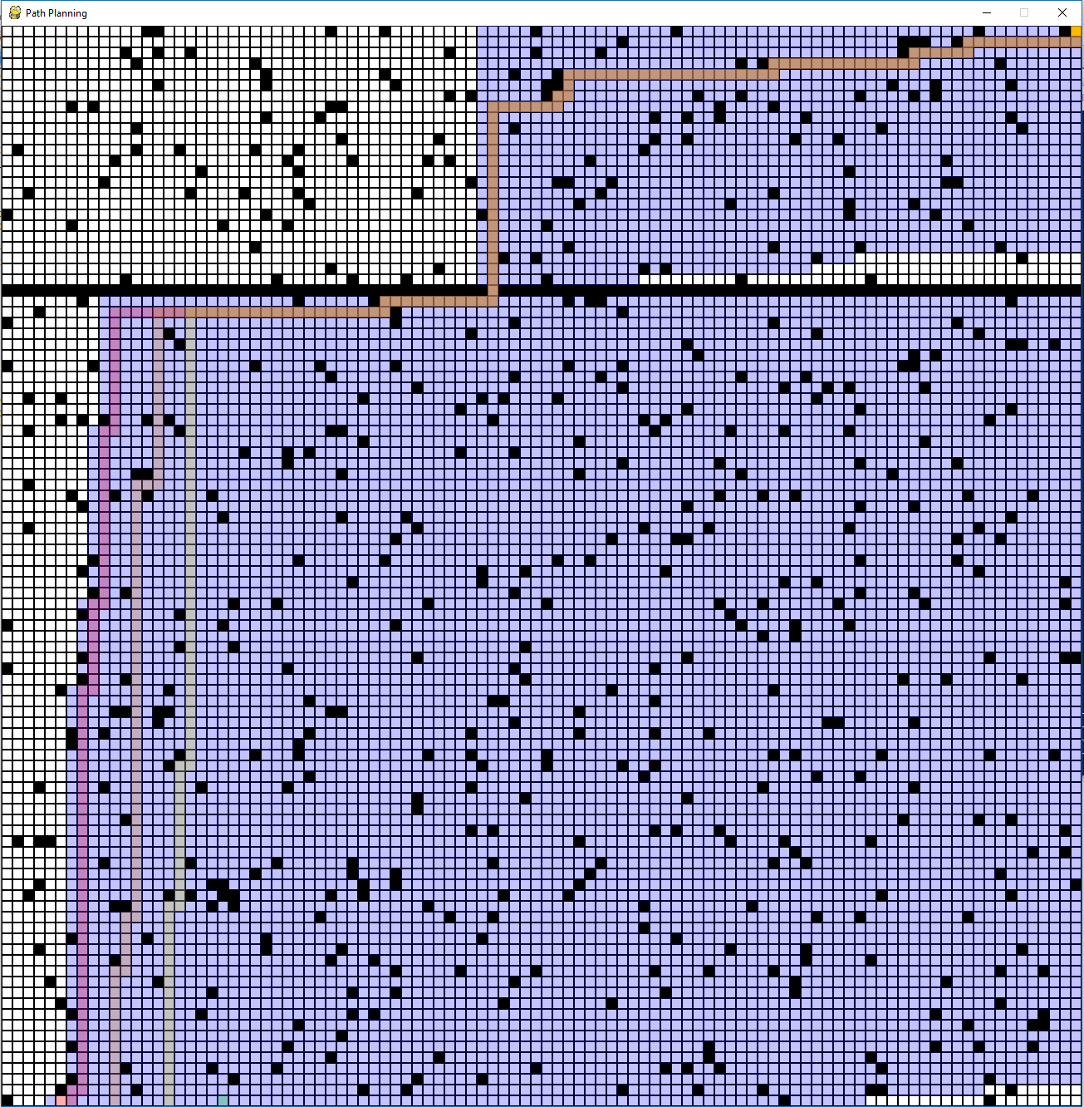
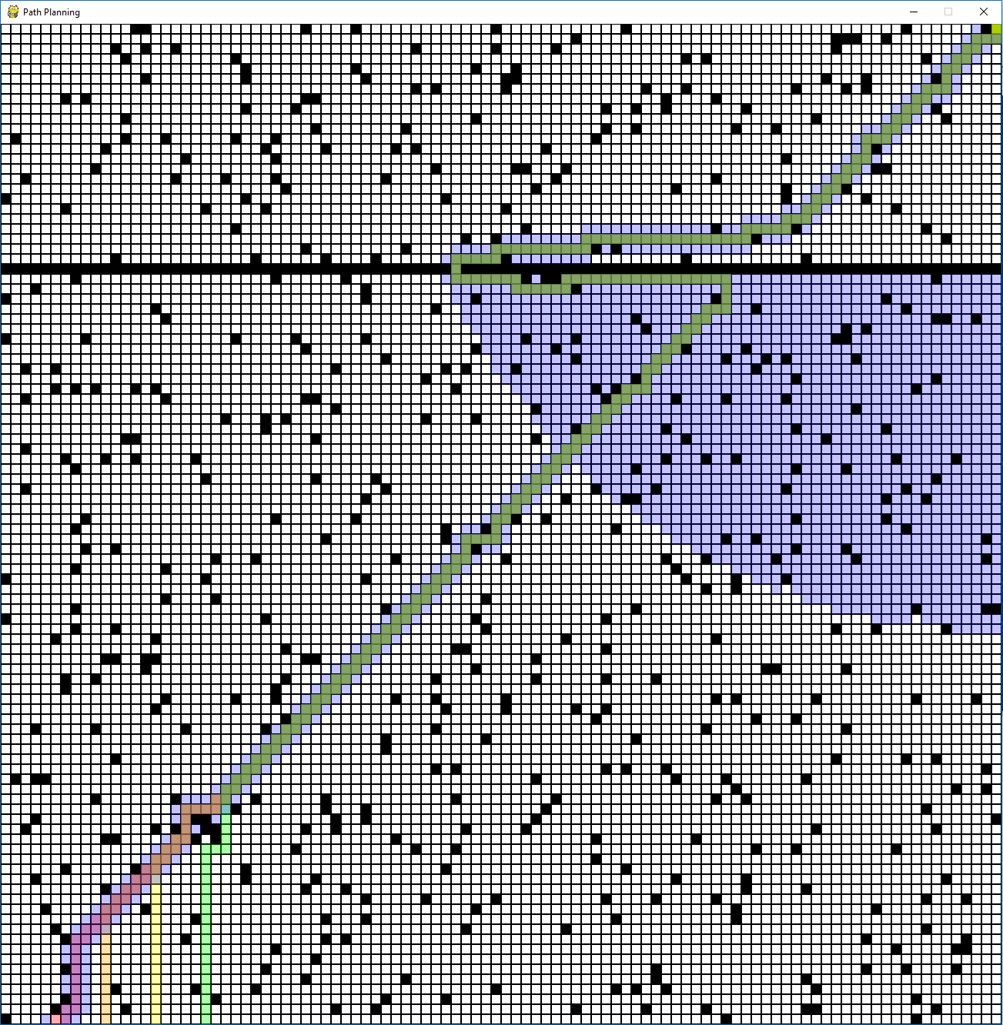
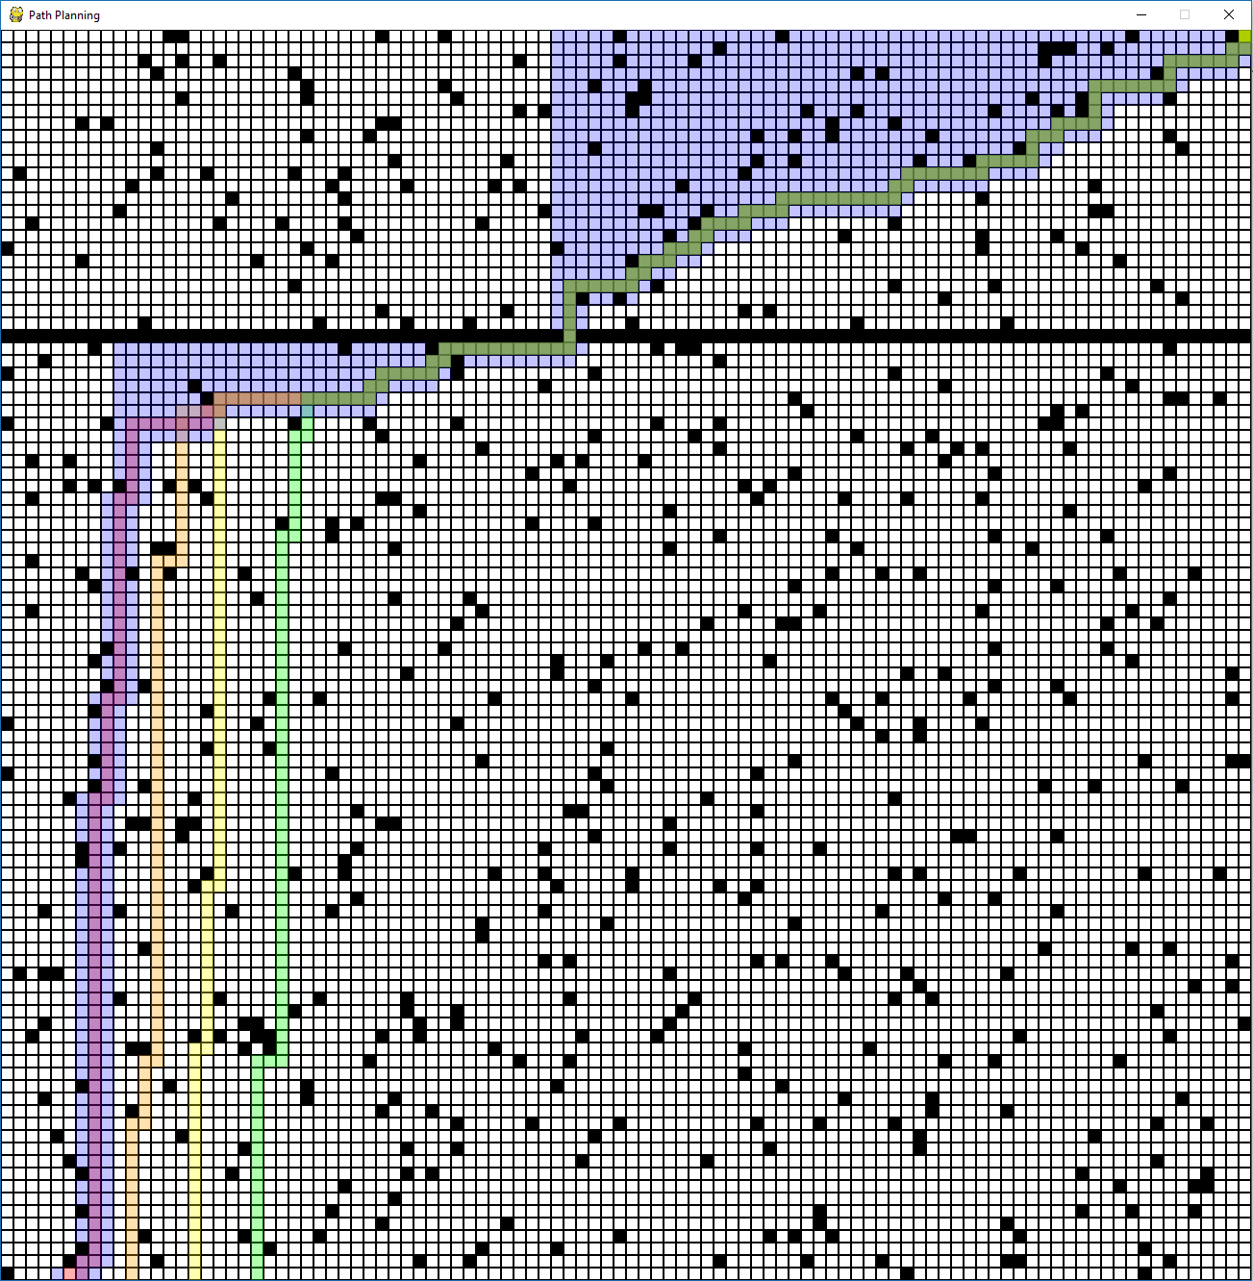
A* - Heuristics
Admissibility - Speed vs. Accuracy
Manhattan Distance, Euclidean Squared, Weighted Manhattan

Slide 5

Demo

Slide 6

Thank You
Questions?

