Slide 1

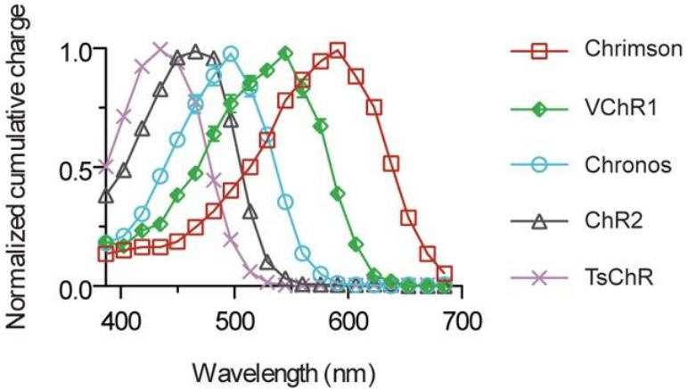
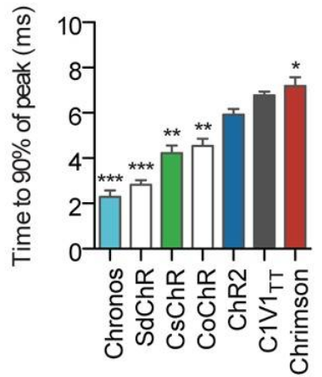
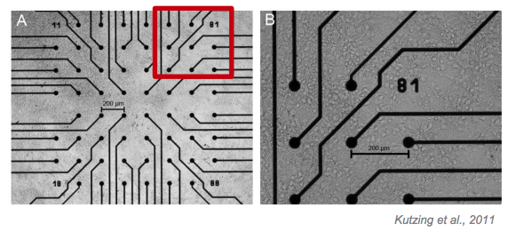
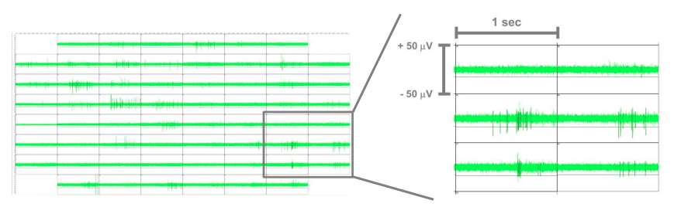
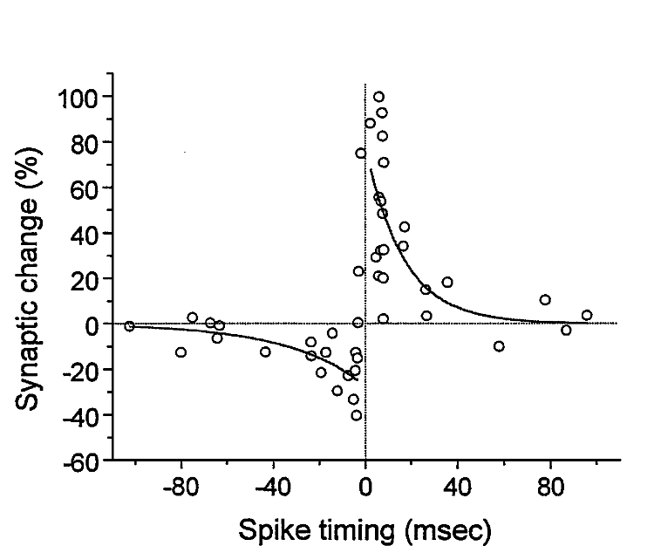
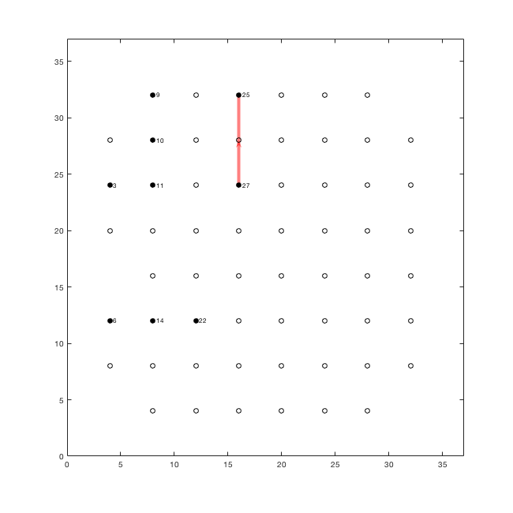
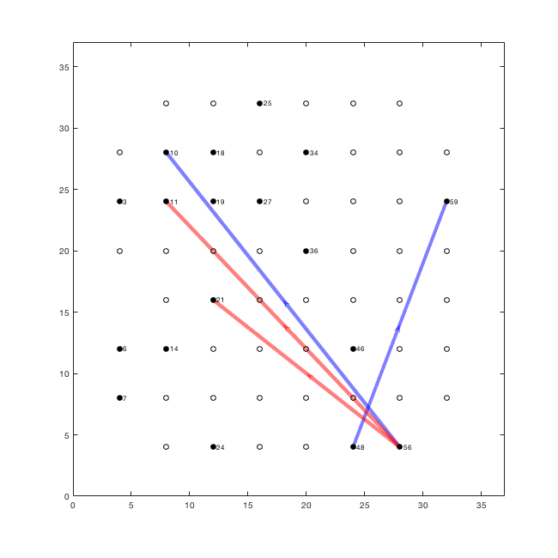
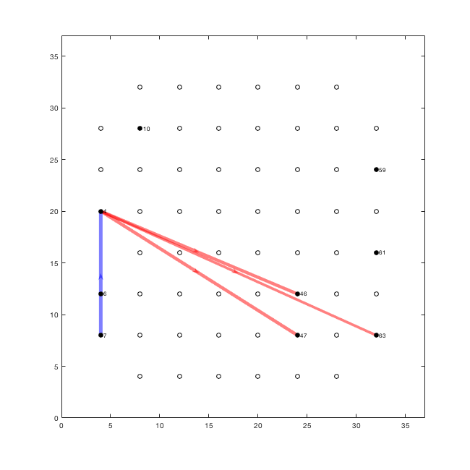
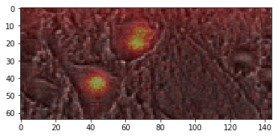
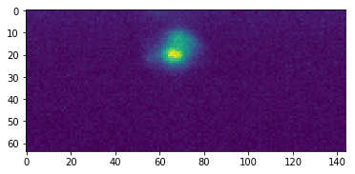
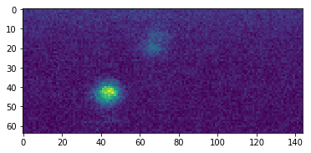
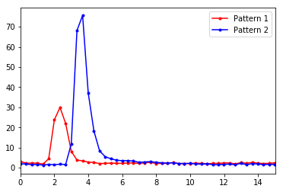
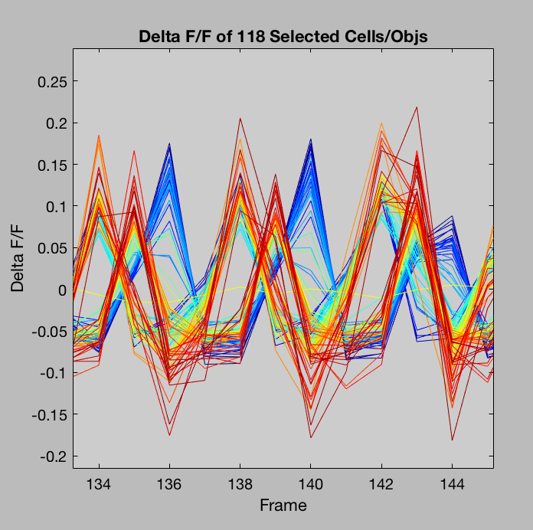
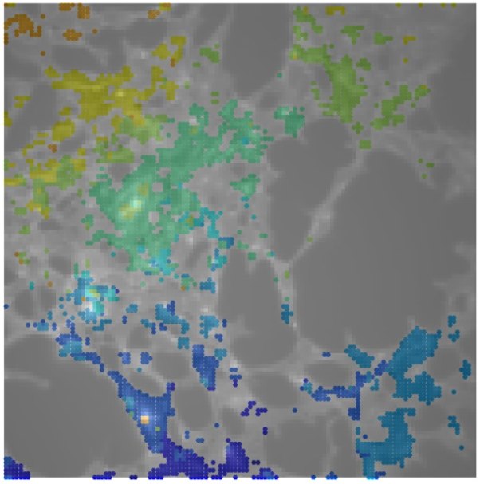
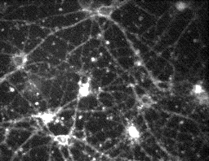
Precision Optogenetics: msec time resolution optical imaging & control of neuronal circuits
L d’Hauthuille, KM O'Neill, PH Alvarez, S Aghayee, SJ Gates III, and W Losert, Department of Physics and IPST, University of Maryland
S Mukherjee, A Sheikhattar, and B Babadi, Department of Electrical Engineering and Computer Engineering, University of Maryland
G Thalhammer and M Ritsch-Marte, Division of Biomedical Physics, Medical University of Innsbruck, Innsbruck, Austria
Motivation
Memory and other information in the brain is encoded in synaptic strength. Changes in synaptic strength sensitively depend on the time sequence of neuronal firing events. The shorter the delay between the firing of presynaptic and postsynaptic neurons, the stronger the effect on plasticity (STDP).
Holographic optogenetics enables targeting of multiple neurons, however, this is currently limited to either simultaneous firing or large delays (~30ms) between firing.
The purpose of this work is to generate new technology in optogenetics to study and perturb the activity of in vitro neuronal circuits on short enough timescales to generate large changes in synaptic strength. We accomplish this by combining the expertise of three groups in fast imaging, fast switching of photo-stimulation patterns and functional connectivity analysis.
Project Goals
Fast Switching of Photostimulation Patterns using SLM
[Losert + Ritsch-Marte Groups]
Channelrhodopsins are naturally occurring light-gated ion channels, that when expressed in neurons, enable optical stimulation. In 2014, the Boyden group at MIT discovered Chronos² (ShChR), an opsin with the fastest kinetics to date: ͳ_{on} = 2.3 ± 0.3 ms, ͳ_{off} = 3.6 ± 0.2 ms
Taking advantage of the fast kinetics of Chronos, 2-photon photo-stimulation will be done using the 1040nm Chameleon Discovery laser
Using a BNS 256x256 SLM that has nominal speeds of 30Hz, through the software-based techniques of overdrive and phase change reduction, transition times between two target intensity patterns of ~1ms have been demonstrated by the Ritsch-Marte Group*
Functional Connectivity Analysis using Granger Causality
[Losert + Babadi Groups]
Embryonic rat hippocampal neurons are cultured on microelectrode arrays (MEA). Spontaneous activity of the networks was recorded on days in vitro (DIV) 7, div 10, and div 17.
Spike times obtained by adaptive thresholding of electrode data. Spikes are binned at 300ms to obtain point processes for burst events. Likelihood models are estimated for active electrodes separately on each day in vitro.
Granger Causal link is established between two electrodes if the bursting likelihood of the first is significantly increased by knowledge of the second’s bursting history.
Functional networks are visualized by compiling all Granger Causal links (Fig. 8).
a)
b)
Fig. 1: Spiking-Time Dependent Plasticity: Change in connection strength increases/decreases substantially with smaller Δt between pre-synaptic and post-synaptic firing. [Bi & Poo 2001]
Fig. 7: Data recorded from neuronal network cultured on MEA. (a) MEA showing cell bodies of critical neurons³. (b) Burst events occurring simultaneously on multiple electrodes during recording.
Fig. 4: Spectral sensitivity of the studied opsins (Dashed red line is ½ λ_{IR} ).
Fig. 5: Time to reach 90% peak, when illuminated near their peak wavelength.
Fast Imaging of HEK Cells
[Losert Group]
The voltage-sensitive dye BeRST¹, developed by the Miller group at Berkeley is used to detect transmembrane potential. Its response time is <1ms.
Imaging BeRST-stained HEK cells at 231 fps, we can detect not only individual electrical activity but propagation through the group.
Neural networks are formed by culturing embryonic rat neurons and allowing them to mature in vitro. The techniques shown above will soon be used on these cultures.
a)
b)
c)
a)
X-axis (Pixels)
b)
Pattern 1
c)
Pattern 2
Y-axis (Pixels)
a)
b)
d)
Fig. 8: Granger Causal Networks on three different days in vitro. Red (blue) links indicate excitatory (inhibitory) connections. Line width indicates strength of link. (a) Links at DIV 7. (b) Links at DIV 10. (c) Links at DIV 17.
In preliminary experiments in July, we used the BNS SLM system in our lab and switched intensity patterns in 2ms, targeting two separate neurons in a fixed sample. (Fig. 6 a, b, c, d)
Intensity
Time (ms)
Fig. 2: Propagation of electrical activity in NK-HEK cells. a) Electrical activity of individual cells shows that there are delays between spikes. b) Phase map showing delays between groups of cells (blue→orange corresponds to 0→35 msec). Imaged at 231 fps.
Fig. 6: Preliminary experimental results.
Next Steps
Integration of fast imaging and fast-switching of photo-stimulation patterns
Study spike time dependent plasticity (STDP) using Granger Causality
Submit Brain Initiative Grant on precision optogenetics
References
Huang YL, Walker AS, Miller EW. A Photostable Silicon Rhodamine Platform for Optical Voltage Sensing. J Am Chem Soc. 2015
Klapoetke NC, Murata Y, Kim SS, et al. Independent optical excitation of distinct neural populations. Nat Methods. 2014
Kutzing MK1, Luo V, Firestein BL. Measurement of synchronous activity by microelectrode arrays uncovers differential effects of sublethal and lethal glutamate concentrations on cortical neurons. Ann Biomed Eng. 2011
Fig. 3: Primary cortical neurons respond to DC stimulation after maturing for 10 days in vitro.

