Slide 1
Module 3
Implementing IPv6
Notes:
Presentation: 110 minutes
Lab: 75 minutes
After completing this module, students will be able to:
Describe the features and benefits of Internet Protocol version 6 (IPv6).
Configure an IPv6 host.
Implement coexistence between Internet Protocol version 4 (IPv4) and IPv6 networks.
Transition from an IPv4 network to an IPv6 network.
Required materials
To teach this module, you need the Microsoft PowerPoint file 20741B_03.pptx.
Preparation tasks
To prepare for this module, you should:
Read all of this module’s materials.
Practice performing the demonstrations and labs.
Work through the Module Review and Takeaways section to determine how you will use the information to reinforce student learning and promote knowledge transfer to on-the-job performance.
As you prepare for this class, it is imperative that you complete the labs yourself. This gives you an understanding of how the labs work and the concepts that each covers, so that you can provide meaningful hints to students who might have issues. Furthermore, it will help guide your lecture to ensure that you discuss the concepts that the labs cover.
20741B
3: Implementing IPv6

Slide 2
Module Overview
Overview of IPv6 addressing Configuring an IPv6 host Implementing IPv6 and IPv4 coexistence Transitioning from IPv4 to IPv6
Notes:
Provide a brief overview of the module contents.
20741B
3: Implementing IPv6

Slide 3
Lesson 1: Overview of IPv6 addressing
Why use IPv6? Differences between IPv4 and IPv6 Overview of IPv6 addressing IPv6 address structure Types of IPv6 addresses Autoconfiguration options for IPv6
Notes:
Provide an overview of the topics that will be discussed in this lesson. Explain that in this lesson you will be comparing IPv4 and IPv6 so that students understand the differences between the two.
20741B
3: Implementing IPv6

Slide 4
Why use IPv6?
Organizations should consider using IPv6 because of:
The exponential growth of the Internet and the impending exhaustion of the IPv4 address space
The growth of the Internet and the ability of Internet backbone routers to maintain large routing tables
The need for simpler configuration
The requirement for security at the IP layer
The need for better support for real-time delivery of data (also known as Quality of Service)
Notes:
20741B
3: Implementing IPv6

Slide 5
Differences between IPv4 and IPv6
Feature | IPv4 | IPv6
Fragmentation | Performed by routers and sending host | Performed only by the sending host
Address resolution | Broadcast ARP request frames | Multicast Neighbor Solicitation messages
Manage multicast group membership | IGMP | Multicast Listener Discovery
Router Discovery | ICMP Router Discovery (optional) | ICMPv6 Router Solicitation and Router Advertisement (required)
DNS host records | A records | AAAA records
DNS reverse lookup zones | IN-ADDR.ARPA | IP6.ARPA
Minimum packet size | 576 bytes | 1280 bytes
Placeholder to ensure the table gets published correctly. This should sit behind the table and not be visible.
Notes:
Use this topic to expand on the differences between IPv4 and IPv6. Note that this topic is not meant to be a comprehensive list of differences. Vary your coverage of this content based on the interest of your students and your comfort with in-depth networking topics.
Here is a recommended list of important changes in IPv6 that improve the IP protocol (some of these are covered in more detail later in the module):
No more NAT (Network Address Translation)
Autoconfiguration
No more private address collisions
Better multicast routing
Simpler header format
Simplified, more efficient routing
True quality of service (QoS), also called flow labeling
Built-in authentication and privacy support
Flexible options and extensions
Easier administration (DHCP not required)
20741B
3: Implementing IPv6

Slide 6
Overview of IPv6 addressing
128-bit address in binary:
00100000000000010000110110111000
00000000000000000010110101001100 00000001110011000000000011011101
00010001001000100001001000110100
128-bit address divided into 16-bit blocks:
0010000000000001 0000110110111000 0000000000000000 0010110101001100 0000000111001100 0000000011011101 0001000100100010 0001001000110100
Each 16-bit block converted to hexadecimal (base 16):
2001:0DB8:0000:2D4C:01CC:00DD:1122:1234
Further simplified by removing leading zeros:
2001:DB8:0:2D4C:1CC:DD:1122:1234
Notes:
Guide students through the process of converting the binary IPv6 on the slide to hexadecimal. It is not important that students have a strong grasp of the manual details. This topic is included to provide students with an overview.
Show a demonstration of binary to decimal to hexadecimal with the Calculator application in Windows Server 2016.
Question
Use the calculator application on your computer to convert the following IPv6 address from binary to hexadecimal. Then, simplify the hexadecimal address by using zero compression.
Binary IPv6 address:
0010 0000 0000 0001 0000 1101 0001 0001 0010 0010 0011 0100 0000 0000 0000 0000
0000 0011 1011 1011 0000 0000 1010 1100 1011 1100 0011 1011 1010 1101 0110 1011
Answer
IPv6 address in hexadecimal format: 2001:0D11:2234:0000:03BB:00AC:CD39:AD6B
IPv6 address simplified by using zero compression: 2001:D11:2234::3BB:AC:CD39:AD6B
20741B
3: Implementing IPv6

Slide 7
IPv6 address structure
The number of network bits is defined by the prefix
Each host has 64 bits allocated to the interface identifier
Type of address | IPv4 address | IPv6 address
Unspecified | 0.0.0.0 | ::
Loopback | 127.0.0.1 | ::1
Autoconfigured | 169.254.0.0/16 | FE80::/64
Broadcast | 255.255.255.255 | Uses multicasts instead
Multicast | 224.0.0.0/4 | FF00::/8
Notes:
In the previous lesson, you described to students what an IPv6 address looks like. In this topic, you need to describe how they can identify the network portion of an IPv6 address. Unlike IPv4, an IPv6 unicast address that is assigned to a host always uses a prefix of /64. Spend some time to describe the IPv6 equivalents to IPv4 special address.
20741B
3: Implementing IPv6

Slide 8
Types of IPv6 addresses
IPv6 supports three types of addresses:
Unicast
Multicast
Anycast
The following are types of unicast IPv6 addresses:
Global unicast addresses
Unique local addresses
Link-local addresses
Site-local addresses:
Formerly deprecated in RFC 3879
Superseded by unique local addresses
Special addresses
Compatibility or transition addresses
Notes:
Note: There are three additional slides in this topic.
20741B
3: Implementing IPv6

Slide 9
Types of IPv6 addresses
Global unicast addresses:
Are routable on the IPv6 Internet
Allocate 16 bits for internal subnetting
Begin with 2 or 3 (2000::/3)
48 bits
45 bits
16
bits
64
bits
Global routing prefix
Subnet
ID
001
Interface ID
Prefix
managed
by IANA
Prefix
assigned to
top-level
ISPs
Subnet bits
for
organizations
Client
interface
ID
Notes:
The key message for students from this slide is that global unicast addresses are the equivalent of public IP addresses on the IPv4 Internet. Describe how an organization is provided with 16 bits for subnetting.
20741B
3: Implementing IPv6

Slide 10
Types of IPv6 addresses
Unique local addresses:
Are equivalent to IPv4 private addresses
Require the organization ID to be randomly generated
Allocate 16 bits for internal subnetting
8
bits
40
bits
16
bits
64
bits
11111101
Organization ID
Subnet ID
Interface ID
FD00::/8
Notes:
The key information for students to understand about unique local addresses is that they are equivalent to IPv4 private addresses, because they are not routable on the Internet. It is also critical for students to understand that randomly generating the organization ID will allow easier mergers between organizations.
20741B
3: Implementing IPv6

Slide 11
Types of IPv6 addresses
Link-local addresses:
Are automatically generated on all IPv6 hosts
Are similar to IPv4 APIPA addresses
Are sometimes used in place of broadcast messages
Include a zone ID that identifies the interface
Examples:
fe80::2b0:d0ff:fee9:4143%3
fe80::94bd:21cf:4080:e612%2
10
bits
54
bits
64
bits
1111 1110 10
000 . . . 000
Interface ID
FE80::/8
Notes:
20741B
3: Implementing IPv6

Slide 12




Autoconfiguration options for IPv6
Check the router for prefixes
Check for a router on the network
Add prefixes
4
Check for address conflicts using neighbor solicitation
2
3
Derive Link-Local Address
5
If Managed or Other flag is set, check DHCPv6
1
6
Autoconfigured IP Timeline
IPv6 Client
Valid
Tentative
Preferred
Deprecated
Invalid
Time
Preferred Lifetime
Valid Lifetime
fe80::d593:e1e:e612:53e4%10
Router configuration information
Additional router prefixes
DHCPv6 information received
IPv6 Router
IPv6 DHCP Server
Notes:
Be sure that students understand that a router can assign network prefixes to a client automatically, but a Dynamic Host Configuration Protocol (DHCP) server is required to assign other configuration options dynamically—such as a Domain Name System (DNS) server. This slide illustrates a simple example where the network prefixes are obtained from the router, but additional configuration information is obtained from DHCP.
Note: This is a build slide.
The first six steps assemble the image on the slide.
The seventh and final part shows the states the IPv6 address passes through during the autoconfiguration process.
20741B
3: Implementing IPv6

Slide 13
Lesson 2: Configuring an IPv6 host
Configurable IPv6 settings Tools for configuring IPv6 Demonstration: Configuring IPv6 Using DHCPv6 Demonstration: Configuring DHCP for IPv6
Notes:
Question
The servers in your organization are configured for IPv6 and receive IPv6 addresses from a DHCPv6 server. You need to add an IPv6 address to the interface on one of your servers. What should you do?
Answer
If you use the New-NetIPAddress cmdlet to add an IPv6 address to an interface on which DHCP is already enabled, DHCP is automatically disabled. As a result, you will need to either:
Use the Set-NetIPInterface cmdlet to disable DHCP configuration on the interface, and then use Set-NetIPAddress and New-NetIPAddress to configure the IPv6 addresses on the interface.
Use New-NetIPAddress to disable DHCP configuration on the interface, and then use New-NetIPAddress to configure the additional IPv6 address on the interface.
20741B
3: Implementing IPv6

Slide 14
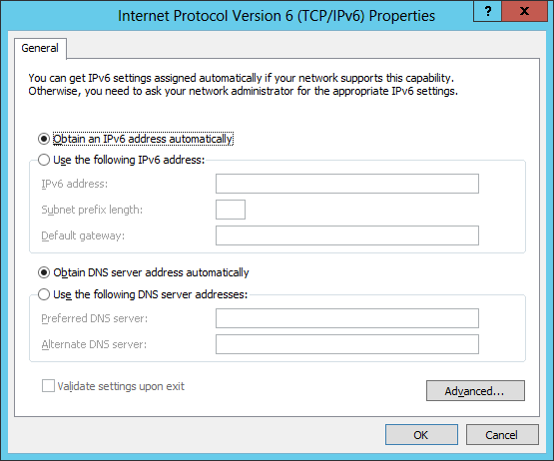
Configurable IPv6 settings
Notes:
Note: This topic has two additional slides.
20741B
3: Implementing IPv6

Slide 15
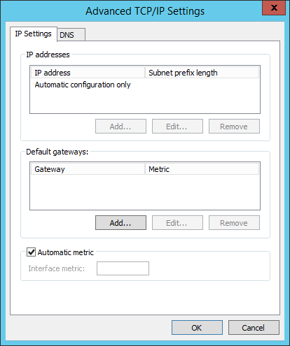
Configurable IPv6 settings
Notes:
20741B
3: Implementing IPv6

Slide 16
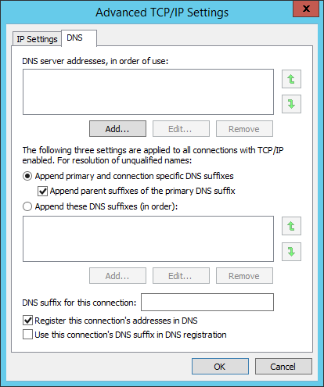
Configurable IPv6 settings
Notes:
20741B
3: Implementing IPv6

Slide 17
Tools for configuring IPv6
In advanced networking scenarios, you can configure IPv6 using any of the following methods:
Basic IPv6 settings through the properties of the TCP/IPv6 component
Windows PowerShell cmdlets
Netsh command-line utility
Notes:
20741B
3: Implementing IPv6

Slide 18
Demonstration: Configuring IPv6
In this demonstration, you will learn how to:
View the IPv6 configuration by using Ipconfig and the Get-NetIPAddress cmdlet
Configure IPv6 on a domain controller and a server
Verify that the IPv6 communication is functional
Notes:
Preparation Steps
Start the 20741B-LON-DC1 and 20741B-LON-SVR1 virtual machines. Sign in as Adatum\Administrator by using the password Pa55w.rd.
Demonstration Steps
View IPv6 configuration by using IPconfig
On LON-DC1, if necessary, open a Windows PowerShell command prompt.
At the Windows PowerShell command prompt, type ipconfig, and then press Enter.
Notice that this returns a link-local IPv6 address.
Type Get-NetIPAddress, and then press Enter.
Configure IPv6 on LON-DC1
On LON-DC1, in Server Manager, click Local Server.
In the Local Server Properties dialog box, next to London_Network, click 172.16.0.10, IPv6 Enabled.
In the Network Connections window, right-click London_Network, and then click Properties.
Click Internet Protocol Version 6 (TCP/IPv6), and then click Properties.
In the Internet Protocol Version 6 (TCP/IPv6) Properties dialog box, click Use the following IPv6 address.
In the IPv6 address text box, type FD00:AAAA:BBBB:CCCC::A.
In the Subnet prefix length text box, type 64.
In the Preferred DNS server text box, type ::1, and then click OK.
In the London_Network Properties dialog box, click Close.
Close the Network Connections window. If the Network page opens, click Yes.
20741B
3: Implementing IPv6
(More notes on the next slide)

Slide 19
Notes:
Configure IPv6 on LON-SVR1
On LON-SVR1, open Server Manager, and then click Local Server.
In the Local Server Properties dialog box, next to London_Network, click 172.16.0.11, IPv6 Enabled.
In the Network Connections window, right-click London_Network, and then click Properties.
In the London_Network Properties dialog box, click Internet Protocol Version 6 (TCP/IPv6), and then click Properties.
In the Internet Protocol Version 6 (TCP/IPv6) Properties dialog box, click Use the following IPv6 address.
In the IPv6 address text box, type FD00:AAAA:BBBB:CCCC::15.
In the Subnet prefix length text box, type 64.
In the Preferred DNS server text box, type FD00:AAAA:BBBB:CCCC::A, and then click OK.
In the London_Network Properties dialog box, click Close.
Close the Network Connections window.
Verify that IPv6 communication is functional
On LON-SVR1, click Start, and then click Windows PowerShell.
At the Windows PowerShell command prompt, type ipconfig, and then press Enter.
Notice that both the link-local IPv6 address and the IPv6 address that you have configured are displayed.
At a command prompt, type ping -6 lon-dc1, and then press Enter.
Type ping -4 lon-dc1, and then press Enter.
Note: Leave all virtual machines in their current state for the next demonstration in this module.
20741B
3: Implementing IPv6

Slide 20
Using DHCPv6
DHCP for IPv6 in Windows Server 2016
Supports IPv6 by default
You can configure DHCP by creating and configuring IPv6 scopes and options
DNS for IPv6 in Windows Server 2016
Supports IPv6 by default
Computers or DHCP can register AAAA records in DNS
You can manually create AAAA records in DNS
You need to create and configure reverse lookup zones for IPv4 and IPv6
Notes:
Explain to students that DHCP and DNS in Windows Server 2016 support IPv6, and discuss DHCP and DNS configuration options. Refer to Lesson 1, “Overview of IPv6 addressing,” on how computers configure their IPv6 address depending whether an IPv6 DHCP server is present in the network.
20741B
3: Implementing IPv6

Slide 21
Demonstration: Configuring DHCP for IPv6
In this demonstration, you will learn how to:
Create an IPv6 scope in DHCP
Configure an IPv6 host (AAAA) resource record for an IPv6 address
Verify name resolution for an IPv6 host (AAAA) resource record
Notes:
Demonstrate configuring IPv6 scope in DHCP and creating AAAA records in DNS. Discuss with the students some real-world scenarios that address configuring DHCP and DNS.
After completing this demonstration, revert all virtual machines.
Preparation Steps
You must complete the previous demonstration in this module before you begin this demonstration. You need the 20741B-LON-DC1 and 20741B-LON-SVR1 virtual machines to complete this demonstration. These machines should already be running after the preceding demonstration. Sign in as Adatum\Administrator by using the password Pa55w.rd.
Demonstration Steps
Configure a scope and scope options in DHCP
On LON-DC1, on the taskbar, click the Server Manager icon, and then, in the Server Manager window, in the upper-right corner, click Tools, and then click DHCP.
In the DHCP console, in the navigation pane, expand LON-DC1.adatum.com, expand IPv6, select and then right-click IPv6, and then click New Scope.
In the New Scope Wizard, click Next.
On the Scope Name page, in the Name box, type Headquarters IPv6, and then click Next.
On the Scope Prefix page, in the Prefix box, type fd00:0000:0000:0000::, and then click Next.
On the Add Exclusions page, type the following, click Add, and then click Next:
Start IPv6 Address: 0000:0000:0000:0000
End IPv6 Address: 0000:0000:0000:00ff
On the Scope Lease page, click Next.
On the Completing the New Scope Wizard page, click Finish.
20741B
3: Implementing IPv6
(More notes on the next slide)

Slide 22
Notes:
Configure DNS with an IPv6 host (AAAA) resource record
On LON-DC1, in Server Manager, click Tools, and then click DNS.
In DNS Manager, expand LON-DC1, expand Forward Lookup Zones, and then click Adatum.com.
Read the records listed for the zone, and notice that LON-SVR1 has dynamically registered its IPv6 address with the DNS server.
Right-click Adatum.com, and then click New Host (A or AAAA).
In the New Host window, in the Name text box, type WebApp.
In the IP address text box, type FD00:AAAA:BBBB:CCCC::A, and then click Add Host.
Click OK to clear the success message.
Click Done to close the New Host window.
Verify name resolution for an IPv6 host (AAAA) resource record
On LON-SVR1, from the Start menu, click Windows PowerShell.
At the Windows PowerShell command prompt, type Test-NetConnection WebApp.adatum.com, and then press Enter.
The result should display Ping Succeeded: True.
20741B
3: Implementing IPv6

Slide 23
Lesson 3: Implementing IPv6 and IPv4 coexistence
What are node types? Options for IPv4 and IPv6 coexistence Considerations for planning a native IPv6 environment What is IPv6 over IPv4 tunneling?
Notes:
Provide a brief overview of the lesson content.
20741B
3: Implementing IPv6

Slide 24
What are node types?
IPv6-only node
IPv6 network
IPv4/IPv6 node
IPv4-only node
IPv4 network
Notes:
It is important that students understand how to classify nodes. When planning an IPv6 network, they must know the state of the network’s nodes or hosts. Explain to students that by describing the nodes with the proper terminology, they can define the capabilities of the nodes on the network. This also is important for tunneling because certain kinds of tunnels require specific node types.
20741B
3: Implementing IPv6

Slide 25
Options for IPv4 and IPv6 coexistence
Windows Server 2016 uses a dual IP layer architecture that supports IPv4 and IPv6 in a single protocol stack
DNS records required for coexistence:
Host (A) resource records for IPv4 nodes
IPv6 host (AAAA) resource records
Reverse lookup pointer resource records for IPv4 and IPv6 nodes
Notes:
The most important point that students need to learn in this topic is that IPv4 and IPv6 can coexist. Students should also be aware that additional DNS records are required for IPv6.
20741B
3: Implementing IPv6

Slide 26
Considerations for planning a native IPv6 environment
When planning for a native IPv6 environment, organizations should consider the support for:
Operating system
Routers and firewalls
Network devices
Application products
Custom applications
Notes:
Explain to students the considerations for planning their IT environment that will be native IPv6.
20741B
3: Implementing IPv6

Slide 27
What is IPv6 over IPv4 tunneling?
IPv6 over IPv4 tunneling allows IPv6 to communicate through an IPv4 network
IPv6 packet
IPv4 packet
IPv6 packet
IPv6
header
Extension headers
Upper layer protocol data unit
IPv4 header
IPv6
header
Extension headers
Upper layer protocol data unit
IPv4 packet
Notes:
The concept of tunneling one protocol inside another might not be familiar to some students. Provide other examples of tunneling to clarify, such as:
Remote Procedure Call (RPC) over HTTP for Outlook Anywhere
Virtual private network (VPN) connections
20741B
3: Implementing IPv6

Slide 28
Lesson 4: Transitioning from IPv4 to IPv6
What is ISATAP? What is 6to4? What is Teredo? What is PortProxy? Process for transitioning to IPv6-only networks
Notes:
Provide a brief overview of the lesson content.
20741B
3: Implementing IPv6

Slide 29
What is ISATAP?
Allows IPv6 communication over an IPv4 intranet
Can be enabled by configuring an ISATAP host record
Connects all nodes to a single IPv6 network
Uses the IPv4 address as part of the IPv6 address:
Private address: FD00::0:5EFE:192.168.137.133
Public address: 2001:db8::200:5EFE:131.107.137.133
ISATAP host
ISATAP router
IPv6-capable network
IPv4-only intranet
ISATAP host
Notes:
Note: This topic has one additional slide.
Ensure that students understand that ISATAP is suitable only within a private network and cannot be used over the Internet, because, in the lab, the students will configure an ISATAP router to enable communication between an IPv4-only subnet and an IPv6-only subnet. You must ensure that students understand the purpose of the ISATAP router and the purpose of the ISATAP host record.
20741B
3: Implementing IPv6

Slide 30
What is ISATAP?
You can configure ISATAP by:
Configuring an ISATAP host record in DNS
Configuring a hosts file
Using the Windows PowerShell cmdlet Set‑NetIsatapConfiguration ‑Router x.x.x.x
Using the command Netsh Interface IPv6 ISATAP Set Router x.x.x.x
Configuring the ISATAP Router Name Group Policy setting
Notes:
Explain to the students the different ways to configure ISATAP.
20741B
3: Implementing IPv6

Slide 31
What is 6to4?
Provides IPv6 connectivity over the IPv4 Internet
Works between sites or from host to site
Is not suitable for scenarios using NAT
Uses the following network address format:
2002:WWXX:YYZZ:Subnet_ID::/64
To enable a 6to4 router:
Enable ICS
Use Windows PowerShell cmdlets
Use Netsh command
6to4 router
IPv6/IPv4
IPv6/IPv4
IPv4 Internet
6to4 router
IPv6/IPv4
IPv6/IPv4
Notes:
Point out to the students that the purpose of 6to4 is for IPv6 connectivity over the IPv4 Internet rather than for an internal network. Also, remind students that 6to4 is not suitable for network address translation (NAT). In most cases, 6to4 will be enabled on existing network infrastructure components rather than using Windows Server 2016 as a router.
Describe NAT briefly. Inform the students that Module 5, “Implementing Remote Access,” includes detailed information about NAT.
20741B
3: Implementing IPv6

Slide 32
What is Teredo?
Teredo:
Enables IPv6 connectivity over the IPv4 Internet through NAT
Requires a Teredo server to initiate communication
Can be configured with the cmdlet Set-NetTeredoConfiguration
Teredo address structure:
2001::/32 (32 bits)
Teredo server IPv4 address (32 bits)
Options (16 bits)
Obscured external port (16 bits)
Obscured external IP address (32 bits)
Teredo server
NAT
IPv4 Internet
NAT
Teredo client
Notes:
Because Teredo and 6to4 perform a similar function, it is essential that students understand the difference between the two. The benefits of Teredo are its ability to traverse NAT and the availability of public Teredo servers.
20741B
3: Implementing IPv6

Slide 33
What is PortProxy?
Use PortProxy to:
Provide IPv6-only hosts with access to IPv4-only applications
Provide access between IPv4-only and IPv6-only hosts
Limitations of PortProxy:
Only TCP applications
Cannot change embedded address information
Notes:
PortProxy has some limitations that should be brought up with the class:
PortProxy can proxy only TCP data.
PortProxy can support only application-layer protocols that do not embed address or port information inside the application-layer data. The PortProxy cannot change address information at the application level.
Additional Reading: For more information about IPv6 Transition Technologies, refer to: “IPv6 Transition Technologies” at http://aka.ms/E8c95o
20741B
3: Implementing IPv6

Slide 34
Process for transitioning to IPv6-only networks
To transition from IPv4 to IPv6, you must:
Update applications to support IPv6
Update routing infrastructure to support IPv6
Update devices to support IPv6
Update DNS with records for IPv6
Upgrade hosts to IPv4/IPv6 nodes
Notes:
Point out to students that most organizations add IPv6 to a functional IPv4 environment and remove IPv4 only when they no longer need it. Organizations will most likely continue to use IPv4 internally for an extended time.
20741B
3: Implementing IPv6

Slide 35
Lab: Configuring and evaluating IPv6 transition technologies
Exercise 1: Reviewing the default IPv6 configuration Exercise 2: Implementing DHCPv6 Exercise 3: Configuring network integration by using ISATAP Exercise 4: Configuring native IPv6 connectivity Exercise 5: Configuring 6to4 Connectivity
Logon Information
Virtual machines: 20741B‑LON‑DC1
20741B-LON-SVR1
20741B‑EU‑RTR
20741B-TOR-SVR1
20741B-LON-CL1
User name: Adatum\Administrator
Password: Pa55w.rd
Virtual machine: 20741B-INET1
User name: Administrator
Password: Pa55w.rd
Estimated Time: 75 minutes
Notes:
Before the students begin the lab, read the lab scenario and display the next slide. Before each exercise, read the scenario associated with the exercise to the class. The scenarios will give context to the lab and exercises, and will help to facilitate the discussion at the end of the lab. Remind the students to complete the discussion questions after the last lab exercise.
Exercise 1: Reviewing the default IPv6 configuration
To understand how IPv6 works and how the planned modifications will affect network traffic, you first must identify and document the default IPv6 configuration at A. Datum Corporation.
Exercise 2: Implementing DHCPv6
The company A. Datum Corporation is planning to implement IPv6 throughout its internal network. To manage the IPv6 addresses assigned to clients, you will configure DHCP to assign the IPv6 addresses.
Exercise 3: Configuring network integration by using ISATAP
The first option for testing IPv4 to IPv6 connectivity is to implement an ISATAP router. You will configure an ISATAP router and verify that users can connect to other subnets by using IPv6 with the router in place.
Exercise 4: Configuring native IPv6 connectivity
The second option for configuring IPv6 connectivity is enabling native IPv6 functionality. You will configure the router to support native IPv6 connectivity between the Sydney office and the London office, and verify that users can connect to other subnets by using native IPv6.
Exercise 5: Configuring 6to4 Connectivity
The final option for configuring IPv6 integration with IPv4 is configuring 6to4 connectivity so that clients from the IPv4-only Internet can connect to computers on the internal network at A. Datum.
20741B
3: Implementing IPv6

Slide 36
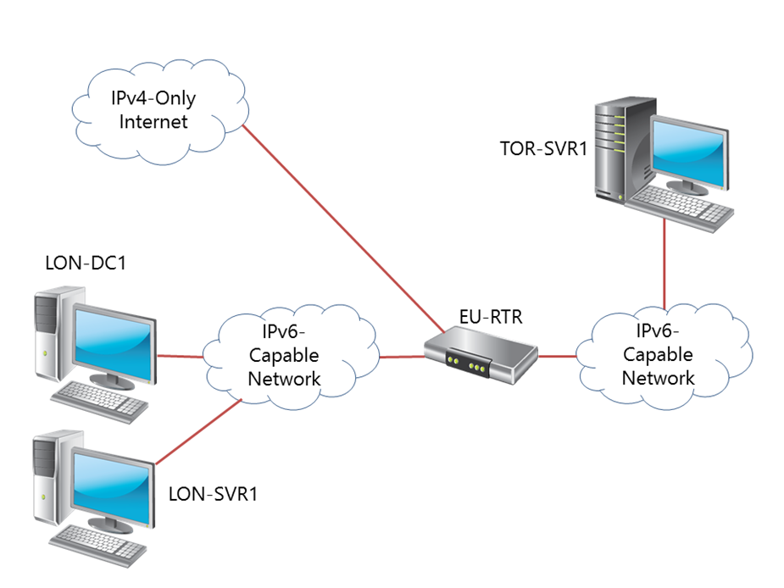
Lab Scenario
Several key applications that A. Datum Corporation uses have recently implemented IPv6 support. As a result, IT management at A. Datum is considering implementing IPv6 on its internal network. To test various IPv6/IPv4 integration strategies, A. Datum has implemented a test network environment between the three main company locations. You need to configure and test the network connectivity by using various integration technologies.
Notes:
20741B
3: Implementing IPv6

Slide 37
Lab Review
Did you configure IPv6 statically or dynamically in this lab? Why did you not need to configure EURTR with the IPv4 address of the ISATAP router?
Notes:
Question
Did you configure IPv6 statically or dynamically in this lab?
Answer
You configured IPv6 dynamically in this lab. You added both IPv6 networks to the router, and the router advertisements configured the LON‑DC1 and LON-CL1 with the correct network address.
Question
Why did you not need to configure EU‑RTR with the IPv4 address of the ISATAP router?
Answer
The default configuration for the Windows client operating systems is set to resolve ISATAP by using DNS to locate the IPv4 address of the ISATAP router. EU‑RTR used the default configuration.
20741B
3: Implementing IPv6

Slide 38
Module Review and Takeaways
Review Questions Best Practices
Notes:
Review Questions
Question
What is the main difference between 6to4 and Teredo?
Answer
Both protocols allow IPv6 connectivity over the IPv4 Internet. However, only Teredo can provide connectivity through NAT.
Question
How can you provide a DNS server to an IPv6 host dynamically?
Answer
To provide a DNS server to an IPv6 host dynamically, you must use DHCPv6. You can use router advertisements to provide the network portion of an IPv6 address, but router advertisements cannot distribute DNS server IP addresses.
Question
Your organization is planning to implement IPv6 internally. After some research, you have identified unique local IPv6 addresses as the correct type of IPv6 addresses to use for private networking. To use unique local IPv6 addresses, you must select a 40-bit identifier that is part of the network. A colleague suggests that you use all zeros for the 40 bits. Why is this not a good idea?
Answer
The 40-bit organization identifier in a unique local IPv6 address should be generated randomly. This ensures the greatest likelihood that no two organizations are using the same organization identifier. If two organizations use the same organization identifier, the networks cannot be joined together after a merger.
20741B
3: Implementing IPv6
(More notes on the next slide)

Slide 39
Notes:
Question
How many IPv6 addresses should an IPv6 node be configured with?
Answer
There is no specific number of IPv6 addresses that an IPv6 node should have. It depends on the organization’s configuration. Each IPv6 node has a link-local IPv6 address. In addition, it might also have a unique local IPv6 address for internal connectivity, and a global unicast IPv6 address for IPv6 Internet connectivity.
Best Practices
Use the following best practices when implementing IPv6:
Do not disable IPv6 on Windows Vista, Windows Server 2008, and newer Windows client and Windows Server operating systems.
Enable coexistence of IPv4 and IPv6 in your organization rather than using transition technologies.
Use unique local IPv6 addresses on your internal network.
Use Teredo to implement IPv6 connectivity over the IPv4 Internet.
20741B
3: Implementing IPv6

