Slide 1
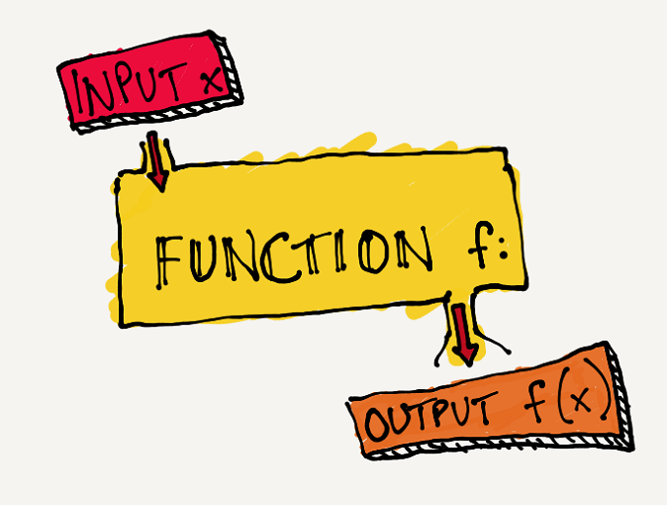
Functional Programming
Simona Orzan, Joris Geurts

Slide 2
Functional Programming

Slide 3
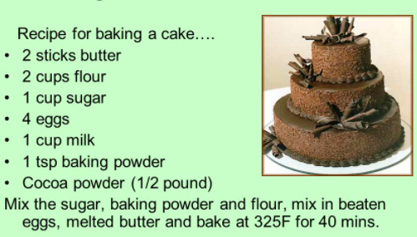
functional programming?!
+
how-> what
what -> how

Slide 4
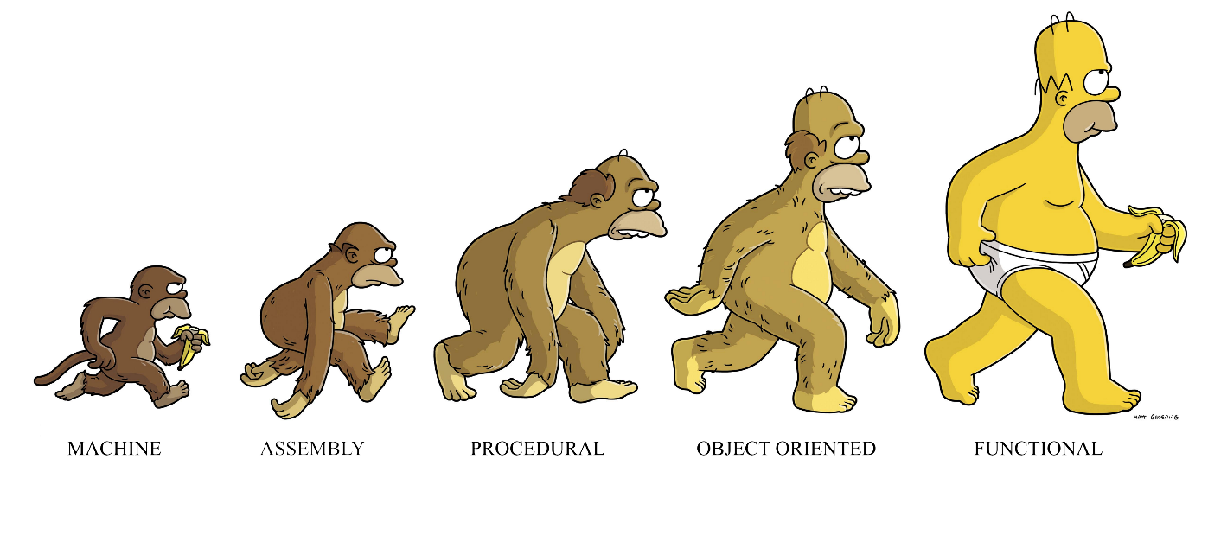
why functional programming?
clean code, easy to read and reason about
easy to test
increasingly popular
fun to write
stimulates creative thinking
mathematics applications
supports parallel and distributed programming
GUI programming
Notes:
Image source: https://medium.com/@cscalfani/so-you-want-to-be-a-functional-programmer-part-1-1f15e387e536

Slide 5
learning outcomes
1 … 7
but basically:
(how to) think in functions; paradigm shift: no variables, no statements, only results
(how to) use the functional paradigms in your own programming practice

Slide 6
week overview
introduction
recursion
foldr, anonymous functions
currying, custom data types
higher-order functions
exam

Slide 7
learning resources
FP (these slides)
weekly motivation and intro
pointers to required and recommended external material
FP_outline
assignments description
Canvas
links to FP_outline and FP
place to submit your research report

Slide 8
teaching and assessment
short introductory explanation of important concepts
self study + lots of exercises
assessment based on:
active participation in lessons, for exercises and weekly assignments
research report and presentation (groups of two)
exam

Slide 9

week Brief introduction to FP and Elm

Slide 10
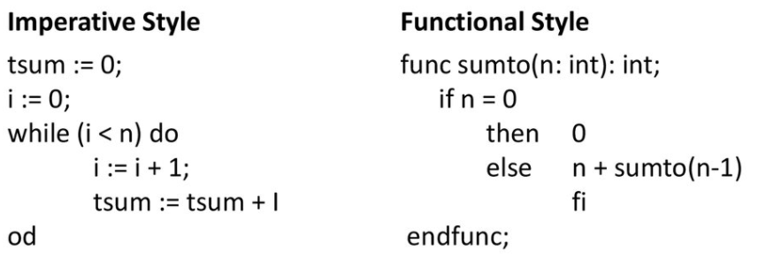

How is FP different? (I)
recursion instead of loops
list operations instead of loops

Slide 11
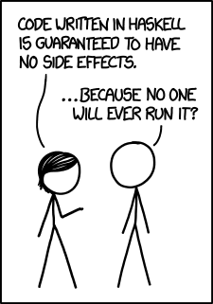
How is FP different? (II)
int i = 7;
string s = "Fontys";
int[5] a;
i++;
s += " Eindhoven";
a[3] = 73;
FP:
new_i = i + 1
new_s = s + " Eindhoven"
new_a = List.update a 3 73
no variables aka: only immutable variables
no side effects
side effect!
double get_pi()
{
i++;
return (3.14);
}
recommended: https://elmprogramming.com/immutability.html

Slide 12
Immutable data
+ simpler application development (no state management, no temporal coupling)
+ parallel programming is much easier (thread-safe)
+ side effects free
- efficiency? High! due to smart internal structural sharing mechanisms

Slide 13
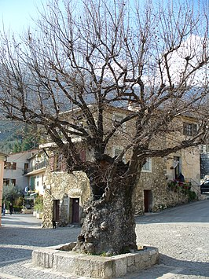

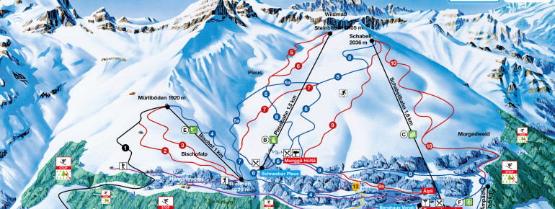
Elm
pure FP language from 2012
especially for web apps, compiles to JS
no runtime exceptions, friendly errors, easy to test, reusable code

Slide 14
Elm
where to start:
assignment 1
online IDE: https://ellie-app.com/
where to continue:
official Elm guide: https://guide.elm-lang.org/
syntax: https://elm-lang.org/docs/syntax and https://elmprogramming.com/ (section "Elm Language Basics")
common libraries: https://package.elm-lang.org/packages/elm/core/latest/Basics
comprehensive tutorial: https://www.tutorialspoint.com/elm/index.htm
Notes:
Background information:
Editor plugins for VS Code, IntelliJ .. https://github.com/elm/editor-plugins
Many example web applications: https://builtwithelm.co/
An interview with the Elm creator Evan Czaplicki : https://youtu.be/Ujrq02VQ9RI

Slide 15
Elm ingredients
collatz: Int -> Int
collatz x =
3 * x + 1
functions
basic types: Int, Bool, Float, Char, String
collections: List, Tuple, Record, custom types
my_list: List Int
my_list = [ 2, 5, 7, 11 ]
my_list2: List String
my_list2 = [ "Fontys", "Eindhoven" ]
my_tuple : ( Int, List Char )
my_tuple = ( 35, [ 'a', 'b', 'c' ] )
my_record : { name: String, age: Int }
my_record = { name = "Jan", age = 42 }

Slide 16
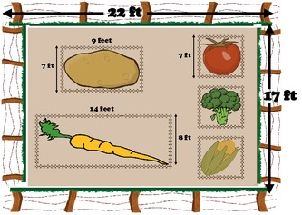
Elm syntax
rental: Int -> Int -> Int
rental x y =
20 * x * y + 300
areaPeriCalc: Int -> Int -> (Int, Int)
areaPeriCalc h w =
(h * w, 2 * (h + w))
farmRental2: (Int, Int) -> Int
farmRental2 (h, w) =
let
(ar,pe) = areaPeriCalc h w
in
if ar > 200 then
ar + pe
else
if ar < 100 then
pe
else
ar
farmRental: (Int, Int) -> Int
farmRental (h, w) =
if (h * w > 200) then
h * w + 2 * (h + w)
else
if (h * w < 100) then
2 * (h + w)
else
h * w

Slide 17
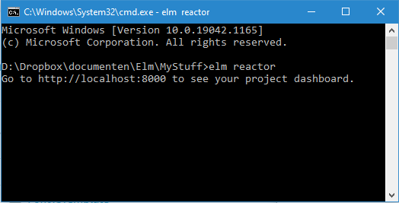
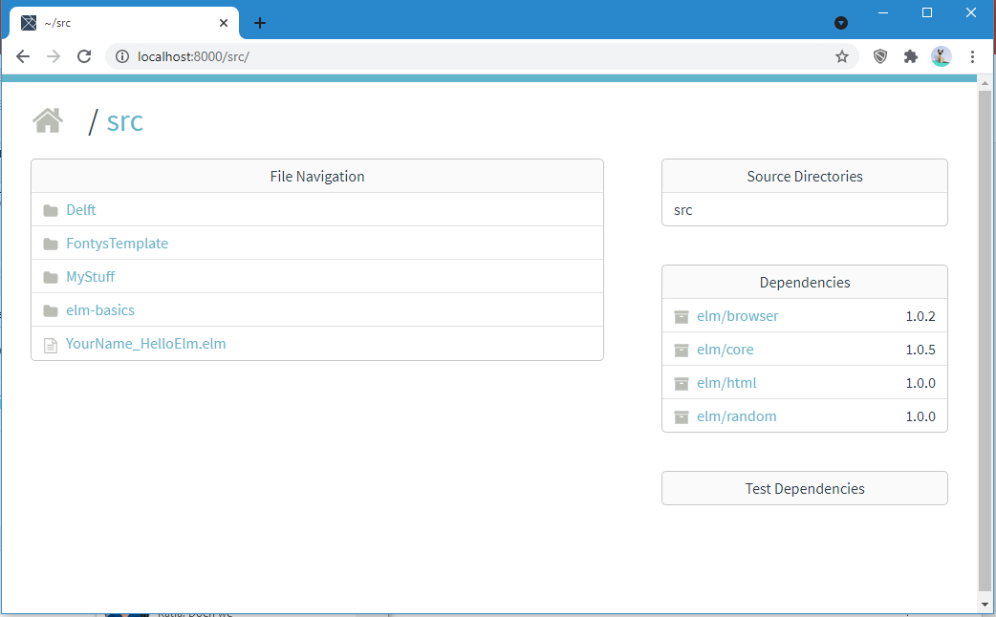
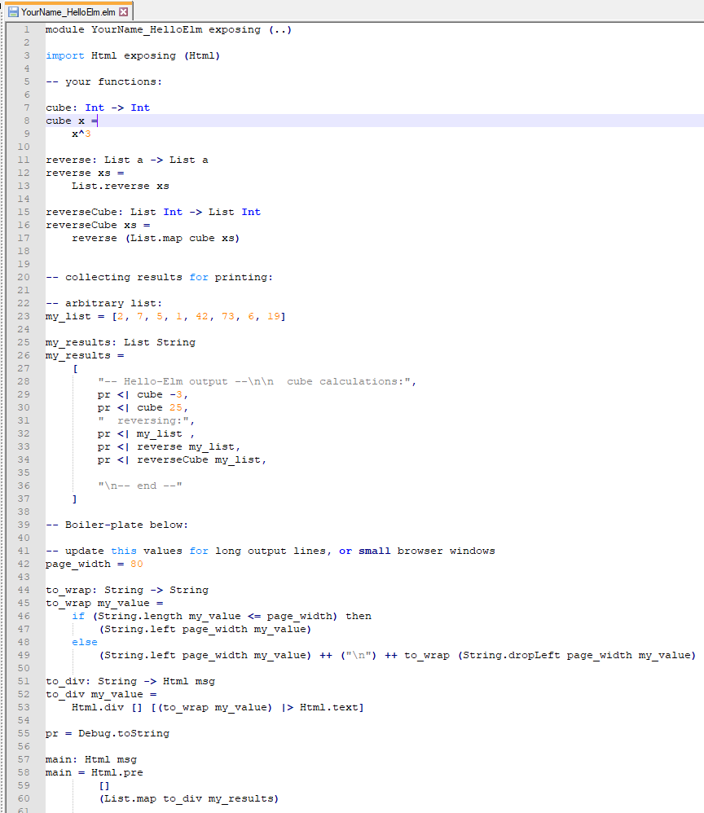
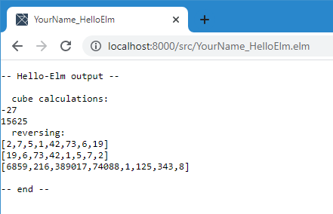
elm reactor

Slide 18
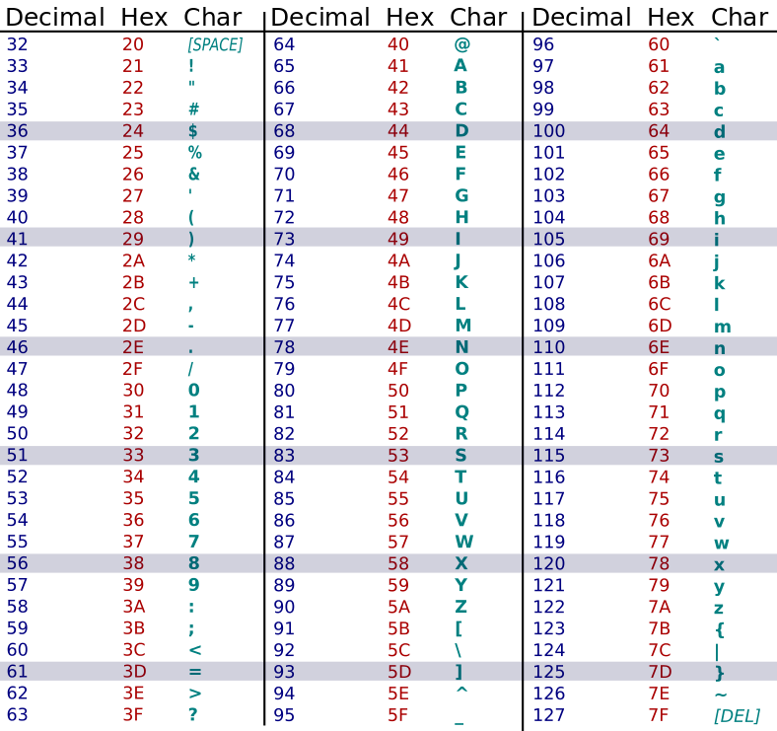
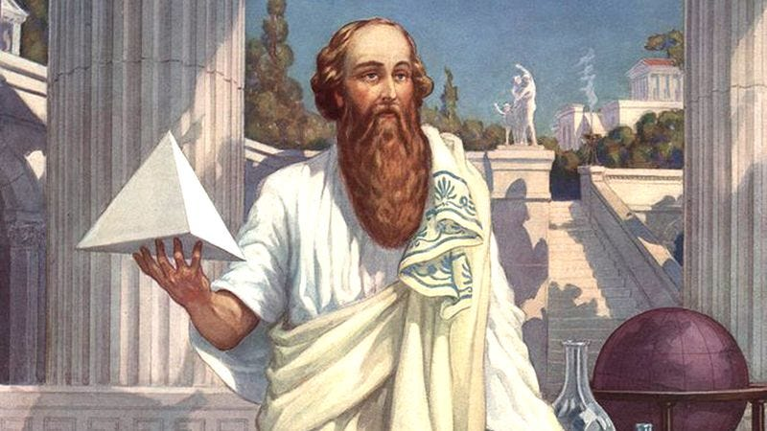
assignments
Char.toCode
Char.fromCode
install & tutorials
cryptography
"HelloFontys" -> "OlssvMvuafz"
Pythagoras

Slide 19

week recursion

Slide 20
loops vs. recursion
5! = 1 ∙ 2 ∙ 3 ∙ 4 ∙ 5
= 4! ∙ 5
= 3! ∙ 4 ...
so:
n! = (n-1)! ∙ n
(for n ≥ 1)
calculate n! = 1 ∙ 2 ∙ 3 .. ∙ n
int factorial(int n)
{
int result = 1;
for (int i = 1; i <= n; i++)
{
result *= i;
}
return (result);
}
factorial: Int -> Int
factorial n =
if n <= 1 then
1
else
n * factorial (n-1)
base case
recursion

Slide 21
recursion on lists (I)
sum of [ 3, 4, 42, 73]
= 3 + sum of [4, 42, 73]
= 3 + 4 + sum of [42, 73]
= 3 + 4 + 42 + sum of [73]
= 3 + 4 + 42 + 73 + sum of []
= 3 + 4 + 42 + 73 + 0
or:
sum of list = first elem ⊕ sum of rest
[ 3, 4, 5, 6 ]
= 3 :: [ 4, 5, 6 ]
= 3 :: 4 :: 5 :: 6 :: []
concatenation
sum: List Int -> Int
sum list =
case list of
[] ->
0
x :: xs ->
x + sum xs
pattern matching
https://elmprogramming.com/pattern-matching.html#pattern-matching-lists

Slide 22
recursion on list (II)
are two lists equal?
= are first elements equal? && are the rest of the lists equal?
equal: List Int -> List Int -> Bool
equal listA listB =
case (listA, listB) of
([], []) ->
True
(x :: xs, []) ->
False
([], y :: ys) ->
False
(x :: xs, y :: ys) ->
x == y && equal xs ys

Slide 23
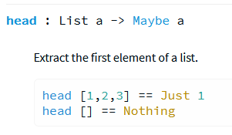
error handling: Maybe
List.head [2, 3, 4] == 2
List.head [73] == 73
List.head [] : error, exception, crash!
case List.head my_list of
Nothing ->
-- do error handling
Just x ->
-- x is the head,
-- do your stuff with it
https://package.elm-lang.org/packages/elm/core/latest/List#head
https://package.elm-lang.org/packages/elm/core/latest/Maybe

Slide 24
recursion on strings
unfortunately: String ≠ List Char
case my_str of
[] ->
-- handle the empty string
x :: xs ->
-- deconstruction of the string + recursion...
alternative:
a string
→ String.toList
→ List operations
→ String.fromList
→ a new string
case String.uncons str of
Nothing ->
-- handle the empty string
Just (head, tail) ->
-- head is first character, tail is the rest
https://package.elm-lang.org/packages/elm/core/latest/String#uncons
https://elm-lang.org/news/0.10#strings

Slide 25
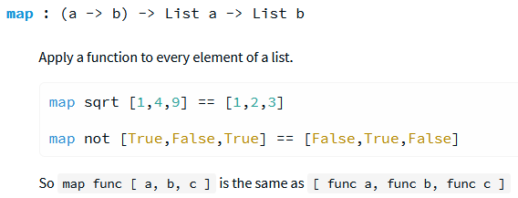
List.map
List.map f0 lst: applies the given function f0 to each element of the original list lst, and puts the result in a new list.

Slide 26
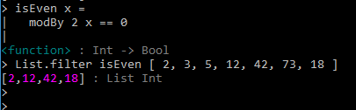
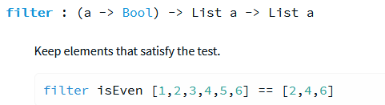
List.filter
List.filter f2 lst applies the given function f2 to every element of the original list lst, and puts only those elements for which the function returns True in a new list.

Slide 27
assignments
pattern matching & recursion
List.map, List.filter, String.map
cryptography
"HelloFontys" -> "OlssvMvuafz"
Pythagoras

Slide 28

week foldr, lambda expressions

Slide 29
lambda expressions (aka. anonymous functions)
> cube x = x^2
> List.map cube [3, 4, 5, 6]
[27, 64, 125, 216]
> List.map (\x -> x^2) [3, 4, 5, 6]
[9, 16, 25, 36]
> List.filter (\x -> String.length x < 4) ["stroopwafel", "ja", "nee", "fiets"]
["ja", "nee"]

Slide 30
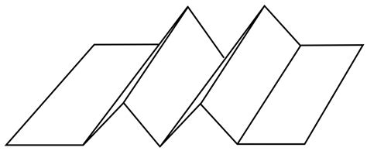
foldr: the Swiss Army knife
List.foldr (\x acc -> x + acc) 0 [2, 5, 7, 4]
4 +
0
7 +
4
5 +
11
2 +
16
final result: 18
in general:
List.foldr (\x acc -> x ⊕ acc) init_val [2, 5, 7, 4]
== (2 ⊕ (5 ⊕ (7 ⊕ (4 ⊕ init_val))))

Slide 31

exercises
what is the result of:
List.foldr (\x acc -> x :: acc) [] [2, 5, 7, 4]
List.foldr (\x acc -> x^2 :: acc) [] [2, 5, 7, 4]
List.foldr (\x acc -> if x>4 then x::acc else acc) [] [2, 5, 7, 4]
List.foldr (+) 0 [2, 5, 7, 4]
List.foldr (::) [] [2, 5, 7, 4]

Slide 32
foldl
similar:
List.foldl (\x acc -> x ⊕ acc) init [2, 5, 7, 4]
== (4 ⊕ (7 ⊕ (5 ⊕ (2 ⊕ init))))
Exercise:
List.foldl (\x acc -> x :: acc) [] [2, 5, 7, 4]

Slide 33

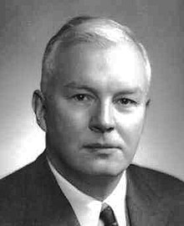
week Currying Custom data types
Haskell Curry (1900-1982)

Slide 34
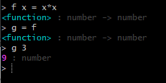
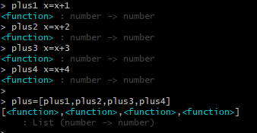
Functions are first class citizens
that is: support all operations available in the language
assign to variables
store in collections

Slide 35

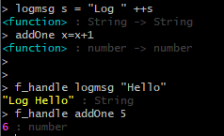
Functions are first class citizens
that is: support all operations available in the language
pass as arguments
f_handle = higher-order function!

Slide 36
Functions are first class citizens
that is: support all operations available in the language
return from a function
eur2usd: Float -> Float
eur2usd x = x * 1.18
bitcoin2gbp: Float -> Float
bitcoin2gbp x = x * 33926.4
getConverter: Int -> (Float -> Float)
getConverter t =
case t of
0 -> eur2usd
_ -> bitcoin2gbp
converter: Float -> Float
converter = getConverter 0
myDollars: Float
myDollars = converter 7.45

Slide 37
Currying & Partial Application
plus5: Int -> Int
plus5 z = 5 + z
add: Int -> Int -> Int
add x y = x + y
add 5
== plus5
add: Int -> (Int -> Int)
plus5 = (\z -> 5 + z)
add = (\x -> (\y -> x + y))
List.map plus5 [ 42, 73 ]
List.map (add 5) [ 42, 73 ]
List.map ((+) 5) [ 42, 73 ]
Currying: function that takes n arguments = function that takes 1 argument and returns a function that takes n-1 arguments
Partial application: apply a function and pass it a fewer number of parameters than it expects
no multi-parameter functions
only single parameter functions returning a new function
order of parameters: design issue!
tripleAdd: Int -> Int -> Int -> Int
tripleAdd: Int -> (Int -> (Int -> Int))
tripleAdd 42 73 -5
((tripleAdd 42) 72) -5
right associative
left associative

Slide 38



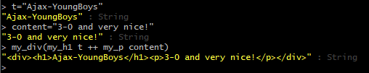
Partial function application example
A function with two String arguments
Partially applied
Fully applied

Slide 39
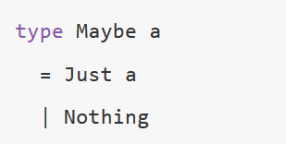
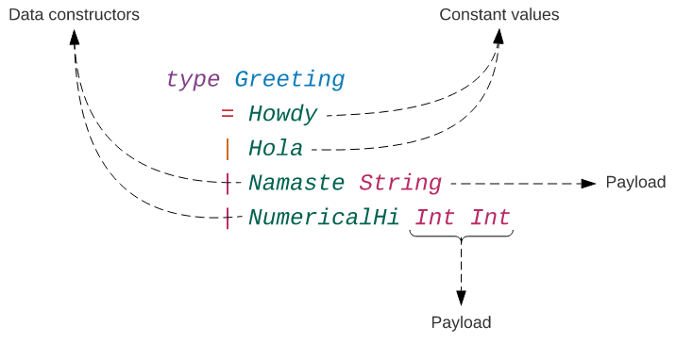
Custom types
https://elmprogramming.com/type-system.html

Slide 40
modelling mathematical functions
f(x) = (x+3)⁵ - 5(2x+3)³(x-2)/7
type Function
= Poly Function Int
| Mult Function Function
| Div Function Function
| Plus Function Function
| Minus Function Function
| Const Int
| X
p0 = Plus X (Const 3)
p1 = Poly p0 5
p2 = Mult (Plus X (Const -2)) p1
p3 = Plus (Plus (Minus p0 (Poly (Plus X (Const 5)) 7)) (Mult p0 (Div p2 X))) (Mult (Plus X X) X)
assignments:
human friendly infix print
evaluate f(x)
graph (ascii-art)
payload
data constructor /
constant value

Slide 41
Research: FP in the wild
How functional is programming language X?
X ∈ { C#, Java, JS, Python, Scala … }
submit report in Canvas, do presentation in lessons

Slide 42

week Higher-order functions

Slide 43
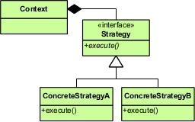
higher order functions (I)
functions that have functions as arguments
Strategy Design Pattern
offer frame work
attach algorithm at run time
list.map, list.filter, list.foldr, ...

Slide 44
higher order functions (II): example
drop list elements as long as a predicate evaluates to True
dropWhile <predicate> <list>
dropWhile: (a -> Bool) -> List a -> List a
$ dropWhile ((<) 0) [ -1, -42, -99, 5, 17, -33, -44, -55, 73 ]
[ 5, 17, -33, -44, -55, 73 ]
spot the bug!
dropWhile : (a -> Bool) -> List a -> List a
dropWhile predicate list =
case list of
[] ->
[]
x :: xs ->
if (predicate x) then
dropWhile predicate xs
else
list
variations:
dropUntil, takeWhile, takeUntil,
repeatWhile, repeatUntil

Slide 45
assignments
higher order function repeatUntil
collatz
https://www.youtube.com/watch?v=094y1Z2wpJg "young mathematicians are warned not to wasted their time on"
expressions
derivative
simplify
research
continuation (submit in separate Canvas assignment)

Slide 46
course evaluation
 | tops | tips
lectures
assignments

