Slide 1
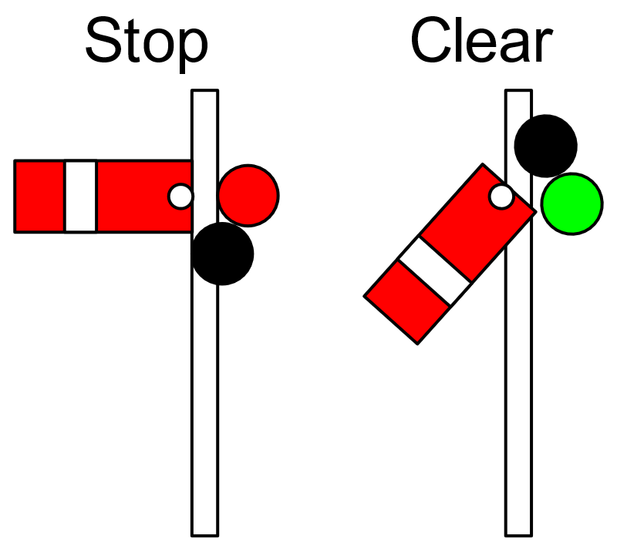
SYNC
SYNCHRONIZATION
Hans van Heumen
Notes:
https://en.wikipedia.org/wiki/Railway_semaphore_signal

Slide 2
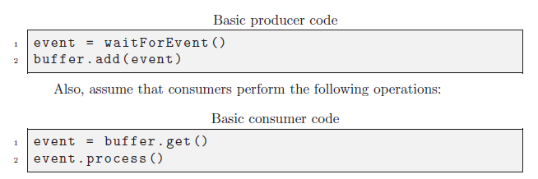
Classical synchronization problems
Producer-consumer problem
While an item is being added to or removed from the buffer, the buffer is in an inconsistent state. Therefore, threads must have exclusive access to the buffer.
If a consumer thread arrives while the buffer is empty, it blocks until a producer adds a new item.

Slide 3
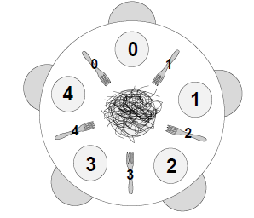
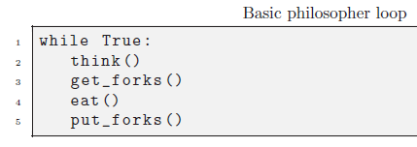
Classical synchronization problems 2
Dining philosophers
Only one philosopher can hold a fork at a time.
It must be impossible for a deadlock to occur.
It must be impossible for a philosopher to starve waiting for a fork.
It must be possible for more than one philosopher to eat at the same time.

Slide 4
Course Outlines
Threads and Processes
Read/Write problem and Mutual Exclusion
Semaphore wait and signal problem
Deadlock
Scheduling
Programming language: Python
…
Assignments
Research
Written Exam

Slide 5
Overview
Planning (See Canvas)
Evaluation (See Canvas)
Resources (See Canvas)

