Slide 1
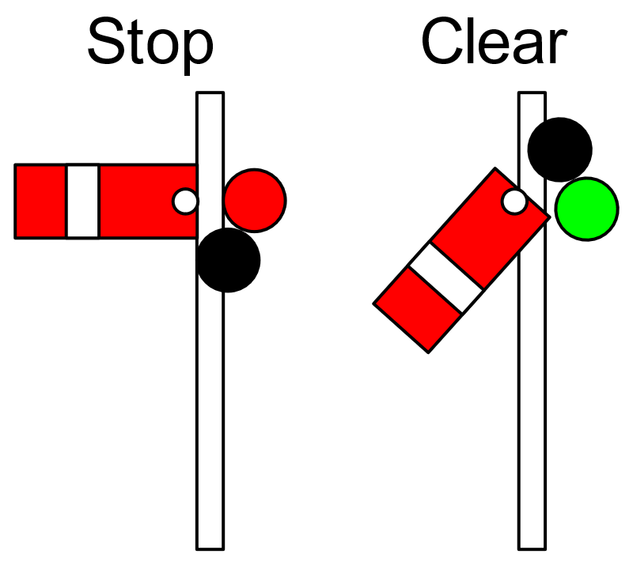
SYNC
SYNCHRONIZATION
Notes:
https://en.wikipedia.org/wiki/Railway_semaphore_signal

Slide 2
Agenda
Processes
Threads

Slide 3
Process
Process: a program in execution; process execution must progress in sequential fashion
A process includes:
Code section (program code)
Data section (global variables)
Heap (dynamically allocated memory)
Stack (parameters, return address, local variables)
Program counter (current location in code)
Content of processor's registers

Slide 4
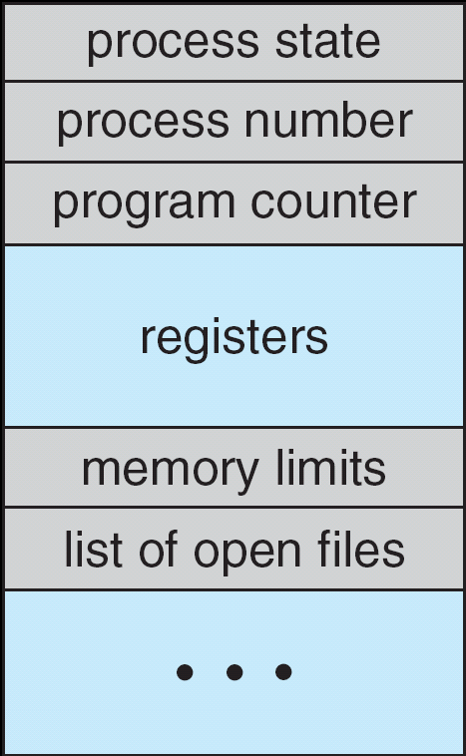
Process Control Block (PCB)

Slide 5
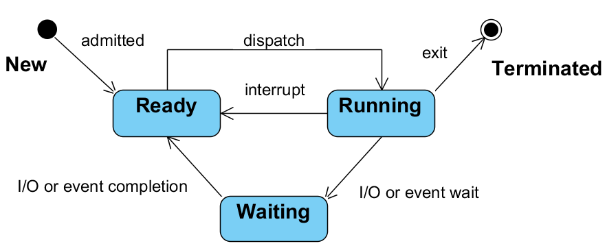
State Diagram of a Process

Slide 6
Process states
As a process executes, it changes state
New: The process is being created
Ready: The process is waiting to be assigned to a processor
Running: Instructions are being executed
Waiting: The process is waiting for some event to occur
Terminated: The process has finished execution

Slide 7



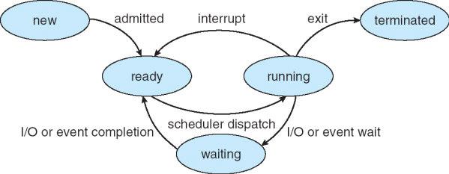


Slide 8
Thread
Thread: the smallest sequence of programmed instructions that can be managed independently by a scheduler
Thread versus process:
A thread is a component of a process
Multiple threads can exist within one process
Threads execute concurrently and share resources such as memory, i/o
Different processes do not share these resources

Slide 9
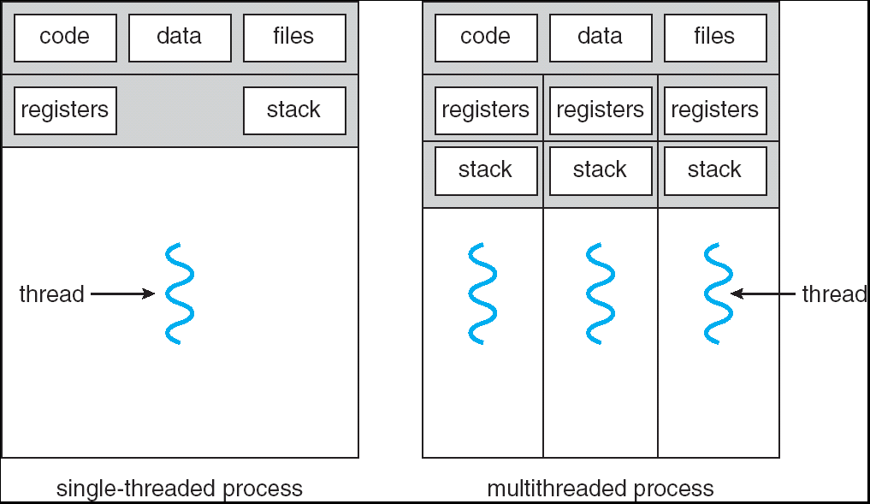
Single- and Multi-threaded Processes

Slide 10
Thread scheduling
Scheduler is concerned with: CPU usage, throughput, turnaround time, response time, fairness. Often conflicting
Scheduling algorithms:
Round Robin/Time Slicing → Time quantum
FCFS: First Come, First Served
SJF: Shortest Job First

Slide 11
Using a shared Boolean to stop thread
Assume shared boolean stop, initially false
In the thread, this variable is checked:
while(!stop) {
… // do some action
}
We can stop the thread by setting stop to true
void stopThread() {
stop = true;
}
Thread will complete the action, and then stop
OK, but not when the thread is waiting or sleeping somewhere in the while statement

Slide 12
Basic synchronization problem
Concurrent access to shared variables may result in data inconsistency
Critical Section: piece of code accessing shared variables that must be protected against concurrent access
Mechanisms are required to ensure orderly execution of parallel threads with shared variables

Slide 13
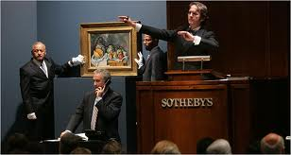
Synchronization problem 1
Suppose, we make an auction application
There could be a class Article, with
an attribute for the highest bid up to now
highestBid = MyInt(-1, “highestBid”)
a function that changes highestBid when there is a higher bid:
def newBid(bid) if (bid > highestBid.v): highestBid.v = bid

Slide 14
Synchronization problem 1
What can go wrong?
Suppose
highestBid is now 10
2 bidders (in 2 threads) call function newBid at almost the same time, eg: newBid(14); and newBid(12);
Then, execution could go like this:
if(14>highestBid.v): if(12>highestBid.v): highestBid.v = 14; highestBid.v = 12;
Result: highestBid is 12, and not 14

Slide 15
Synchronization problem 1
Reason:
context switch between threads can occur between test (bid>highestBid.v) and block (highestBid.v=bid;) of the if-statement
Solution:
make sure that at most one thread at a time can call this method
Same kind of problem can occur within one single statement (see next slide)

Slide 16
Synchronization problem 2
Suppose count=5 is shared between 2 threads
One thread does count+=1 and the other does count—=1
both at the same time
Expected result: 5
count+=1 could be implemented as
❶ register1 = count; ❷ register1 = register1 + 1; ❸ count = register1;
count-=1 could be implemented as
❹ register2 = count; ❺ register2 = register2 – 1; ❻ count = register2;
Consider this execution interleaving: ❶ ❷ ❹ ❺ ❸ ❻
Result?
?
"non-atomic
operation"
Notes:
Can be emulated in code with sleep() or wait() inbetween commands.

Slide 17
Non-atomic actions
Most statements in Python (and also in other languages like e.g. Java) consist of a number of steps
Steps can be interleaved with other threads
Such statements are not thread-safe

Slide 18
Mutual exclusion in Python
For synchronizing non-atomic statements, we can use a ‘mutex‘ that serves as a lock
A lock can be held by at most one thread
When 2 or more threads compete to get the lock:
one will succeed and
others have to wait

Slide 19
Mutex
Is a synchronization primitive that has an initial value (1)
Two methods are defined on a mutex:
Mutex.wait() – Effect:
If the mutex value is 1, then the value will be decremented by 1.
If the mutex value is zero the thread that executes that wait will block.
Mutex.signal() – Effect
The mutex value will be incremented by 1. If there are 1 or more blocked threads one of them may continue (after decrementing the mutex value by 1)
A mutex is used to achieve mutual exclusion (i.e. one thread gets exclusive access to a shared variable)

Slide 20
Critical section
The lines of code that access shared data are called the Critical section.
A mutex is used to guard critical sections in threads:
In order to control exclusive access to the shared variable
In order to avoid data inconsistency

Slide 21
Use of mutex
mutex.wait()
// critical section if (bid > highestBid.v): highestBid.v = bid mutex.signal()
Then: a thread must first get object’s lock (“ball”) before it can execute method
And: lock is released (“ball is thrown”) when method is finished

Slide 22
Lock-analogy
Suppose it is not allowed to speak concurrently
Speaking protocol:
There is one ball (=lock) in the group → only the person with the ball may speak
Everybody who wants to speak tries to get ball → only one person will succeed
When finished speaking, ball is thrown upwards → others try to catch it
In Python, a mutex is used as a ‘ball’

Slide 23
When to use a mutex?
Use a mutex when a shared variable can be changed by multiple threads at the same time
Using a mutex has some disadvantages:
the code becomes slightly slower
extra waiting is introduced because of the locks
Therefore, mutexes should be used with care

Slide 24
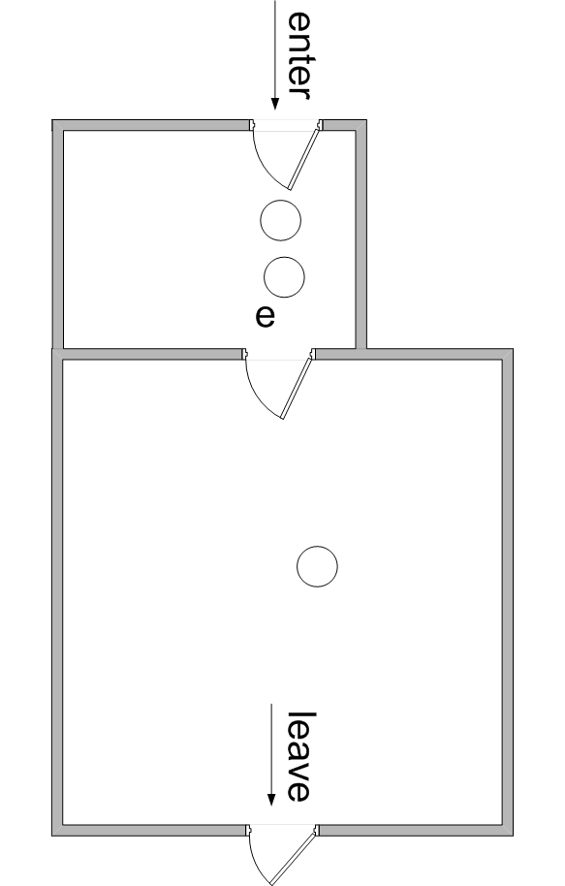
Dentist analogy (I)
Compare with dentist practice
There is a treatment room (t), where at most one patient can be
There is a waiting room (e) for patients that just came in
t

Slide 25
Waiting
Sometimes we want to wait inside synchronized method
For that, we can use a semaphore

Slide 26
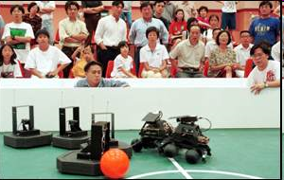
Synchronization problem
while True:
---
---
move_to_ball()
---
while True:
---
shoot()
---
---
while x==0:
nop
busy waiting
(don't use this!)
x = 1

Slide 27
Solution: semaphore
init value for count
class Semaphore():
def __init__(self, c):
self.count = c
def wait(self):
with self._blockCondition:
self.count -= 1
if self.count < 0:
'block this thread'
def signal(self):
with self._blockCondition:
self.count += 1
if self.count <= 0:
'wake-up a blocked thread'
mySem = Semaphore(0)
move()
mySem.signal()
mySem.wait()
shoot()
mySem = Semaphore(1)
mySem.wait()
CritSec()
mySem.signal()
mySem.wait()
CritSec()
mySem.signal()
mySem = Semaphore(N)
mySem.wait()
play()
mySem.signal()
mySem.wait()
play()
mySem.signal()
https://en.wikipedia.org/wiki/Semaphore_%28programming%29

Slide 28
Example: producer-consumer problem
Suppose one thread (producer) sends values to another thread (consumer) through a 1-place Buffer
Every value must be handled exactly once
Producer
Consumer
Buffer
put
n
get

Slide 29
Mutual exclusion is not enough
Producer thread:
while True:
mutex.wait()
// critical section
buffer.v = produceValue()
mutex.signal()
Consumer thread:
while True:
mutex.wait()
// critical section
processValue(buffer.v)
mutex.signal()

Slide 30
Mutual exclusion is not enough
Semaphore: bufferFree = new MySemaphore(0, “bufferFree”)
Boolean: valueSet = new MyBool(False, “valueSet”)
Producer thread:
while True:
mutex.wait()
while (valueSet.v):
mutex.signal()
bufferFree.wait() // semaphore
mutex.wait()
// critical section
buffer.v = produceValue()
valueSet.v = True
bufferFree.signal()
mutex.signal()

Slide 31
Mutual exclusion is not enough
Semaphore: bufferFree = new MySemaphore(0, “bufferFree”)
Boolean: valueSet = new MyBool(False, “valueSet”)
Consumer thread:
while True:
mutex.wait()
while (not(valueSet.v)):
mutex.signal()
bufferFree.wait() // semaphore
mutex.wait()
// critical section
buffer.v = processValue()
valueSet.v = False
bufferFree.signal()
mutex.signal()

Slide 32
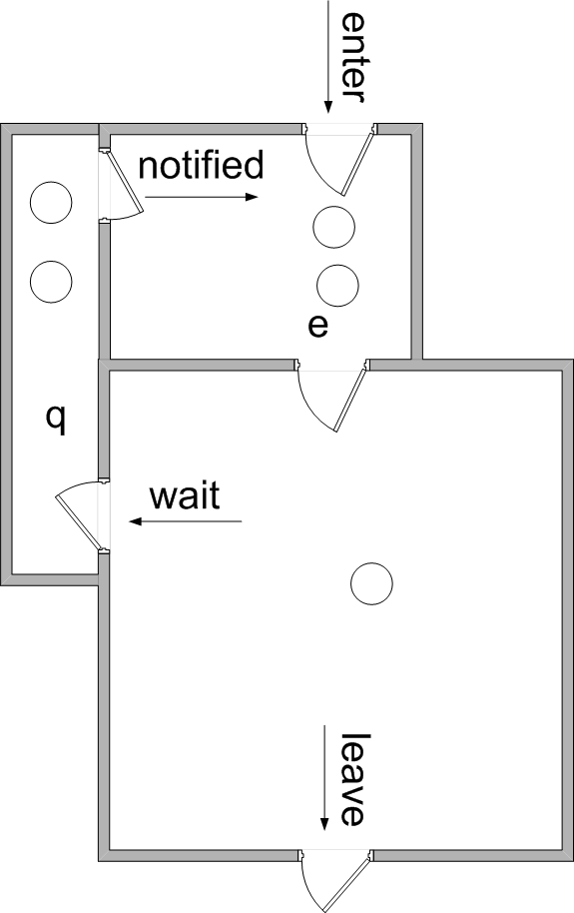
Dentist analogy (II)
Compare with dentist practice again
Now, there is a waiting room (q) for patients that just received a painkiller, and have to wait until it kicks in
t

