Slide 1
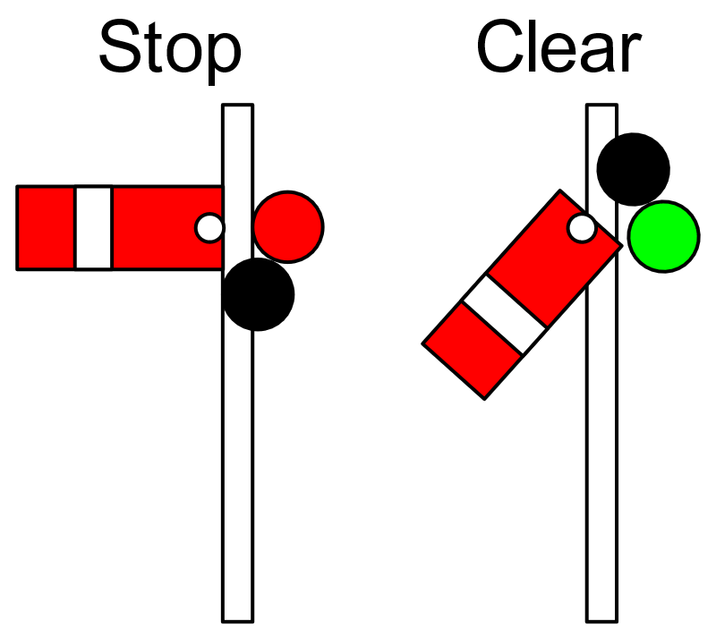
SYNC
SYNCHRONIZATION
Notes:
https://en.wikipedia.org/wiki/Railway_semaphore_signal

Slide 2
Agenda
Sample synchronization problem
Basic synchronization patterns

Slide 3
Introduction
Mutex and semaphore are the basic building blocks for synchronization.
This week we will see some larger building blocks for synchronization -> convenient in particular situations!
All implemented using mutex and semaphore

Slide 4
Synchronization
Goal
restrict the possible interleavings of thread executions
We control cooperation using synchronization
Synchronization ensures proper coordination among threads
Many ways to provide synchronization:
Mechanisms to control access to shared resources
Locks, mutexes, semaphores, monitors, condition variables, etc.
Patterns for coordinating access to shared resources
Producer-consumer, reader-writer, etc.

Slide 5
Mutual Exclusion
We want to create critical sections
Section of code in which only one thread may be executing at a given time
All other threads are forced to wait on entry
When a thread leaves a critical section, another can enter
Example: bathroom on airplanes
We can use mutual exclusion to create critical sections
This allows us to have larger atomic blocks

Slide 6
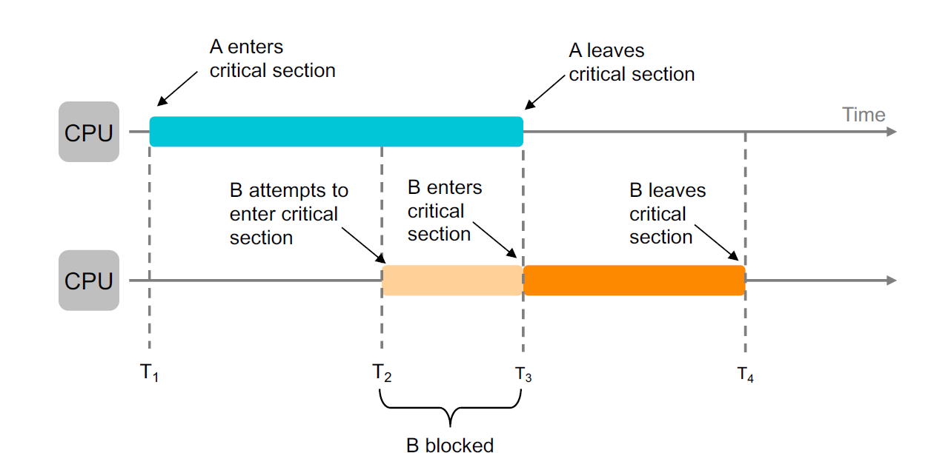
Mutual Exclusion Using Critical Sections

Slide 7
Critical Section Goals
Mutual exclusion
If one thread is in the critical section, then no other thread is
Progress
If some thread T is not in the critical section, then T cannot prevent some other thread S from entering the critical section
A thread in the critical section will eventually leave it
Bounded waiting (no starvation)
If some thread T is waiting on the critical section, then T will eventually enter the critical section
Performance
The overhead of entering and exiting the critical section is small relative to the work being done within it

Slide 8
About the Goals
Goals can also be expressed as three properties:
Safety property: nothing bad happens
Mutual exclusion
Liveness property: something good happens
Progress, bounded waiting
Performance property:
Performance
Rule of thumb: when designing a concurrent algorithm, worry about safety first (but don’t forget liveness!)
Performance is nice to have but won’t affect correctness

Slide 9
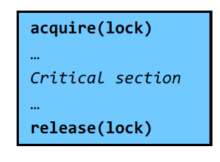
Using Locks
Locks are useful for implementing critical sections
But locks have limited semantics
Just provide mutual exclusion
Mutual exclusion does not solve all synchronization problems
Sometimes we want other semantics, for example:
Wait for shared resources to become available
Allow multiple threads to generate different resources
Use certain conditions to decide when to enter a critical section

Slide 10
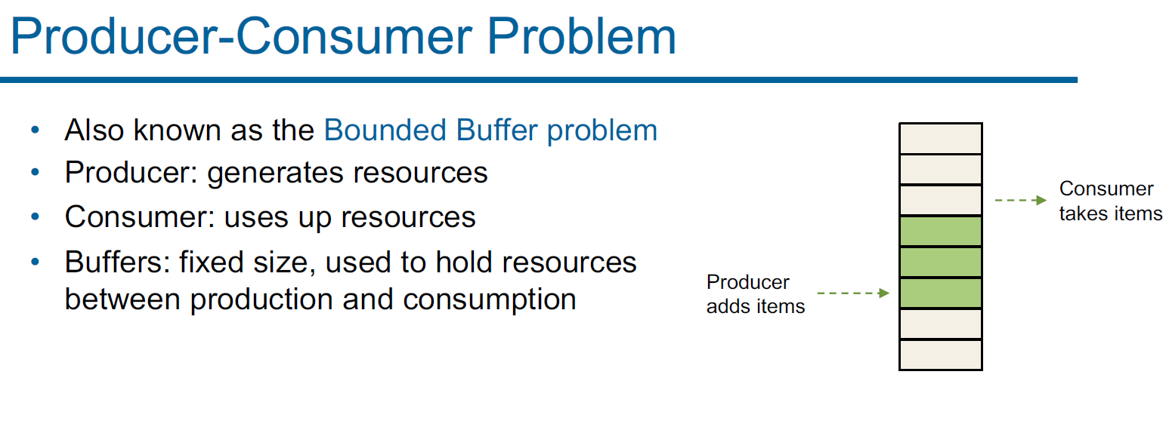

Slide 11
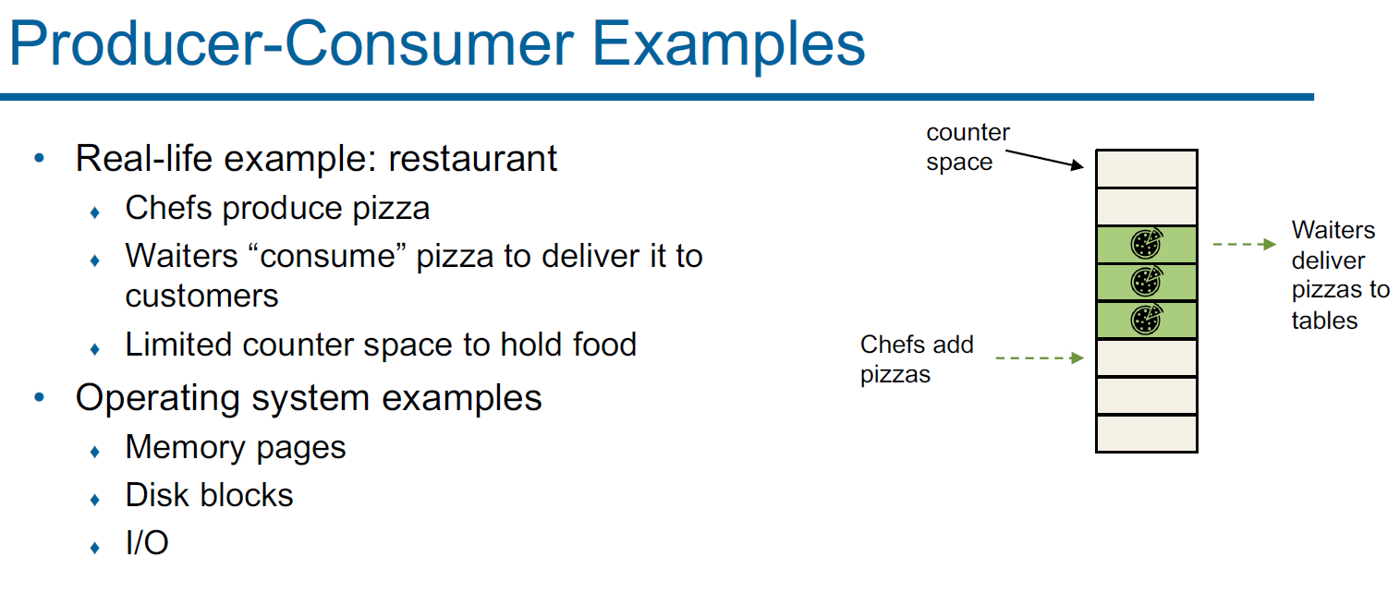

Slide 12
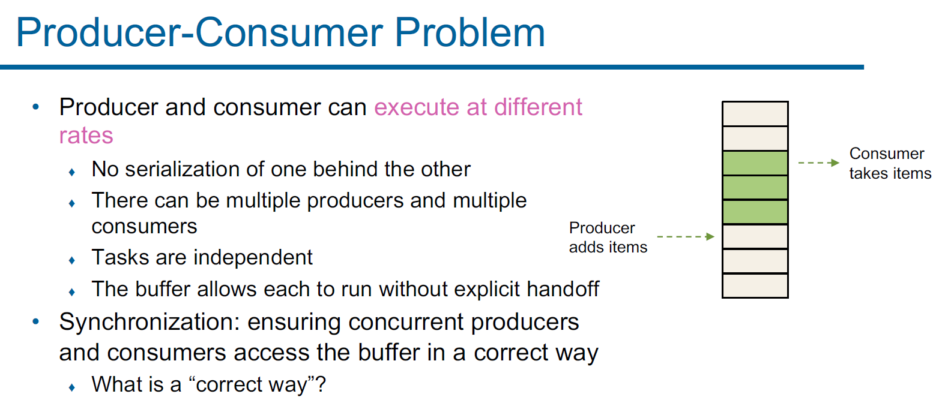

Slide 13
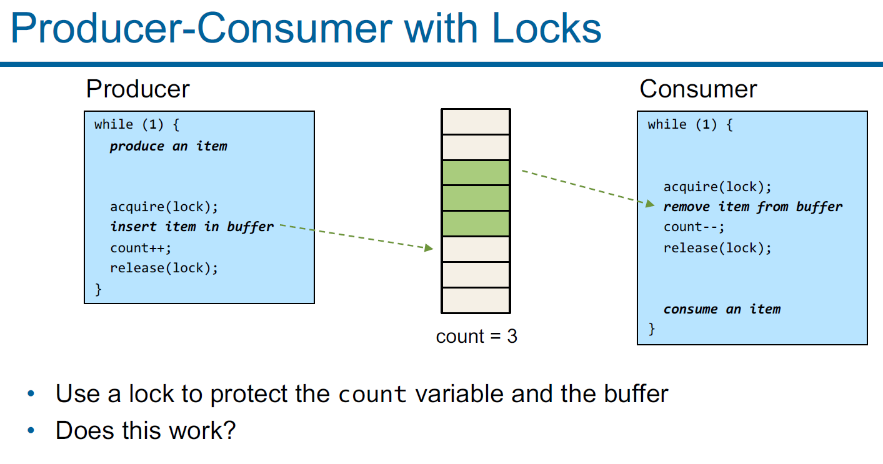

Slide 14
Limitations of Locks
Locks provide mutual exclusion
Only one thread can be in the critical section at one time
Locks do not provide ordering or sequencing
How does the producer know when to stop producing?
How does the consumer know when it can consume?

Slide 15
Semaphores
A synchronization variable that takes on non-negative integer values
Invented by Edsger Dijkstra in the mid 60’s
Semaphores support two operations:
wait(): an atomic operation that waits for the semaphore to become greater than 0, then decrements it by 1
Also P() after the Dutch word for “try to reduce” (Probeer te verlagen)
signal(): an atomic operation that increments the semaphore by 1
Also V() after the Dutch word for increment (Verhoog)
Initialize the semaphore to some value
Cannot read the semaphore’s value directly

Slide 16
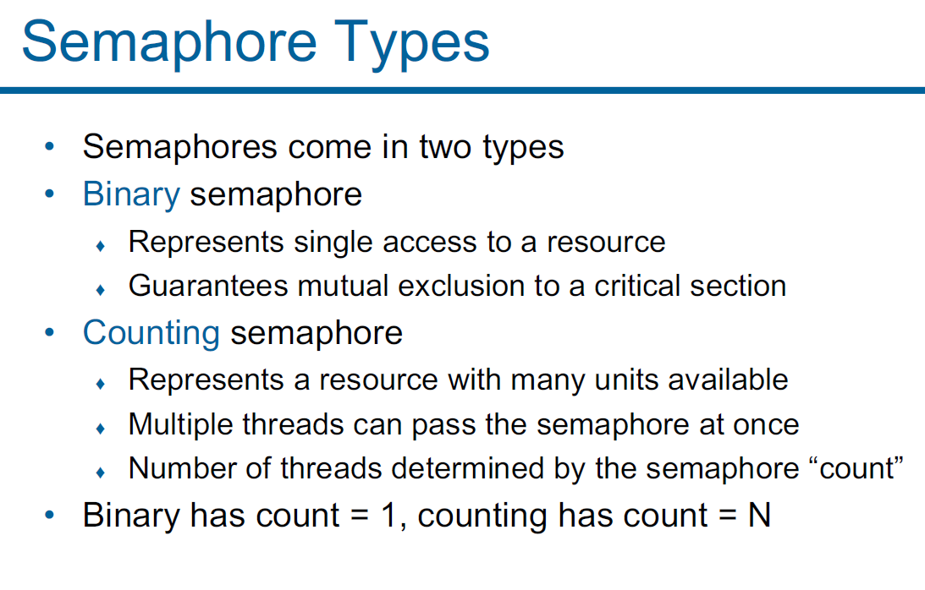

Slide 17
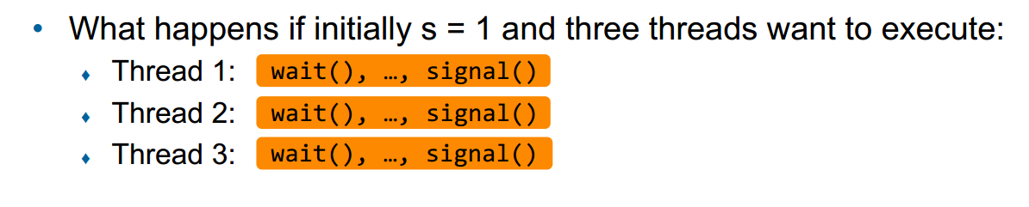
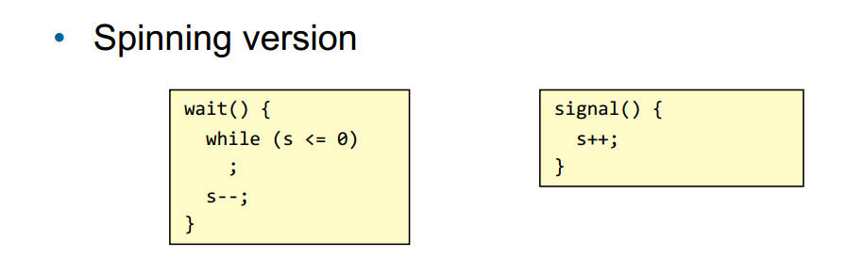
Semaphore Example: Binary Semaphore

Slide 18
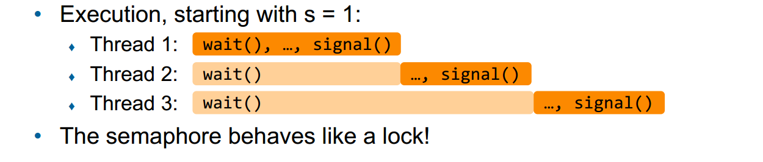
Semaphore Example: Binary Semaphore

Slide 19
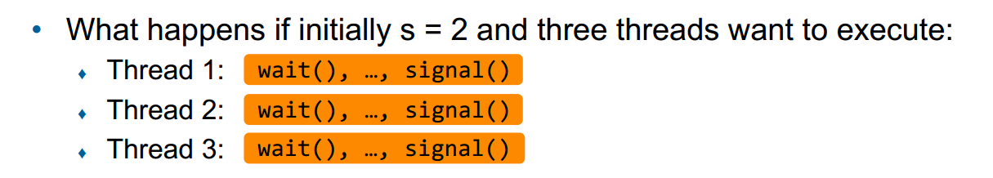
Semaphore Example: Binary Semaphore

Slide 20
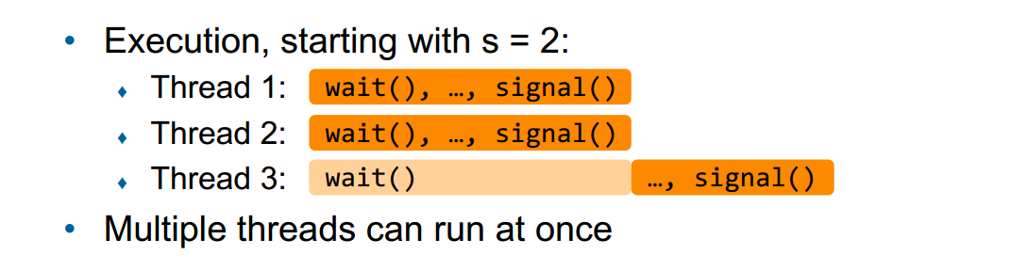
Semaphore Example: Binary Semaphore

Slide 21
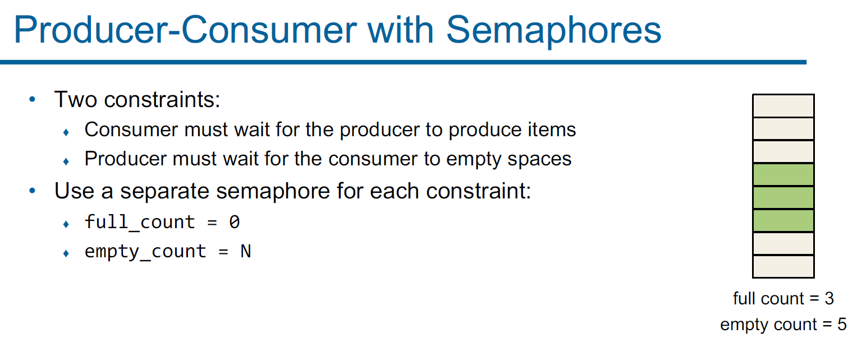

Slide 22
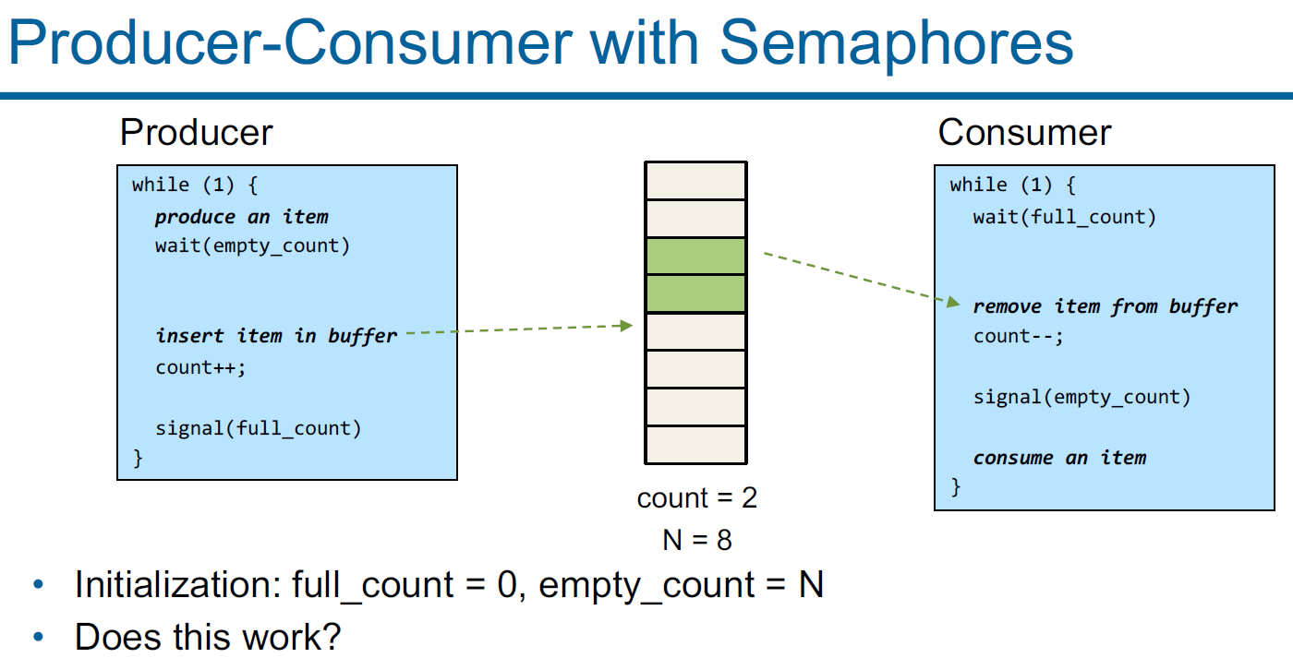

Slide 23
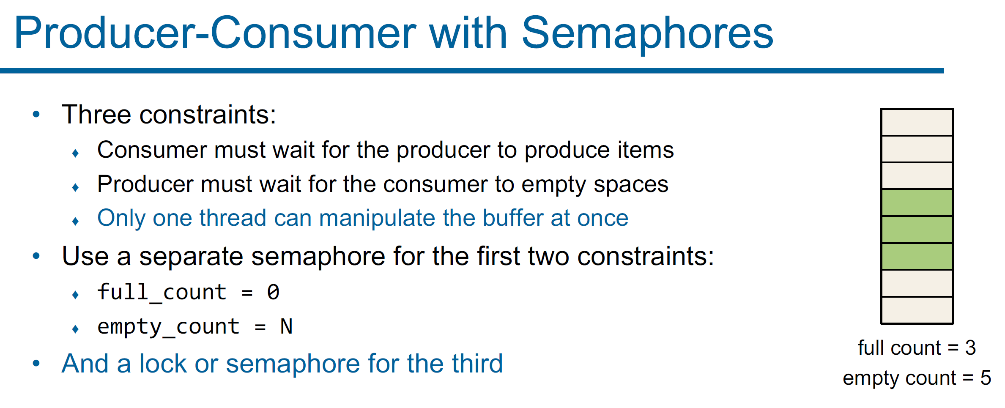

Slide 24
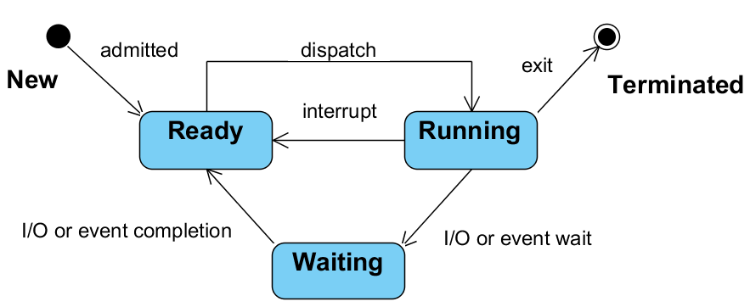
State Diagram of a Process

Slide 25
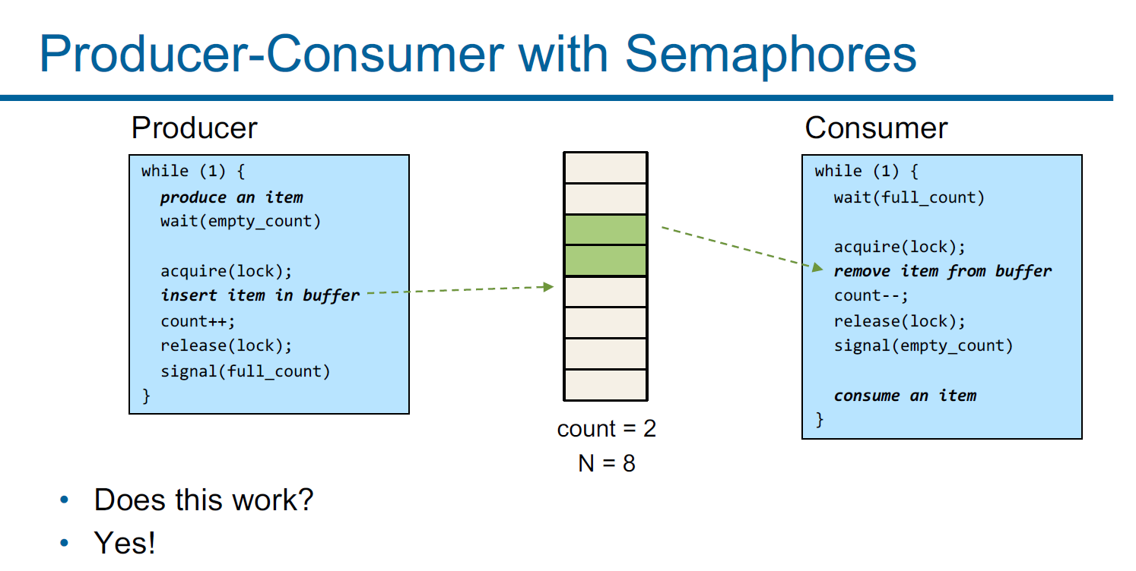
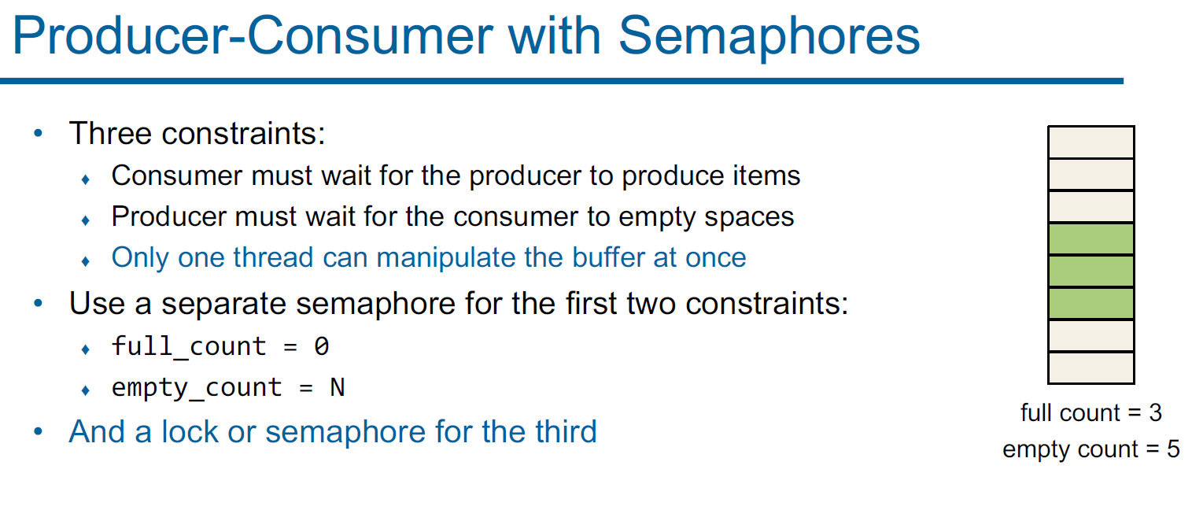

Slide 26
Agenda
Sample synchronization problem
Basic synchronization patterns

Slide 27

Rendezvous
a = Semaphore(0)
b = Semaphore(0)
Thread A
DoSomeAthing()
b.signal()
a.wait()
DoMoreOfA()
Thread B
DoSomeBThing()
a.signal()
b.wait()
DoMoreOfB
Thread A: When Thread A reaches the rendezvous point, it signals its semaphore (indicating it has arrived) and waits on the semaphore of Thread B.
Thread B: Similarly, when Thread B reaches the rendezvous point, it signals its semaphore and waits on the semaphore of Thread A.

Slide 28
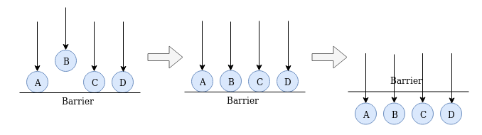
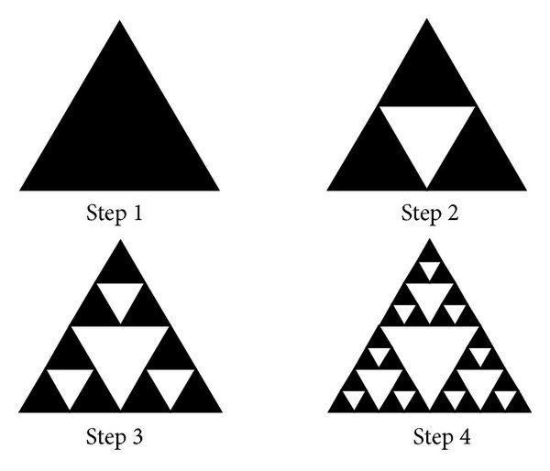
Barrier
Serves as a synchronization primitive for a group of threads/processes.
Rendezvous for multiple threads
Sierpinski triangle

Slide 29

Queue
init:
queue = Semaphore(0)
arrive:
queue.wait()
let someone pass:
queue.signal()

Slide 30
Monitor
Monitors contain both the data and the synchronization code and manage access to an object themselves, handling the use of mutexes internally.
Use cases: Used in environments with higher abstraction.
Examples: Python with the “with” context manager for locks.

