Slide 1
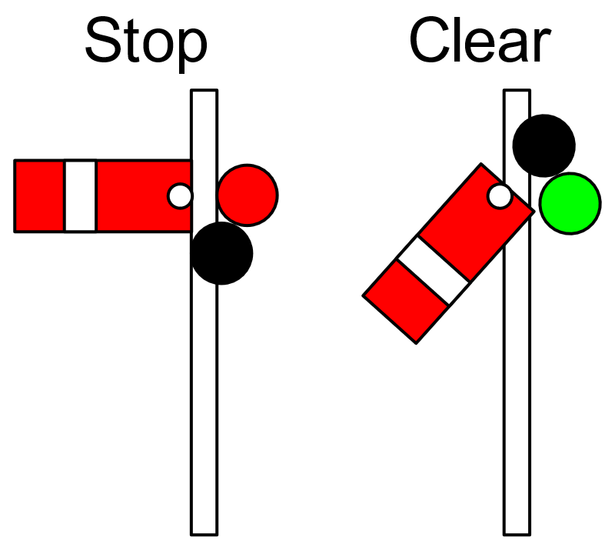
SYNC
SYNCHRONIZATION
Notes:
https://en.wikipedia.org/wiki/Railway_semaphore_signal

Slide 2
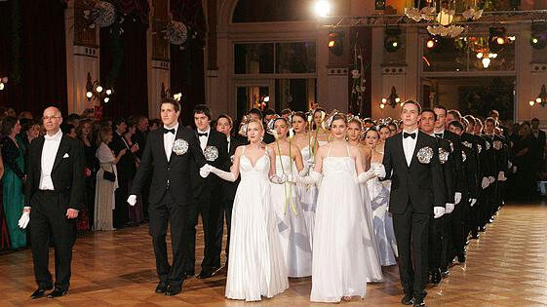
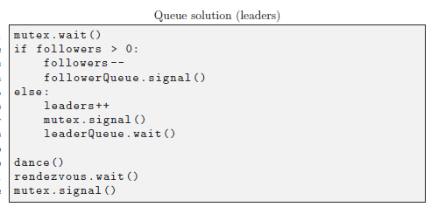
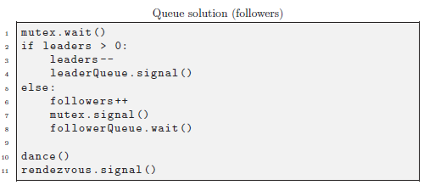
3.8 followers & leaders
design principles:
mutex: for resource protection
semaphore: for activation

Slide 3
categorical exclusion (II)
sem.wait()
// CS
sem.signal()
sem = semaphore(1)
mutex.wait()
nrof++
if nrof==1:
sem.wait()
mutex.signal()
// CS
mutex.wait()
nrof--
if nrof==0:
sem.signal()
mutex.signal()
Notes:
Writer’s code at left hand side, reader’s code at right hand side.
Note that in readers’s code, before sem.wait, make sure to release the mutex (and obtain it again after the sem.wait())

Slide 4
alternative version?
// see if you can enter:
semA.wait()
// block the other:
semB.wait()
// CS
semA.signal()
semB.signal()
semA = semaphore(1)
semB = semaphore(1)
// see if you can enter:
semB.wait()
// block the other:
semA.wait()
// CS
semB.signal()
semA.signal()
Notes:
wrong solution!
deadlock

Slide 5
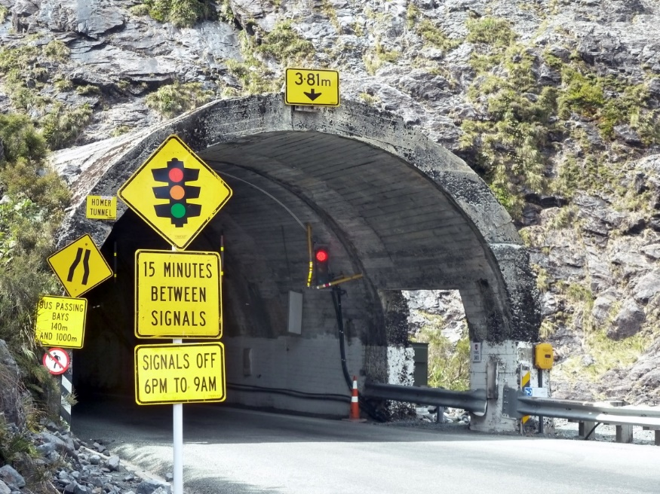
categorical exclusion (examples)
narrow tunnel: either North-bound or South-bound traffic
unisex bathroom: either males or females
database: either a writer or (a lot of) readers

Slide 6

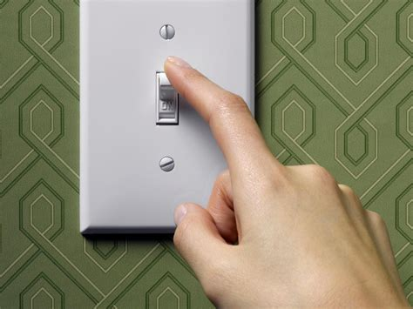
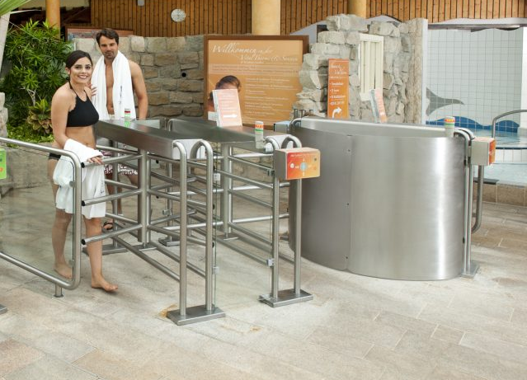
lightswitch
the first person into a room turns on the light (locks the semaphore) and the last one out turns it off (unlocks the semaphore)
alternative name: FamilyTicket-RedCarpet

Slide 7
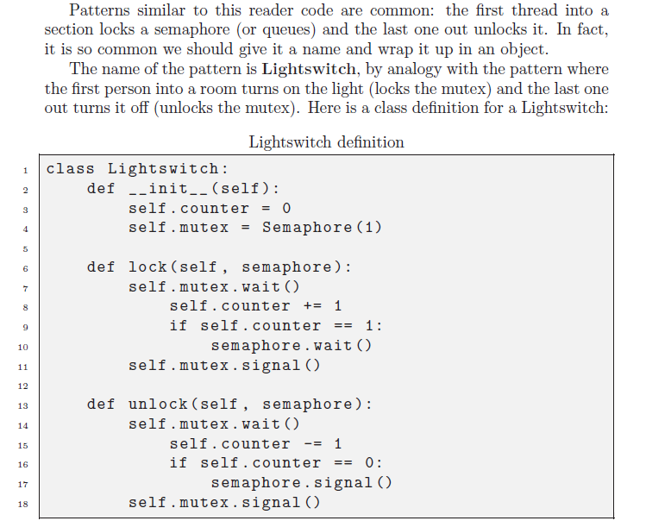
lightswitch

Slide 8
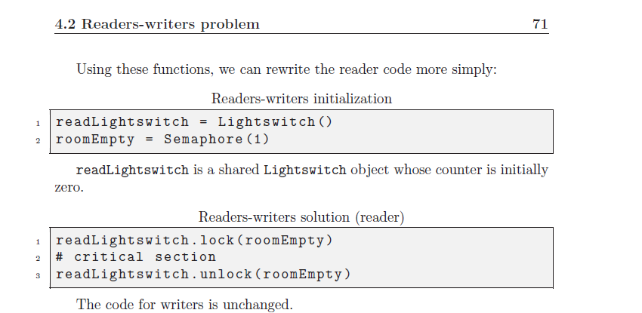

Lightswitch for readers/writers

Slide 9
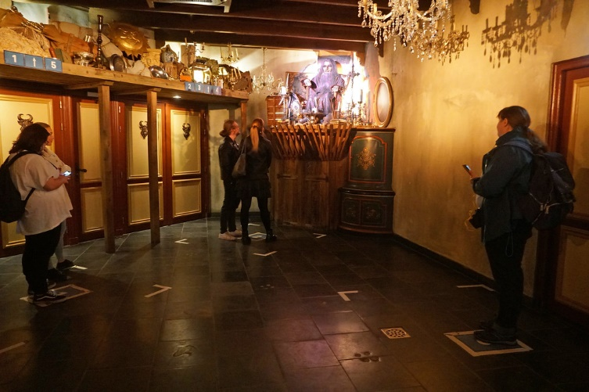

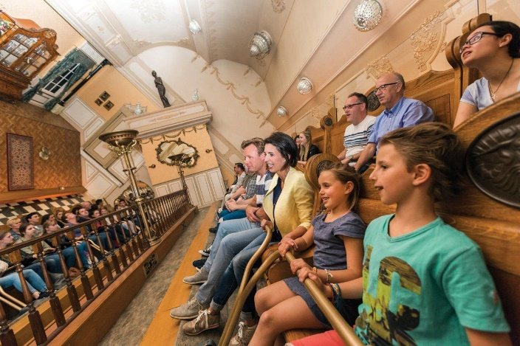
4.3 no-starve mutex
mu.wait()
CS()
mu.signal()
mu.wait()
CS()
mu.signal()
mu.wait()
CS()
mu.signal()
mu.wait()
CS()
mu.signal()
mu.wait()
CS()
mu.signal()
mu.wait()
CS()
mu.signal()
mu.wait()
CS()
mu.signal()
Notes:
Note that in the above situation it is not guaranteed that each thread makes progress.
One thread may not be able to get the mutex.

Slide 10
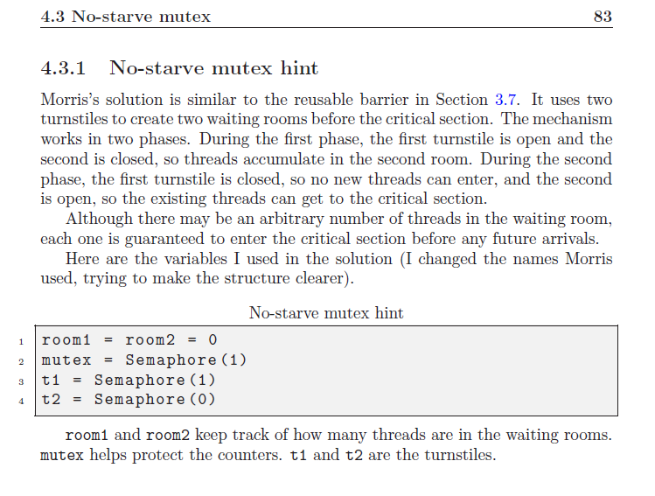
No starve mutex

Slide 11
