Slide 1
Day trip Saturday 14

Slide 2
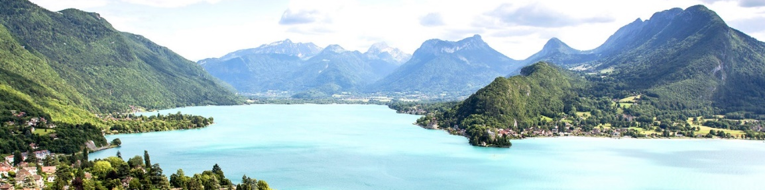
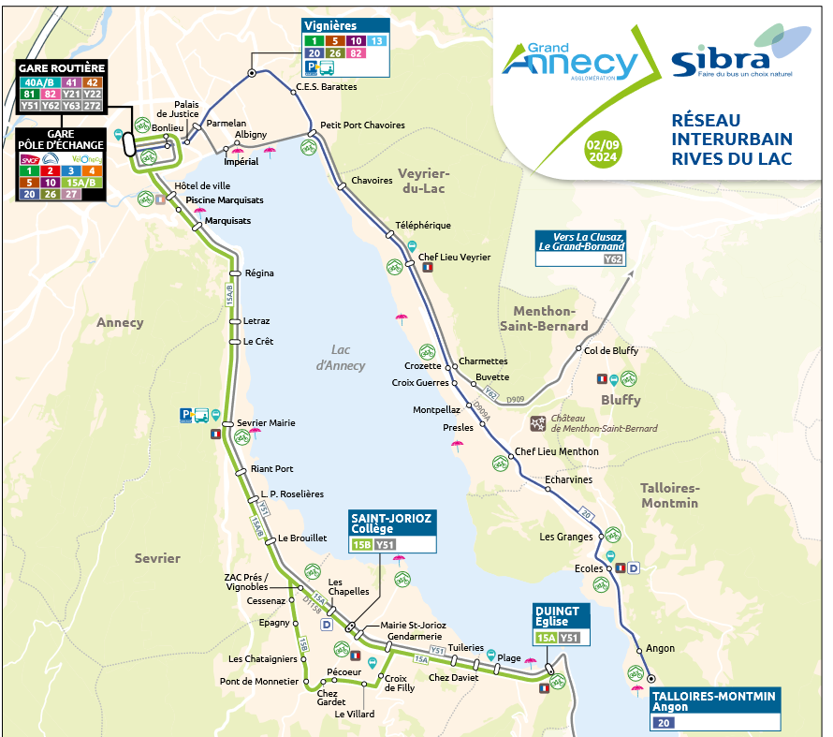
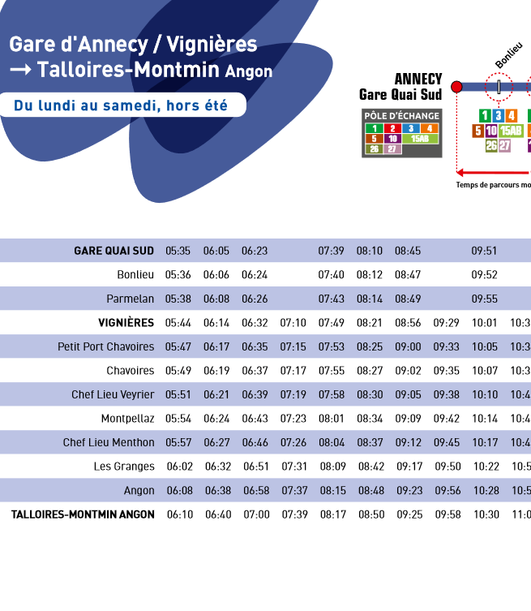
Day trip Saturday
9:29 Bus stop « Vignière »
9:50 Talloires
Bus line 20

Slide 3
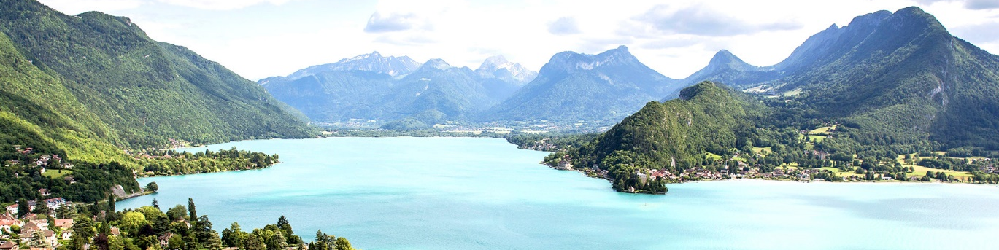
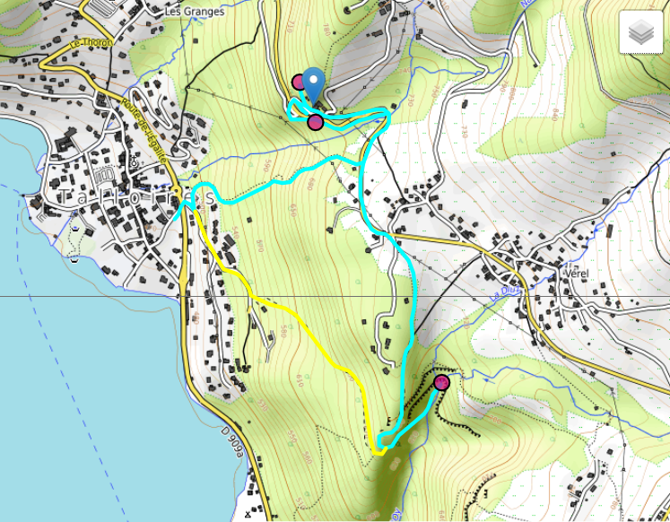

Day trip Saturday
Hike at
Hermitage Saint-Germain and Angon Waterfall
about 2h walk. Take sports shoes
Snack lunch at Talloires beach
Return by bus
Infos will be sent by email

Slide 4
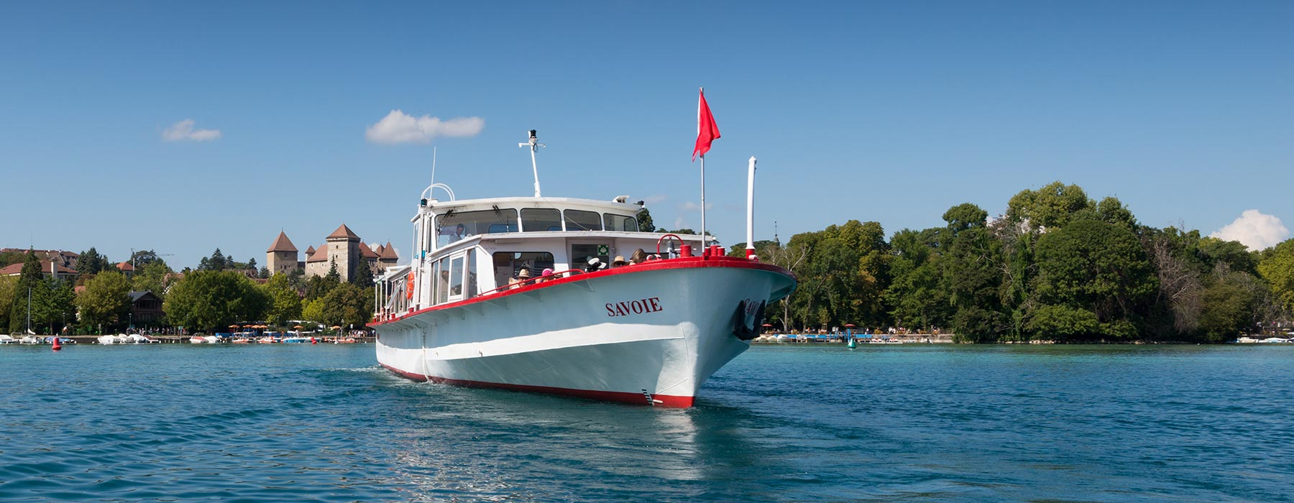
Sunday activity
Option to take a one-hour cruise on the lake on your own
Sunday at 14:45
Let me know if you want to participate

