Slide 1




2019
INFO 802
Master Advanced Mechatronics
Luc Marechal
Introduction
Course 3

Slide 2



ROS Messages
They are files where we put a specification about the type of data to be transmitted and the values of this data.
Defined in *.msg files stored in the msg subdirectory of a package
CMakeLists.txt
my_package
Package.xml
msgfile1.msg
msg
…
msgfilen.msg
See message definition information with
> rosmsg show [message_type]

Slide 3
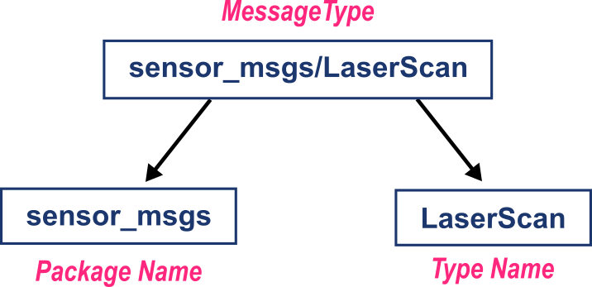
ROS Messages
Example:
Every message type belongs to a specific package
Message type names always contain a slash, and the part before the slash is the name of the containing package:
> package_name/type_name

Slide 4
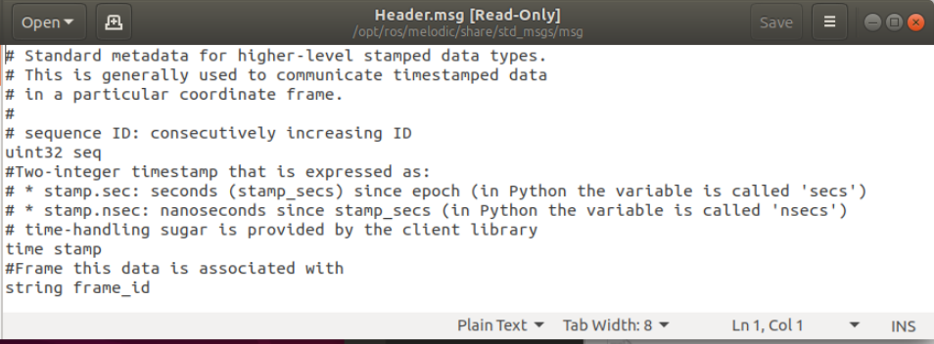
ROS Messages
msgs are just simple text files with a field type and field name per line. The field types you can use are:
int8, int16, int32, int64 (plus uint*)
float32, float64
string
time, duration
other msg files
variable-length array[] and fixed-length array[C]
Header: special type in ROS
The header contains a timestamp and coordinate frame information that are commonly used in ROS to communicate timestamped data in a particular coordinate frame.
uint32 seq time stamp string frame_id

Slide 5
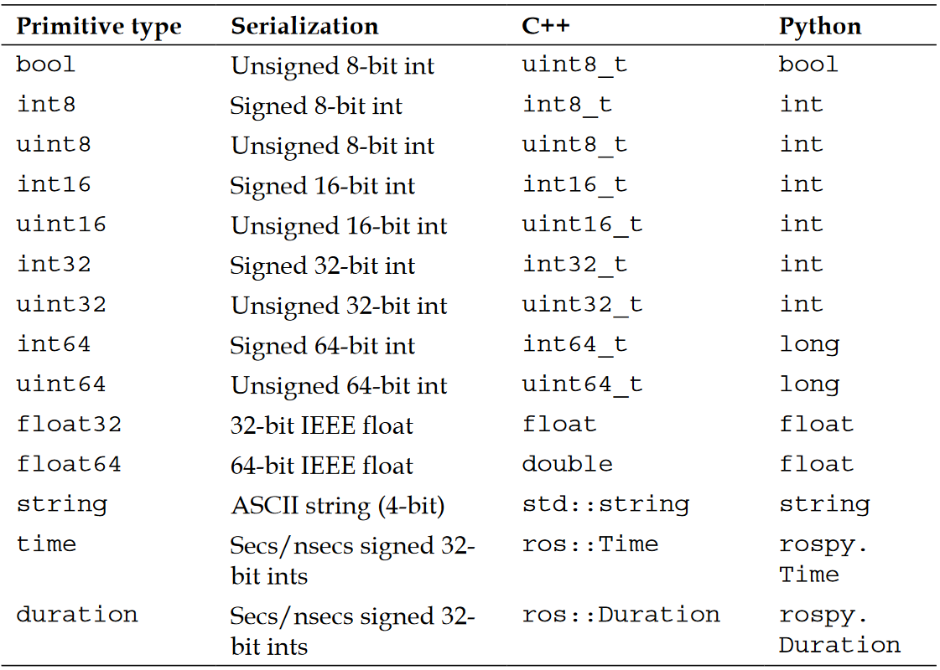
ROS Messages
Standard type to use in message

Slide 6
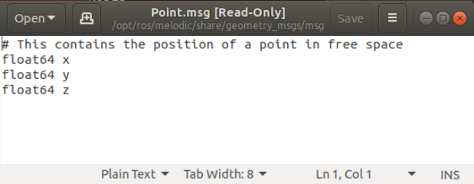
ROS Messages
Examples
geometry_msgs/Points.msg
float64 x
float64 y
float64 z
geometry_msgs/Quaternions.msg
float64 x float64 y
float64 z
float64 w

Slide 7
ROS Messages
Example
geometry_msgs/Points.msg
float64 x
float64 y
float64 z
geometry_msgs/Pose.msg
geometry_msgs/Point position
geometry_msgs/Quaternion orientation
geometry_msgs/Quaternions.msg
float64 x float64 y
float64 z
float64 w
You can use message type from already existing message

Slide 8
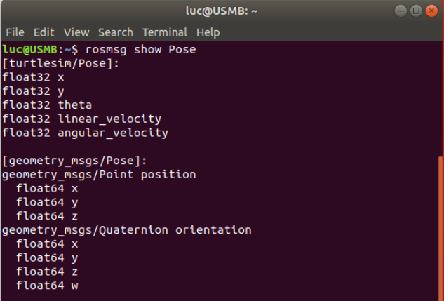
ROS Command Tools
See message definition information:
> rosmsg show [message_type]
The message of type Pose is defined in the package turtlesim but also in the package geometry_msgs but they are not the sames !

Slide 9
ROS Command Tools
See message definition information:
> rosmsg show [message_type]
See active topics:
> rostopic list
See node information:
> rosnode info [message_type]

Slide 10
How to use ROS Messages in code?
#!/usr/bin/env python
from geometry_msg.msg import Pose
from beginner_tutorials.msg import My_Custom_Message
# without creating an object
Pose.position.x = 1.0
# by creating an object
My_Object = Pose()
My_Object.position.x = 1.0
My_Object.orientation.y = My_Object.position.x + 43.2
Import the message type from the msg library
Use the message directly with an oriented object way
Use the message with an Object

Slide 11
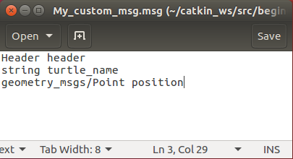
Creating a custom ROS msg
Edit *.msg file
When Should You Make a New Message Type?
Only when you absolutely have to (check before with rosmsg to see if there is already something there that you can use instead).
However, there are times when the built-in message types are not enough, and we have to define our own messages
Create a subfolder named msg in your package folder
> cd ~/catkin_ws/src/beginner_tutorials
> mkdir msg
Create a new my_custom_msg.msg file and add the following lines
> gedit msg/my_custom_msg.msg

Slide 12
Creating a custom ROS msg
Modifify package.xml file
We need to make sure that the msg files are turned into source code for C++, Python, and other languages
uncomment those two lines in the package.xml file
<build_depend>message_generation</build_depend>
<run_depend>message_runtime</run_depend>
Note that at build time, we need "message_generation", while at runtime, we need "message_runtime"

Slide 13
Creating a custom ROS msg
Modifify CMakefile.txt file
In CMakeLists.txt add the message_generation dependency to the find package call so that you can generate messages:
find_package(catkin REQUIRED COMPONENTS
roscpp
rospy
std_msgs
message_generation
}
Also make sure you export the message runtime dependency:
catkin_package(
# INCLUDE_DIRS include
# LIBRARIES multi_sync
CATKIN_DEPENDS roscpp rospy std_msgs message_runtime
# DEPENDS system_lib
)

Slide 14
Creating a custom ROS msg
Modifify CMakefile.txt file
Find the following block
## Generate messages in the 'msg' folder
# add_message_files(
# FILES
# Message1.msg
# Message2.msg
# )
Uncomment it by removing the # symbols and then replace the stand in Message*.msg files with your .msg file, such that it looks like this:
add_message_files(
FILES
my_custom_msg.msg
)

Slide 15
Creating a custom ROS msg
Modifify CMakefile.txt file
ensure the generate_messages() function is called: uncomment this lines
# generate_messages(
# DEPENDENCIES
# std_msgs
# )
So it looks like:
generate_messages(
DEPENDENCIES
std_msgs
)
cmake will then know that the project needs to be reconfigurated with the addition of msg files
Notes:
Check > rosmsg show my_custom_msg

Slide 16
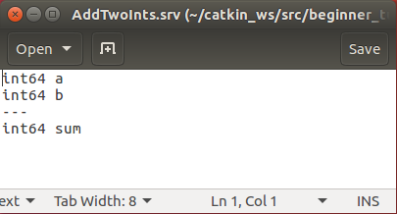
Creating a ROS srv
Defined in *.srv files stored in the srv subdirectory of a package
srv files are just like msg files, except they contain two parts: a request and a response. The two parts are separated by a '---' line.
CMakeLists.txt
my_package
Package.xml
srvfile1.srv
srv
…
srvfilen.srv

Slide 17
Creating a ROS srv
Modifify package.xml file
Create a subfolder named srv in your package folder
> cd ~/catkin_ws/src/beginner_tutorials
> mkdir srv
Example: create AddTwoInts.srv file and add the following lines
> gedit srv/AddTwoInts.srv

Slide 18
Creating a ROS srv
Modifify package.xml file
We need to make sure that the srv files are turned into source code for C++, Python, and other languages
uncomment those two lines in the package.xml file
<build_depend>message_generation</build_depend>
<run_depend>message_runtime</run_depend>
Note that at build time, we need "message_generation", while at runtime, we need "message_runtime"

Slide 19
Creating a ROS srv
Modifify CMakefile.txt file
In CMakeLists.txt add the message_generation dependency to the find package call so that you can generate messages:
(Despite its name, message_generation works for both msg and srv.)
find_package(catkin REQUIRED COMPONENTS
roscpp
rospy
std_msgs
message_generation
}

Slide 20
Creating a ROS srv
Modifify CMakefile.txt file
Find the following block
## Generate messages in the 'msg' folder
# add_service_files(
# FILES
# Service1.msg
# Service2.msg
# )
Uncomment it by removing the # symbols and then replace the stand in Service*.msg files with your .srv file, such that it looks like this:
add_service_files(
FILES
AddTwoInts.srv
)

Slide 21


Creating a Service and Client Node (Python)
Writing the Service Node
Edit a py file in scripts folder
> cd ~/catkin_ws/beginner_tutorials/src/scripts
> sudo gedit Add_two_ints_server.py
#!/usr/bin/env python
from beginner_tutorials.srv import *
import rospy
def handle_add_two_ints(req):
print "Returning [%s + %s = %s]"%(req.a, req.b, (req.a + req.b))
return AddTwoIntsResponse(req.a + req.b)
def add_two_ints_server():
rospy.init_node('add_two_ints_server')
s = rospy.Service('add_two_ints', AddTwoInts, handle_add_two_ints)
print "Ready to add two ints."
rospy.spin()
if __name__ == "__main__":
add_two_ints_server()
beginner_tutorials
dddTwoInts.srv
srv
add_two_ints_server.py
scripts
… and make it executable
> chmod +x scripts/add_two_ints_server.py

Slide 22
Creating a Service and Client Node (Python)
Examining the Service Node
#!/usr/bin/env python
from beginner_tutorials.srv import *
import rospy
def handle_add_two_ints(req):
print "Returning [%s + %s = %s]"%(req.a, req.b, (req.a + req.b))
return AddTwoIntsResponse(req.a + req.b)
def add_two_ints_server():
rospy.init_node('add_two_ints_server')
s = rospy.Service('add_two_ints', AddTwoInts, handle_add_two_ints)
print "Ready to add two ints."
rospy.spin()
if __name__ == "__main__":
add_two_ints_server()
The service file has been defined and is located in the srv folder
init_node(): declare the node
This declares a new service named add_two_ints with the AddTwoInts service type. All requests are passed to handle_add_two_ints function. handle_add_two_ints is called with instances of AddTwoIntsRequest and returns instances of AddTwoIntsResponse.

Slide 23
Creating a Service and Client Node (Python)
Writing the Client Node
#!/usr/bin/env python
import sys
import rospy
from beginner_tutorials.srv import *
def add_two_ints_client(x, y):
rospy.wait_for_service('add_two_ints')
try:
add_two_ints = rospy.ServiceProxy('add_two_ints', AddTwoInts)
resp1 = add_two_ints(x, y)
return resp1.sum
except rospy.ServiceException, e:
print "Service call failed: %s"%e
def usage():
return "%s [x y]"%sys.argv[0]
if __name__ == "__main__":
if len(sys.argv) == 3:
x = int(sys.argv[1])
y = int(sys.argv[2])
else:
print usage()
sys.exit(1)
print "Requesting %s+%s"%(x, y)
print "%s + %s = %s"%(x, y, add_two_ints_client(x, y))
Edit a py file in scripts folder
> cd ~/catkin_ws/beginner_tutorials/src/scripts
> sudo gedit Add_two_ints_client.py
beginner_tutorials
AddTwoInts.srv
srv
add_two_ints_server.py
scripts
add_two_ints_client.py
… and make it executable
> chmod +x scripts/Add_two_ints_client.py

Slide 24
Creating a Service and Client Node (Python)
Examining the Client Node
#!/usr/bin/env python
import sys
import rospy
from beginner_tutorials.srv import *
def add_two_ints_client(x, y):
rospy.wait_for_service('add_two_ints')
try:
add_two_ints = rospy.ServiceProxy('add_two_ints', AddTwoInts)
resp1 = add_two_ints(x, y)
return resp1.sum
except rospy.ServiceException, e:
print "Service call failed: %s"%e
def usage():
return "%s [x y]"%sys.argv[0]
if __name__ == "__main__":
if len(sys.argv) == 3:
x = int(sys.argv[1])
y = int(sys.argv[2])
else:
print usage()
sys.exit(1)
print "Requesting %s+%s"%(x, y)
print "%s + %s = %s"%(x, y, add_two_ints_client(x, y))
Wait for the service named add_two_ints to be advertised by the server
Once the service is advertised, we can set up a local proxy for it

Slide 25
Creating a Publisher and a Subscriber Node (Python)
Building the nodes
If not done yet: make the node executable (for Python only)
> chmod +x scripts/add_two_ints_server.py
> chmod +x scripts/add_two_ints_client.py
Build package
(we use Cmake as the build system even for Python nodes)
> cd ~/catkin_ws
> catkin_make beginner_tutorials
Make sure you have sourced your workspace's setup.bash file
> cd ~/catkin_ws
> source ./devel/setup.bash

Slide 26
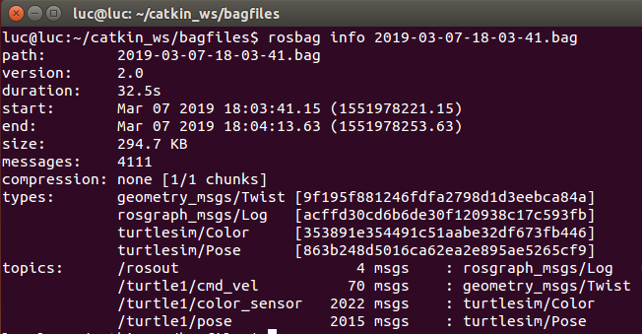
ROS Bags
rosbag: set of tools for recording messages and playing back later to ROS topics offline.
Can be used to mimic real sensor streams for offline debugging.
Useful for debugging algorithm.
The file a name is in the format: file_name_YYYY-MM-DD-HH-mm-ss.bag
Examples
> rosbag record –a
> rosbag play --clock mybag.bag
Record topics with
> rosbag record [topic_1] [topic_2] -o [bag_name]
Playback messages with
> rosbag play [bag_name]

Slide 27
Example logging turtlesim

Slide 28
ROS computation graph rqt
rqt_graph creates a dynamic graph of what's going on in the system
rqt_console attaches to ROS's logging framework to display output from nodes. rqt_logger_level allows us to change the verbosity level (DEBUG, WARN, INFO, and ERROR) of nodes as they run.
Prerequisit: Install rqt package
> sudo apt-get install ros-kinetic-rqt ros-kinetic-rqt-common-plugins
Launch rqt_console
> rosrun rqt_console rqt_console
Launch rosrun rqt_logger_level rqt_logger_level (in an other terminal)
> rosrun rqt_logger_level rqt_logger_level

Slide 29
ROS computation graph rqt
Visualize running topics and nodes
> rosrun rqt_graph rqt_graph
Visualize running topics and nodes
> rosrun rqt_plot rqt_plot

Slide 30
Further References
ROS Wiki
http://wiki.ros.org/
Installation
http://wiki.ros.org/ROS/Installation
Tutorials
http://wiki.ros.org/ROS/Tutorials
Available packages
http://www.ros.org/browse/
ROS Cheat Sheet
https://www.clearpathrobotics.com/ros-robot-operating-system-cheat-sheet/
https://kapeli.com/cheat_sheets/ROS.docset/
ROS Best Practices
https://github.com/leggedrobotics/ros_best_practices/wiki
ROS Package Template
https://github.com/leggedrobotics/ros_best_practices/tree/master/ros_package_template

Slide 31
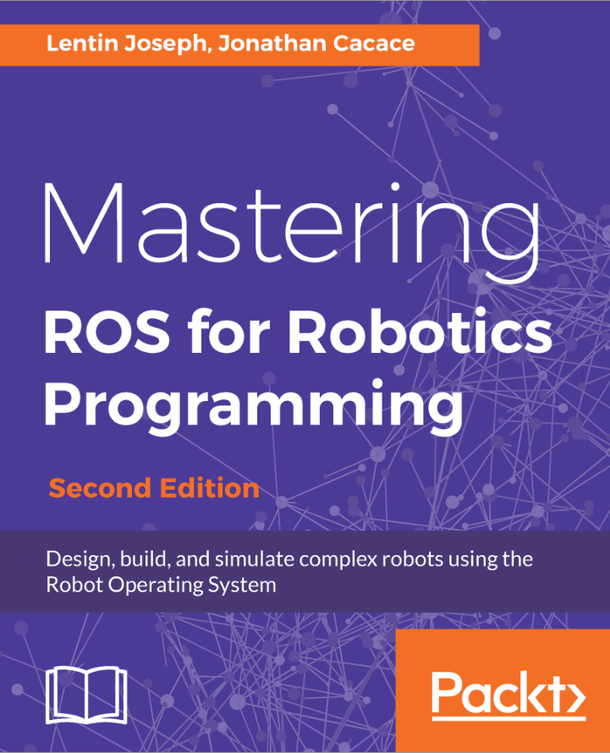

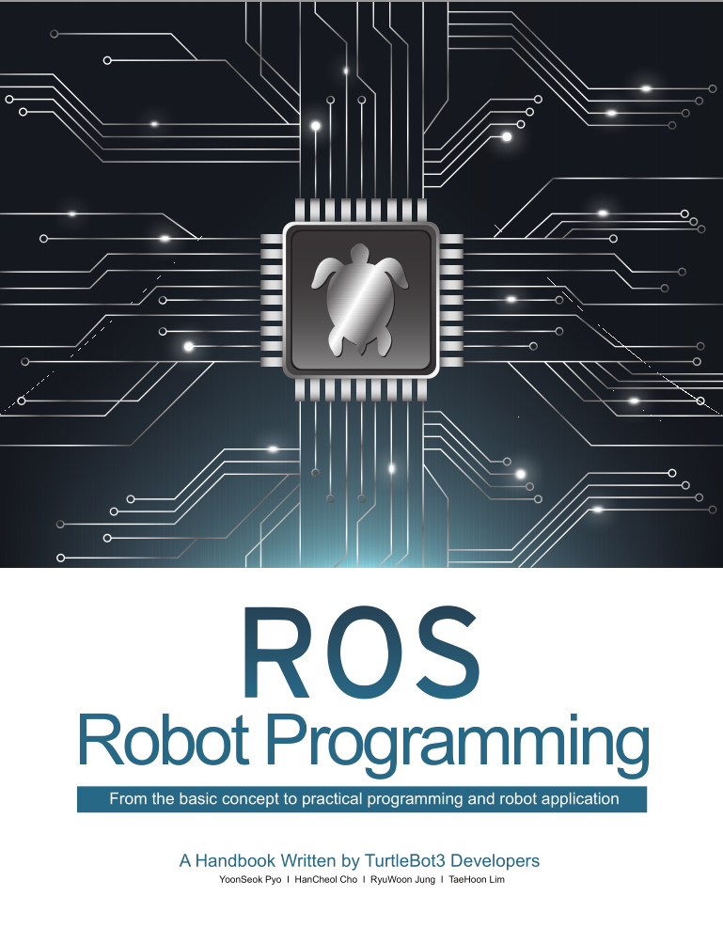
Relevant books

Slide 32

Contact Information
Université Savoie Mont Blanc
Polytech’ Annecy Chambery
Chemin de Bellevue
74940 Annecy
France
https://www.polytech.univ-savoie.fr
Lecturer
Luc Marechal (luc.marechal@univ-smb.fr)
SYMME Lab (Systems and Materials for Mechatronics°

