Slide 2





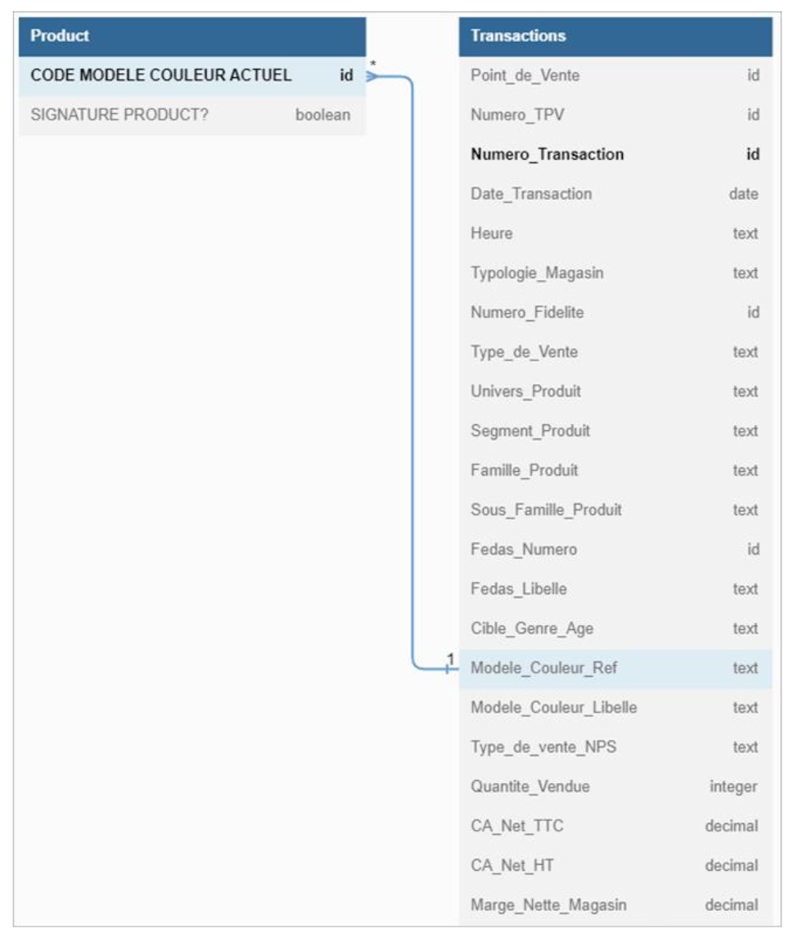

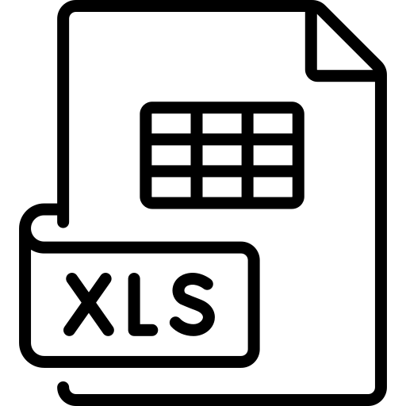



Data Profiling + Preperation
Container Deployment + ETL
Queries
</profiling.ipynb>*
</*.sql>
</metadata/>
</dataset_profiling.py>
</routing.py>
</reporting.py>
</schemas_regex.py>
</data_validation.py>
</pipeline.py>
</schema.sql>
</docker-compose.yml>*
</.env>
</pgpass>
</servers.json>
</create_db.py>*
</data_loader.py>*
</run_sql_cli.py>*
</*.sql>
Transactions
Transactions
Products
Products
* Run file for each step

