Slide 1

Punch’em Videogame
Luca Tartaglia
Kamran Mehravar
Farzaneh Moghani

Slide 2
Introduction and Objectives
Problem Description
A player fights against two type of enemies, minions and bosses, one at a time. A fight lasts until the opponent is defeated.
When the player is fighting a minion and a boss arrives, the fight against the minion is stopped and the minion is queued again recovering some health.
Evaluated Scenario
Exponential distribution of the interarrival times and fighting times
Objectives
Study the number of minion and bosses fought in the unit of time as a function of the arrival rates
Study the queueing time of bosses and minions.
KPIs (Key Performance Indexes)
Throughput T
Mean Waiting Time E[W]
Mean Response Time E[R]

Slide 3

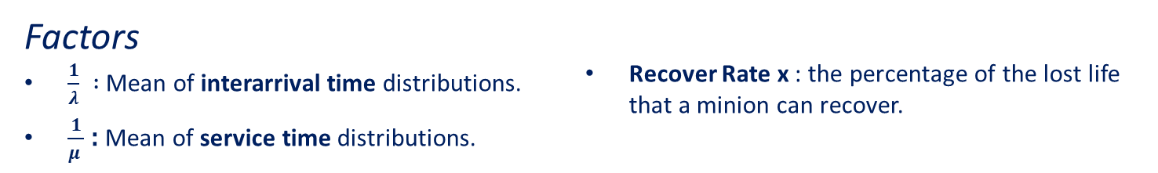
Modeling
Model Description
Opponents (Bosses and Minions):
The opponents, sent respectively from the modules Boss and Minion to the module Player, are considered as messages (new type defined, called OpponentMessage) that are placed in a FIFO queue (different queues are used for each opponent type).
The new type of opponent message has a parameter attached, the service time, that is expressed in seconds and represent the opponents life.
The Player:
An opponent message is extracted from the queue (start of the fight) and when the time corresponding to the latter’s life (service time) runs out, the battle is declared finished and the opponent defeated.
Recovering System: When a minion is under service and a boss arrives, the player stops the fight and perform these operations:
Takes off the minion under service;
Computes the percentage of the lost life ;
Takes the “x” percentage of the lost life, called recovering percentage (x is set in the configuration and can assume values 0 ≤ x ≤100 );
Applies the recovering percentage to the current life, in order to compute the life to be added;
Sum up the current life and the life to be recovered;
Queue up the recovered minion again.
Factors
$\frac{1}{λ}$ $:$ Mean of interarrival time distributions.
$\frac{1}{μ }$ : Mean of service time distributions.
Recover Rate x : the percentage of the lost life that a minion can recover.

Slide 4
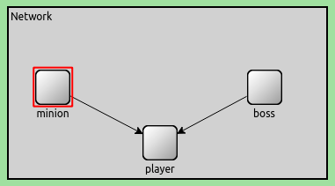
Implementation
Modules
Boss and Minion :
Generate a random number from interarrival distribution
Generate a random number from service time distribution
Send a message to Player module
Player :
Pushes minion and boss messages in their own FIFO queue.
When needed, it computes the recover life and pushes the minion again in the queue.
Process minion and boss messages.
Record statistics.
Messages
Opponent Message : New type of messages that hold the service time for each opponent in simtime_t format.

Slide 5
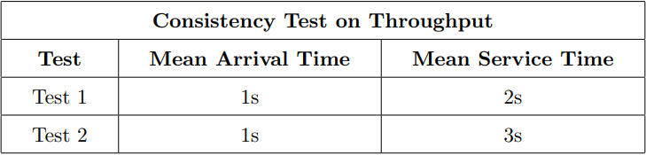
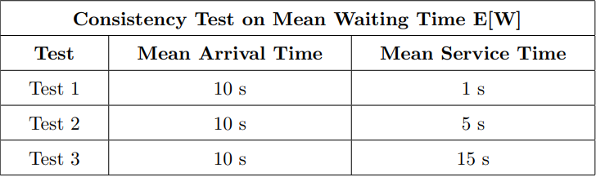
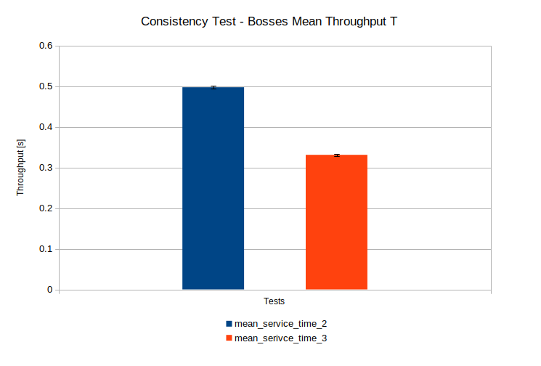
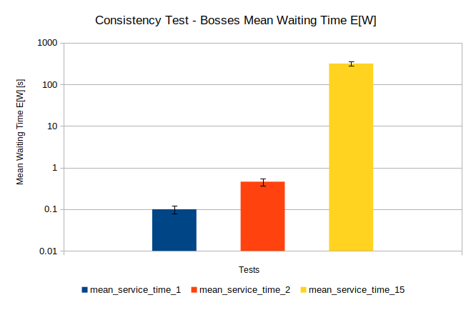
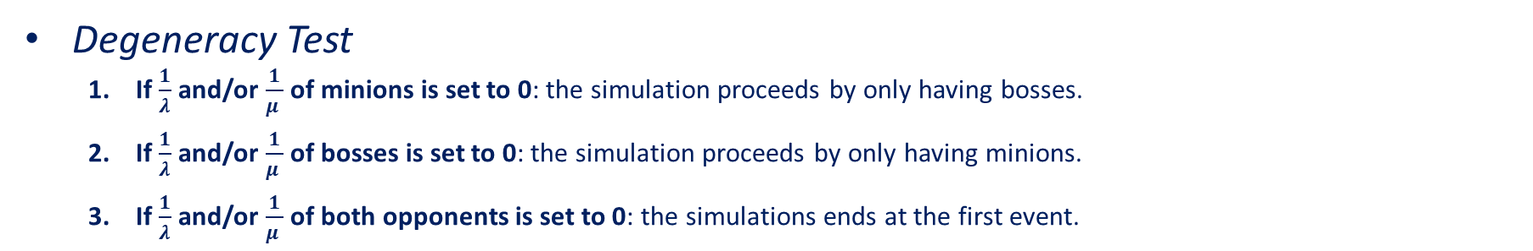
Verification – Degeneracy and Consistency Test
Degeneracy Test
If $\frac{1}{λ}$ and/or $\frac{1}{μ }$ of minions is set to 0: the simulation proceeds by only having bosses.
If $\frac{1}{λ}$ and/or $\frac{1}{μ }$ of bosses is set to 0: the simulation proceeds by only having minions.
If $\frac{1}{λ}$ and/or $\frac{1}{μ }$ of both opponents is set to 0: the simulations ends at the first event.
Consistency Test
The Throughput is higher when the service time decreases and vice-versa.
In terms of the model studied the player defeats more opponents if their life decreases.
When the service time is lower than the arrival time, the Mean Waiting Time takes values around 0 (the player has enough time to fight and defeat the opponents before a new one arrives)

Slide 6
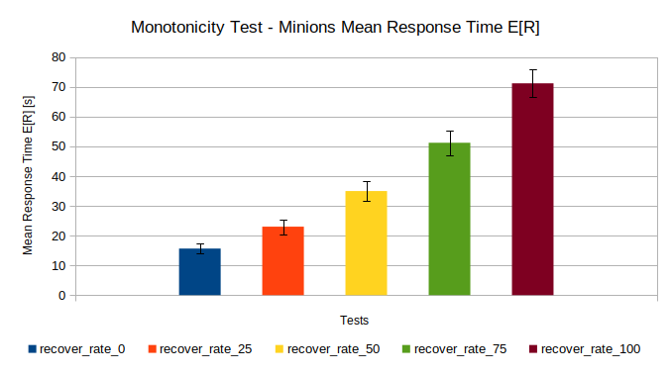
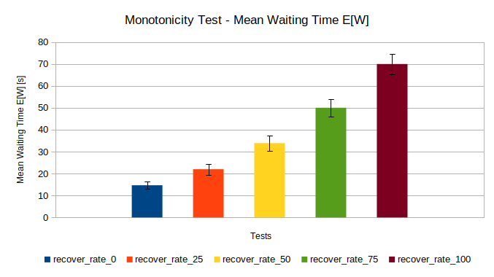
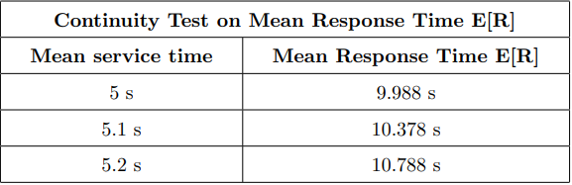
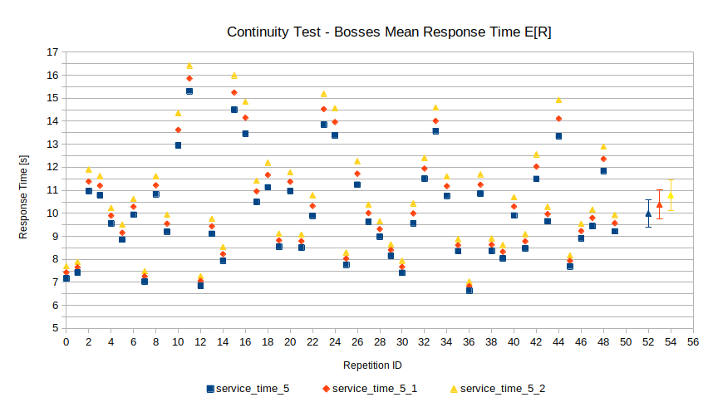
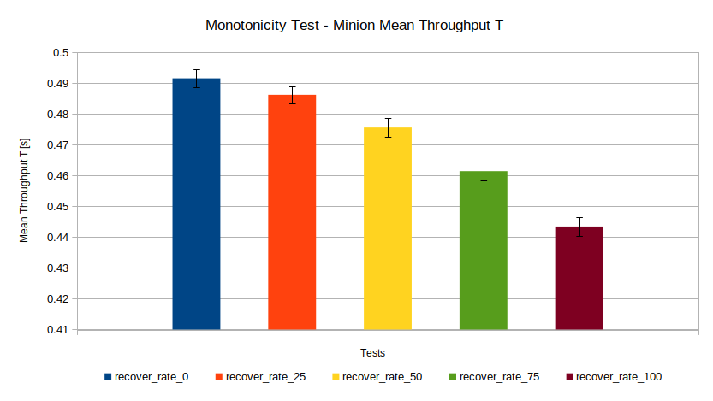
Verification – Continuity and Monotonicity Test
Continuity Test
Monotonicity Test

Slide 7
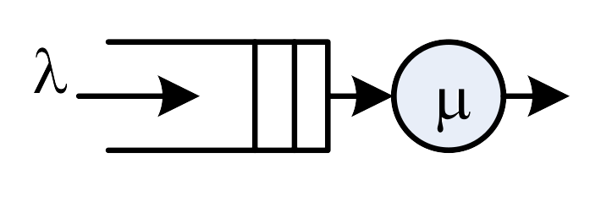
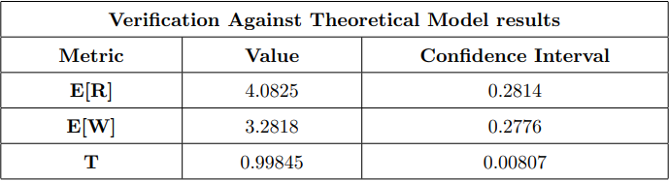
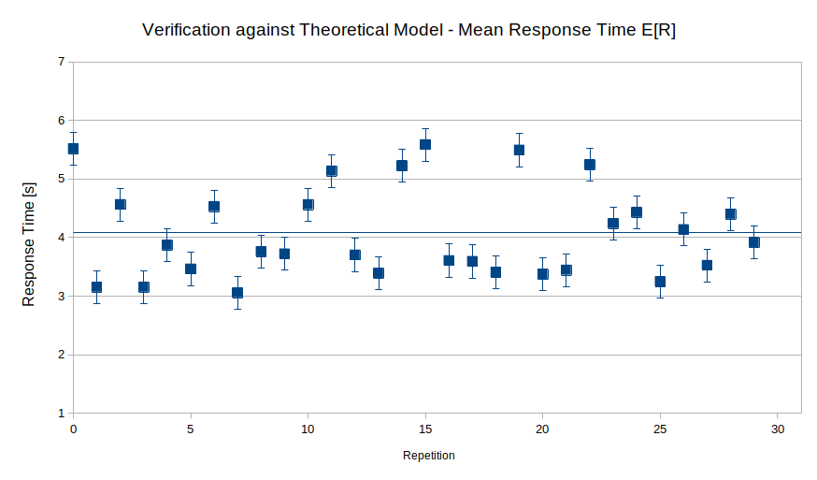
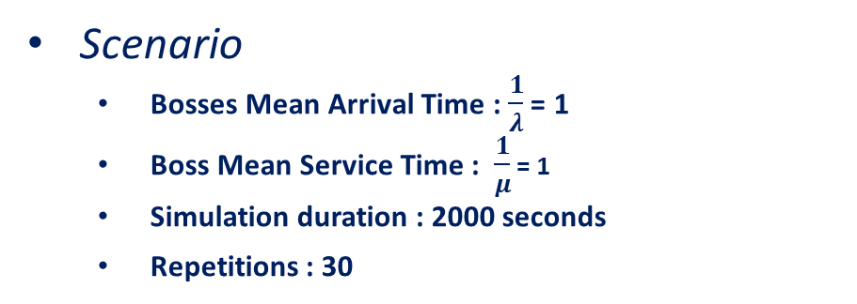
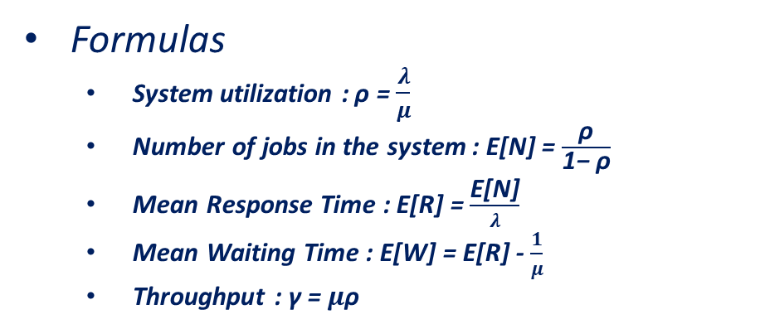
Verification – Against Theoretical Model
Assumptions
Only one opponent type ( bosses or minions)
Exponential interarrival and service time
Results
ρ = 0.8, E[N] = 4, E[R] = 4, E[W] = 3.2, T = 1
Formulas
System utilization : ρ = $\frac{λ}{μ}$
Number of jobs in the system : E[N] = $\frac{\text{ρ}}{\text{1− }\text{ρ}}$
Mean Response Time : E[R] = $\frac{\text{E}\text{[}\text{N}\text{]}}{λ}$
Mean Waiting Time : E[W] = E[R] - $\frac{1}{μ}$
Throughput : γ = $μ$ρ
Scenario
Bosses Mean Arrival Time : $\frac{1}{λ}$ = 1
Boss Mean Service Time : $\frac{1}{μ}$ = 1
Simulation duration : 2000 seconds
Repetitions : 30

Slide 8
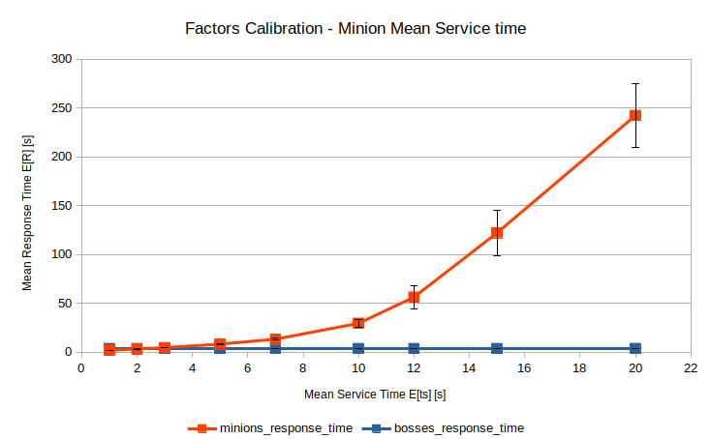
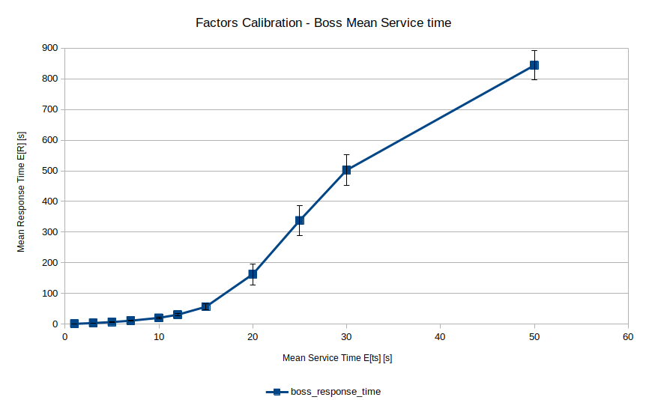
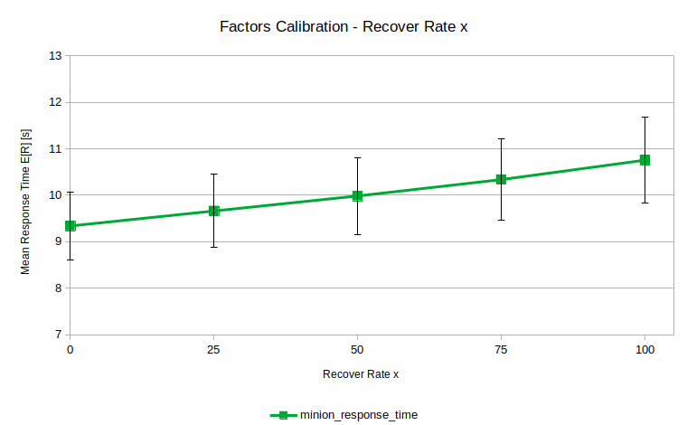
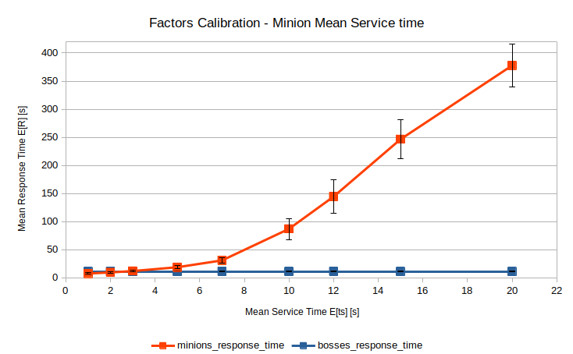
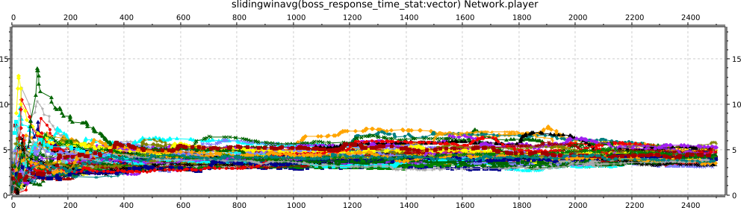
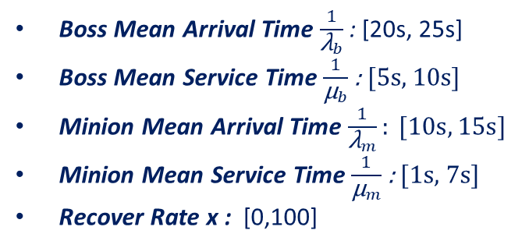
Factors Calibration
Scenario Calibration
Bosses Factors
Minions Factors
Recover Rate x
Warm-Up and Simulation Time
Boss Mean Arrival Time $\frac{1}{{\text{λ}}_{b}}$: [20s, 25s]
Boss Mean Service Time $\frac{1}{{\text{µ}}_{b}}$ : [5s, 10s]
Minion Mean Arrival Time $\frac{1}{{\text{λ}}_{m}}: [10s, 15s]$
Minion Mean Service Time $\frac{1}{{\text{µ}}_{m}}$ : [1s, 7s]
Recover Rate x : [0,100]
Warm-up Time : 350 seconds
Simulations Time : 2500 seconds

Slide 9
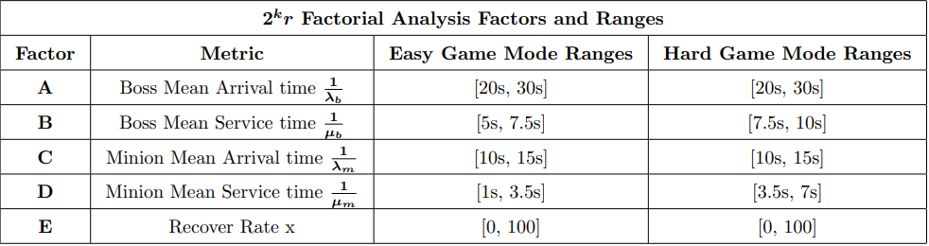
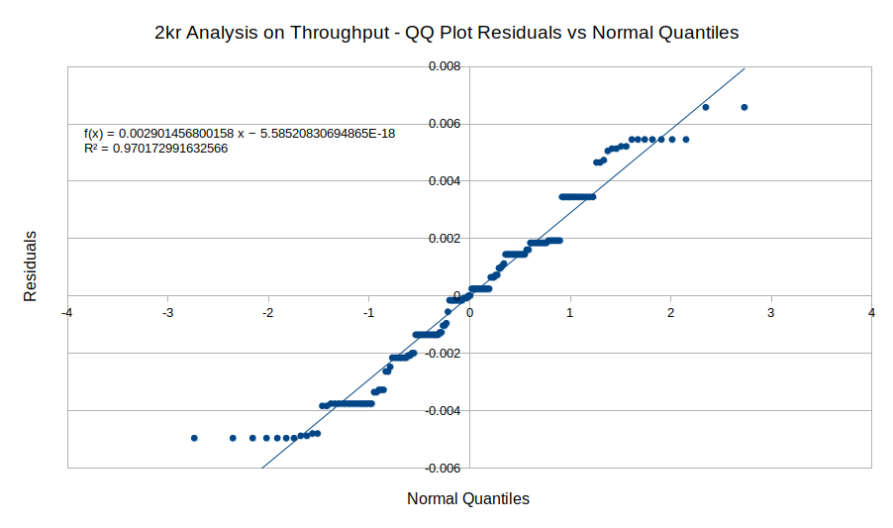
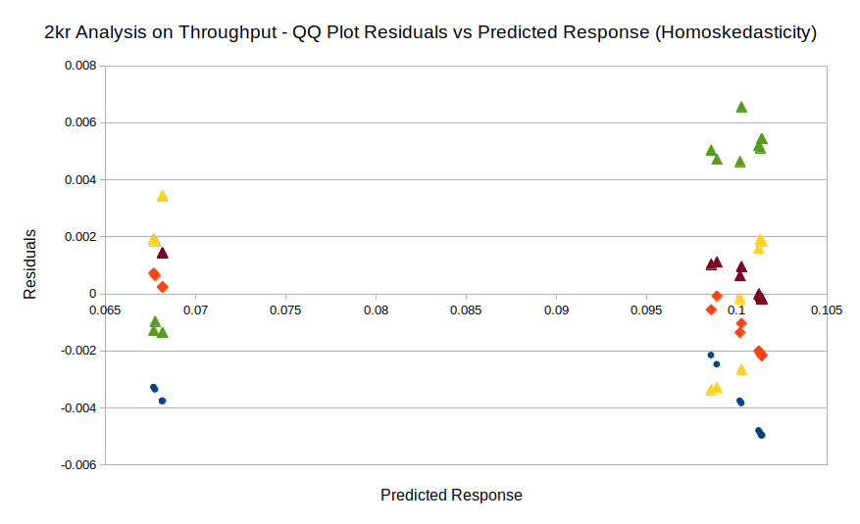
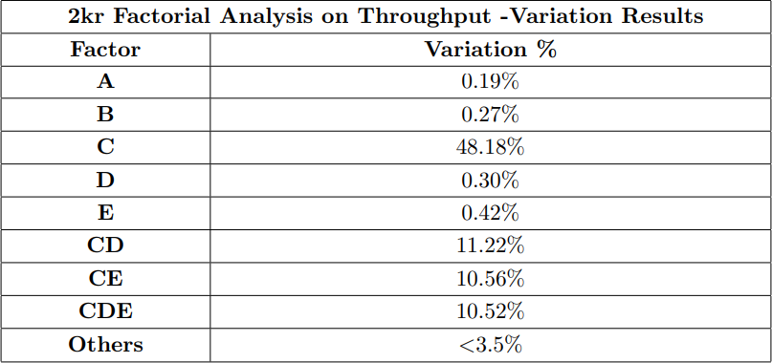
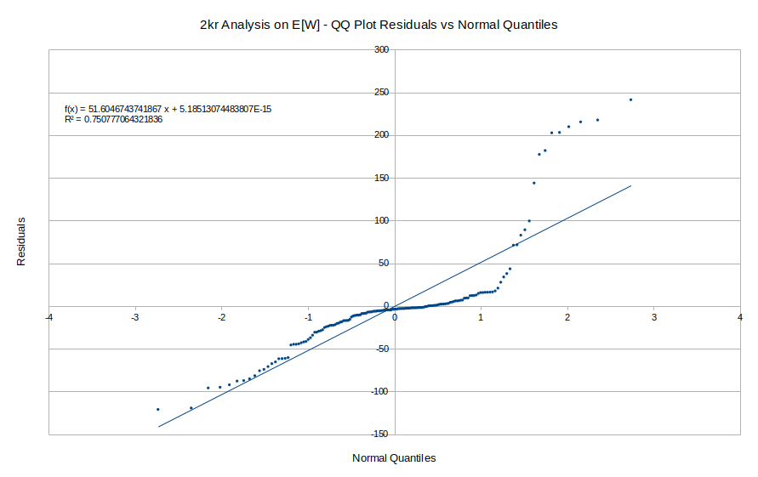
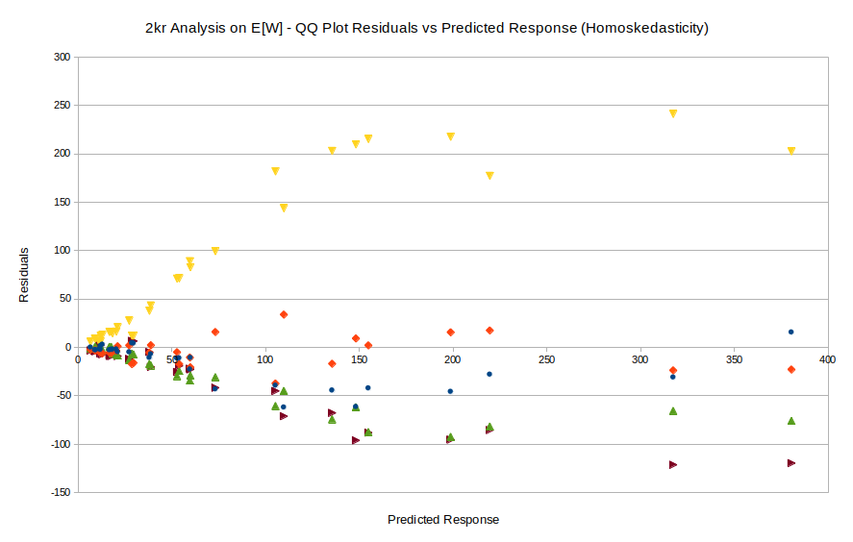
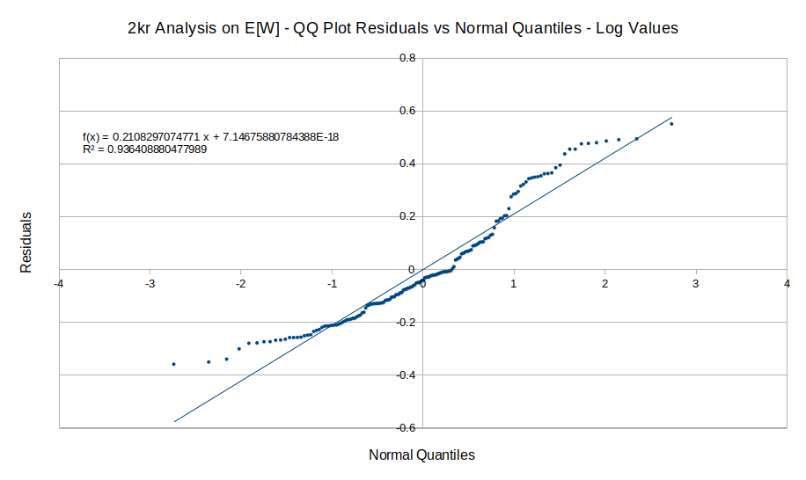
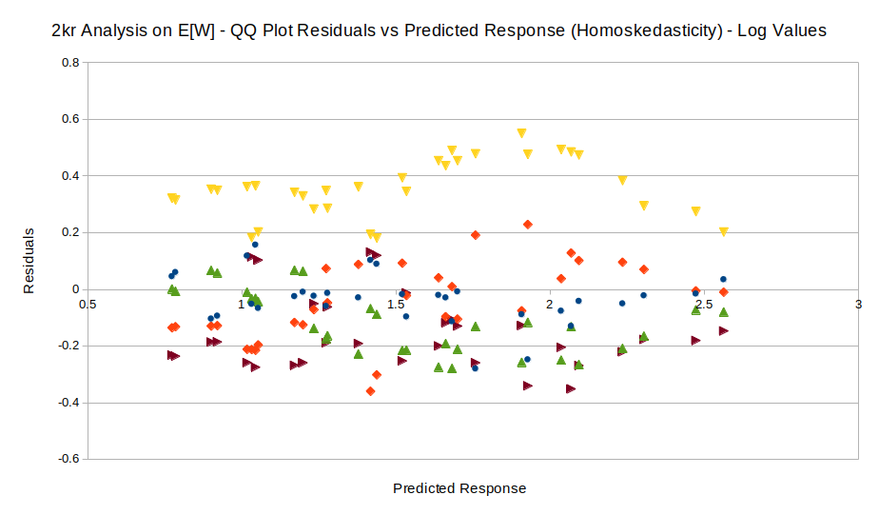
2kr Factorial Analysis
The 2kr analysis is made on both metrics to be analysed, the Throughput T and the Mean Waiting Time E[W], with the aim of understanding the contribution of factors.
Hypotesis to assess: The residuals (errors) are IID’s normal RV with a null mean and a costant standard deviation.
Throughput
Results
Waiting Time
Log Transformation

Slide 10
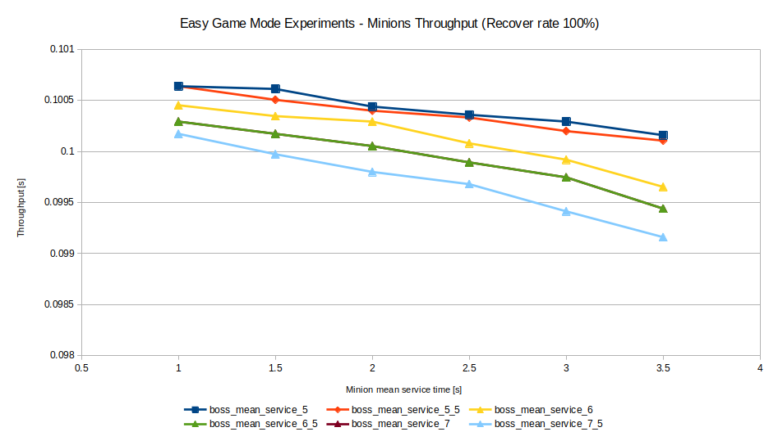
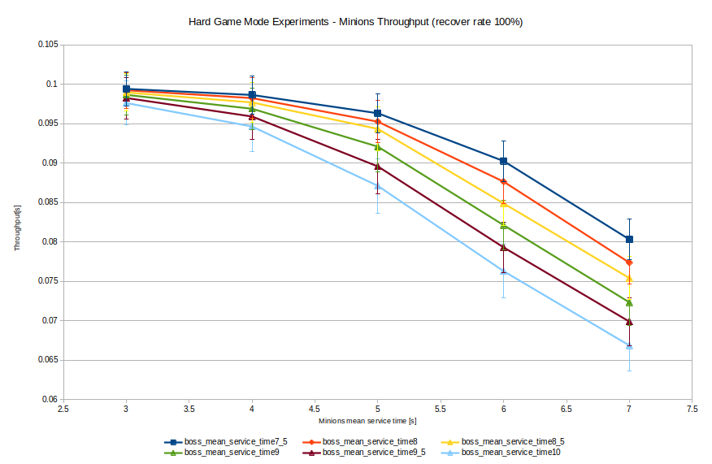
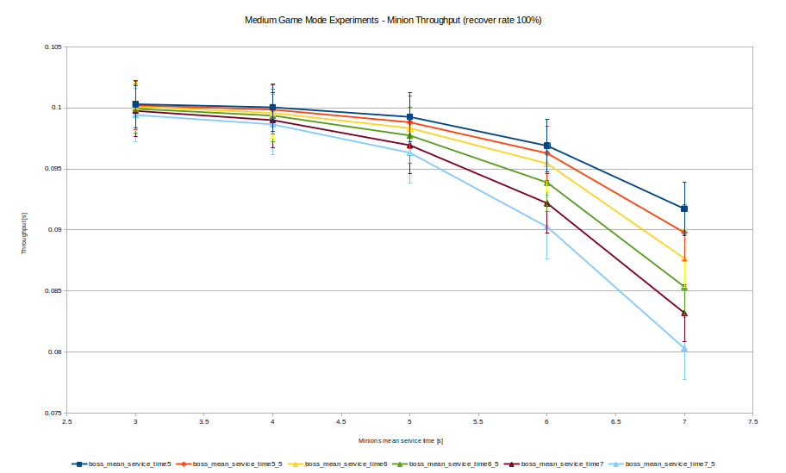
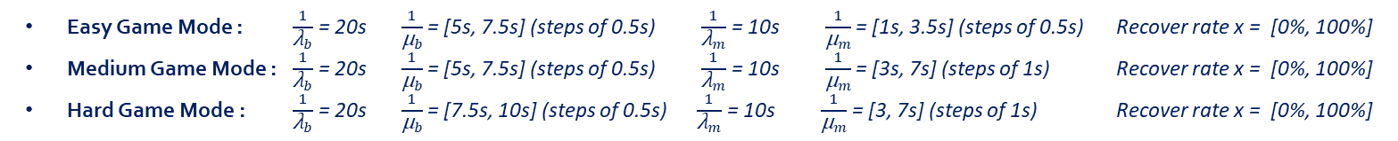
Simulation Experiments - Throughput
Easy Game Mode : $\frac{1}{{\text{λ}}_{b}}$ = 20s $\frac{1}{{\text{µ}}_{b}}$= [5s, 7.5s] (steps of 0.5s) $\frac{1}{{\text{λ}}_{m}}$= 10s $\frac{1}{{\text{µ}}_{m}}$ = [1s, 3.5s] (steps of 0.5s) Recover rate x = [0%, 100%]
Medium Game Mode : $\frac{1}{{\text{λ}}_{b}}$ = 20s $\frac{1}{{\text{µ}}_{b}}$= [5s, 7.5s] (steps of 0.5s) $\frac{1}{{\text{λ}}_{m}}$= 10s $\frac{1}{{\text{µ}}_{m}}$ = [3s, 7s] (steps of 1s) Recover rate x = [0%, 100%]
Hard Game Mode : $\frac{1}{{\text{λ}}_{b}}$ = 20s $\frac{1}{{\text{µ}}_{b}}$= [7.5s, 10s] (steps of 0.5s) $\frac{1}{{\text{λ}}_{m}}$= 10s $\frac{1}{{\text{µ}}_{m}}$ = [3, 7s] (steps of 1s) Recover rate x = [0%, 100%]
Medium Game Mode Throughput Results : it could take up to 12.5 seconds to defeat a minion (throughput equal to 0.08s), which, for long simulations, could be relevant for the overall performance of the system.
Easy Game Mode Throughput Results : The results are almost identical among the various experiments
Hard Game Mode Throughput Results: the minion throughput shows a further drop, due to the increase in the bosses mean service time values employed in the hard game mode. the throughput value reached approximately 0.065s, i.e. 1 minion defeated every 15 seconds.

Slide 11
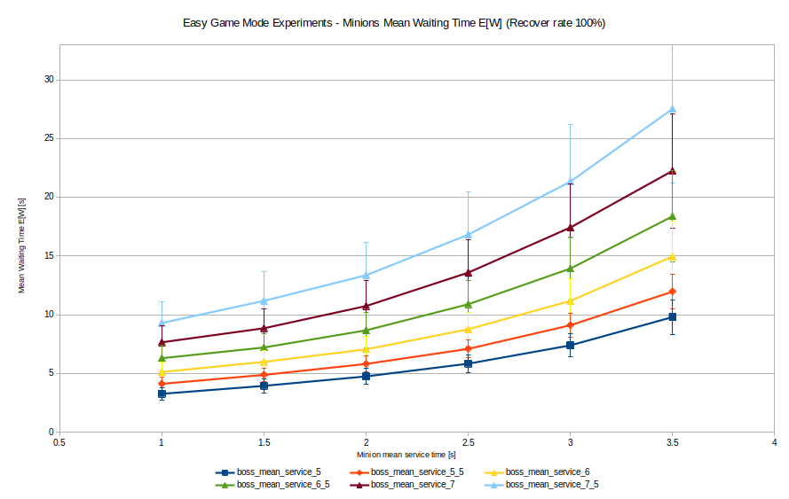
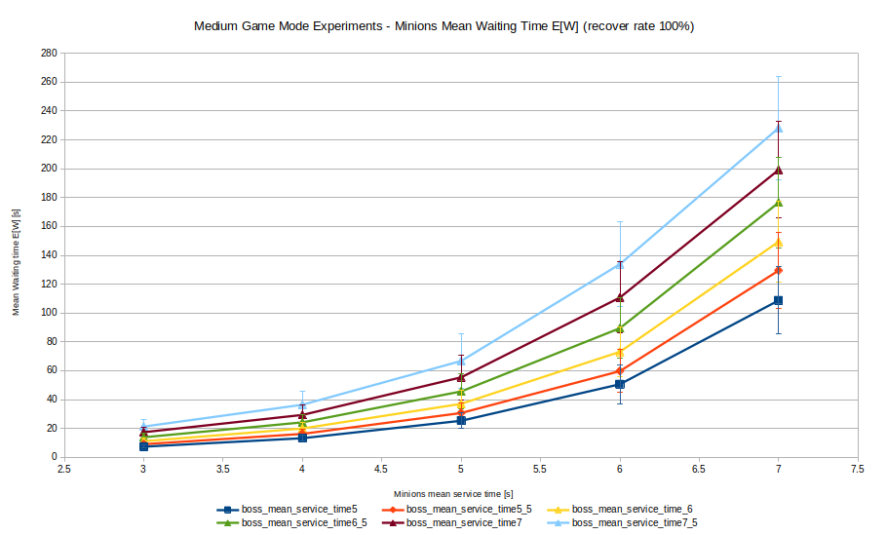
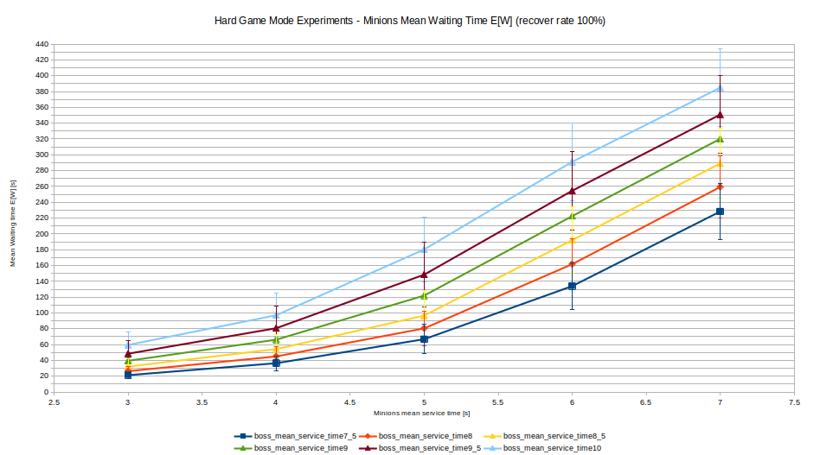
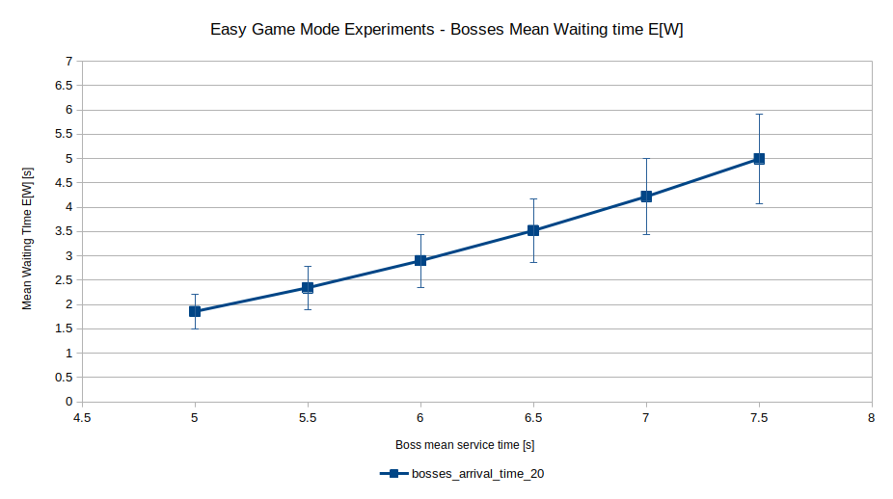
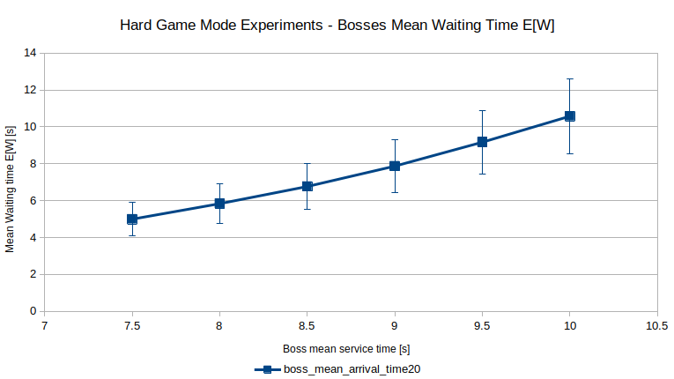
Simulation Experiments – Mean Waiting Time E[W]

Slide 12
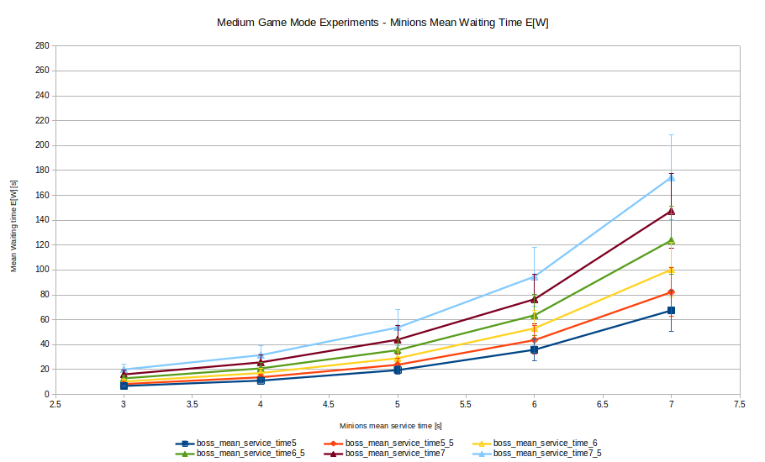
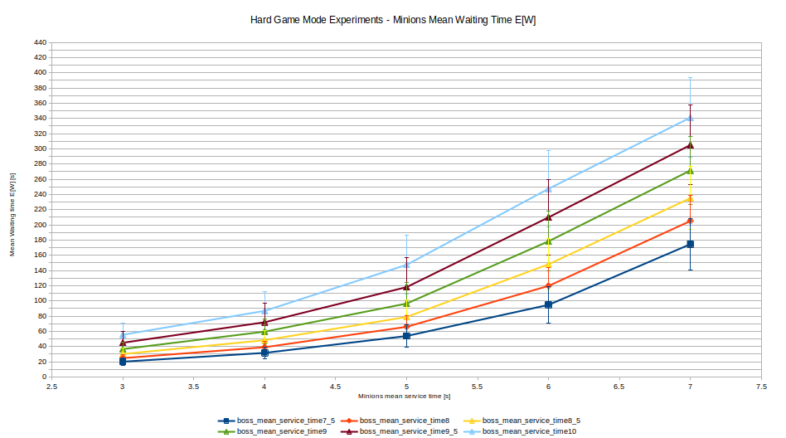
Simulation Experiments – Recover Rate x Effect
Medium Game Mode MEAN WAITING TIME E[W]
Hard game Mode MEAN WAITING TIME E[W]

Slide 13
Conclusions
Why is this study useful and which kind of benefits can it give us?
Knowing these results, average game experiences can be estimated, predicting how a game might take place and which goals users would achieve.
Being able to study the possible outcomes of a game in advance and set the basic parameters of the game appropriately can improve users performance and, above all, their level of satisfaction and fulfilment, which can be key factors in the success of a videogame.

