Slide 1
Url Shortener
SQS-Project 2025
Lucas Weiss

Slide 2
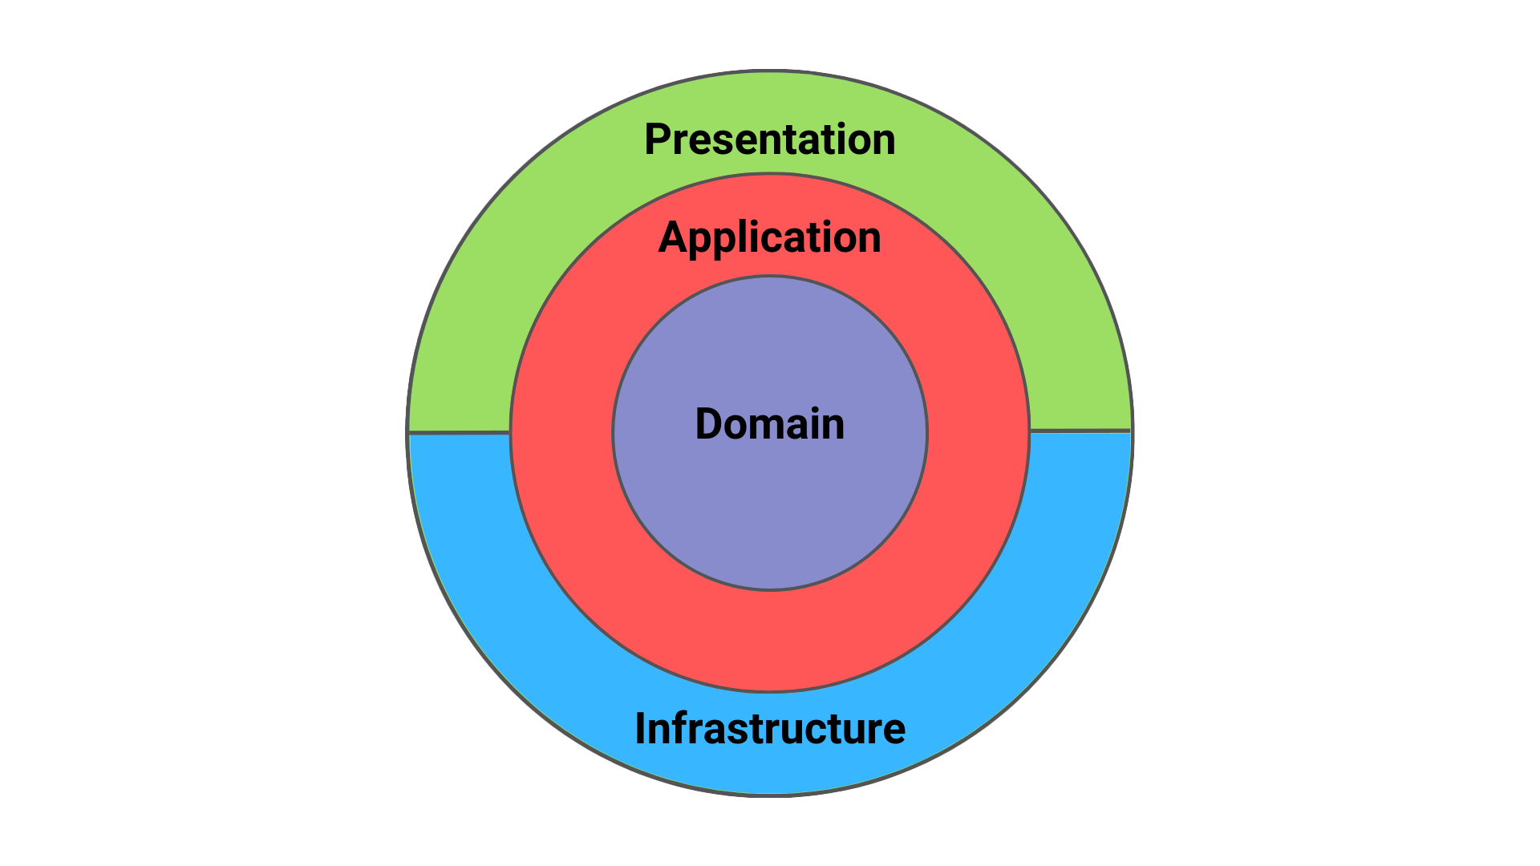
Techstack
Backend:
ASP.NET 9.0 (C#)
Clean Architecture
Minimal Apis (Carter + MediatR)
Entity Framework Core
Microsoft Identity
JWT-Token auth
Refit für http Requests
SqlServer
mssql/server:2022-latest
Frontend
Vue.js + Typscript
Nginx
Docker

Slide 3
Live Demo + Statische Code Analyse
http://localhost:8080/register
http://localhost:8080/login
http://localhost:8080/dashboard
https://sonarcloud.io/project/overview?id=LucZZ_sqs-project

Slide 4
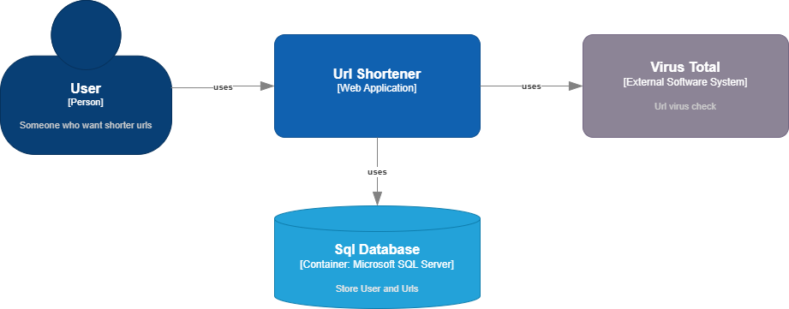
Project Struktur nach C4: C1
Context Diagram

Slide 5
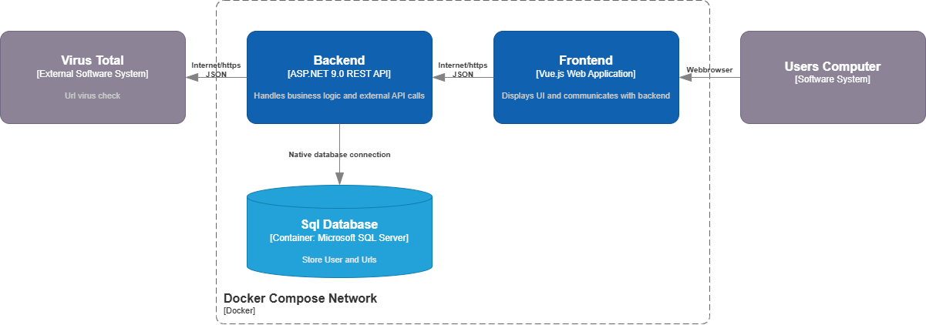
Project Struktur nach C4: C2
Container Diagram

Slide 6
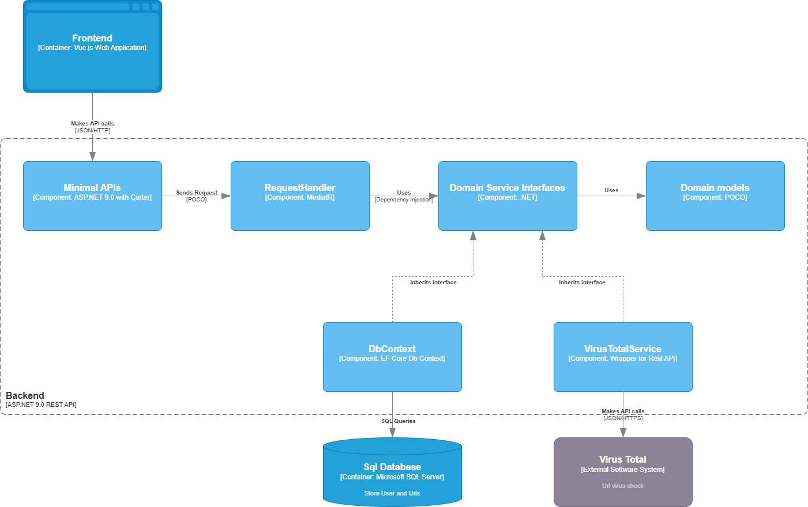
Project Struktur nach C4: C3
Component Diagram

Slide 7
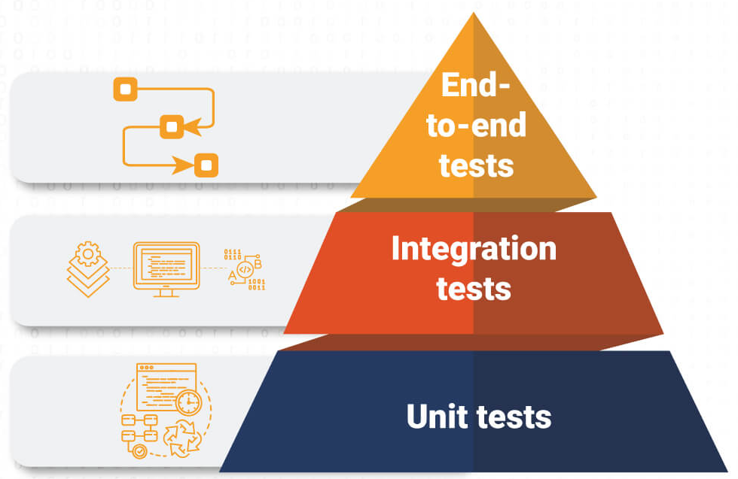
Testkonzept
Unit Tests
xUnit
Moq
Integration Tests
xUnit
WebApplicationFactory
Testcontainers
Api Fake
Bogus
Pen Test um Authentifizierung zu testen
Coverlet collector + Reportgenerator
E2E Tests
.NET Playwright
Architecture Tests
NetArchTest.Rules

