Slide 1
TEAM ER OVERFLOW
STATUS UPDATE 04

Slide 2
WHERE WE LEFT OFF
Agent-Beats Terminal Bench 2.0:
89 command-line tasks
Docker environment for cli execution
focus on tool and multi-agent architecture design
Notes:
A brief overview of the challenge we're participating in
You can go over multiple turns

Slide 3
WHERE WE LEFT OFF
Single role agent
Static syntax checker
Memory module
Successfully ran 7 out of 52 tasks
27 Tasks didn’t try
Notes:
reached the api key limit

Slide 4
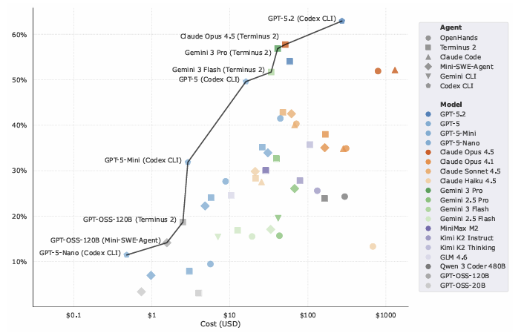
Where we left off
Terminal-Bench: https://doi.org/10.48550/arXiv.2601.11868
Notes:
Focus is on relatively small models

Slide 5
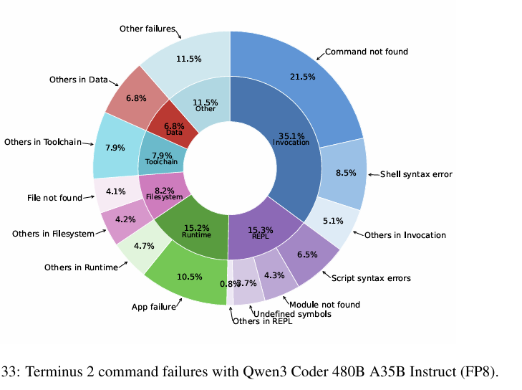
Challenges
Limitations of single-agent architecture
Planning over multiple runs
Semantics
API Limitations from KISSKI
Terminal-Bench: https://doi.org/10.48550/arXiv.2601.11868

Slide 6
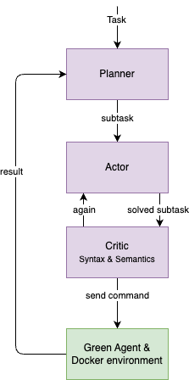
Literature and Strategy
Multi-agent architecture
Planner – creating a plan over multiple turns
Actor – focuses only on one subtask
Critic – evaluating result from Actor and gives feedback
Prescribed procedure between agents
Agents should focus on technical decision

Slide 7
Implementation
Multi-agent architecture
L3S API as backend
Qwen 3.6 27b model for evaluation
Backoff logic if API is slow

Slide 8
RESULTS & Evaluation
Evaluation takes about 8 hours
2 out of 89 tasks solved with multi-agent architecture
65x Request timed out
22x HTTP Error 503
5 out of 89 tasks solved with single-agent architecture
3 tasks failed
81 timed out

Slide 9
Next Steps
Try to reduce workload
Checking errors in multi-agent architecture
Eventually:
Try different models across entire benchmark
Prompt engineering

Slide 10
Q&A
Any Questions?

