Slide 1
BACHELOR’S DEGREE IN COMPUTER SCIENCE
Design and Implementation of a
Simple Kathará-Based Framework
Network emulation • Automated testing • DoS simulation
Luca Bortoluzzi | Student ID: 1097723 | Supervisor: Prof. Gianluca Rizzo
University of Turin • Academic Year 2025/2026

Slide 2
FOUNDATIONS / NETWORK EMULATION
What is Kathará?
An open-source network emulation platform that uses Linux containers to create virtual network laboratories.
Virtual network nodes
Flexible topologies
Hosts, routers and servers in isolated containers.
Virtual links and collision domains.
Real network software
Academic and professional use
Network protocols, routing daemons and services.
Teaching, research, testing and security experiments.
Kathará provides the emulation environment; the thesis framework automates its configuration and testing.
LUCA BORTOLUZZI | UNIVERSITY OF TURIN
02

Slide 3
01 / MOTIVATION
Why this project?
Manual setup
Hard to modify and scale
Need for testing
Multiple configuration files
Repeated setup commands
Routing and addressing errors
Connectivity is not enough
Measure service behaviour
Compare normal and adverse conditions
Lab configuration scattered across files
Manual updates across files
Time spent debugging setup
Research objective: simplify laboratory creation without replacing Kathará.
LUCA BORTOLUZZI | UNIVERSITY OF TURIN
03

Slide 4
02 / FOUNDATIONS
Technology stack
Kathará
Docker
YAML
Network emulation and lifecycle
Containerised network nodes
Declarative topology definition
Python
FRRouting
CSV / Wireshark
Parsing, generation and testing
Dynamic routing configuration
Metrics and traffic inspection
LUCA BORTOLUZZI | UNIVERSITY OF TURIN
04

Slide 5
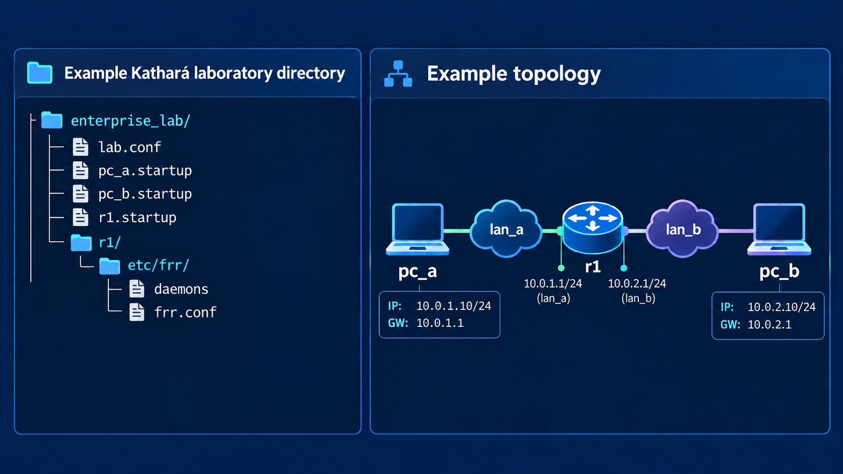
LABORATORY GENERATION / EXAMPLE
Example of a Kathará laboratory
lab.conf
Node-to-network associations
*.startup
Interface addresses and gateways
FRRouting files
Routing configuration, if requested
Example of the project directory for one Kathará laboratory.
LUCA BORTOLUZZI | UNIVERSITY OF TURIN
05

Slide 6
03 / YAML INPUT
Laboratory configurations change
pc_a:
type: host
interfaces:
- network: lan_a
ip: 10.0.1.10/24
default_gateway: 10.0.1.1
r1:
type: router
interfaces:
- network: lan_a
ip: 10.0.1.1/24
- network: lan_b
ip: 10.0.2.1/24
pc_b:
type: host
interfaces:
- network: lan_b
ip: 10.0.2.10/24
default_gateway: 10.0.2.1
Nodes and interfaces
Hosts, routers, collision domains
Network configuration
IP addresses, gateways and routes
Optional services
Routing daemons, resources, inspection
LUCA BORTOLUZZI | UNIVERSITY OF TURIN
06

Slide 7
04 / CONTRIBUTION
The proposed solution
A lightweight Python orchestration layer built on top of Kathará
01
02
03
04
05
Describe
→
Validate
→
Generate
→
Deploy
→
Evaluate
YAML topology
Syntax and semantics
Kathará folder + FRR files
Kathará containers and routing
Connectivity + service metrics
Key principle: keep standard Kathará artefacts readable and editable.
LUCA BORTOLUZZI | UNIVERSITY OF TURIN
07

Slide 8
05 / IMPLEMENTATION
Solution internal architecture
Lexer.py
Find and safely load YAML
↓
Parser.py
Validate structure and semantics
↓
gen_lab.py
Write lab.conf, startup files, FRRouting and Wireshark integration
↓
labs/<name>/
Generated standard Kathará laboratory
Run: generate_lab.py <path to YAML configuration>
LUCA BORTOLUZZI | UNIVERSITY OF TURIN
08

Slide 9
06 / RELIABILITY
Validation before deployment
What is checked?
Known limitations
Node identifiers and supported types
Interface addressing and network structure
Default-gateway consistency
Protocol configuration constraints
Unknown YAML keys may be ignored
Some static-route next hops lack reachability checks
Raw FRR commands are not fully validated
The implemented validator has explicit boundaries; it is not a full network verifier.
LUCA BORTOLUZZI | UNIVERSITY OF TURIN
09

Slide 10
07 / SECURITY EXPERIMENT
Controlled Denial-of-Service experiment
Attacker
Legitimate clients
Zombies
Controlled traffic sources
Server
Same topology · Same measurement method · Different load conditions
LUCA BORTOLUZZI | UNIVERSITY OF TURIN
10

Slide 11
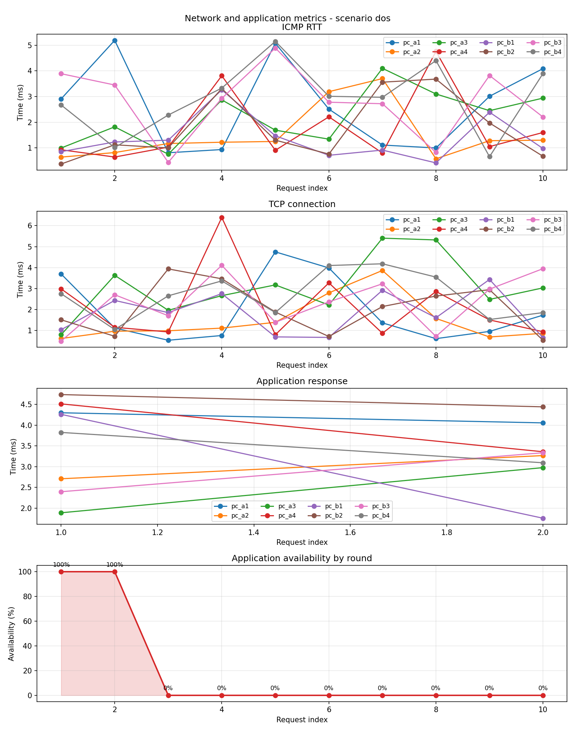
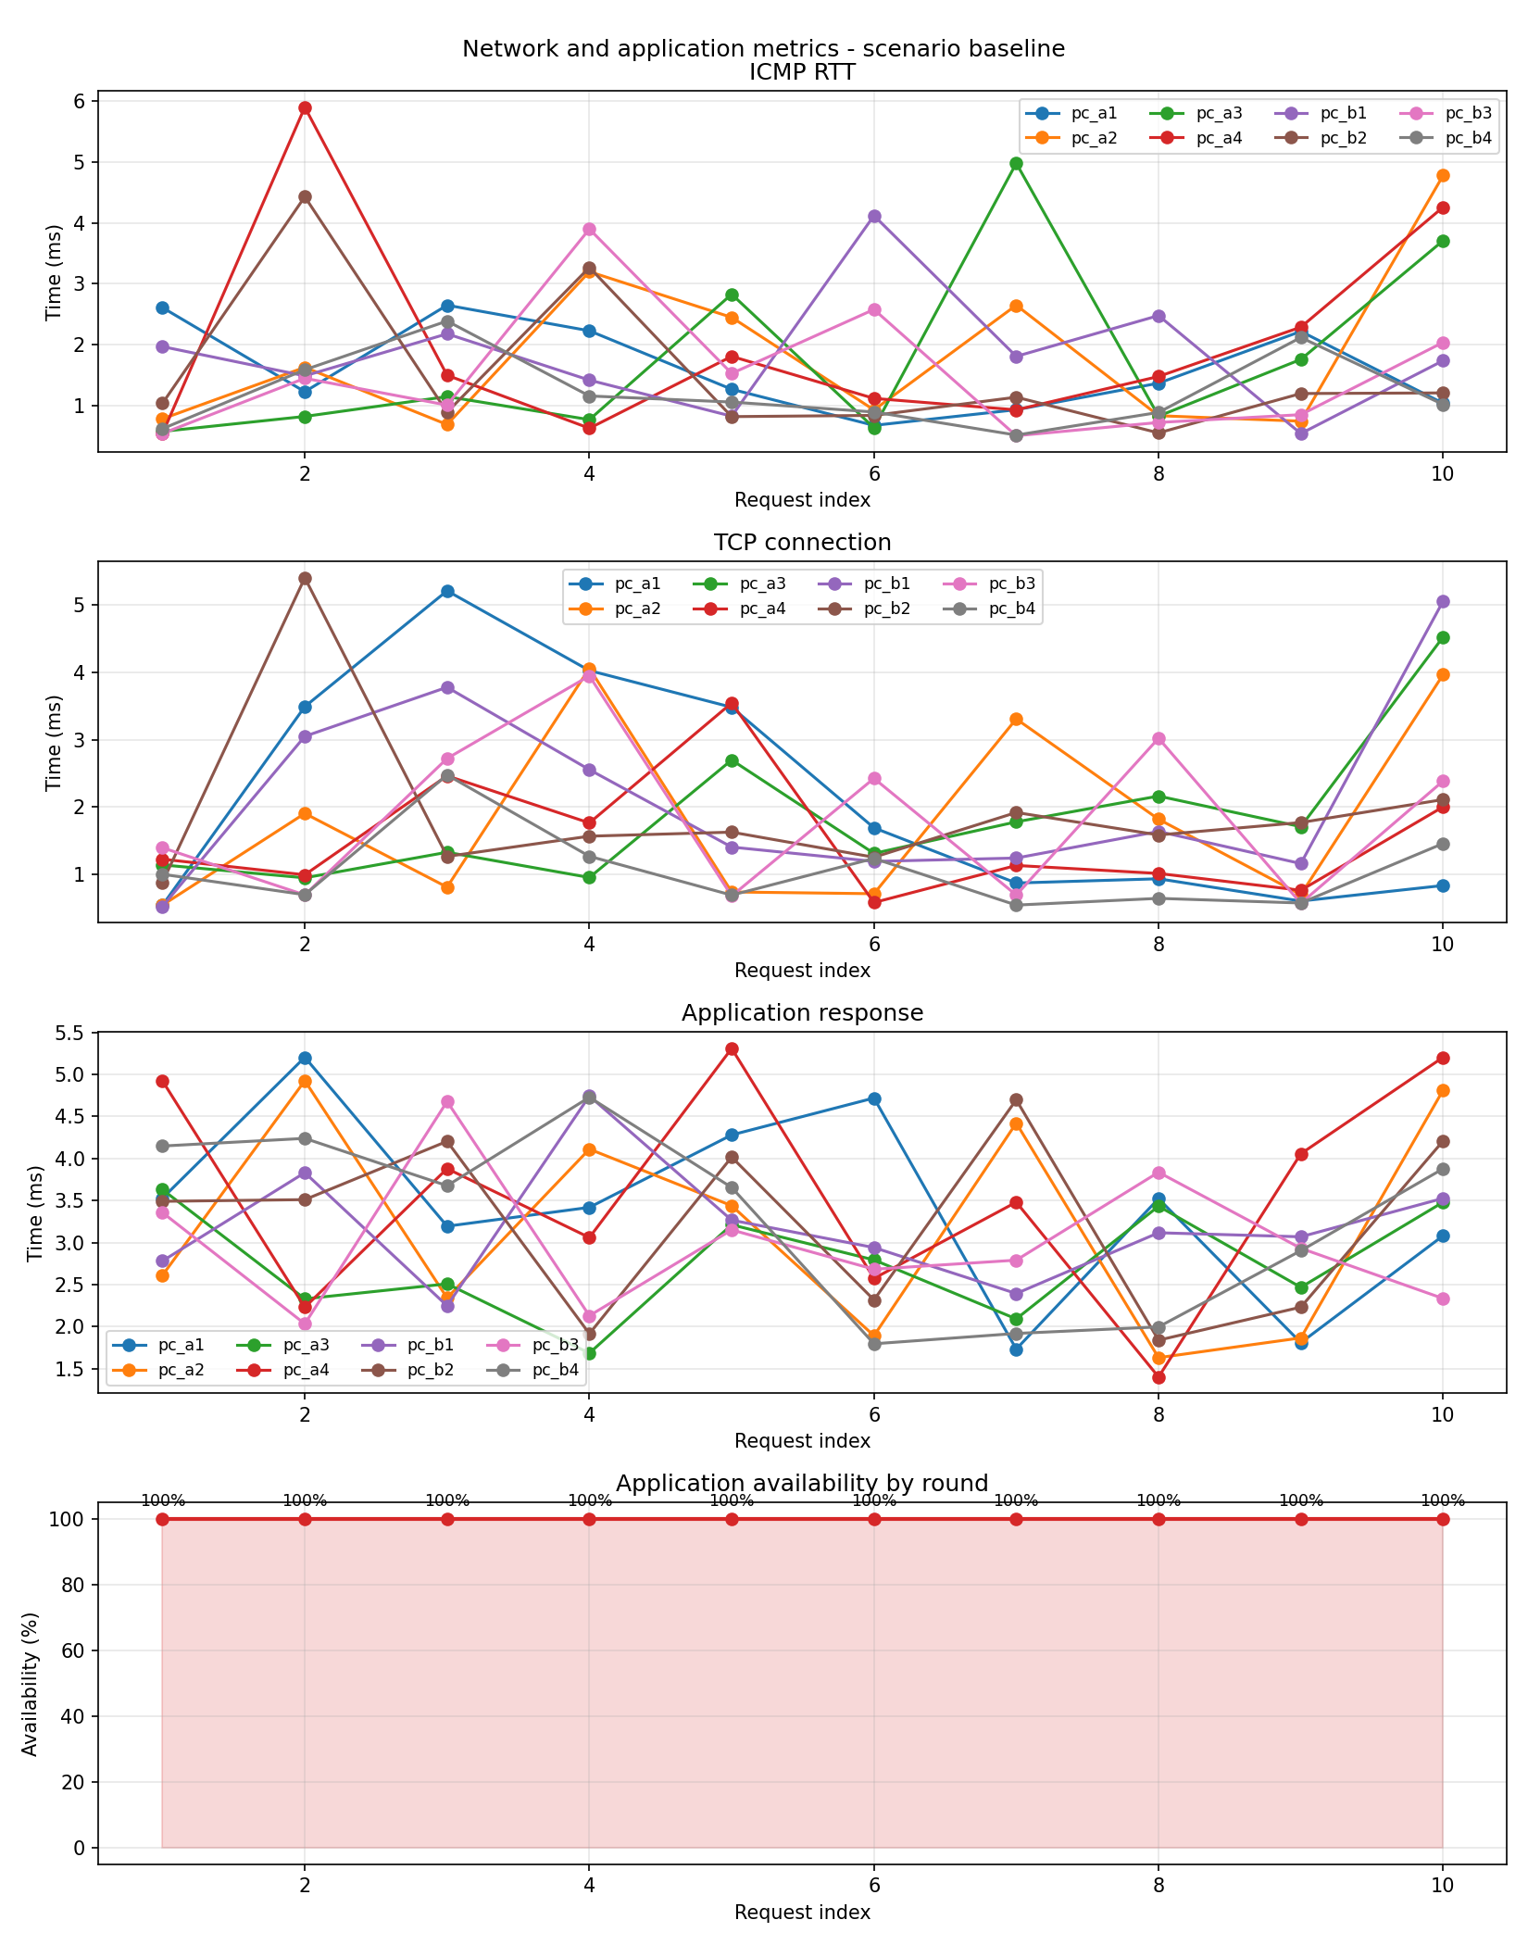
08 / INTERPRETATION
What the experiment demonstrates
With DoS attack
Baseline
Interpret DoS results relative to the valid baseline, not as a universal performance claim.
LUCA BORTOLUZZI | UNIVERSITY OF TURIN
11

Slide 12
09 / NEXT STEPS
Limitations and future directions
Validation
Evaluation
Others
Reject or warn about unknown keys
Extend next-hop verification
Check raw FRR configuration
More topologies and loads
Repeated experiments
Stronger performance statistics
Optional graphical user interface
Mandatory deterministic validation
LUCA BORTOLUZZI | UNIVERSITY OF TURIN
12

Slide 13
Thank you.
Questions?

